Slide 1

OpenEyeAlert
Automatic Camera Detection Safety Device
Group 1 Members –
Devika M. Bongarde, Vinayak C. Kadate, Avadhoot S. Gurav ,Shivraj P. Chougule

Slide 2
TABLE OF CONTENTS
01
02
03
04
05
INTRODUCTION
PURPOSE OF THE PROJECT
OUR GOALS
METHODOLOGY
CONSLUSION
06
REFERENCES

Slide 3
INTRODUCTION
In today's world, hidden cameras can easily invade personal spaces like homes, hotel rooms, or offices, posing a significant threat to privacy. This project focuses on finding a way to detect these hidden cameras using wireless technology, helping people protect their privacy by identifying and locating these devices quickly and effectively.

Slide 4
PURPOSE OF THE PROJECT
The purpose of this project is to design a straightforward method to detect hidden cameras through wireless signals, ensuring people can easily protect their privacy. By enabling the quick identification of these devices, the project seeks to enhance security and give individuals peace of mind in their private environments.

Slide 5
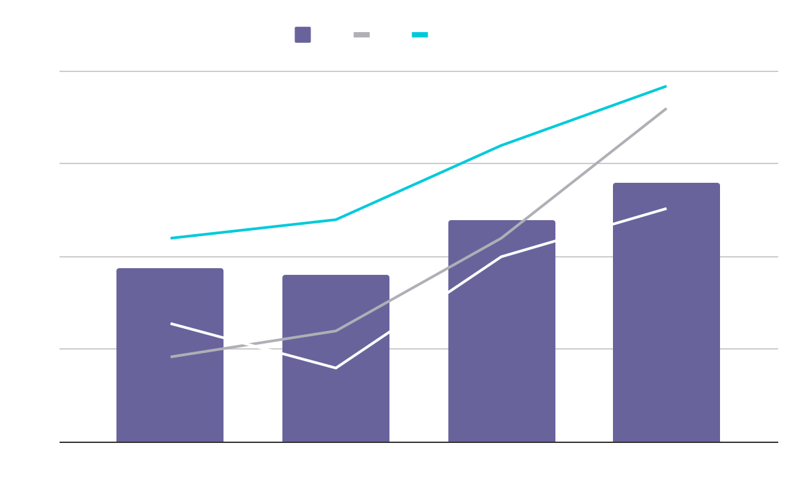
OUR GOALS
Automatic Detection
Portable
Application Support
One-Click Action

Slide 6
METHODOLOGY
Installing the OS
In the module
Upgrading the System to the latest version
Installing the Required Software
Installing Python for Required Libraries
Execute the Nilsimsa Algorithm for Capturing the packets
Write the Python Script for Packet Analysis
Execute the Python Script for Camera Detection
Create an Application for User Interface

Slide 7
CONCLUSION
OpenEyeAlert offers a powerful solution for enhancing personal privacy and security by automatically detecting and alerting users to the presence of hidden wireless cameras. By leveraging advanced detection technologies and pattern recognition, this device ensures that individuals are informed of potential surveillance threats, helping them maintain their privacy and peace of mind in both public and private spaces.

Slide 8
REFERENCES
Wireless Spy Camera Spotter System WithReal-Time Traffic Similarity Analysisand WiFi Signal Tracing Hyeyoung an , Woojin Park , (Student Member, IEEE), And Soochang Park , (Member, IEEE)
Detection and Localization of Hidden Wi-Fi Cameras Author Cunningham, Rhys, Tan, Wee Lum (IEEE)
Detecting Hidden Streaming Cameras Through Similarity of Simultaneous Observation Kevin Wu, Brent Lagesse (IEEE)

Slide 9
THANK YOU !!

