Slide 1

INFOSYS SPRINGBOARD
Virtual Internship 6.0
TALK2TOPICS
Automated Podcast Transcription and Topic Segmentation

Slide 2
PROJECT OVERVIEW
Problem Statement
Long podcast episodes contain valuable insights but are difficult to quickly search or skim.
Users must listen to entire recordings to locate specific discussions or topics.
Existing transcripts lack structure, making navigation and information retrieval inefficient.
Objectives
Develop a system that converts podcast audio into structured, readable text automatically.
Detect topic boundaries using semantic analysis for meaningful segmentation.
Generate concise summaries and keywords to highlight important information
Significance
Reduces time required to explore long audio content.
Makes podcasts searchable, readable, and easier to analyze and improves accessibility for students, researchers, and professionals.
Transforms raw audio into structured knowledge for efficient understanding.

Slide 3

DATASET DESCRIPTION
Dataset Source
Audio Format
Preprocessing
Final Dataset
Dataset Source
2
Audio Format
1
TED Talks speech dataset
Real long-form spoken content
Multiple speakers & accents
Natural conversational tone Realistic pauses and emphasis
Original format: MP3
Converted to WAV for processing and standardized sampling rate
Mono channel audio used and ensured ASR compatibility
3
Preprocessing
4
Final Dataset
Volume normalization applied
Silence segments trimmed
Noise reduced where possible
Audio split into chunks
Prepared for transcription
10 podcast recordings processed
Duration: 30–63 minutes each
Cleaned and standardized audio
Ready for NLP pipeline input
Supports segmentation tasks

Slide 4
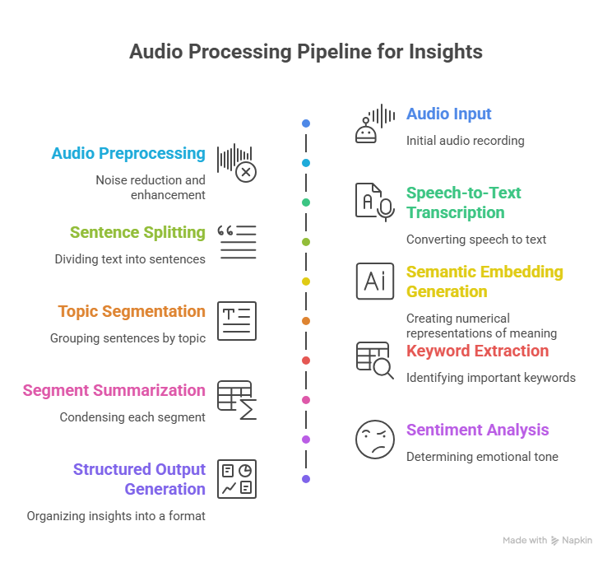
SYSTEM ARCHITECTURE
Pipeline Explanation
• Audio Input — Raw podcast audio collected , serves as the starting point of the processing pipeline.
• Preprocessing — Cleaned, normalized, converts format and mono channel if required , and splits long audio into chunks.
• Transcription — Speech converted into timestamped text using ASR Model.
• Segmentation — Sentences grouped into meaningful topics ,Semantic embeddings generated.
• Keywords — Key terms extracted from each segment.
• Summaries — Concise segment summaries
• Sentiment — Tone detected
• Output — Structured results generated , results are organized for easy navigation.

Slide 5
TOOLS & LIBRARIES
Audio Processing
Speech - to - Text
LibROSA – Used to load audio files, analyze waveform signals.
PyDub – Used for format conversion, normalization, and splitting long audio into smaller chunks for efficient processing.
Tech Stack: Python · Signal Processing
Whisper – Converts spoken audio into text while preserving timestamps and handling accents, pauses, and speech variations.
Tech Stack: Python · Deep Learning
NLP & Analysis
Visualization / UI
SentenceTransformers – Generates semantic embeddings for sentences.
TF-IDF – Extracts important keywords from each segment by identifying statistically significant terms.
Tech Stack: Python · NLP · Machine Learning
HTML + JavaScript – Builds interactive interface for segment.
WordCloud – Displays keyword frequency patterns visually for quick topic understanding.
Tech Stack: Frontend Rendering · Data Visualization

Slide 6
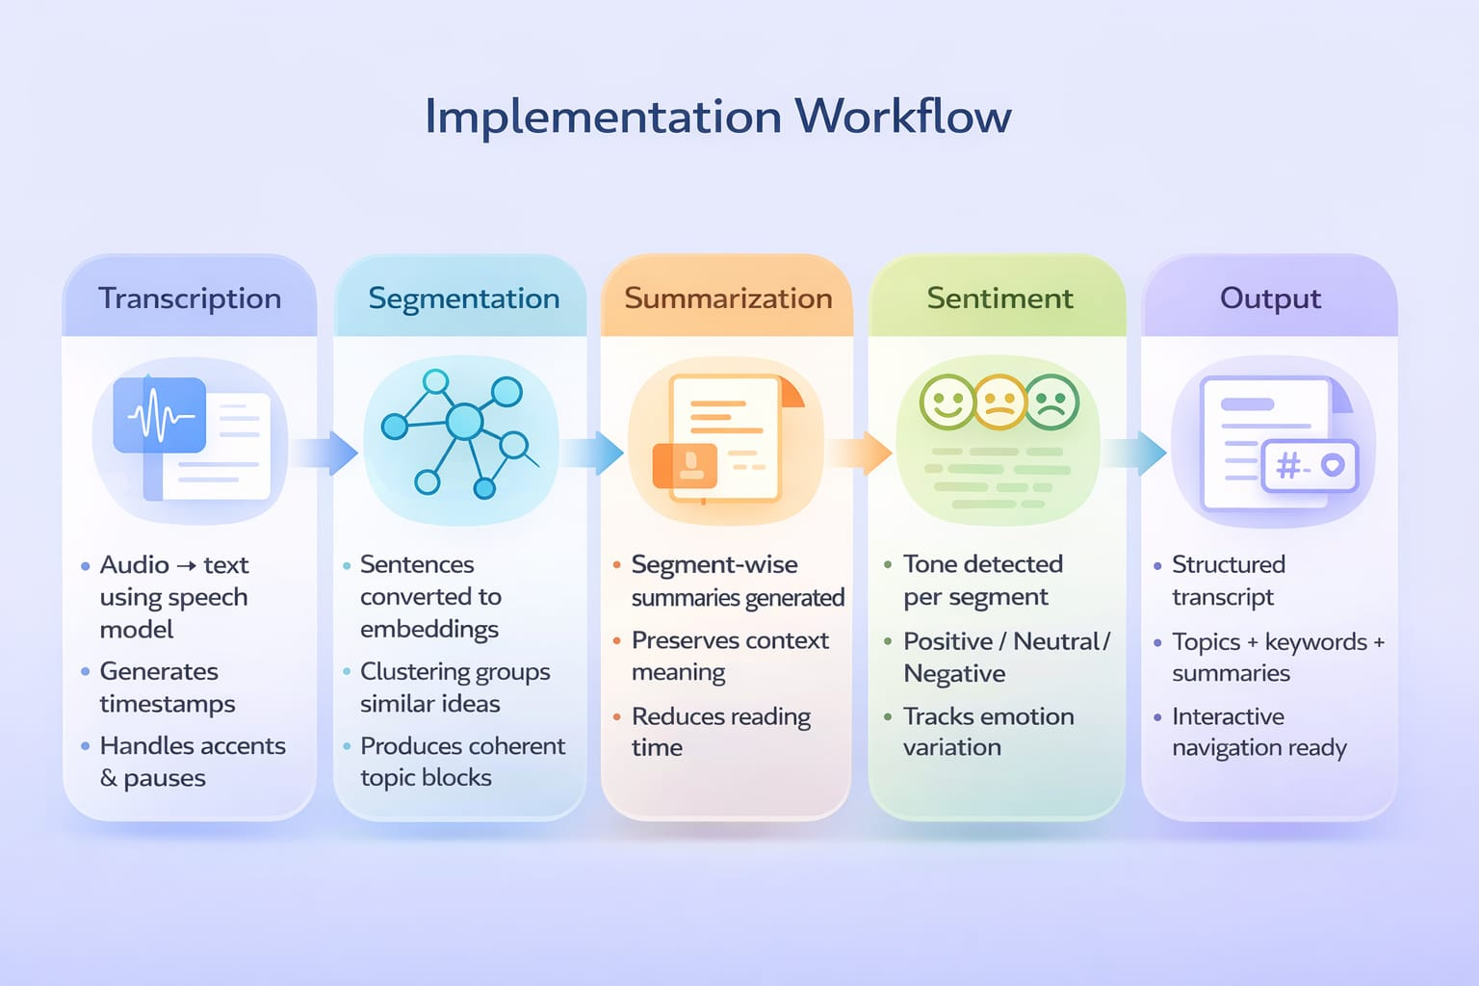

Slide 7
The system successfully transforms raw podcast audio into structured, navigable information that enables efficient content exploration without listening to full recordings. Instead of producing only transcripts, the pipeline generates multiple layered outputs that improve usability, readability, and information retrieval.
Generated Outputs Per Podcast
Structured Transcript — Timestamp-aligned text generated from audio speech.
Topic Segments — Logically grouped discussion sections detected using semantic clustering.
Segment Summaries — Concise explanations that capture the core idea of each topic.
Keywords — Important terms representing each segment’s theme.
Sentiment Labels — Emotional tone classification (Positive / Neutral / Negative).
Observed System Performance
Segmentation produced coherent topic boundaries across varied podcast styles.
Summaries accurately reflected discussion content while remaining concise.
Keywords were generally meaningful and useful for quick topic identification.
Timestamp alignment enabled precise navigation to audio positions.
Interface allowed users to scan podcast content significantly faster than linear listening.
Practical Impact
Results & Outputs

Slide 8



TESTING & VALIDATION
Sample | Test Condition | Issue Observed | System Response | Improvement Applied
Podcast 1 | Long discussion topic | Segments too frequent | Detected topic shifts | Increased clustering similarity threshold
Podcast 2 | Informational lecture | Summary too detailed | Generated full-context summary | Reduced summary compression length
Podcast 3 | Multi-topic dialogue | Keywords less relevant | Extracted generic terms | Tuned TF-IDF weighting
Podcast 4 | Background noise present | Minor transcription errors | Recognized most speech | Applied noise reduction preprocessing
USER FEEDBACK
Keyword are irrelevant for some podcasts
Suggested clearer topic titles
Found Transcripts slightly lengthy
User 1
User 2
User 3

Slide 9


LIMITATIONS AND FUTURE WORK
LIMITATIONS
FUTURE WORK
• Accuracy depends on audio clarity and background noise
• Segmentation may slightly split or merge related topics
• Sentiment detection sometimes misses subtle emotions
• Long recordings increase processing time
• Keyword extraction may include generic terms
• Integrate noise-robust speech recognition models
• Apply adaptive topic segmentation techniques
• Improve sentiment detection using contextual models
• Optimize pipeline for faster processing speed
• Implement smarter keyword ranking methods

