Slide 1

Department of Computer Sciences and Engineering
B.Tech CE (AI) Sem - 7
Health Portal
Presented By
Devik Shah(12191)
Manan Trivedi(12200)
Guided By
Dr. Pankti Bhatt

Slide 2
Introduction
Background:
The healthcare industry faces numerous challenges like delayed diagnoses and inefficiencies.
Traditional methods are time-consuming and need for innovative solutions to quick diagnostics.
Objective:
Develop a machine learning-based disease prediction system using decision trees.
Aim to enhance the diagnostic process and support healthcare professionals.

Slide 3
Literature Review
Key Findings:
Decision trees are highly effective for disease prediction .
Data quality directly impacts prediction accuracy
Technological Insights:
Machine learning provides scalable, efficient solutions to healthcare problems
Machine learning enables predictive analytics for faster
decision-making.

Slide 4
Modules and Functionalities
Modules:
Symptom Input: Allows users to enter symptoms.
Prediction: Analyzes symptoms to predict diseases using decision trees.
Medicine Recommendation: Suggests relevant medicines based on predicted diseases.
2. Functionalities:
Fast disease prediction and user-friendly interface for input and results.

Slide 5
Tools and Technology for Implementation
Technologies Used:
Python: Backend programming, machine learning model implementation.
Flask: Web framework for integrating frontend and backend.
HTML, CSS, JavaScript: Used for creating a responsive user interface.
SQL/CSV: For managing datasets.
Libraries:
Scikit-learn: Used for implementing the decision tree algorithm.
Pickle: Used to save and load the trained model for later use.

Slide 6
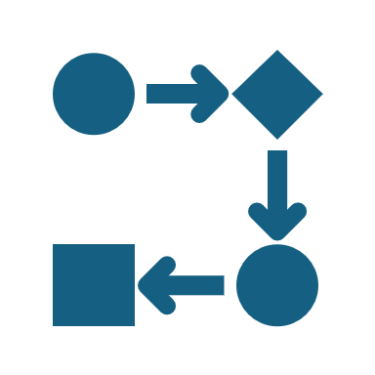
Software Development Model
Development Approach:
Iterative development approach, focusing on continuous feedback and improvements.
Purpose:
Frontend design to ensure a responsive interface.
Enhance Healthcare Accessibility: Enable users to input symptoms and get disease and medicine predictions.
Testing for bug fixes and ensuring smooth functionality.

Slide 7
Project Planning
Phases:
Requirement analysis, model training, system design, integration, and testing.
Milestones:
Completion of the disease prediction model.
Successful integration of the system's input-output flow.
Develop User Interface
Implement Medicine Recommendation
Test and Optimize System

Slide 8
Analysis of System
Key Diagrams:
Entity-Relationship Diagram (ERD): Describes entities like user, symptoms, diseases, and their relationships.
Data Flow Diagram (DFD): Demonstrates data processes from user input to disease prediction.
Use Case Diagram: Shows how users interact with the system.
Sequence Diagram: Illustrates how objects or components in a system interact over time.
Activity Diagram: Represents the workflow or process in a system.
Class Diagram: Illustrates the main classes and their attributes.
System Diagram: Represents the high-level structure and data flow between components in the system.

Slide 9
Data Dictionary
Key Fields:
Username: User identifier.
Symptoms: Array of symptoms entered by the user.
Predicted Disease: Disease predicted by the system.
Medicines: Array of medicines recommended for the disease.
Constraints:
Fields must be valid and unique to ensure accuracy.

Slide 10
Test Cases
Tests Conducted:
Unit Testing: Ensures each component functions correctly.
Integration Testing: Verifies seamless operation between modules.
System Testing: End-to-end testing to validate the full system.
Outcomes:
Accuracy: 80% for disease prediction.

Slide 11
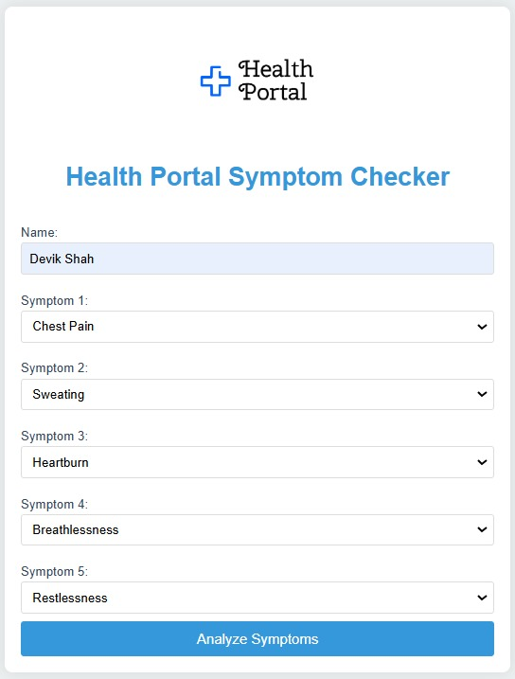
Implementation Snapshots
Symptom Input Page

Slide 12
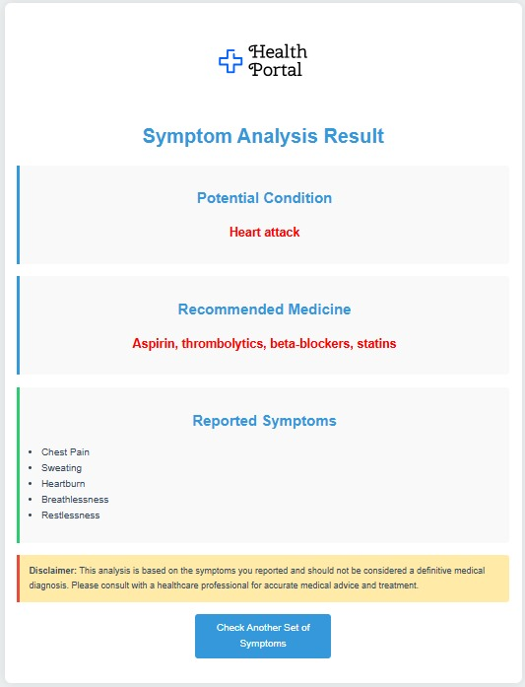
Implementation Snapshots
Result Page

Slide 13
References
1. Smith, J., & Johnson, R. (2018). Decision Trees in Healthcare: Enhancing Diagnostic Accuracy.' Journal of Medical Informatics. Highlights the effectiveness of decision trees for disease prediction.
2. Nguyen, T., & Wong, K. (2020). AI-Powered Healthcare: Machine Learning Applications in Early Diagnosis.Global AI Journal. Discusses the integration of machine learning in healthcare systems.
3. Vora, P., & Mehta, S. (2022). Scalable Healthcare Solutions Using AI. International Conference on Artificial Intelligence in Medicine. Focuses on creating scalable AI systems for real-world healthcare problems.
4. Patel, D., & Shah, R. (2021). AI in Rural Health Diagnostics. Journal of AI Applications. Explores the role of AI-based diagnostic tools in improving accessibility.
5. Kaggle Dataset. https://www.kaggle.com/datasets/devikshah/health-symptoms-and-disease-prediction-dataset
6. OpenAI Research (2023). The Future of AI in Diagnostics: A Comprehensive Study.AI Healthcare Systems Review. Demonstrates the potential of AI in improving health outcomes.
7. Li, H., & Chen, Z. (2019). 'Machine Learning in Clinical Medicine.Healthcare Informatics Journal. Focuses on improving diagnostic workflows with AI tools.

Slide 14

Thank you!

