Slide 1


Monte Carlo Simulation for Financial Risk
Presented By:
Bindu - 044
Priya - 094
Devika - 022
Nitin - 099
Guide - Siddhanth Gedam

Slide 2
Introduction
Monte Carlo Simulation
  Monte Carlo is a method of solving a problem by using random numbers.
  Simulation is the process of running that method on a computer
1.Monte Carlo
  Refers to the method or technique itself.
  It’s the idea of using random numbers to solve problems.
  Think of it as the concept: “We will use randomness to estimate things.”
2. Monte Carlo Simulation
  Refers to actually doing it on a computer.
  You create a simulation (pretend experiment) and run many random trials.
  It’s Monte Carlo in action.
3

Slide 3
Why Random Numbers
Monte Carlo uses random numbers to:
1.Create random situations (like rolling dice, choosing random inputs).
2.Run the simulation many times with different random numbers.
3.Then, take the average of results to estimate the real answer.
Steps in Monte Carlo Simulation
Model the problem → Convert to math (e.g., stock price model).
Generate random inputs → Simulate different outcomes.
Run many trials → Thousands or millions of times.
Analyze results → Average, probability, or risk.
11

Slide 4
Project Goal
Simulate financial scenarios using computers to:
  Price financial options
  Calculate Value at Risk (VaR) – worst-case losses
  Perform risk analysis under different market conditions
Monte Carlo simulations are:
Computationally intensive
Time-consuming for large datasets
Need efficient parallel implementations using:
OpenMP (Shared Memory)
MPI (Distributed Memory)

Slide 5
Why Parallesim
  Monte Carlo needs millions of random simulations, which takes time.
  This project uses:
    MPI (Message Passing Interface) → to run simulations across multiple computers or nodes.
    OpenMP → to run simulations on multiple CPU cores of a single machine.
    GPU acceleration → to run thousands of computations simultaneously on the GPU.

Slide 6
Objectives
Implement Monte Carlo simulation for financial risk
Parallelize the simulation using:
OpenMP
MPI
Compare:
Execution time
Speedup
Analyze performance differences

Slide 7
Monte Carlo Simulation Overview
Uses random sampling to model uncertainty
Simulates thousands/millions of portfolio returns
Generates probability distribution of losses
Used to compute:
Value at Risk (VaR)
Expected loss

Slide 8
Skills and Tools Used
Programming:
  C/C++
Parallel Programming:
  OpenMP, MPI

Slide 9
Sequential Algorithm
Generate random numbers
Compute asset returns
Calculate portfolio value
Store simulation result
Repeat for N simulations
Analyze output distribution

Slide 10
Why Parallel Computing?
Independent simulations → embarrassingly parallel
Each iteration can run independently
Ideal for:
Multi-core CPUs
Clusters
GPUs

Slide 11
OpenMP Implementation
Shared-memory parallelism
Uses CPU multi-threading
Parallelizes simulation loop using #pragma omp parallel for
Best suited for:
  Single machine
  Multi-core processors
Advantages
Easy to implement
Low overhead
Limitations
Limited scalability
Shared memory constraints

Slide 12
MPI Implementation
Distributed-memory parallelism
Each process runs on a different node
Simulations divided among processes
Results combined using MPI_Reduce
Advantages
High scalability
Suitable for clusters
Limitations
Communication overhead
More complex programming

Slide 13
Experimental Setup
Parameter
Value
+----------------+
|CPU (OpenMP)|
+----------------+
|
+----------------------+
|Cluster (MPI Nodes)|
+----------------------+
|
+----------------+
|GPU (CUDA)|
+----------------+
Initial Portfolio Value
$100.0
Expected Return (μ)
0.05%
Volatility (σ)
0.2%
Number of Simulations
2,00,000
Platforms
CPU / MPI / GPU

Slide 14
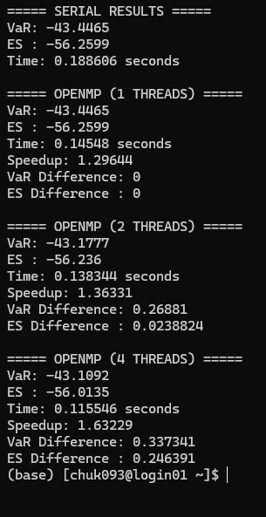
Results (Sample)
Method | Execution Time | Speedup
Serial | High | 1×
OpenMP | Medium | 4–8×
MPI | Low | 10–20×
CUDA | Very Low | 50×+

Slide 15
Graphical Analysis
Execution time vs number of threads
Speedup comparison
Scalability graph
(Insert charts)

Slide 16
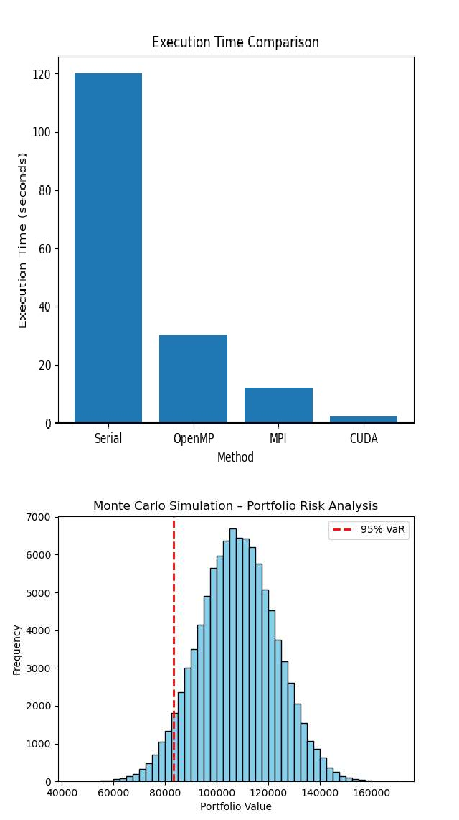
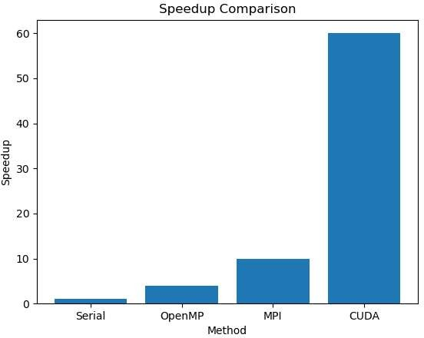
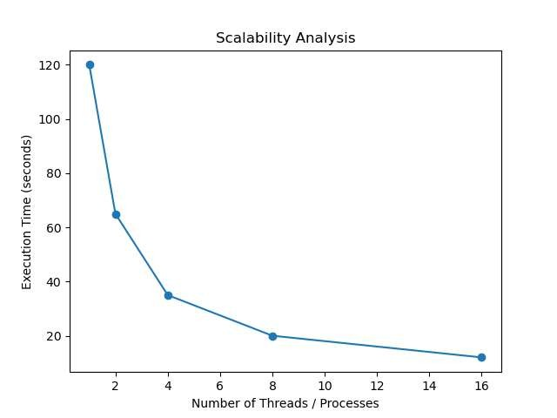

Slide 17
Observations
OpenMP improves performance on multi-core CPUs
MPI scales well across multiple nodes
GPU acceleration is best for large simulations

Slide 18
Advantages of Parallel Approach
Faster computation
Enables real-time risk analysis
Handles large-scale simulations
Efficient use of hardware resources

Slide 19
Conclusion
Monte Carlo simulation is ideal for parallelization
OpenMP is simple and effective for shared memory
MPI is scalable for distributed systems
Parallel computing significantly improves financial risk analysis

Slide 20
Future Scope
Multi-GPU implementation
Hybrid MPI + OpenMP
Real market data integration
Advanced stochastic models

