Slide 1
Service-Oriented Architecture
-{SOA}

Slide 2
DEFINITION:-
Service-Oriented Architecture (SOA) is an approach to organizing and designing software where applications are built as a collection of independent services that can communicate with each other over a network.

Slide 3
Each service performs a specific task and can be used by multiple applications as needed.
SOA promotes flexibility, reusability, and interoperability between different software systems.

Slide 4
EXAMPLES FOR SOA:-
Online Retail Platform
Travel Booking System
Banking Application
Healthcare Management System

Slide 5
These examples illustrate how SOA allows organizations to build complex systems by breaking them down into manageable, interoperable services.
Each service performs a specific function and communicates with others using standardized interfaces, promoting flexibility, scalability, and reusability in software development.

Slide 6
LETS SEE ONE CASE STUDY OF SOA

Slide 7
Case study :{soa} (online banking):---
An online banking system is being developed to provide banking services to customers over the internet.
The system aims to integrate various banking functionalities into a cohesive platform using SOA principles.

Slide 8
Online banking typically involves web applications that customers access through their web browsers or mobile apps. These web applications provide a user-friendly interface for customers to perform various banking activities such as checking account balances, transferring funds, paying bills, applying for loans, and more.
In the context of Service-Oriented Architecture (SOA), these web applications interact with backend services that are implemented as independent modules or components. Each service within the SOA framework encapsulates specific business logic (e.g., account management, transaction processing) and exposes well-defined interfaces that the web application can interact with

Slide 9
Implementation of SOA:
Service Modularity:----
Account Management Service
Transaction Service
Authentication Service
Notification Service
Reporting Service

Slide 10
Service Interaction.
User Experience.
Security Measures: Encryption and secure communication protocols (like HTTPS) are used to protect user data and financial transactions.

Slide 11
Integration with Banking Systems:--
It means connecting different software and services together so they can work smoothly with the core banking functions

Slide 12
Benefits:
Accessibility: Customers can access banking services anytime and anywhere through a user-friendly interface.
Efficiency: SOA streamlines banking operations, reduces manual processes, and improves transaction processing times.

Slide 13
Security: Centralized security measures and encryption protocols protect user data and financial transactions.
Scalability: Services can be scaled independently to accommodate increasing numbers of users and transaction volumes.

Slide 14
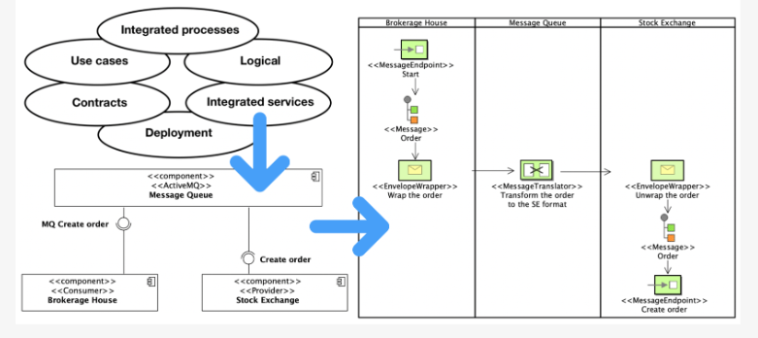
UML Of online banking:-

Slide 15
Thank you ..

