Slide 1

DOCTOR APPOINTMENT BOOKING SYSTEM
DEVIKA S
MES24MCA-2011
Department of Computer Applications
MES College of Engineering, Kuttippuram
20/08/2025

Slide 2
PRODUCT OWNER Mr.BALACHANDRAN K P ASSOCIATE PROFESSOR DEPARTMENT OF COMPUTER APPLICATIONS MES COLLEGE OF ENGINEERING, KUTTIPPURAM

Slide 3
TABLE OF CONTENTS
Introduction
Objective
Existing System
Proposed System
Motivation
Functionalities
Module Description
Developing Environment
Sprint Backlog
Product Backlog
User Story
Project Plans
Data Flow Diagrams
ER Diagram

Slide 4
DOCTOR APPOINTMENT BOOKING SYSTEM
Web-based platform that designed specially for clinics to simplify the appointment scheduling process between doctor and patient.
Appointments are managed manually through phone calls or walk-ins, which result miscommunication and long waiting times.
Through this system patient can overcome these challenges, where patients can register, search for doctors by specialty or name and book appointments in real time.
Patients can also book, cancel, or reschedule appointments and receive automated reminders to reduce missed consultations.

Slide 5
DOCTOR APPOINTMENT BOOKING SYSTEM
Doctor can configure their working hours, mark leave days, and view upcoming appointments through dedicated panel.
Admin dashboard provides full control over patient and doctor data, as well as to assist patients in booking or rescheduling appointments.
Built using HTML, CSS, JavaScript (React.js or Vue.js) on the frontend and Python (Django) on the backend and database like MySQL, ensuring scalability, security and improving communication and enhances overall efficiency in healthcare.

Slide 6
OBJECTIVES
Reduce waiting times and avoid confusion caused by manual
bookings.
Patients can see available slots instantly and book without delays.
Allow patients to book, reschedule, or cancel appointments easily.
Doctors can set working hours, mark leave, and manage bookings.
Provide a dashboard for reception/admin to manage records and
generate reports.
Send automated SMS/Email reminders to patients.
Minimize manual errors, optimize doctor time utilization, and
improve patient satisfaction.
Use modern web technologies that can adapt to clinic growth.

Slide 7
EXISTING SYSTEM
Appointments are booked manually through phone calls or by
visiting the clinic.
Receptionist records bookings in a register/notebook.
Doctor’s availability is not transparent to patients , they must ask
receptionist.
If doctor takes leave, patients are informed individually
time-consuming and inefficient.
High chance of scheduling conflicts such as double booking or
overlapping slots.
Patients often face long waiting times at clinics due to poor time
management.
No proper reminder system many patients forget appointments.

Slide 8
PROPOSED SYSTEM
Patients can register & book appointments online.
View doctor’s real-time availability.
Doctors can manage schedules & update leave in the system.
Receptionist/Admin can assist bookings & manage records via
dashboard.
Automated SMS/Email reminders.
Option to reschedule/cancel without manual calls.
Secure login for patients, doctors, and admin.
Scalable & user-friendly web platform .
Reduces errors, waiting time, and manual workload.

Slide 9
MOTIVATIONS
To streamline manual booking processes, reducing wait times,
scheduling errors, and administrative burden.
To offer real-time doctor availability and improve patient access to
appointments.
To reduce no-shows with automated reminders and improve clinic
efficiency.
To enhance patient engagement through accessible, digital tools.
To support digital transformation in healthcare with a secure and
user-friendly system.

Slide 10
FUNCTIONALITIES
Secure registration & login for patients and doctors.
Patients can search doctors by specialty/location.
Patients can view real-time doctor availability.
Book, reschedule, or cancel appointments online.
Receive SMS/Email reminders for appointments.
Doctors can set schedules & update leave/unavailability.
Doctors can view and manage their bookings.
Receptionist/Admin can manage patient & doctor records.
Admin can assist patients with booking/rescheduling.
System prevents double booking / overlapping slots.
Admin can generate reports (appointments, cancellations, patient list).
Scalable, secure, and user-friendly web platform

Slide 11
MODULE DESCRIPTION
Patient Module
Patient Registration/Login – Allows patients to securely create accounts and log in to the system.
Doctor Search & Filtering – Patients can search for doctors based on specialization, location, and availability.
Appointment Booking – Patients can select preferred time slots and confirm appointments with available doctors.
Appointment Management – Patients can cancel or reschedule their appointments as needed.
Notification System – Patients receive automated SMS/email reminders for upcoming appointments.
Medical History View – Allows users to view their past appointments and consultation history.

Slide 12
MODULE DESCRIPTION
2. Doctor Module
Doctor Registration/Login – Enables doctors to register securely and manage their profile and availability.
Schedule Management – Doctors can set, update, or block their available time slots for appointments.
Appointment Overview – Provides a view of upcoming, completed, or cancelled appointments.
Patient Medical Notes – Allows doctors to add brief notes or observations after a consultation.
Profile Management – Update personal details, specialization, and contact information

Slide 13
MODULE DESCRIPTION
3. Admin Module
Admin Login – Secure access for administrators or receptionists.
Doctor & Patient Management – Add, update, or remove doctor/patient records.
Appointment Oversight – Monitor all scheduled, canceled, and rescheduled appointments.
Schedule Updates – Update doctor’s availability and assist patients with bookings.
Report Generation – Generate reports on appointments, cancellations, and patient visits.

Slide 14
DEVELOPING ENVIRONMENT
.
Operating System: Windows
Front End: React.js (JavaScript, HTML, CSS)
Back End: Django (Python)
Database: MySQL (Relational Database)
Authentication: Django Built-in Authentication System
Location Services: Google Maps API
IDE: Visual Studio Code / PyCharm
Version Control: Git & GitHub

Slide 15
SPRINT BACKLOG
Backlog item | Status And Completion Date | Original Estimation in Hours | Day 1 hrs | Day 2 hrs | Day 3 hrs | Day 4 hrs | Day 5 hrs | Day 6 hrs | Day 7 hrs | Day 8 hrs | Day 9 hrs | Day 10 hrs
SPRINT 1
Project setup | 06/08/2025 | 2 | 1 | 1 | 0 | 0 | 0 | 0 | 0 | 0 | 0 | 0
User registration & login | 15/08/2025 | 3 | 1 | 1 | 1 | 0 | 0 | 0 | 0 | 0 | 0 | 0
Database design | 24/08/2025 | 3 | 1 | 1 | 1 | 0 | 0 | 0 | 0 | 0 | 0 | 0
SPRINT 2
Doctor schedule | 02/09/2025 | 7 | 1 | 1 | 1 | 1 | 1 | 1 | 1 | 0 | 0 | 0
Appointment | 11/09/2025 | 7 | 1 | 1 | 1 | 1 | 1 | 1 | 1 | 0 | 0 | 0

Slide 16
SPRINT BACKLOG
Backlog item | Status And Completion Date | Original Estimation in Hours | Day 1 hrs | Day 2 hrs | Day 3 hrs | Day 4 hrs | Day 5 hrs | Day 6 hrs | Day 7 hrs | Day 8 hrs | Day 9 hrs | Day 10 hrs
SPRINT3
Patient dashboard | 20/09/2025 | 7 | 1 | 1 | 1 | 1 | 1 | 1 | 1 | 0 | 0 | 0
Doctor dashboard | 29/09/2025 | 7 | 1 | 1 | 1 | 1 | 1 | 1 | 1 | 0 | 0 | 0
SPRINT 4
Admin dashboard | 08/10/2025 | 7 | 1 | 1 | 1 | 1 | 1 | 1 | 1 | 0 | 0 | 0
Testing | 12/10/2025 | 7 | 1 | 1 | 1 | 1 | 1 | 1 | 1 | 0 | 0 | 0
TOTAL |  | 50 | 9 | 9 | 8 | 6 | 6 | 6 | 6

Slide 17
PRODUCT BACKLOG
ID | NAME | PRIORITY <high/medium/low> | ESTIMATE (Hours) | STATUS <Planned/In progress/Completed>
1 | User Registration & Login | High | 5 | In Progress
2 | Doctor Profile & Schedule Setup | High | 8 | In Progress
3 | Appointment Booking System | High | 10 | In Progress
4 | Patient Dashboard | High | 6 | In Progress
5 | Doctor Dashboard | High | 6 | In Progress

Slide 18
PRODUCT BACKLOG
ID | NAME | PRIORITY <high/medium/low> | ESTIMATE (Hours) | STATUS <Planned/In progress/Completed>
6 | Admin Panel | Medium | 10 | In Progress
7 | Notification System | Medium | 8 | In Progress
8 | Search & Filter | Medium | 5 | In Progress
9 | Appointment Reschedule & Cancel | Medium | 5 | In Progress
10 | Reports and Analytics | Low | 7 | In Progress

Slide 19
USER STORY
User Story ID | As a type of User | I want to | So that i can
1 | ADMIN | Login | Access the admin dashboard with correct credentials
2 | ADMIN | Manage doctors and patients | View, edit, or remove registered users and doctors
3 | ADMIN | Generate reports | Monitor system activity and performance metrics
4 | DOCTOR | Login | Access my schedule and patient bookings
5 | DOCTOR | Set availability | Allow patients to book appointments based on my available time slots
6 | DOCTOR | View appointments | Prepare for upcoming consultations

Slide 20
USER STORY
User Story ID | As a type of User | I want to | So that i can
7 | PATIENT | Register | Create an account to access appointment features
8 | PATIENT | Login | Securely access my account
9 | PATIENT | Search for doctors | Find doctors by specialty, location, or availability
10 | PATIENT | Book an appointment | Schedule a consultation with the desired doctor
11 | PATIENT | Reschedule/cancel booking | Manage my appointments easily
12 | SYSTEM | Send reminders | Notify patients and doctors of upcoming appointments via SMS/email

Slide 21
PROJECT PLAN
User StoryID | Task Name | Start Date | End Date | Days | Status
1 | Sprint 1 | 06/08/2025 | 10/08/2025 | 14 | In Progress
2
7 |  | 11/08/2025 | 15/08/2025 |  | In Progress
3 |  | 16/08/2025 | 19/08/2025 |  | In Progress
4 | Sprint 2 | 23/08/2025 | 30/08/2025 | 14 | In Progress
5 |  | 31/08/2025 | 05/09/2025 |  | In Progress

Slide 22
PROJECT PLAN
User StoryID | Task Name | Start Date | End Date | Days | Status
6 | SPRINT 3 | 07/09/2025 | 13/09/2025 | 14 | In Progress
7 |  | 14/09/2025 | 20/09/2025 |  | In Progress
8 | SPRINT 4 | 24/09/2025 | 30/09/2025 | 14 | In Progress
9 |  | 01/10/2025 | 07/10/2025 |  | In Progress
.

Slide 23
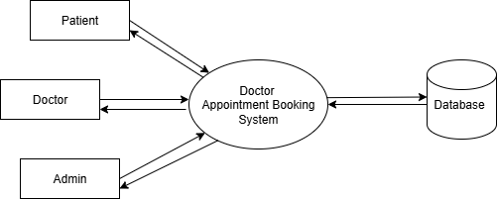
DATA FLOW DIAGRAM
LEVEL 1

Slide 24
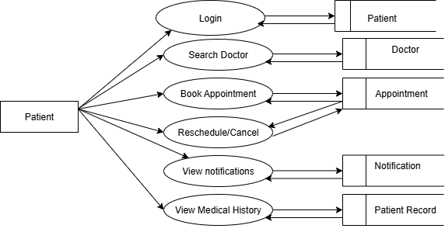
DATA FLOW DIAGRAM
Level 1.1
.

Slide 25
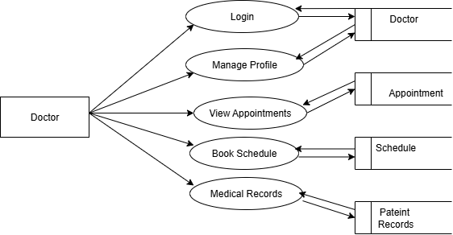
DATA FLOW DIAGRAM
Level 1.2

Slide 26

DATA FLOW DIAGRAM
Level 1.3

Slide 27
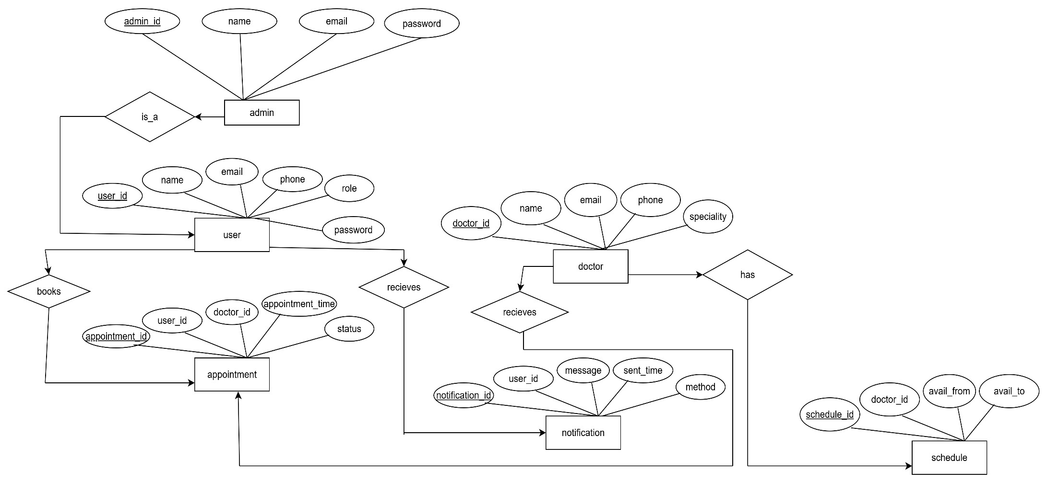
ER DIAGRAM

Slide 28
THANK YOU

