Slide 1
CRICKETIQ
IPL Analytics & Predictive Intelligence Platform
[Student Name 1]
[Student Name 2]
[Student Name 3]
Backend & Frontend
ML / Data
Integration & Deployment
Team No: [XX] | Dept. of Computer Applications | Review 1 | [Month Year]

Slide 2
PROJECT OVERVIEW
Abstract
CricketIQ is a web analytics platform for the Indian Premier League. It unifies a full team / player / match database with a season analytics dashboard and four statistical intelligence tools behind one consistent interface.
For the Analyst
What Makes It Different
Browse the full team / player / match record
Season win trends & leaderboards
Win-probability, form forecast, XI suggestion, similarity
One design-token CSS layer, not per-page styling
ML models cached in-process, loaded once
Every list/API call has a defined empty & error state
Current status: ~20% complete — data model, seed data and the full UI/UX are built; ML endpoints run on placeholder models pending training on the full dataset (see Section 11).
CricketIQ — Review 1
2

Slide 3
IMPLEMENTATION
Technology Stack
Layer | Technology
Web Frontend | Jinja2 templates, custom OKLCH design-token CSS, Bootstrap 5 grid, vanilla JavaScript
Backend Framework | Flask (Python), Flask-SQLAlchemy, Flask-Migrate
Database & ORM | SQLite (development) / MySQL (production target) via SQLAlchemy 2.0
Matching & ML | scikit-learn (RandomForest / classifier), joblib for cached model persistence
Charts | Chart.js, themed at runtime from the CSS token layer
Icons | Inline SVG sprite (no icon web-font dependency)
Auth & Security | None — the application is read-only with no accounts (by design, see Scope)
CricketIQ — Review 1
3

Slide 4
PLANNING
System Study
Problem Statement
Scope
Solution Approach
Raw IPL stats sit in disconnected sources with no unified view.
No single tool combines directory browsing with predictive analysis.
Existing dashboards are either static tables or opaque black-box models.
Team, player & match directories with full detail pages.
Season analytics: win trends, leaderboards.
Win probability, form forecast, playing-XI, similarity search.
No accounts / auth — public, read-only tool.
Flask + SQLAlchemy relational schema, normalised to 3NF.
One CSS design-token layer driving every page consistently.
ML endpoints isolated behind a cached loader (lib/loaders.py).
Iterative delivery: schema + UI first, model training next.
CricketIQ — Review 1
4

Slide 5
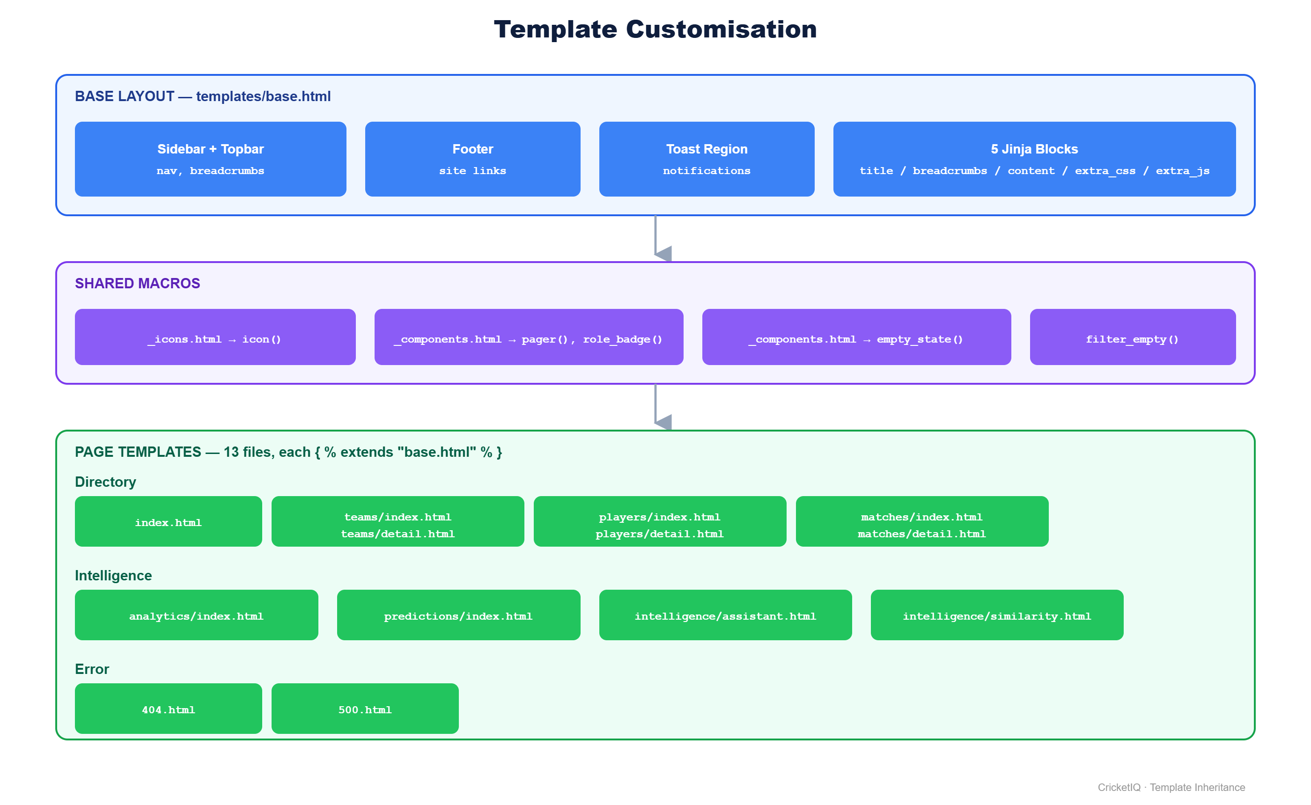
DESIGN
System Architecture
Three-tier design: Browser — Flask API — Database
CricketIQ — Review 1
5

Slide 6
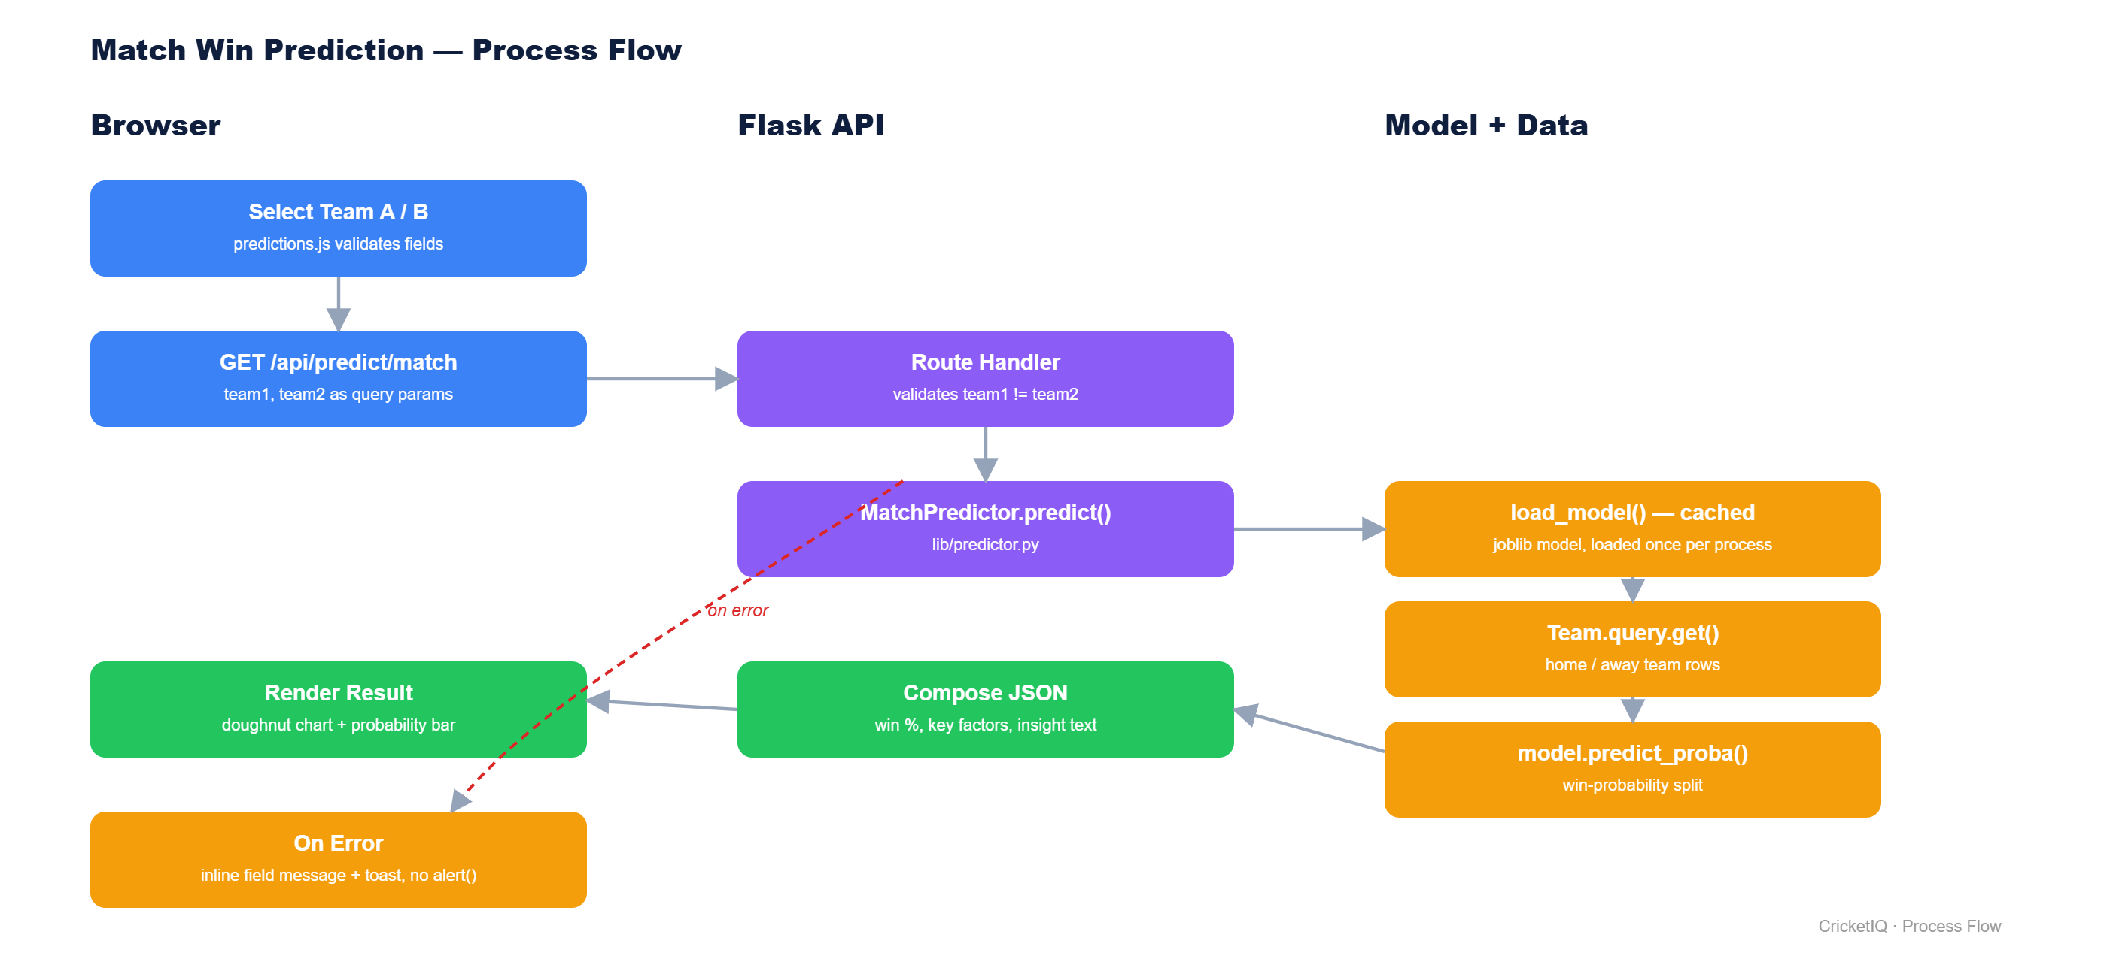
DESIGN
Prediction Workflow
End-to-end process flow for the match win-prediction use case
CricketIQ — Review 1
6

Slide 7
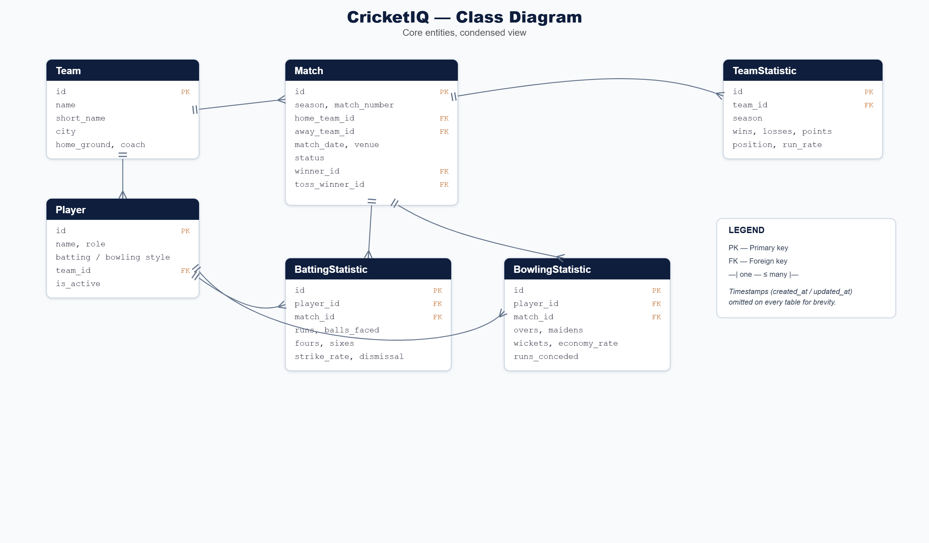
DATA MODEL
Database Design
Condensed class diagram — Team is the hub, referenced by Player and Match
CricketIQ — Review 1
7

Slide 8
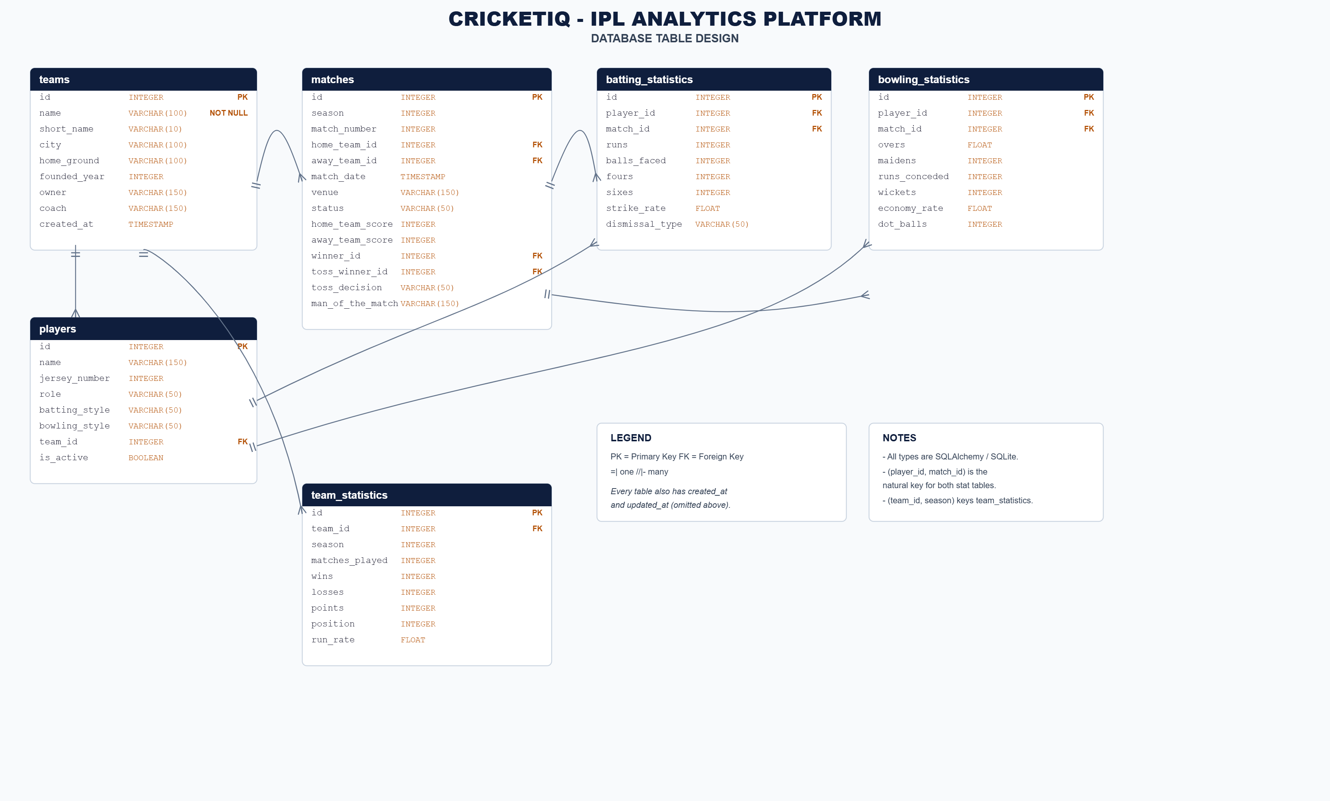
DATA MODEL
Table Design
CricketIQ — Review 1
8

Slide 9
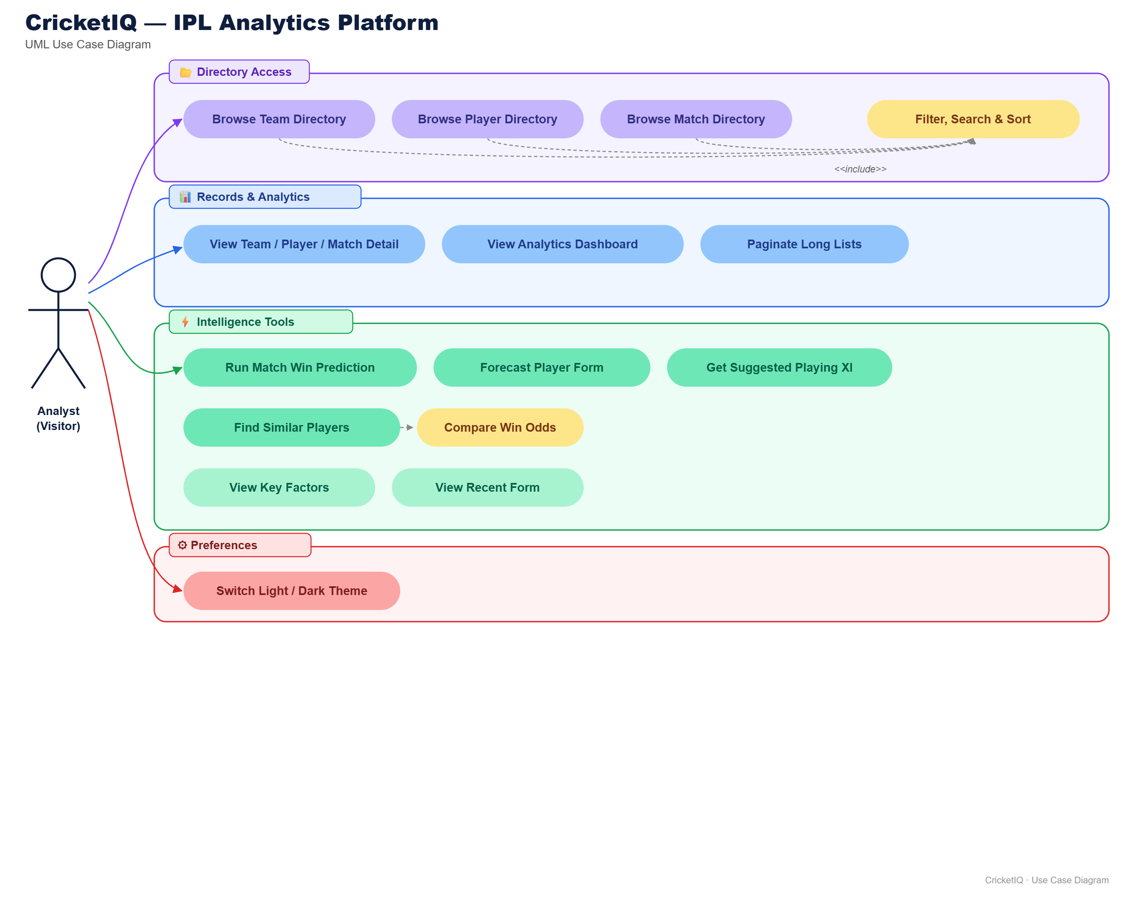
REQUIREMENTS
Use Case Diagram
CricketIQ — Review 1
9

Slide 10
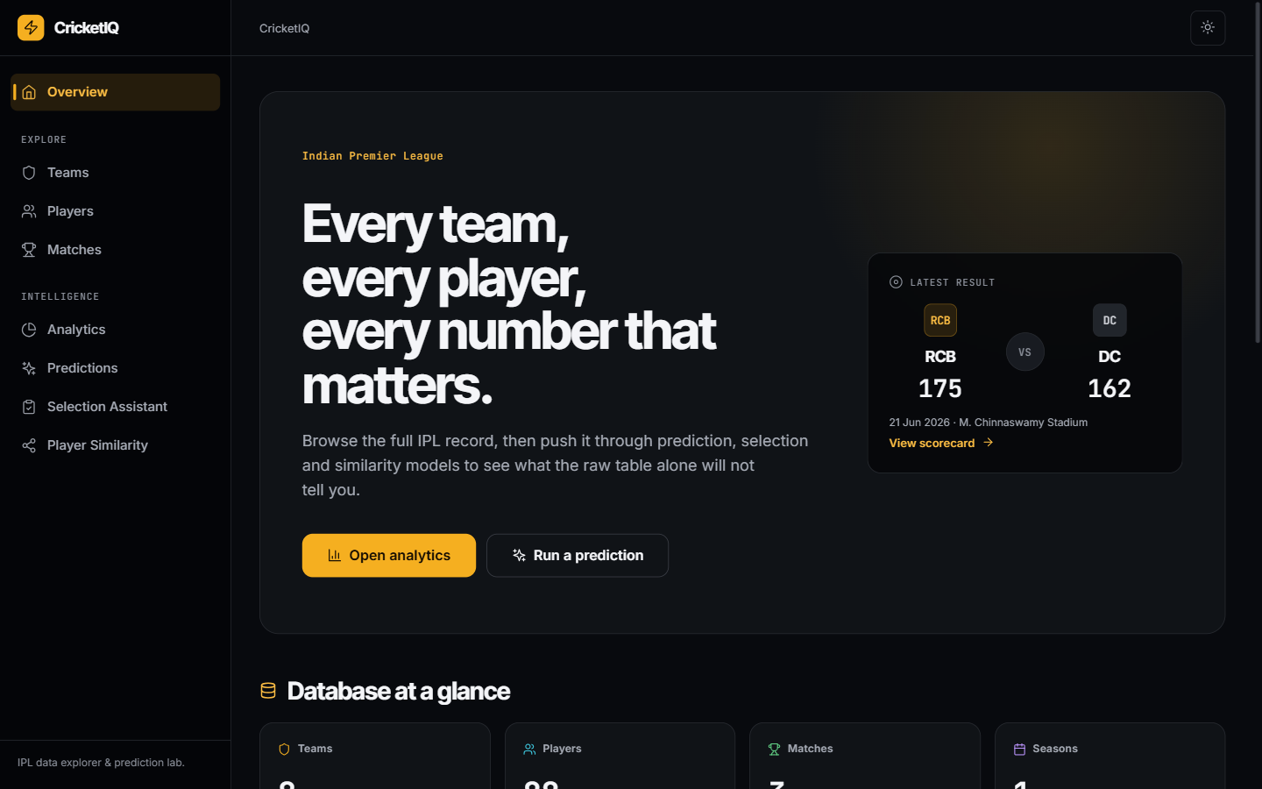
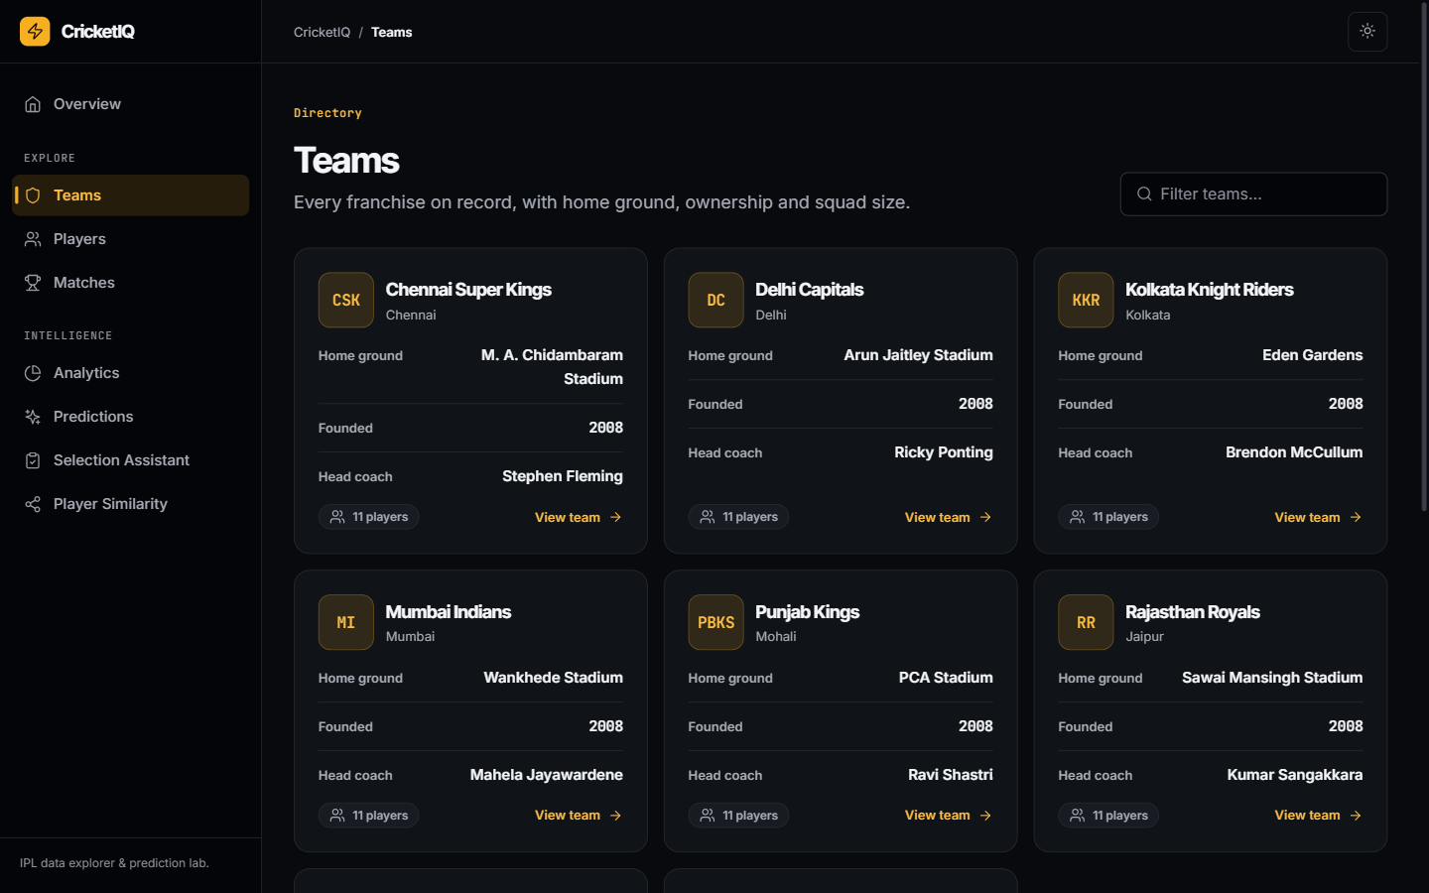
IMPLEMENTATION
UI — Overview & Directory
CricketIQ — Review 1
10

Slide 11
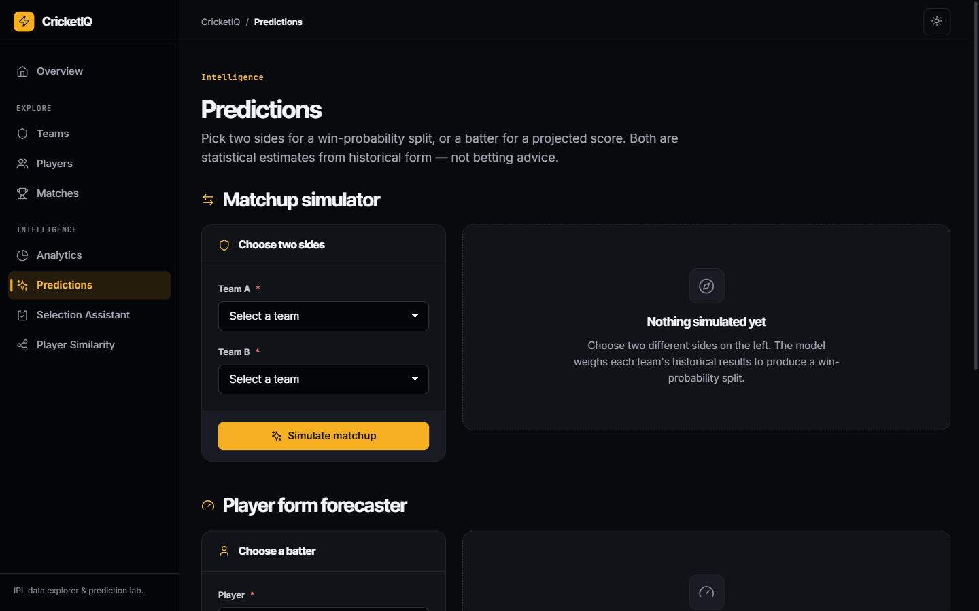
IMPLEMENTATION
UI — Intelligence Tools
CricketIQ — Review 1
11

Slide 12
REVIEW 1
~20%
Project Completion Status
COMPLETE
DONE — Demo-Ready
PLANNED — In Development
Normalised schema — 6 tables, seeded with 8 teams, 88 players
Full directory UI — teams, players, matches, detail pages
Analytics dashboard — win-trend and leaderboard charts
Design system shipped — dark/light themes, responsive shell
Train match win-probability model on the full historical dataset
Train player run-forecasting model, replace placeholder heuristic
Persist batting/bowling scorecards for every match
Deploy to a production MySQL instance
Add automated tests for API endpoints and ML pipeline
Sprint plan: S1 Schema + Seed Data + UI → S2 Model Training + Scorecard Ingestion → S3 Deployment + Tests
CricketIQ — Review 1
12

