Slide 1
MINI PROJECT EVALUATION
CricketIQ
IPL Data Analytics & Predictive Intelligence Platform
TEAM MEMBERS (Team No. 08)
GUIDE
Ahana Saji
Arjun T P
Devika Anil
Dr. Amrita Priya K
MGP22NMC-007
MGP22NMC-022
MGP22NMC-027
Department of Computer Applications | Saintgits College of Engineering | IMCA 22 - 27

Slide 2
OVERVIEW
Introduction
The Indian Premier League (IPL) produces a huge volume of cricket data every season.
CricketIQ is a web platform that collects this data in one place and makes it easy to explore.
It stores ball-by-ball records of 1,243 IPL matches in a relational database.
It adds an analytics dashboard and four machine-learning tools on top of the data.
Built with Python, Flask and scikit-learn; usable by fans, analysts and students.
1,243
809
matches
players
15
18,842
franchises
batting innings
CricketIQ - Mini Project Evaluation
2

Slide 3
OVERVIEW
Problem Statement
IPL statistics are scattered across many sources, mostly static, and offer no single place to explore history or get data-driven predictions.
Scattered Data
Static Analysis
No Prediction Aid
Records spread across sites and broadcasts
No unified, queryable history
Player aliases cause duplicates
Tables and PDFs, not interactive
Hard to filter by season or team
Toss / venue effects not shown
No quick win-probability view
No form forecast for a player
Squad selection done by gut feel
CricketIQ - Mini Project Evaluation
3

Slide 4
OVERVIEW
Objectives
Build a clean relational database of all IPL teams, players and matches
Ingest ball-by-ball data and compute career statistics automatically
1
2
Provide searchable directories and detailed player / match pages
Visualise season trends and leaderboards in an analytics dashboard
3
4
Add ML tools: match prediction, run forecast, playing XI, player similarity
Deliver a fast, accessible, responsive web interface
5
6
CricketIQ - Mini Project Evaluation
4

Slide 5
ANALYSIS
Existing System
How it works today
Limitations / Drawbacks
IPL stats read from sports websites and broadcast graphics
Raw datasets downloaded as CSV / JSON, analysed by hand in spreadsheets
Each source covers only a slice: scores, or players, or standings
Any prediction is expert opinion, not computed from history
No single unified view of teams, players and matches
Manual and time-consuming; results are static
No structured database to query historical trends
Same player appears under several name variants
No data-backed win probability or form forecast
Poor usability on mobile and in low light
CricketIQ - Mini Project Evaluation
5

Slide 6
SOLUTION
Proposed System
Proposed Solution
Advantages
Automated pipeline loads 1,243 ball-by-ball fixtures into one SQLite database
Flask web app with directories, detail pages and an analytics dashboard
Four ML tools served as JSON APIs and cached for speed
One design system: dark and light themes, responsive layout
One place for the complete IPL record
Career stats (average, strike rate, 100s, 50s) computed automatically
Interactive: filter, search, sort and chart without reloads
Predictions in under a second after first load
Normalised (3NF) schema keeps data consistent
Open-source stack, no licence cost
CricketIQ - Mini Project Evaluation
6

Slide 7
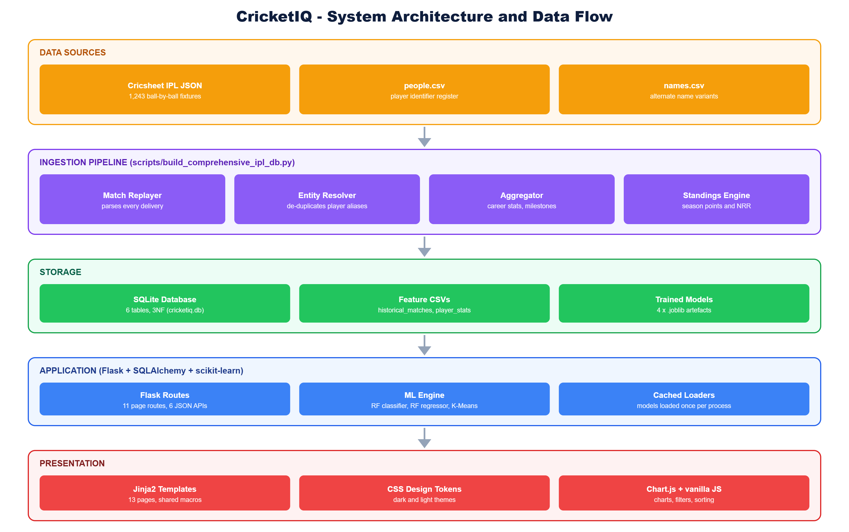
DESIGN
Methodology / System Architecture
Approach Followed
Collect: Cricsheet JSON + player registers
Clean: resolve aliases, validate fixtures
Store: 6-table normalised schema
Model: train 3 scikit-learn models
Serve: Flask routes + JSON APIs
Present: Jinja2 pages with Chart.js
CricketIQ - Mini Project Evaluation
7

Slide 8
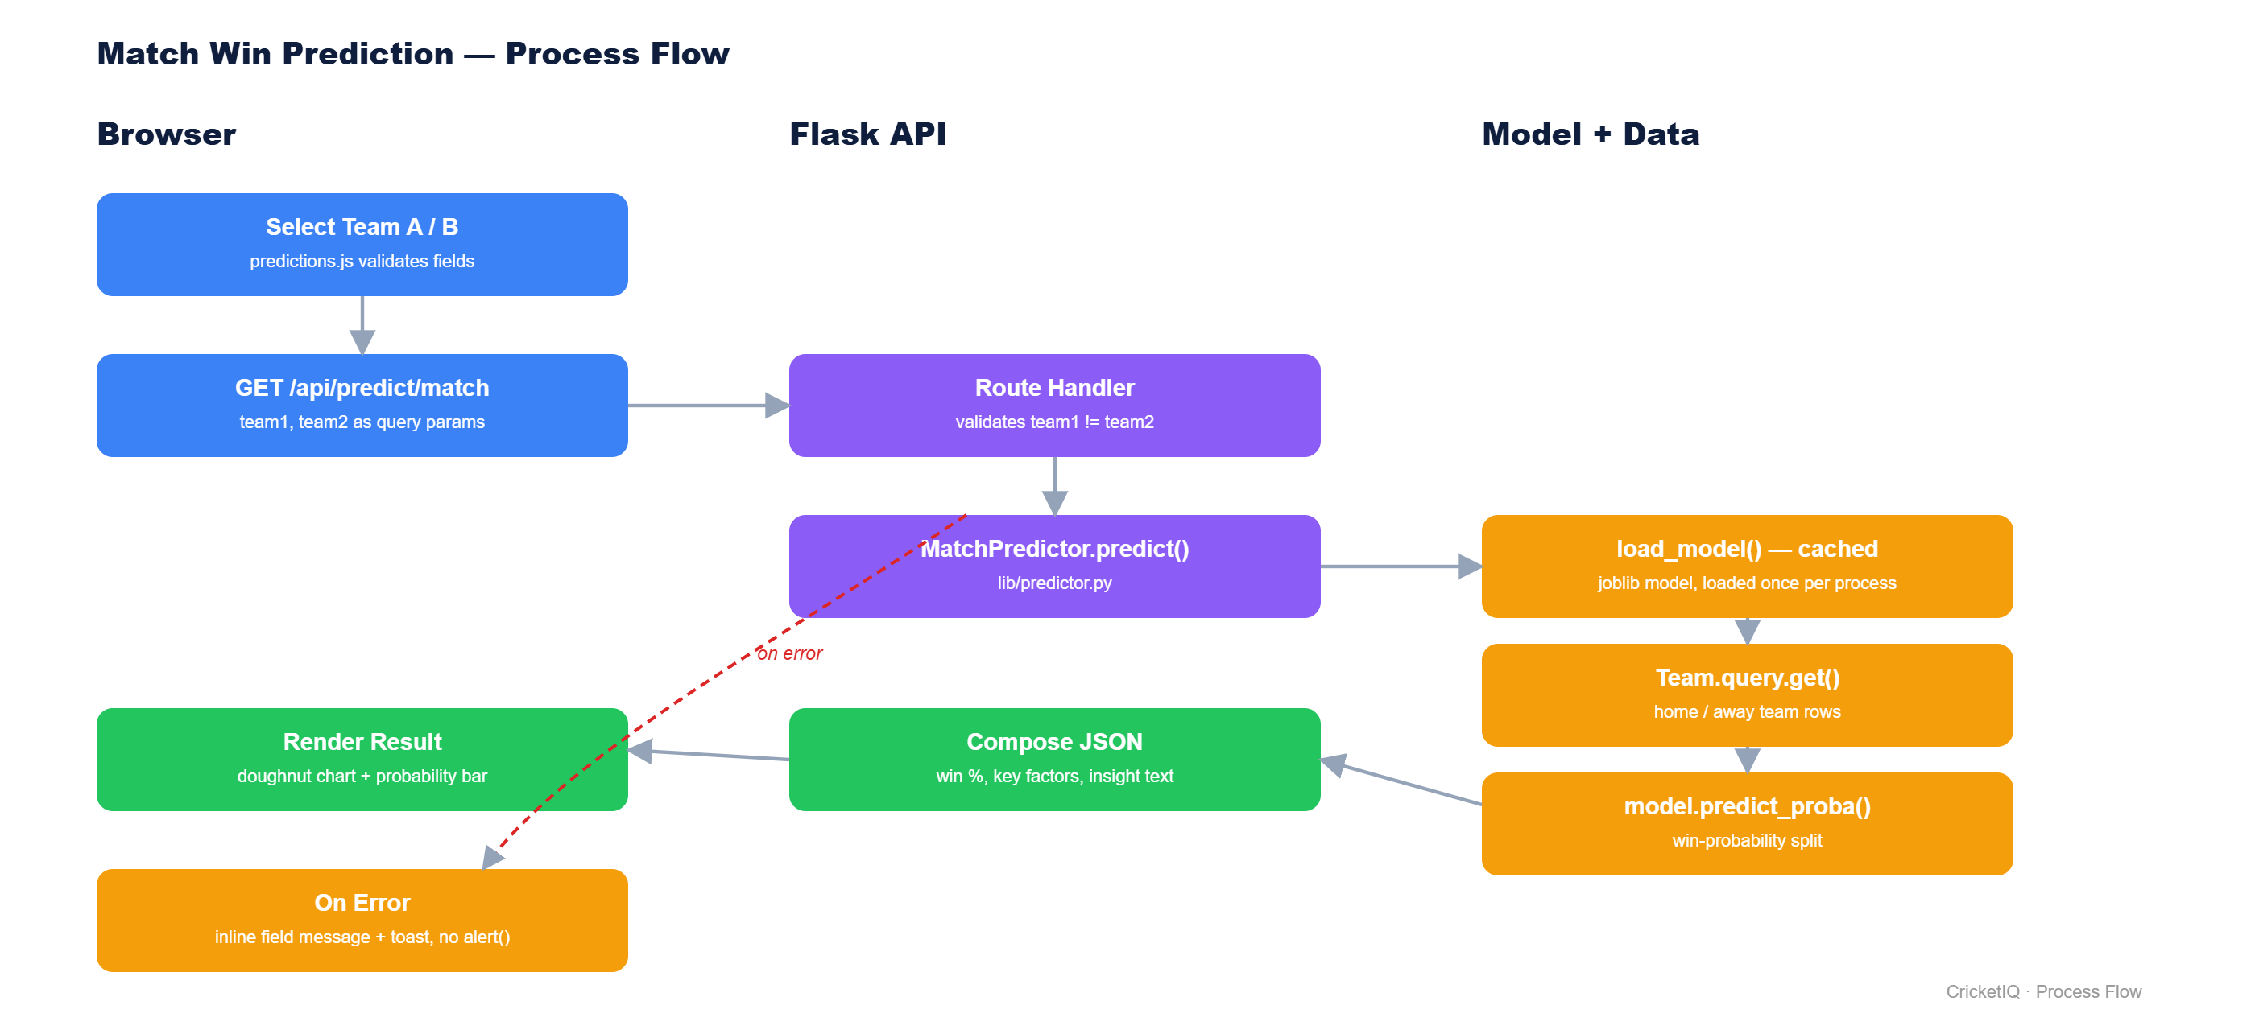
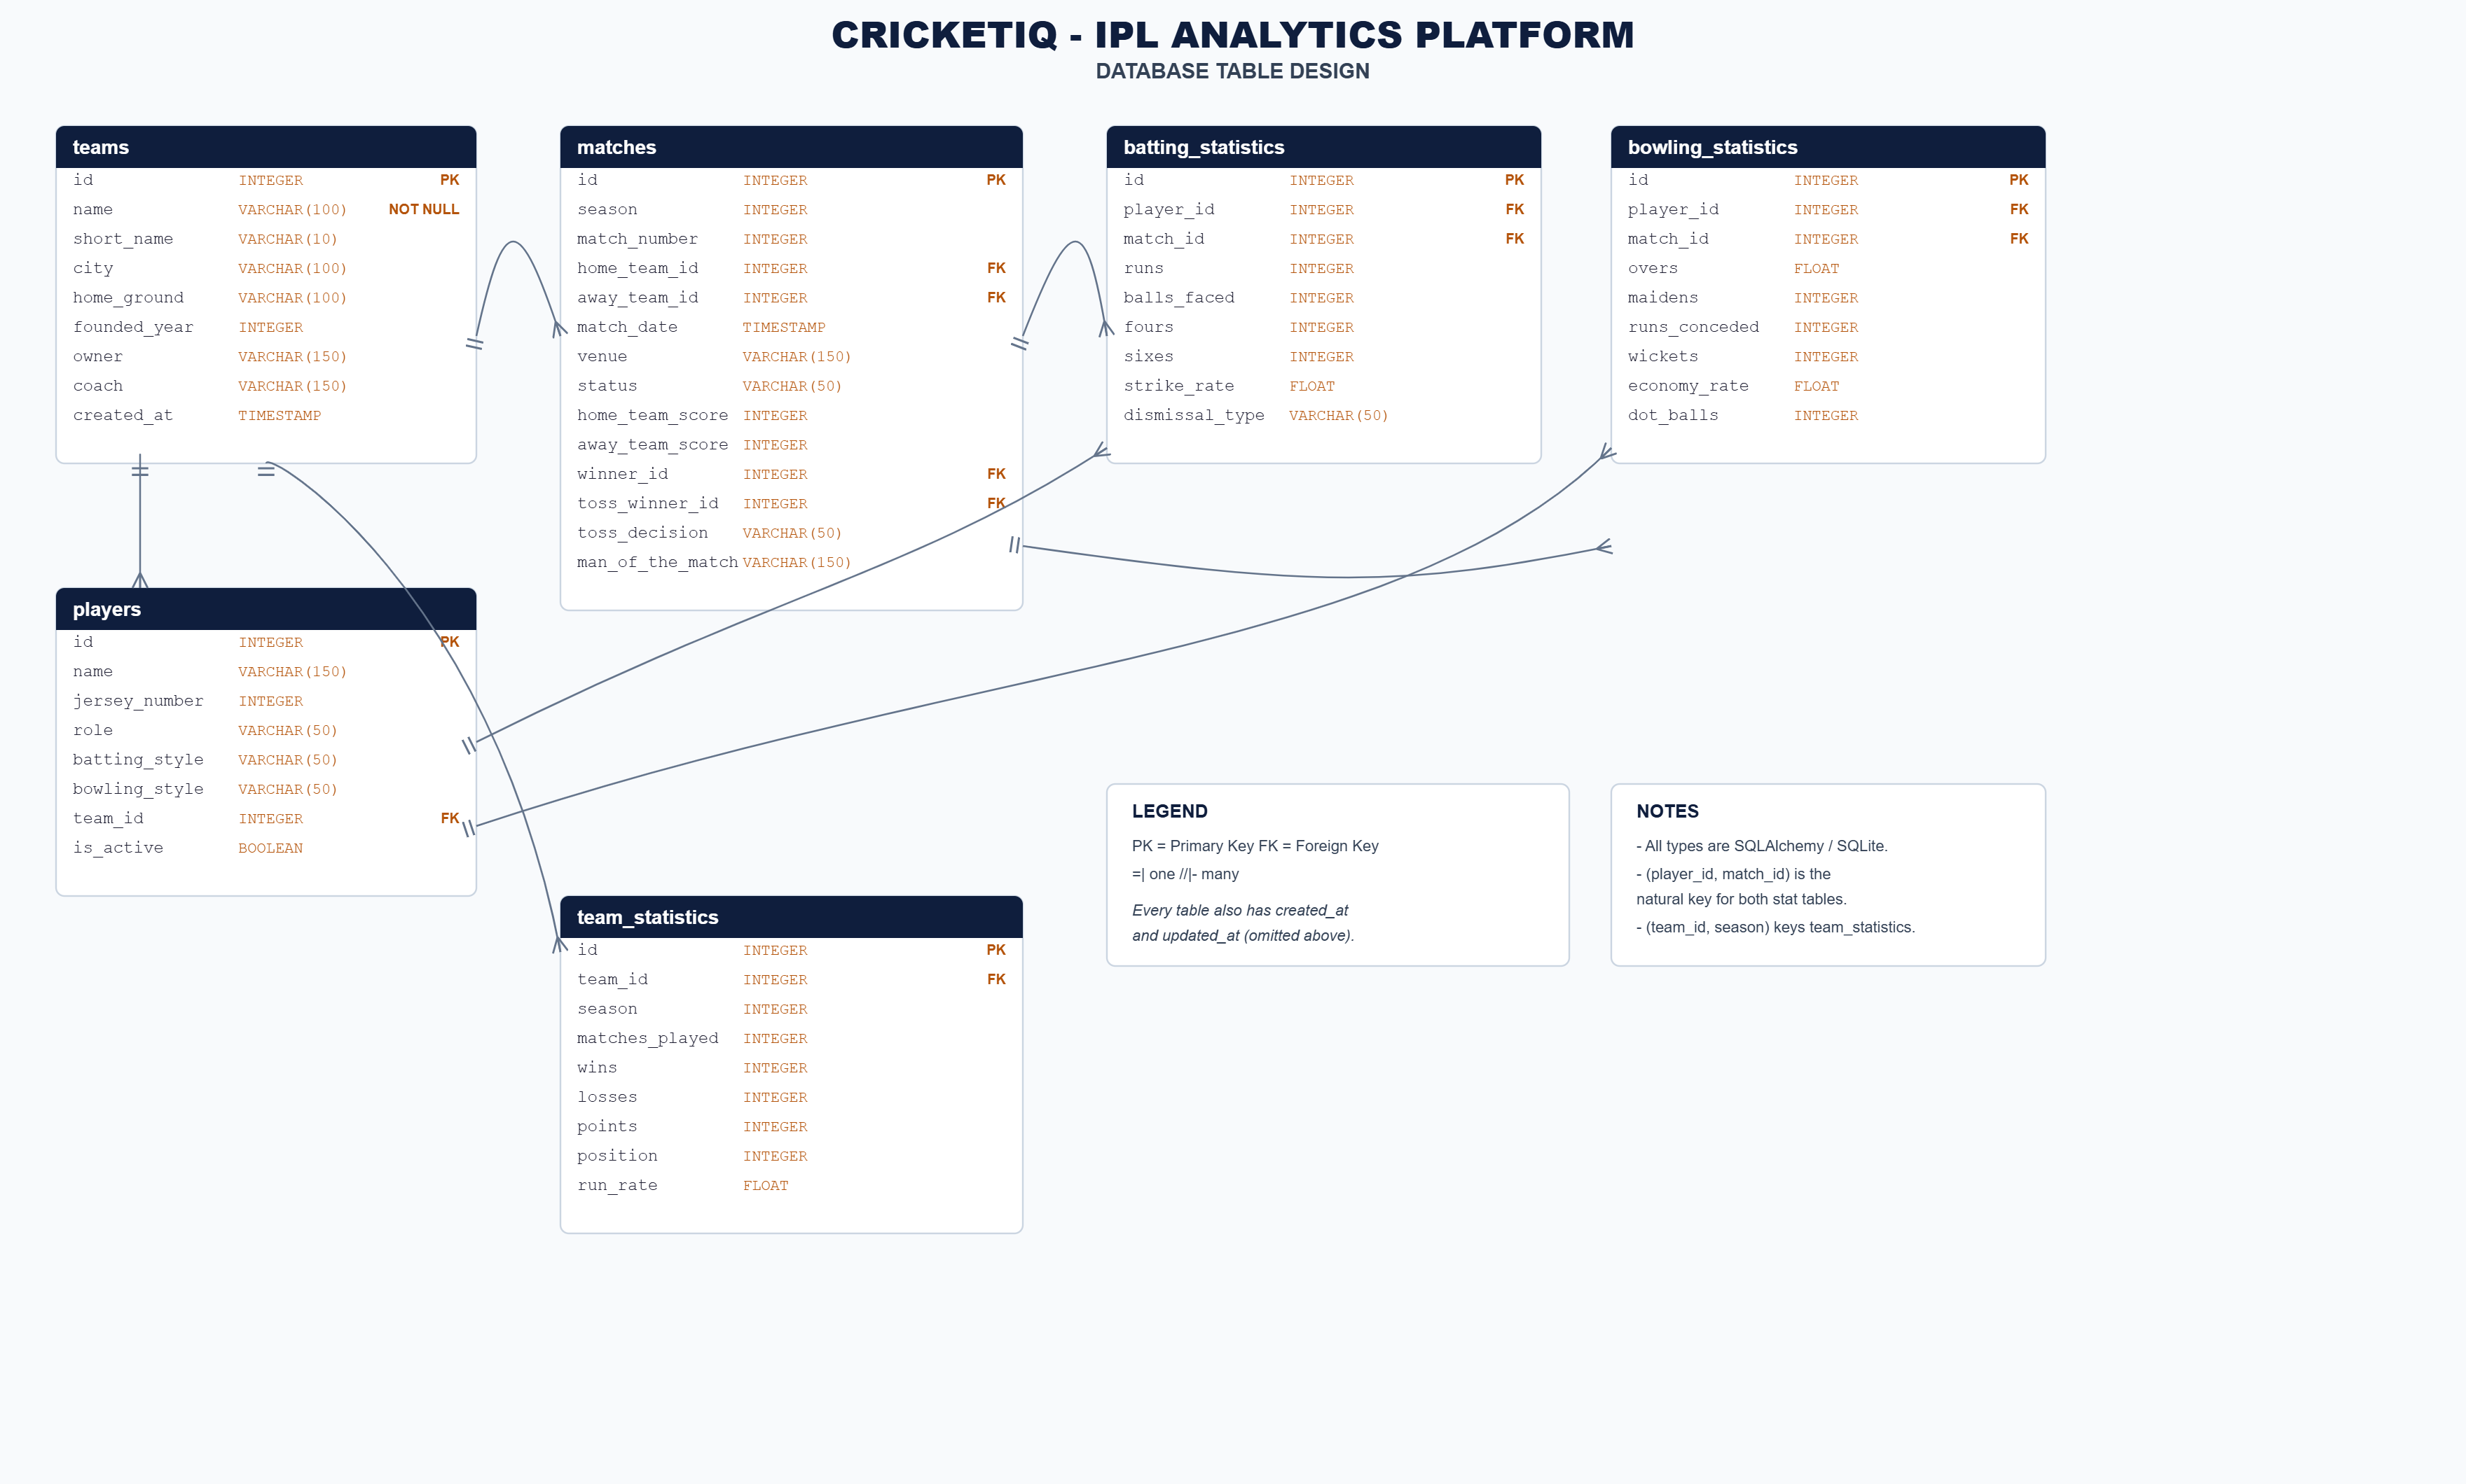
DESIGN
System Design - Workflow and Database
Match-prediction process flow
Teams are the hub: referenced by players, matches and season statistics.
Batting and bowling statistics are one row per (player, match) - no repeating columns.
Database table design (6 tables, 3NF)
CricketIQ - Mini Project Evaluation
8

Slide 9
IMPLEMENTATION
Technologies Used
Category | Technology
Language | Python 3, JavaScript, HTML5, CSS3
Backend framework | Flask, Flask-SQLAlchemy (SQLAlchemy 2.0), Jinja2
Database | SQLite (cricketiq.db); MySQL-ready via configuration
Data processing | pandas, NumPy, Cricsheet ball-by-ball JSON
Machine learning | scikit-learn: Random Forest (classifier, regressor), K-Means, StandardScaler; joblib
Frontend | Custom CSS design tokens, Bootstrap 5 grid, Chart.js, vanilla JS
Tools / platform | Git + GitHub, VS Code, Chromium (testing); runs on Windows / Linux
CricketIQ - Mini Project Evaluation
9

Slide 10
IMPLEMENTATION
Modules / Major Features
Data Ingestion
Team Directory
Player Profiles
Parses 1,243 fixtures
Resolves player aliases
Builds standings
15 franchises
Squad and season record
Live search filter
809 players
Average, SR, 100s, 50s
Match-by-match log
Matches & Scorecards
Analytics Dashboard
Intelligence Tools
Filter by season
Full batting / bowling card
Result and toss info
Wins-per-season trends
Run / wicket leaderboards
Themed Chart.js charts
Match win probability
Run forecast, playing XI
Player similarity (K-Means)
CricketIQ - Mini Project Evaluation
10

Slide 11
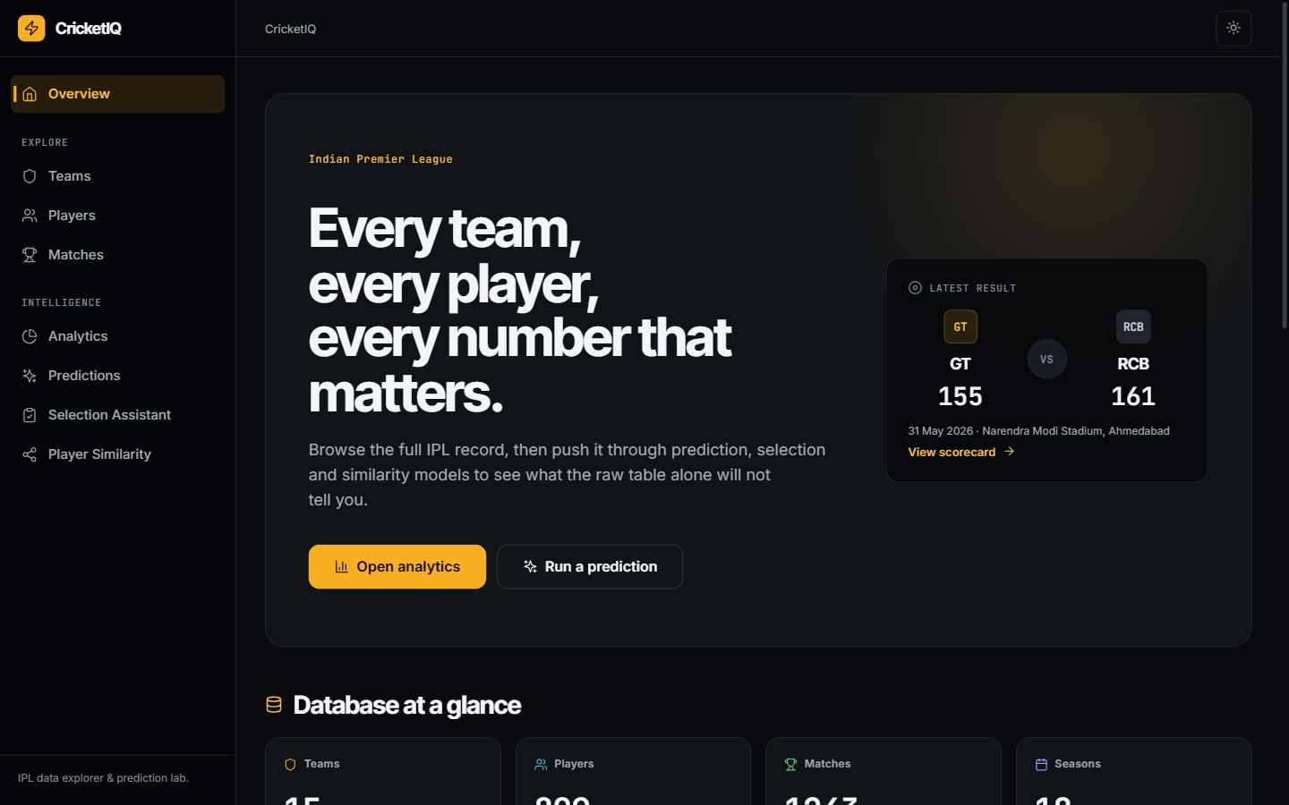
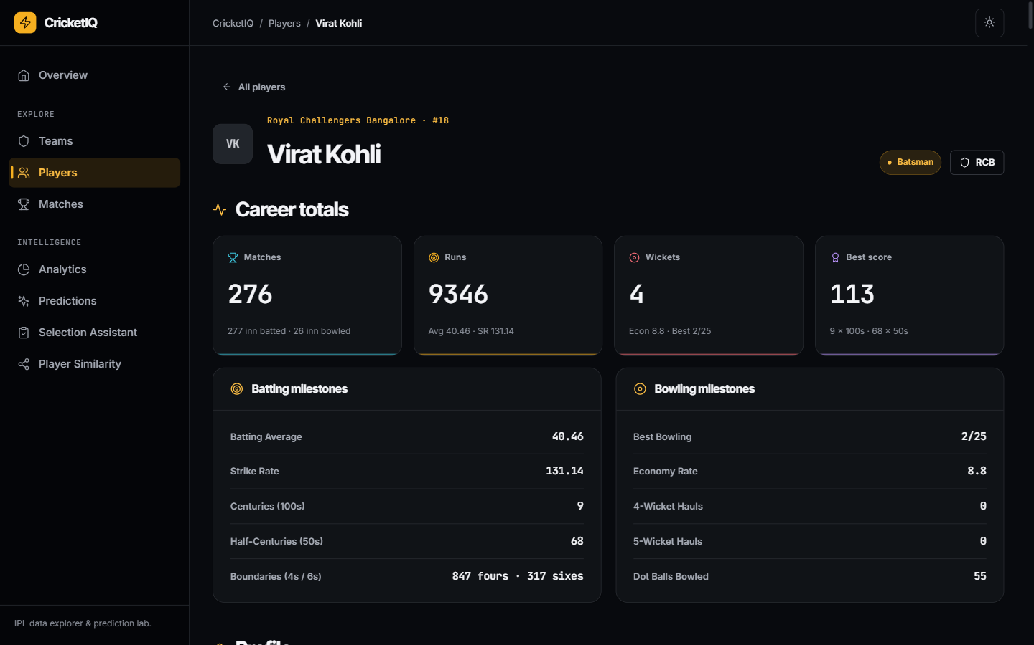
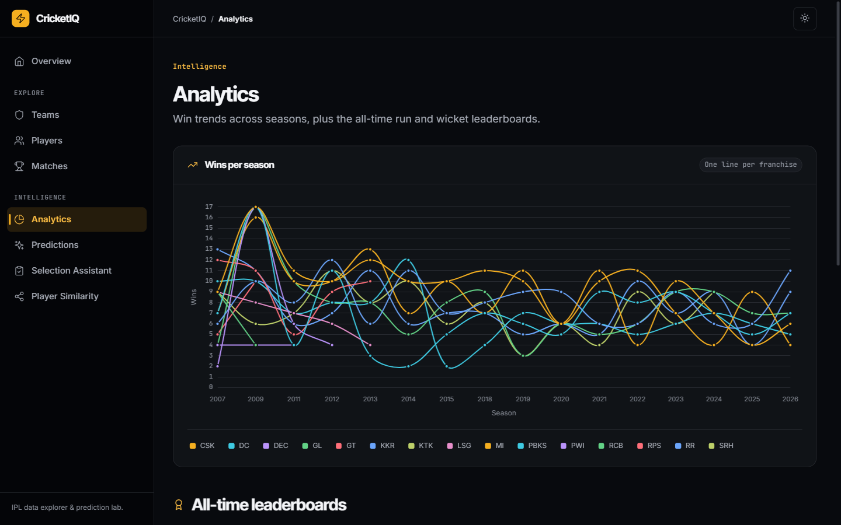
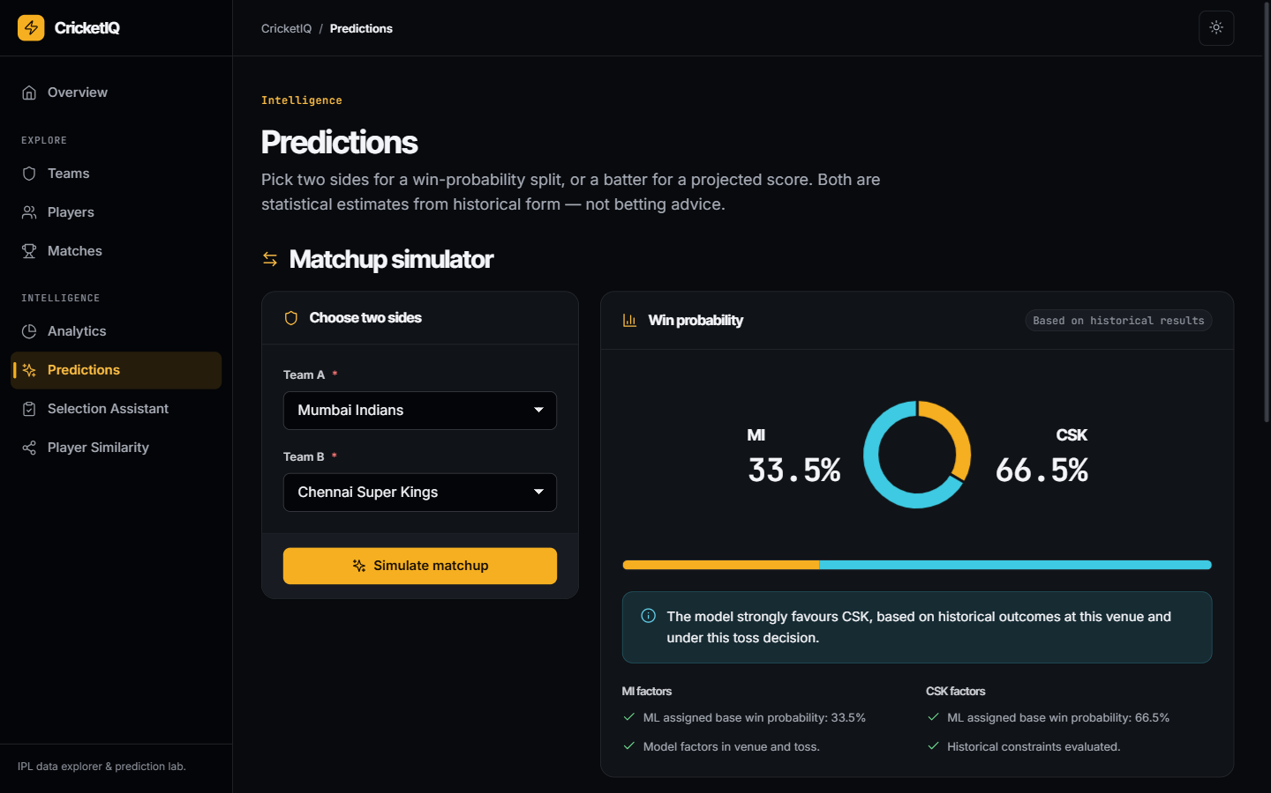
IMPLEMENTATION
Screenshots of the Working Project
Overview dashboard
Player profile (V Kohli)
Season analytics
Match prediction (MI vs CSK)
CricketIQ - Mini Project Evaluation
11

Slide 12
RESULTS
Results / Output
155
54.7%
55.7%
< 1 s
wins by MI - the most of any franchise
toss winners who chose to field won
match-predictor accuracy (held-out 20%)
prediction response once model is cached
Choosing to field after winning the toss pays off: 443 of 810 matches won (54.7%) vs 185 of 408 (45.3%) when batting first.
Win-probability model beats a 50% coin-flip but only modestly - cricket outcomes are noisy.
Run forecaster (MAE 17.1 runs) is no better than a plain average (16.9) - not reliable for single innings.
CricketIQ - Mini Project Evaluation
12

Slide 13
WRAP-UP
Conclusion
Work Completed
Key Outcomes
Full IPL history loaded: 1,243 matches, 809 players, 15 franchises
Normalised 6-table database with computed career statistics
11 web pages and 6 JSON APIs with a consistent, accessible UI
Three trained models plus a squad-balancing assistant
Single platform replaces scattered sources
Data answers real questions: toss effect, top performers, team trends
Match predictor reaches 55.7% accuracy
Honest evaluation: forecaster needs richer features
Reusable codebase on GitHub for future work
CricketIQ - Mini Project Evaluation
13

Slide 14
WRAP-UP
Future Scope
Possible Improvements
Future Enhancements
Richer model features: venue form, head-to-head, batting order, pitch type
Compare models (gradient boosting, logistic regression) with cross-validation
Smarter XI assistant using form and opposition matchups
Add automated tests and a CI pipeline
Live-score ingestion during the season
Deploy on a cloud host with MySQL / PostgreSQL
Player comparison and head-to-head pages
Exportable reports (CSV / PDF)
User accounts for saved teams and favourites
CricketIQ - Mini Project Evaluation
14

Slide 15
WRAP-UP
References
Cricsheet - Free structured cricket data (ball-by-ball IPL JSON). https://cricsheet.org
Breiman, L. (2001). Random Forests. Machine Learning, 45(1), 5-32.
Pedregosa, F. et al. (2011). Scikit-learn: Machine Learning in Python. JMLR, 12, 2825-2830.
Flask Documentation. https://flask.palletsprojects.com
SQLAlchemy 2.0 Documentation. https://docs.sqlalchemy.org
pandas and NumPy Documentation. https://pandas.pydata.org | https://numpy.org
Chart.js Documentation. https://www.chartjs.org/docs
Bootstrap 5 Documentation. https://getbootstrap.com/docs/5.3
Project source code. https://github.com/arjuntp-397/Mini-Project-2
CricketIQ - Mini Project Evaluation
15

