Slide 1
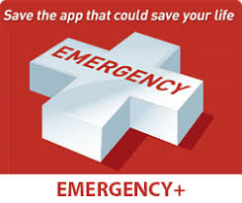
Emergency Reporter App
Team 2:
Team Members:
K. Pallavi 1602-16-737-088
B. Devika 1602-16-737-071
B. Kalyani 1602-16-737-076

Slide 2
Problem Statement
There are situations where in people have died or there situations may have turned critical because of not receiving timely help and this happens when a person with health issues is left alone and can not move to greater distances.
To overcome he above situations we came up with an idea called ‘Emergency Reporter App’ .
Not only a person with health issues can use this app but also a normal person can use it when he he/she faces a medical emergency.

Slide 3
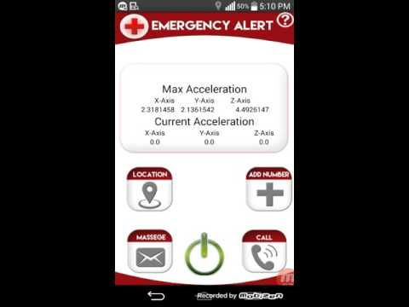
Solution
So our solution for this kind of a problem is to make an app which can send the person’s current location to the nearby hospitals and contacts to important people through an sms or call by clicking a power button for four times continuously

Slide 4
Use Cases and Dependencies
User Login.
Personal Information.
Medical Details.
Contact details of important people.
GPS to be turned on.

Slide 5

UML Diagram
For location tracking:
Sending location
to receiver
Start location
tracking
Receiver
User
Fetch location
Display map

Slide 6

UML Diagrams
For sending notifications:
User
Make a Call
Send panic
message
Fetch
location
Contact near by hospital
Send panic messages to important people
Send location to nearby hospital and people
Important People

Slide 7


Technology Stack
Android Studio
Fire Base

Slide 8
Show Stoppers
GPS has to be turned on for the app to send the location.
This app may not work if the persons mobile is far away from him and the person is in critical condition to access the phone.

Slide 9
Thank you!!

