Slide 1
Data Analytics Project
Olympics Data Exploration and analysis
Analyze trends in data and make predictions for future Olympics.
By
Chinmayi P S Devika Mishra

Slide 2
What problem have you selected?
History and current state of analytics in sports specifically for the summer olympics held every 4 years.

Slide 3
Why is what you have done important/ useful?
Two key aspects of sports analytics - on-field and off-field analytics

Slide 4
What is the approach you have taken?
Major factors affecting medal count:
1)GDP per capita.
2) Performance of the country in the previous year

Slide 5
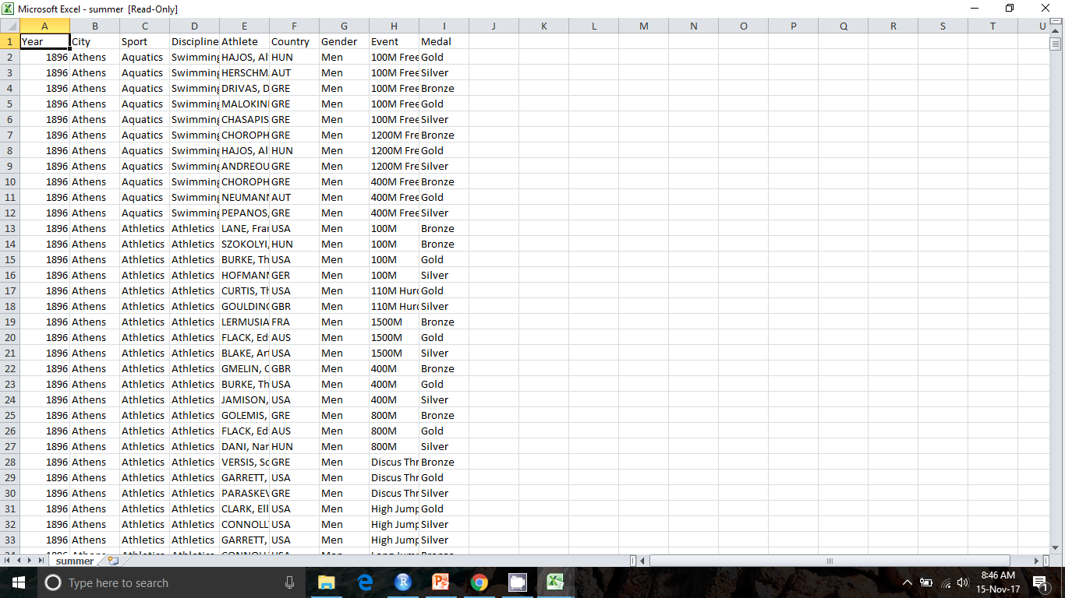

Slide 6
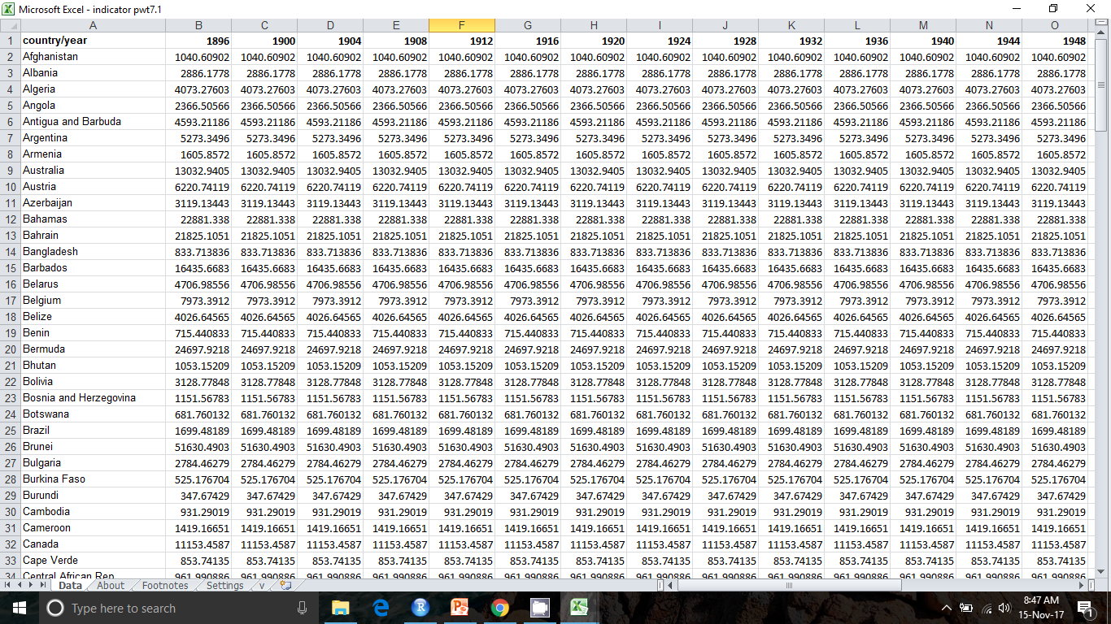

Slide 7
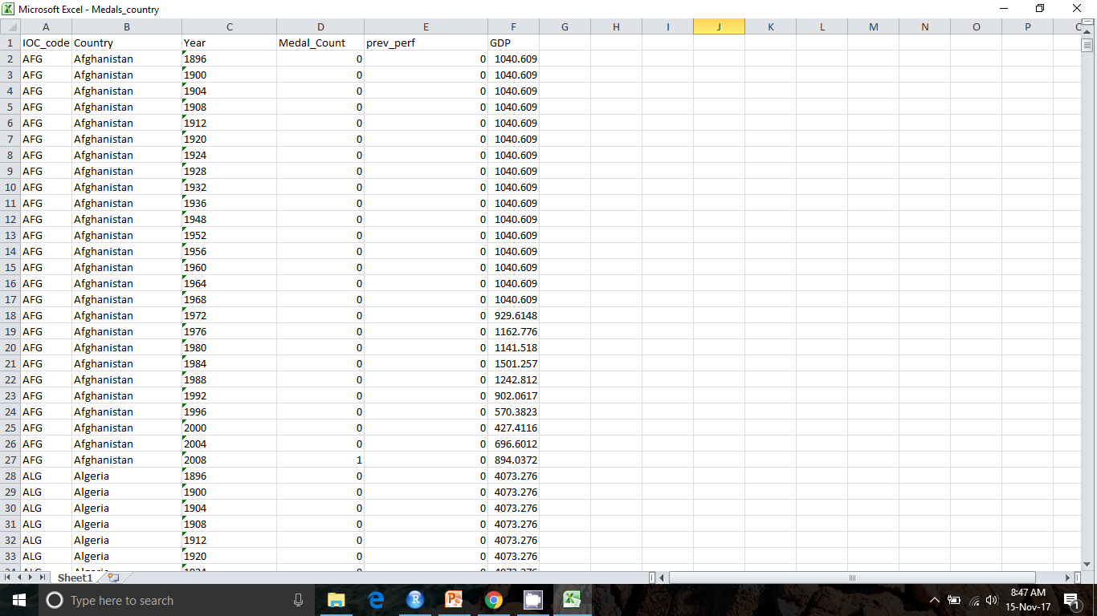

Slide 8
How did you evaluate your solution/ the algorithm you implemented?

Slide 9
Anything interesting that you inferred about the data or learnt through the process?

Slide 10
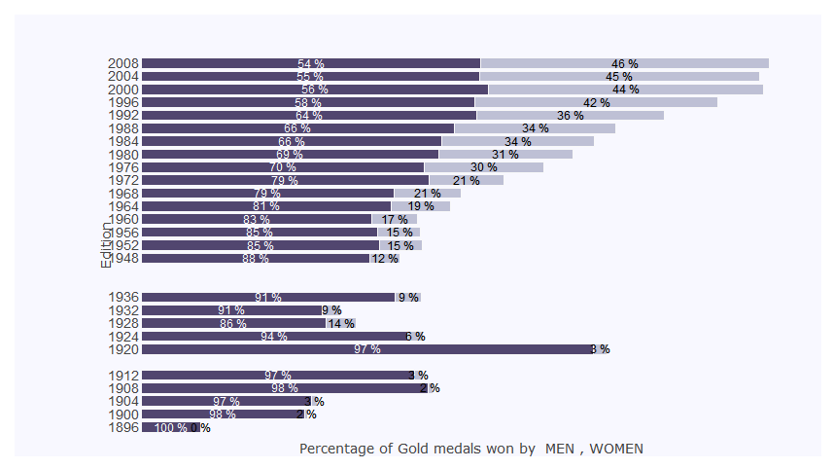

Slide 11
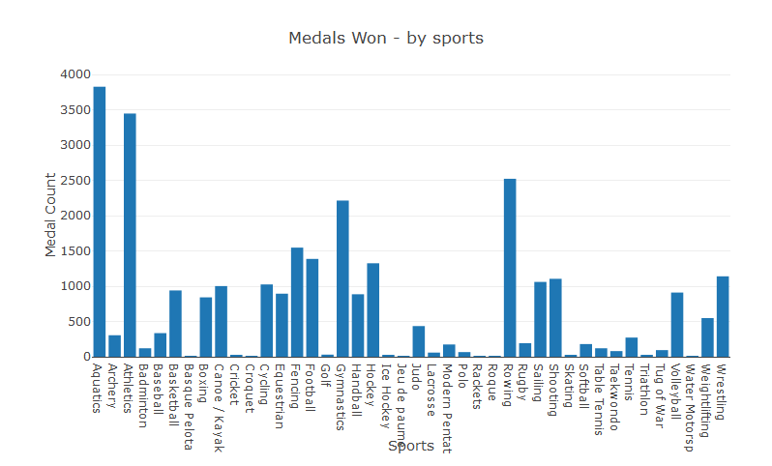

Slide 12
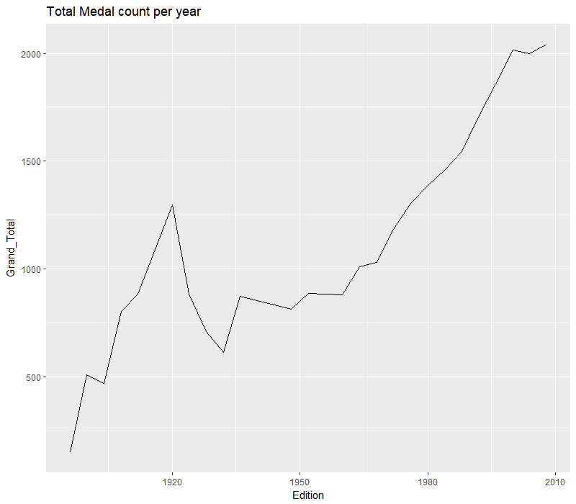

Slide 13
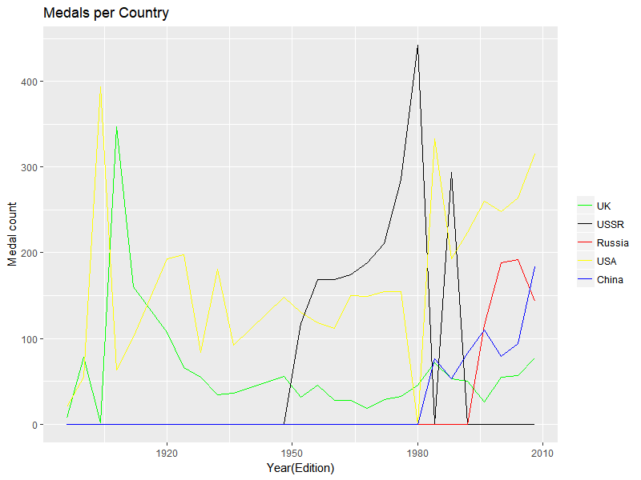

Slide 14
Thank you…..
By TEAM ELIXIR
Chinmayi P S(01FB15ECS078) Devika Mishra(01FB15ECS093)

