Slide 1
DMart Opportunities Analysis
Food Services Division — Strategic Growth Review
Prepared for: Shaun, Sales Director
Data Period: 2011–2014 | 4,117 Orders | 792 Customers | 15 Countries

Slide 2
Executive Summary
Key findings at a glance
€2.3M
€283K
12.1%
+19.8%
Total Sales
Total Profit
Profit Margin
YoY Growth (2014)
▸ Consumer segment dominates at 51.8% of sales, with Corporate (31.2%) as the biggest growth opportunity
▸ Central region accounts for 55% of revenue — North and South regions are under-penetrated
▸ France, Germany, and UK are top 3 markets — 7 smaller countries represent untapped potential
▸ Discounts above 20% destroy profitability — disciplined pricing is critical for margin protection
▸ Technology and Furniture categories offer higher margins vs. Office Supplies volume play
▸ Year-over-year growth accelerating: from 12.7% (2012) to 25.3% (2014), signalling strong momentum

Slide 3
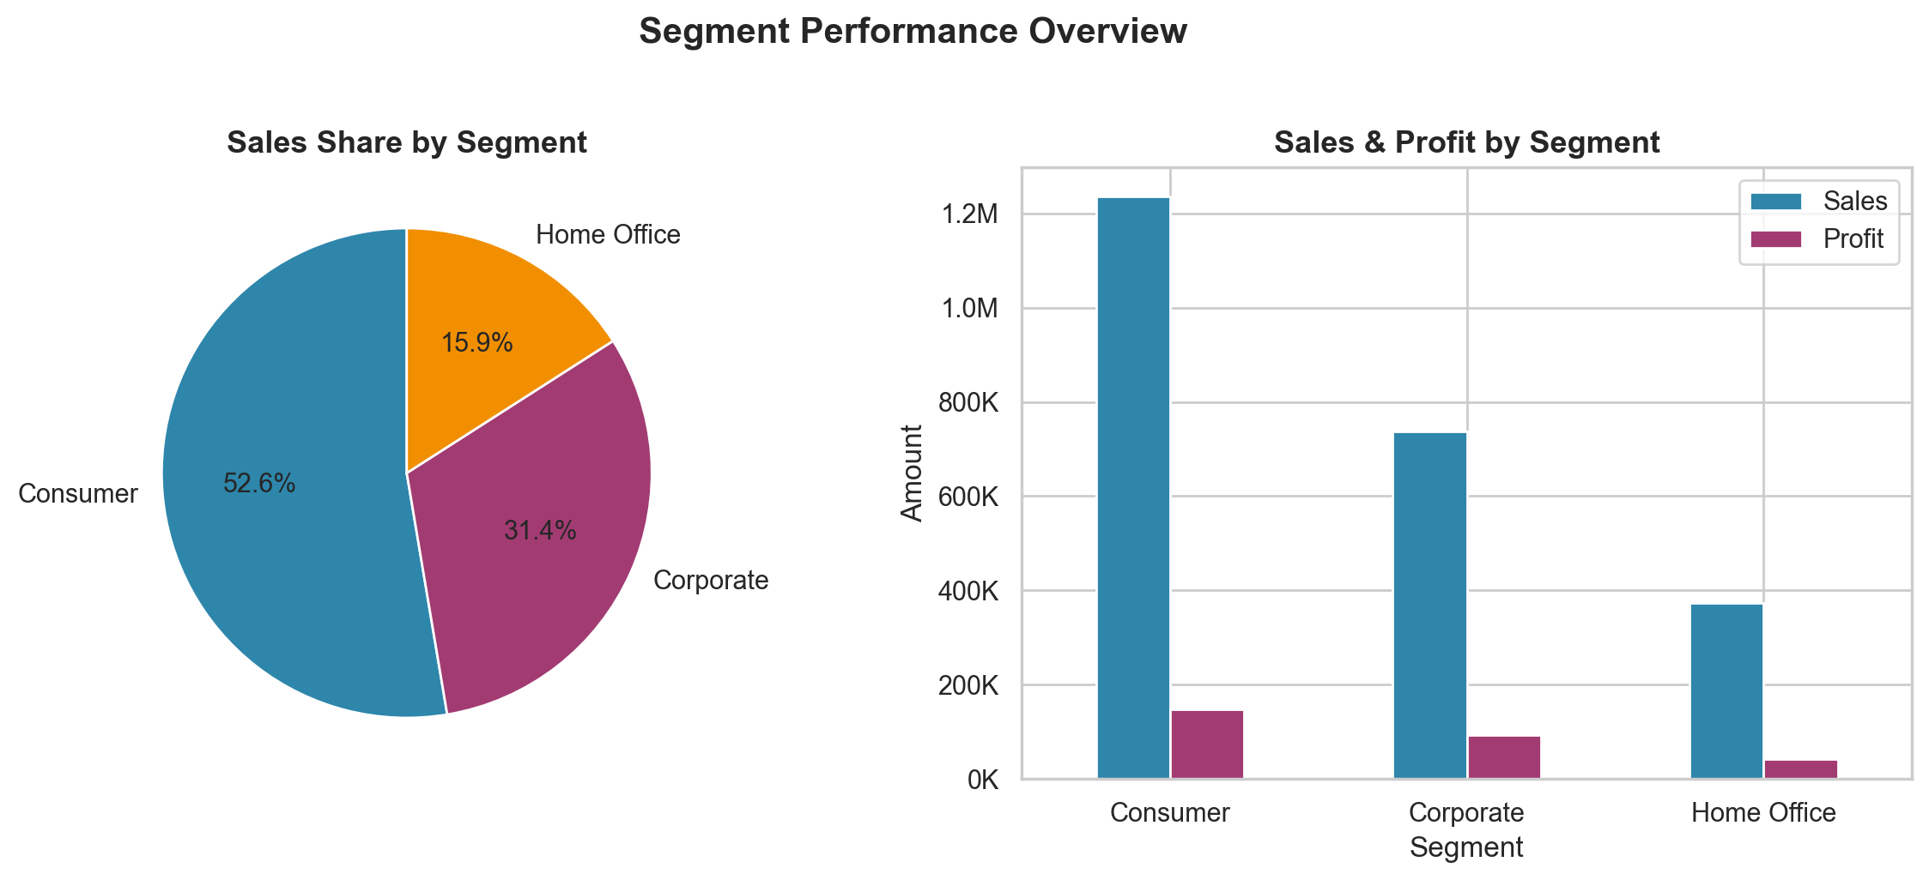
Segment Performance Overview
Share of total spends across Customer, Corporate & Home Office

Slide 4
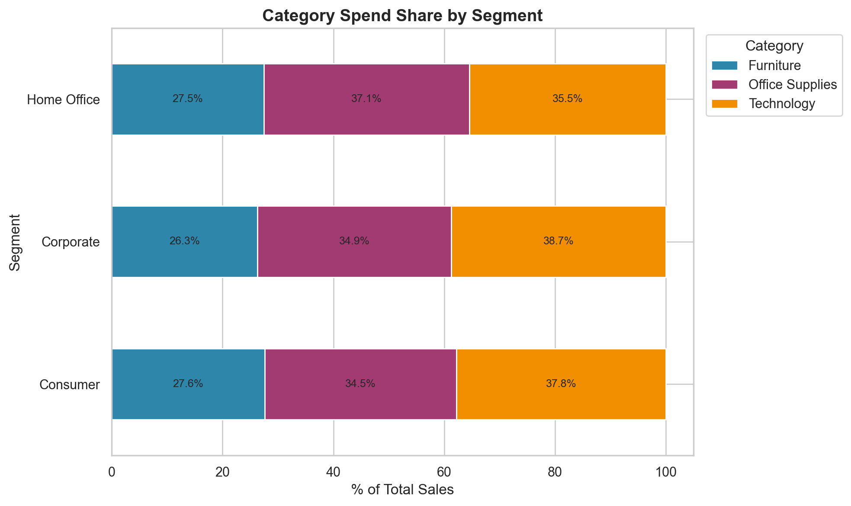
Category Spend Share by Segment
How each segment allocates spend across product categories

Slide 5
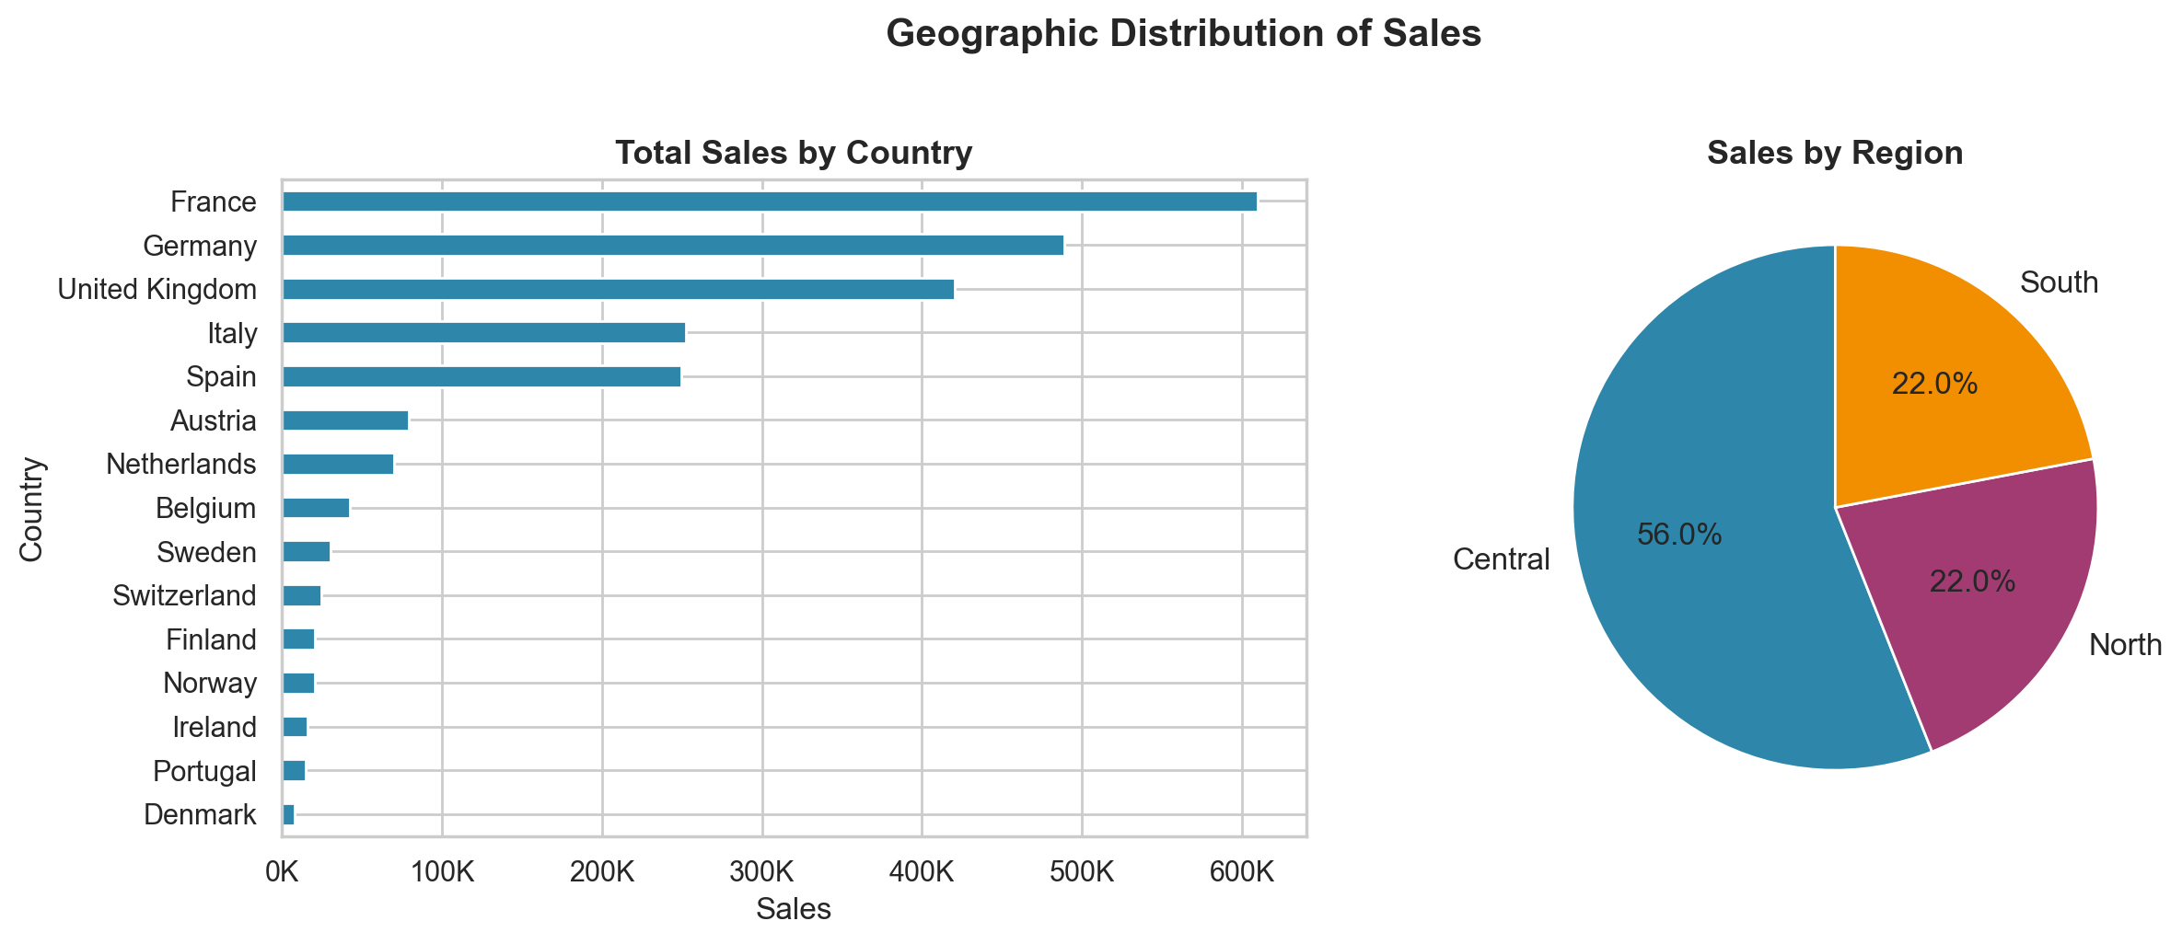
Geographic Distribution of Sales
Sales breakdown across 15 European countries and 3 regions

Slide 6
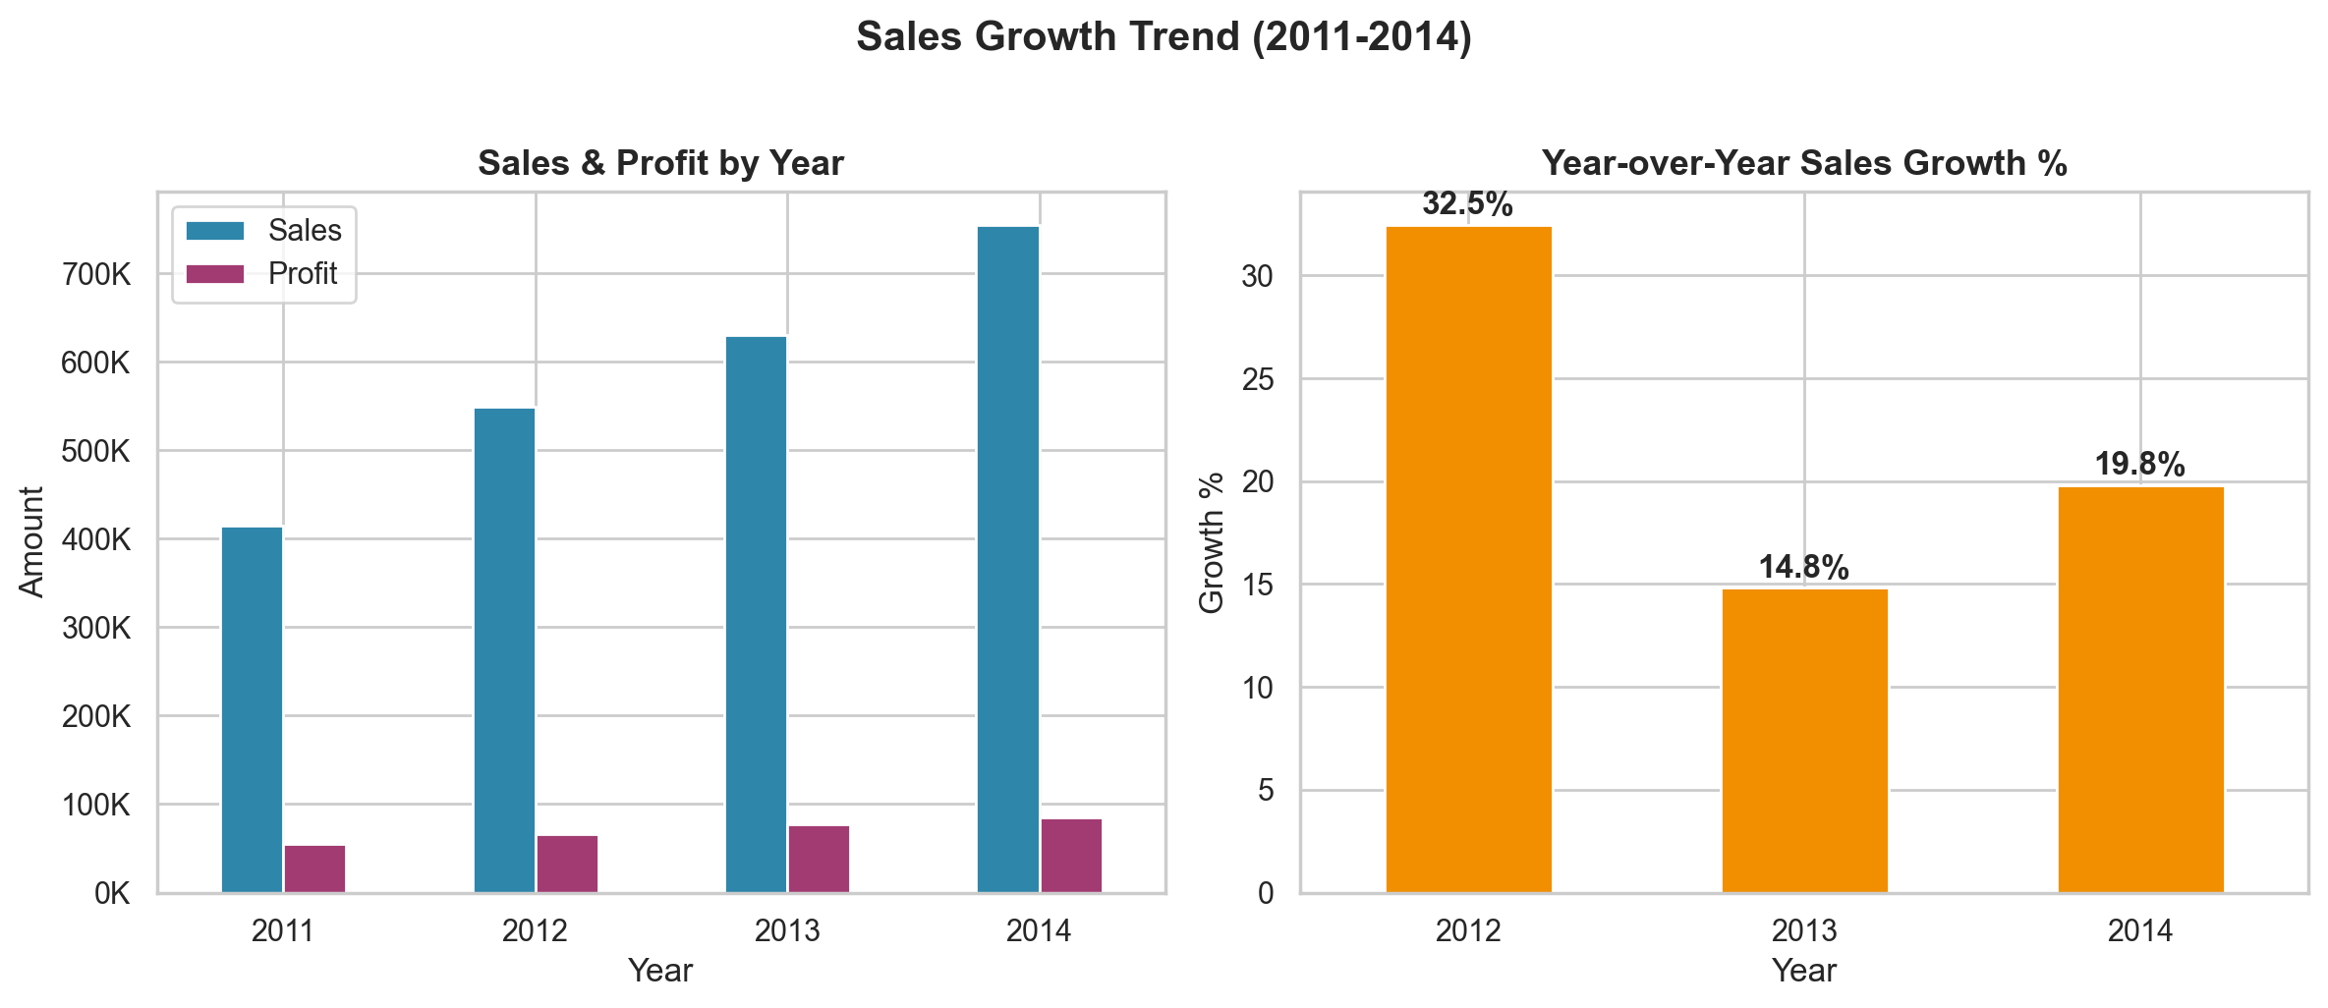
Sales Growth Trend (2011–2014)
Year-over-year growth acceleration signals strong momentum

Slide 7
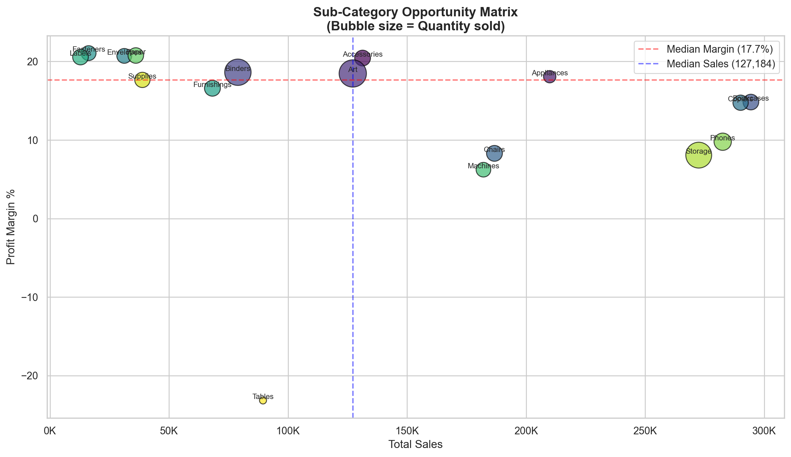
Sub-Category Opportunity Matrix
Identifying high-margin, high-volume growth opportunities

Slide 8
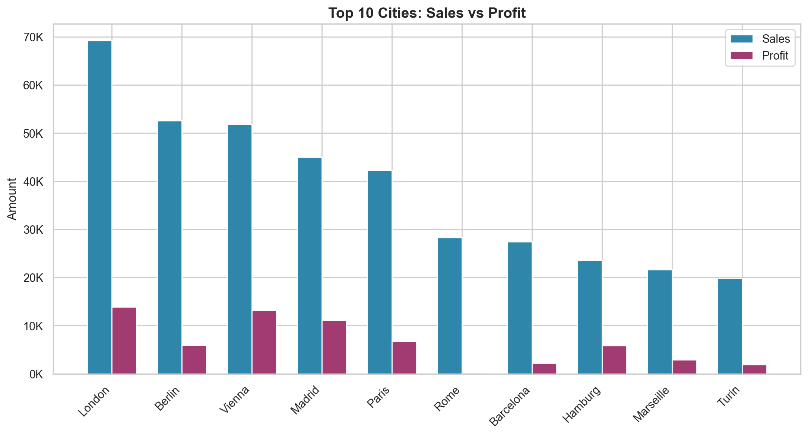
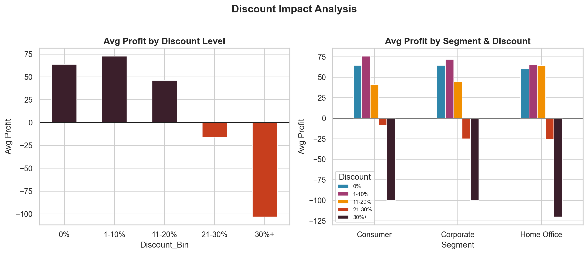
City Performance & Discount Impact
Where we win and how discounting affects profitability

Slide 9
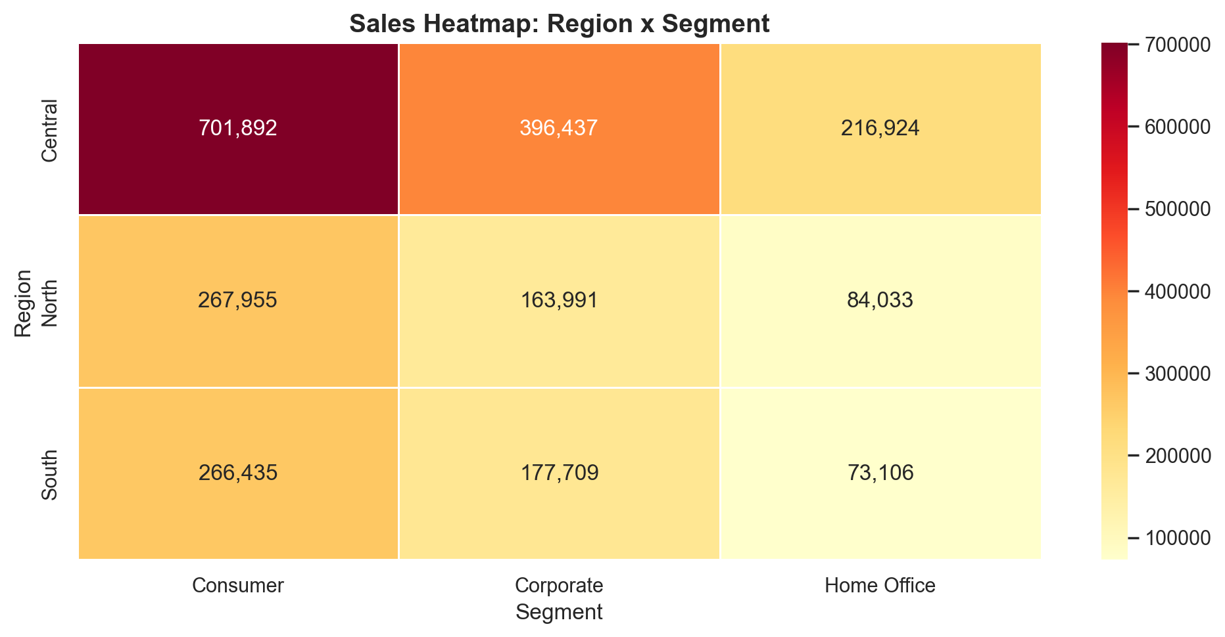
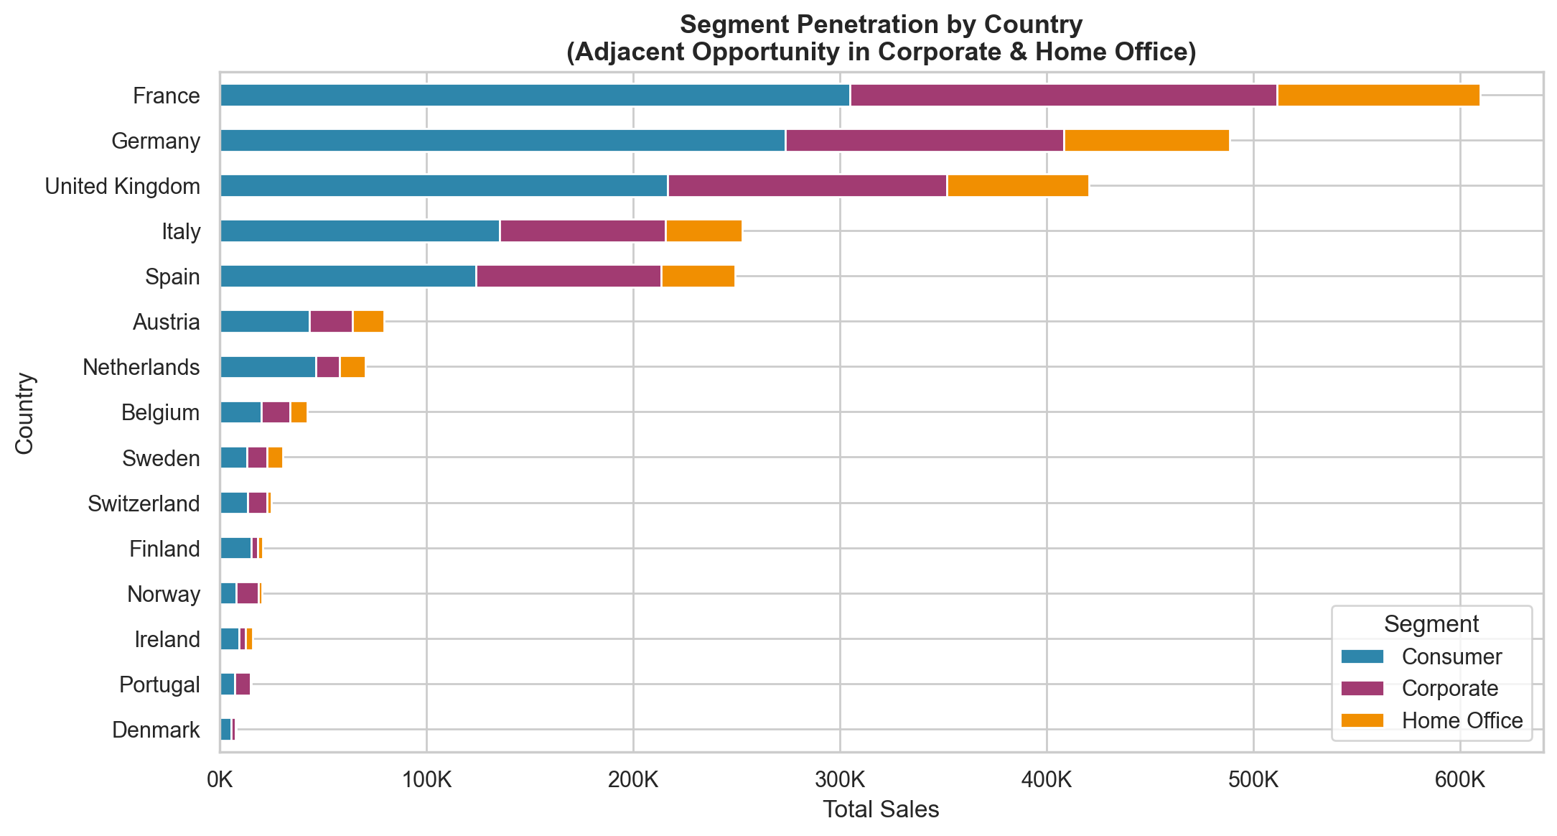
Adjacent Segment & Regional Opportunities
Identifying under-penetrated segments across geographies

Slide 10
Strategic Recommendations & Next Steps
Where are our biggest opportunities?
1. EXPAND CORPORATE SEGMENT — Corporate represents 31% of sales but shows higher avg. order values. Targeted campaigns in France, Germany & UK can capture an additional estimated €200K+ annually.
2. PENETRATE UNDER-SERVED GEOGRAPHIES — 7 smaller markets (Nordics, Benelux, Portugal, Switzerland) account for only 14% of sales. Deploying dedicated sales coverage can unlock significant new revenue.
3. OPTIMIZE DISCOUNT STRATEGY — Discounts above 20% result in negative profit margins. Implement tiered discount caps: max 10% for Office Supplies, max 15% for Technology, max 20% for Furniture.
4. DOUBLE DOWN ON HIGH-MARGIN SUB-CATEGORIES — Copiers, Phones, and Accessories show the best margin-to-volume ratio. Prioritize these in sales incentive plans.
5. INVEST IN NORTH & SOUTH REGIONS — Central region is mature at 55% share. North (22%) and South (23%) offer the best incremental growth with focused regional sales teams.
6. LEVERAGE CUSTOMER FEEDBACK — Only 50% of transactions include feedback. Implement systematic feedback collection to improve NPS and retention in top accounts.

