Slide 1
A Look into Airbnb Hosting: Berlin
Presented by : Devika Lahari
Notes:
Hi everyone! This is my presentation a ‘Look into Airbnb Hosting: Berlin’
Airbnb can be a great way to visit a city at a reasonable price (compared to a hotel),
but how does this affect the locals that live there?
As a person that lived in Berlin for a while.
From my own experience in 2015 it was nearly
impossible to find affordable or even available housing,
so, in turn I lived in two different Airbnb’s which cost me way more money than renting an apartment.
That is why I wanted to see how Airbnb is affecting the housing landscape within Berlin.

Slide 2
Overview
1.
Brief history of Airbnb and Berlin
2.
A look at hosts and listings
3.
Conclusion
4.
Further Analysis & Sources

Slide 3
Airbnb Timeline
2008 – The Airbedandbreakfast.com website launches beginning just with beds and shared spaces.
2011 – Airbnb acquires Accoleo (a small German company) expanding into Germany.
2018 – May 1st the law is updated after many court cases.
2009 – The name is shortened to Airbnb and the site’s contents expand drastically. Including: entire homes, apartments, private rooms, castles, boats, manors, treehouses, other properties, etc.
2016 – May 1st Zweckentfremdungsverbot (Ban on Wrongful Use law) was enacted in Germany.
Notes:
2008 – The Airbedandbreakfast.com website launches beginning
just with beds and shared spaces.
2009 – The name is shortened to Airbnb and the site’s contents
expand drastically. Including: entire homes, apartments, private rooms,
castles, boats, manors, treehouses, other properties, etc.
2011 – Airbnb acquires Accoleo (a small German company) expanding into Germany.
2016 – May 1st Zweckentfremdungsverbot (Ban on Wrongful Use law)
was enacted in Germany.
2018 – May 1st the law is updated after many court trials.

Slide 4
Vacation Rental Laws
Since May 1st, 2016, Zweckentfremdungsverbot is a law aimed at landlords/ apartment owners due to rising rents/lack of housing within the city.
Regulations began to soften in 2018.
Hosts are now able to list more than private rooms.
In both iterations of the law all hosts listings must have a permit from the city of Berlin and have it listed on Airbnb.
Notes:
Currently Airbnb is still perfectly legal in Berlin.
In effect since May 1st 2016, Zweckentfremdungsverbot (Ban on Wrongful Use) a law aimed at landlords and apartment owners that are taking their apartments off the regular rental market.
This is happening because there is more money to be made per night than renting it out as a regular monthly rental.
The law basically makes it illegal to rent out more than 50% of their apartment short-term without a city permit.
The fine could be up to $100,000 euro ($125,000).
Law was created because of rising rents and a lack of housing within the city
Exceptions:
If you are occupying at least 50% of the apartment.
If the apartment was already used as a commercial holiday rental prior to May 1st of 2014 AND it was be officially registered as a holiday apartment.
These registrations are nearly impossible to get as a normal person but easy for larger corporations.
Regulations began to soften in 2018
Between 2016-2018 you were only able to rent private rooms - as of May 2018 that has changed
Host can rent second properties for up to 90 days a year
PERMITS STILL NEEDED and permit holders MUST indicate a registration number on their listing
Fee for violation up to $616,000

Slide 5
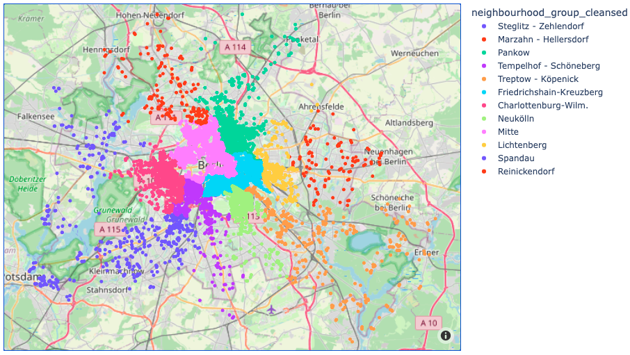
Breakdown
Berlin is composed of 12 neighborhoods with 136 localities.
Hosts:
10,125
Listings:
35,700
Price Range (per night):
$8.00 - $4,375.00
Interactive listings map.
Notes:
I have decided to work on the Berlin Airbnb dataset from Sept 2022.
Here is a breakdown of the data I have chosen to work with after the data cleaning process just for transparency
there were over 16 thousand records

Slide 6
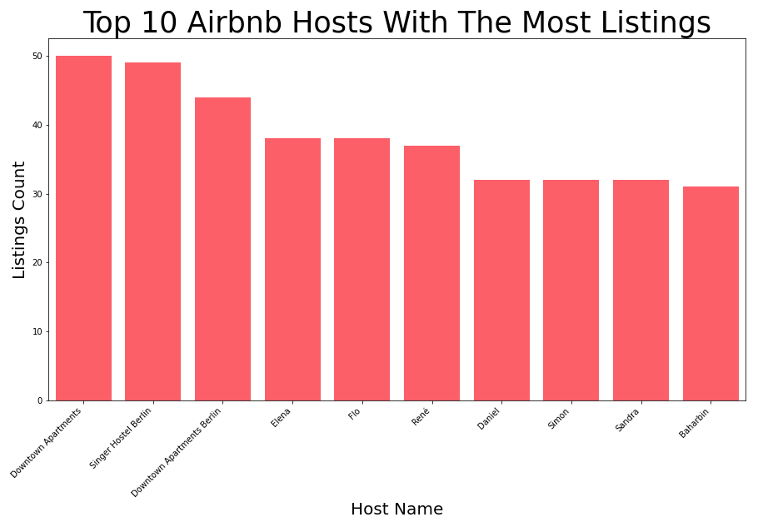
Notes:
Given the vacation rental laws imposed in Berlin aimed directly at companies like Airbnb.
I wanted to find out whether there were multiple hosts with listings more than 2 and if so, which were the biggest player?
I was expecting most hosts to have between 1 or 2 listings due to the law in 2018 with a few outliers.
To my surprise you can see here that the top ten listing hosts list between around 30 – 50 different listings.
So, this got me thinking:
Could this mean that this is their main source of income?
I decided I would then look into, availability of listings in comparison to listing amount.

Slide 7
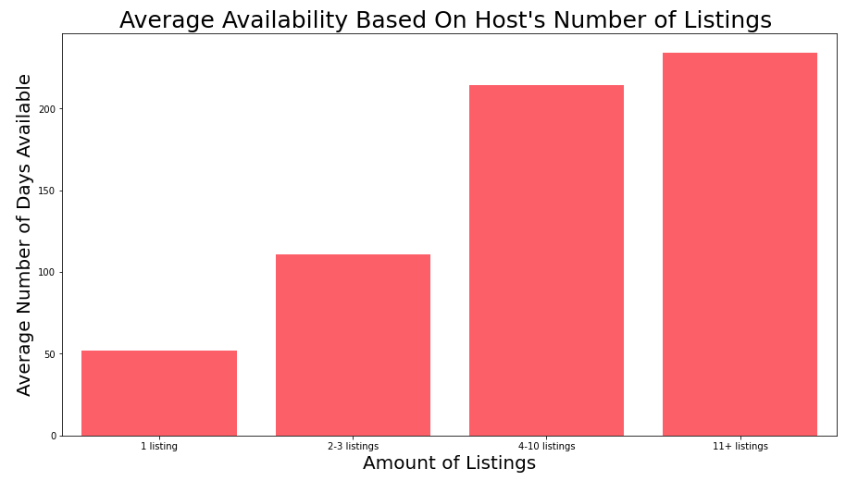
Notes:
From this chart we can see that the average availability dramatically increases with the listings number a host has.
The average availability for 1 listing is around 50 days where the average of 11+ listings is well over 200 days.
But how is this possible when you can only rent out your 2nd property for up to 90 days?
The more listings a person has the more likely they are to be using it as their main source of income or business.
Somethings, still didn’t feel right about this information though.
I then decided to look into the number of listings vs. hosts.

Slide 8
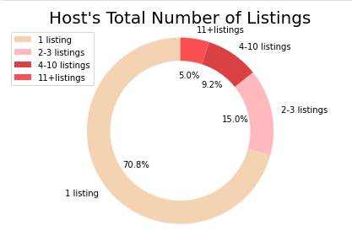
Notes:
From this pie chart it is clear, that even though the top 10 have a significant number of listings, people that
own 2 + properties make up only 29.22% while the other 70.78% have only one listing
This leads me to believe that a majority of hosts are using Airbnb as dictated by the law and are mostly renting out rooms, but does that mean that a majority have the necessary permits.

Slide 9
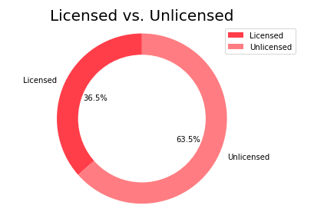
Notes:
As we can see from the chart above most hosts are unlicensed, based on the law each rental listing must have a permit.
Meaning that they are not in line with the Berlin Law EVEN if they are renting in accordance to the law.
In the future I would like to break down this pie chart to include the top 10 host with the most listings to see
Whether the consensus of being a cooperation makes getting a permit easier.

Slide 10
Conclusions
With laws restricting vacation rentals :
2+ listings rent for longer than 90-day
Most hosts are still unlicensed
Hosts with 4 or more listings are likely using Airbnb as their main source of income.
Listing availability is strongly tied in with the number of listings a host has.
Notes:
In the end, I can’t say with 100% certainty that Airbnb and similar companies are fueling the housing crisis
but being a host does have its financial perks and that in some way is keeping rooms and apartments off the
general housing market for Berlin Renters. Something I had no idea I experienced until now.
What I can conclude for certain is:
Even with laws restricting how hosting works for vacation rentals :
Many with more than 2+ listings rent for longer than the 90-day cut off
A majority are still unlicensed
Hosts with 4 or more listings are most likely using this as their main source of income.
While the majority of host have only one listing
Listing availability is strongly tied in with the number of listings a host has.

Slide 11
FURTHER ANALYSIS
Explore what types of rentals each of the listings are.
Investigate Airbnb data prior to 2016 and between 2016-2018 during Zweckentfremdungsverbot .
How are companies still major players within the Airbnb space in Berlin?
Notes:
Could 20 listings be in one property?
I believe in doing so it will give a clearer picture on how Airbnb may or may not be fueling Berlin's housing crisis.

Slide 12
Thank you!
Contact information:
Email - laharidevikabandi@gmail.com
LinkedIn - https://www.linkedin.com/in/devika-lahari-dataanalyst/
Data set:
http://insideairbnb.com/get-the-data
Sources:
Wikipedia (slide 3) - https://en.wikipedia.org/wiki/Timeline_of_Airbnb
WSP (slide 4)- https://www.washingtonpost.com/world/europe/berlin-had-some-of-the-worlds-most-restrictive-rules-for-airbnb-rentals-now-its-loosening-up/2018/03/27/e3acda90-2603-11e8-a227-fd2b009466bc_story.html
The Guardian (slide 4) -https://www.theguardian.com/technology/2016/jun/08/berlin-ban-airbnb-short-term-rentals-upheld-city-court
BBC (slide 4) - https://www.bbc.com/news/business-36287031

