Slide 1

ADVENTURE WORKS CYCLES
PURCHASE ORDERS ANALYSIS
BY:
DEVIKA PATIL

Slide 2
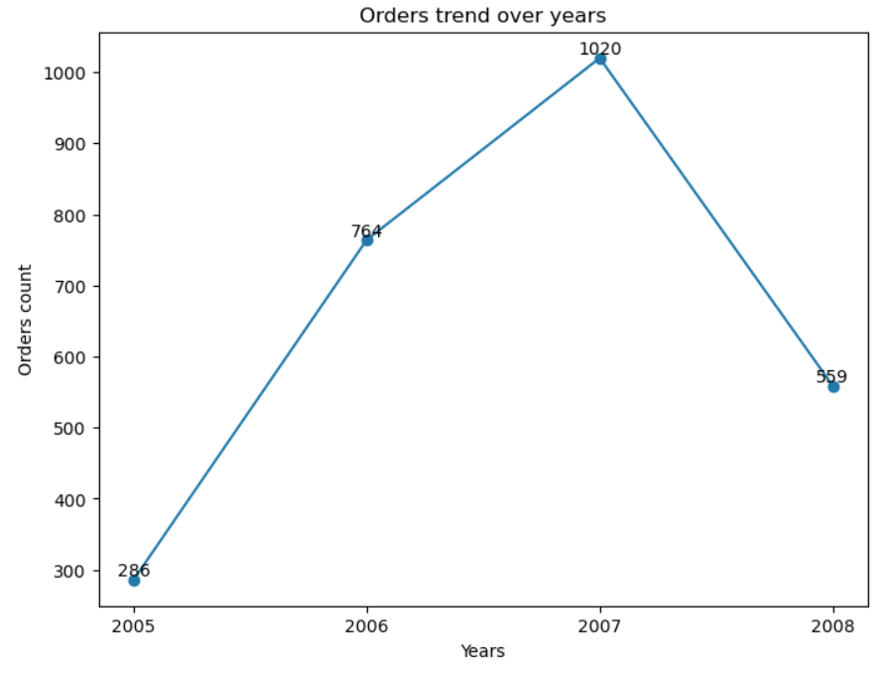
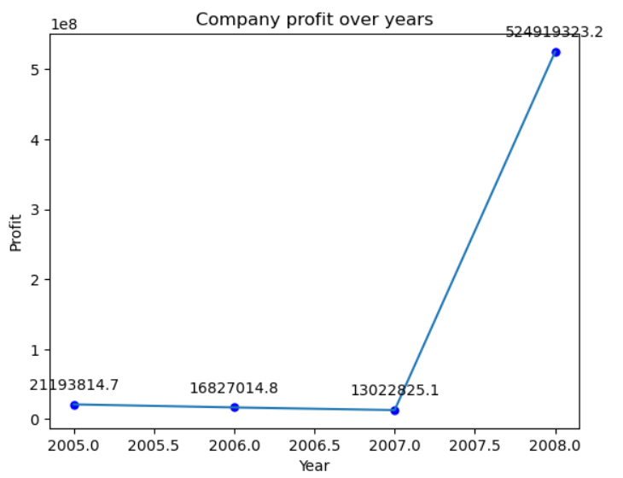
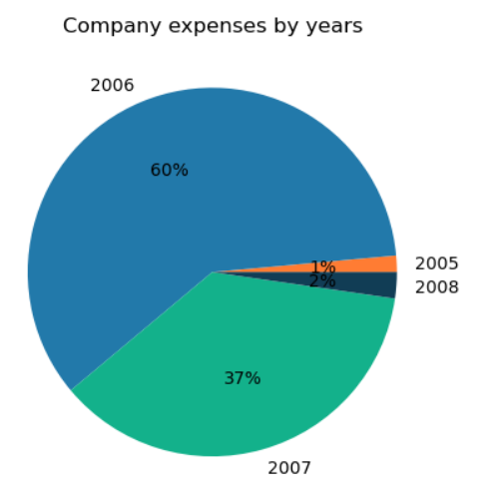
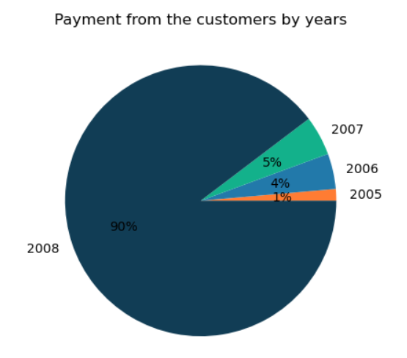
Number of orders over years fell in 2008 after steady growth till 2007 but profit increased
Cost incurred by company was less in 2008 but payments from customers was the highest

Slide 3
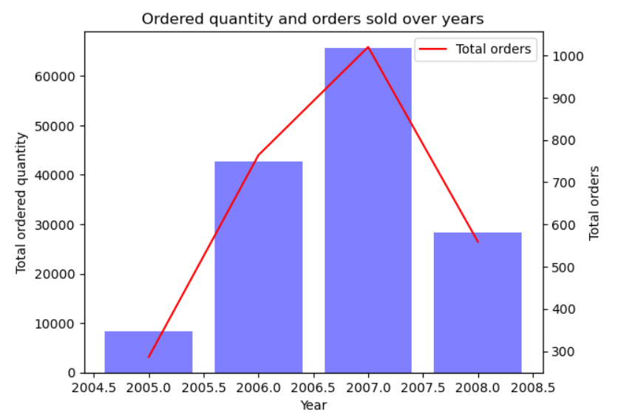
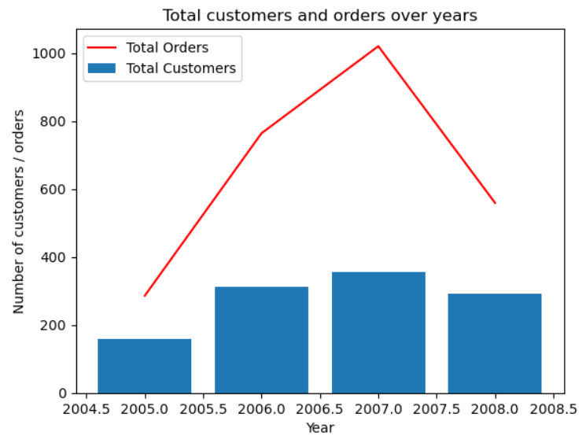
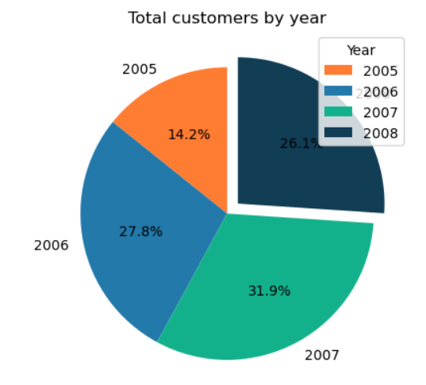
The numbers of customers saw a decline in 2008 which could be a reason why sales orders and quantity sold was less

Slide 4
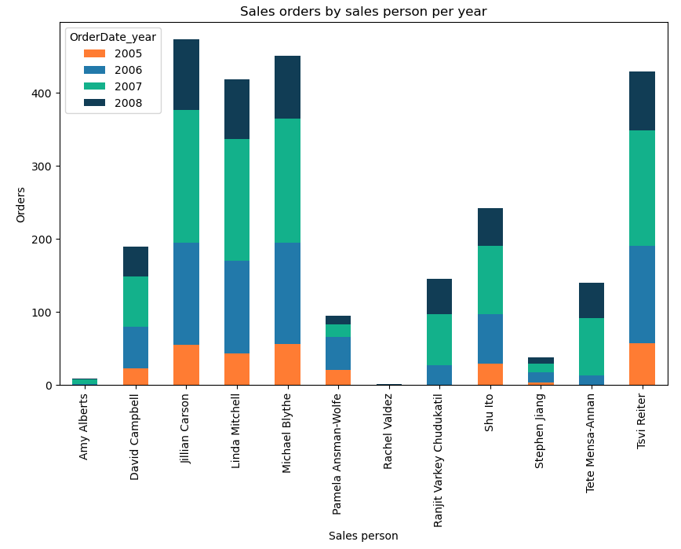
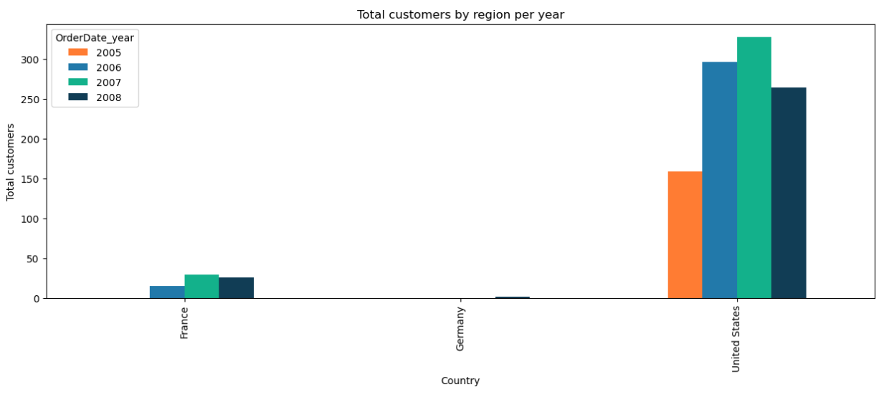
Performance of sales persons also fell which could be due to customer churn but need to mentor them to increase sales
Also, focus should be more on United States as customer churn was significant there

Slide 5
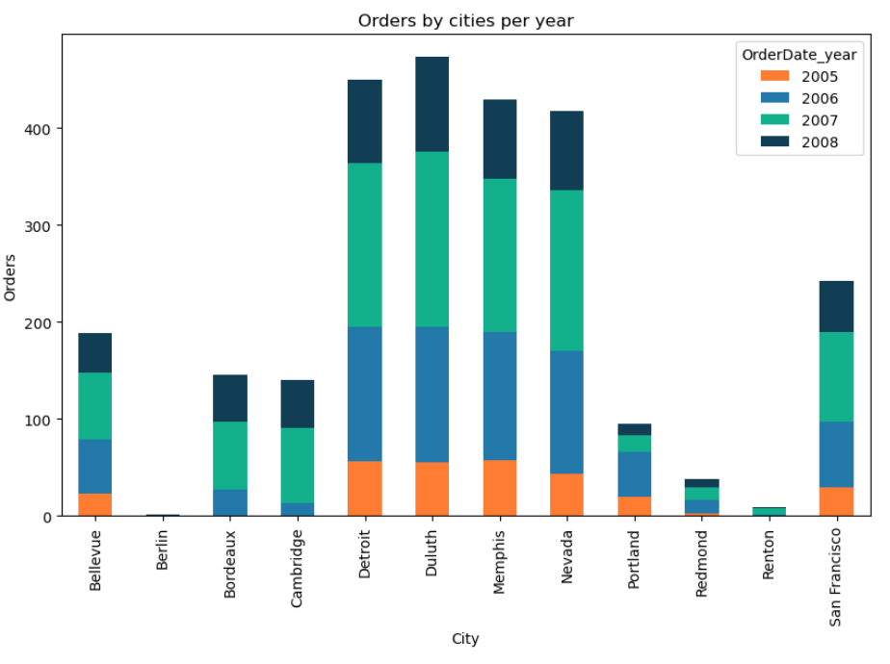
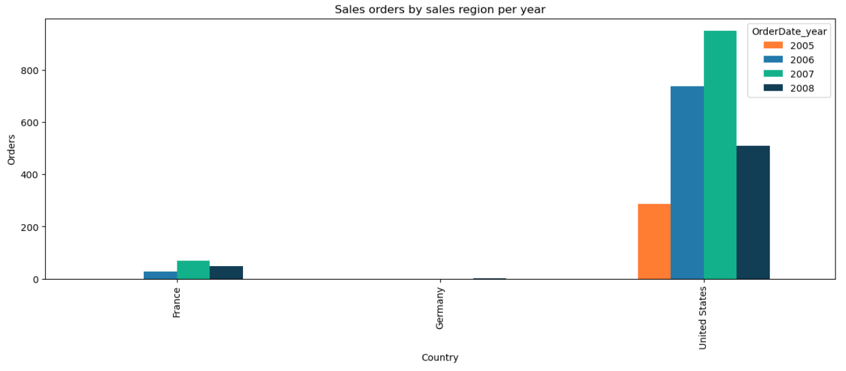
As seen in the previous slide, US region needs more attention followed by France and Germany which are in growing phase

Slide 6
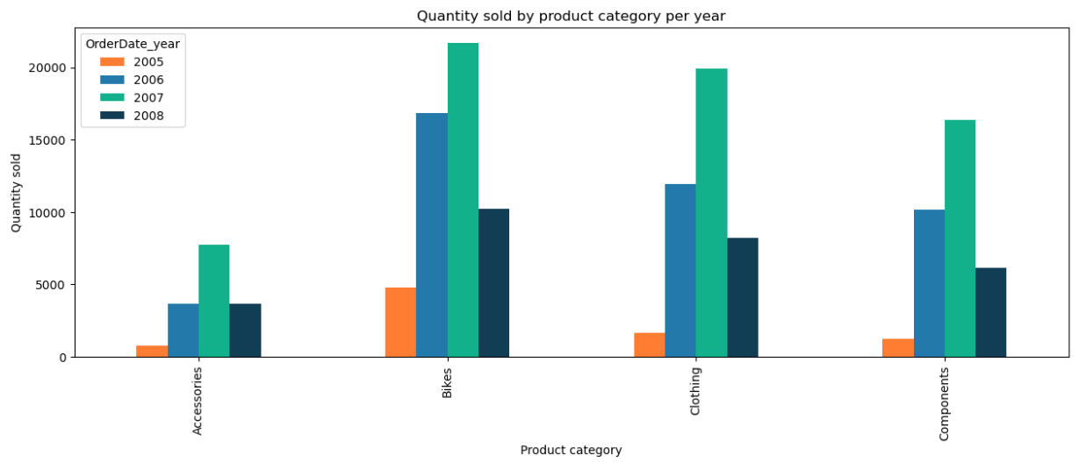
When it comes to drop in sales by product category, “Bikes” were the most sold in past years and fell drastically in 2008.
The product category need to be monitored.

Slide 7
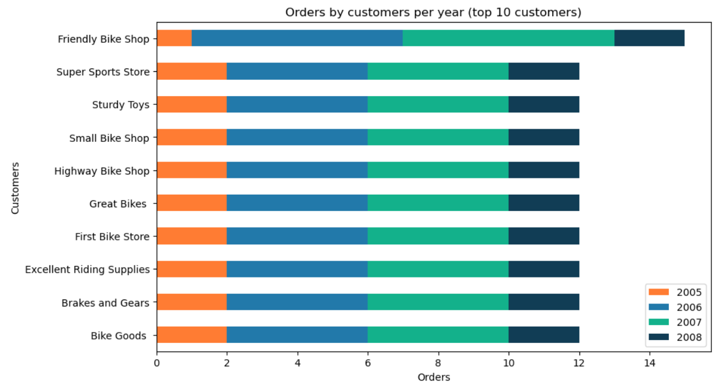
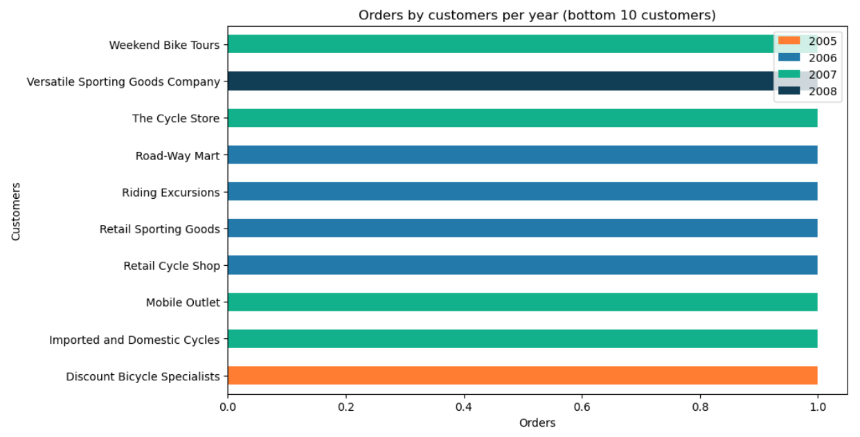
In case of market and customer analysis, top 10 and bottom 10 buying customers can be studied to identify the issue and come up with a strategy for customer retention and sales growth

Slide 8
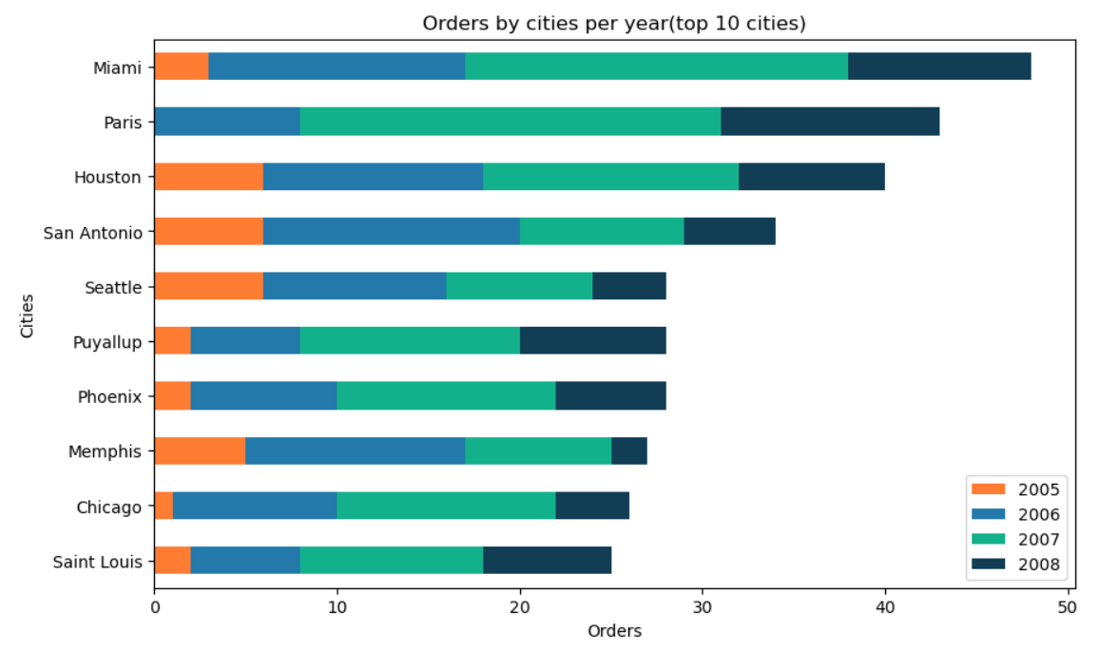
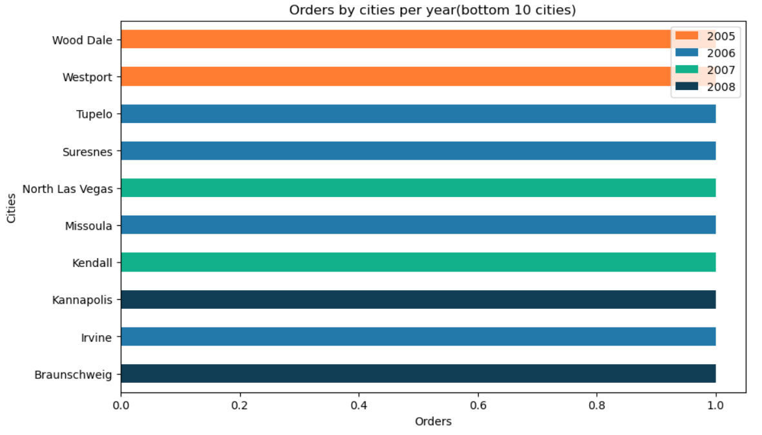
In case of market and customer analysis, top 10 and bottom 10 cities with respect to orders count can be studied to identify the issue and come up with a strategy for customer retention and sales growth

Slide 9
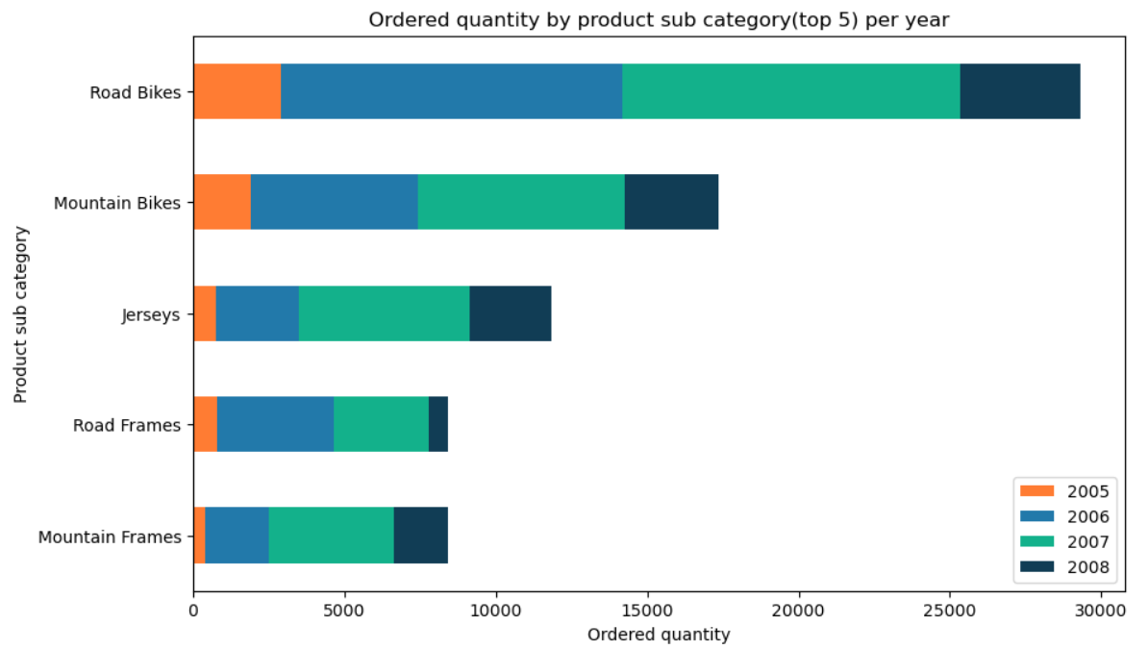
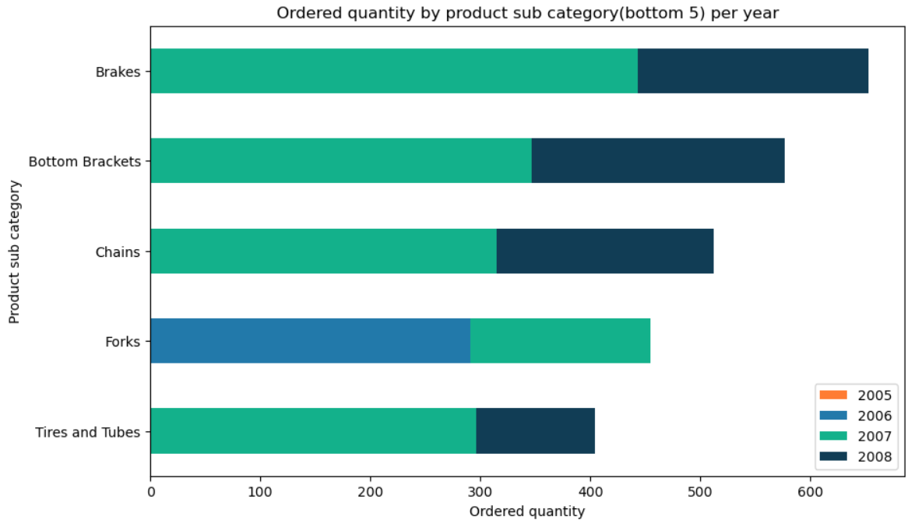
Top and bottom 5 selling sub categories need to be looked into to understand customer demands and come up with new or updated products
Like for Road Frames being in top 5 had least sales in 2008 as compared to past years

Slide 10
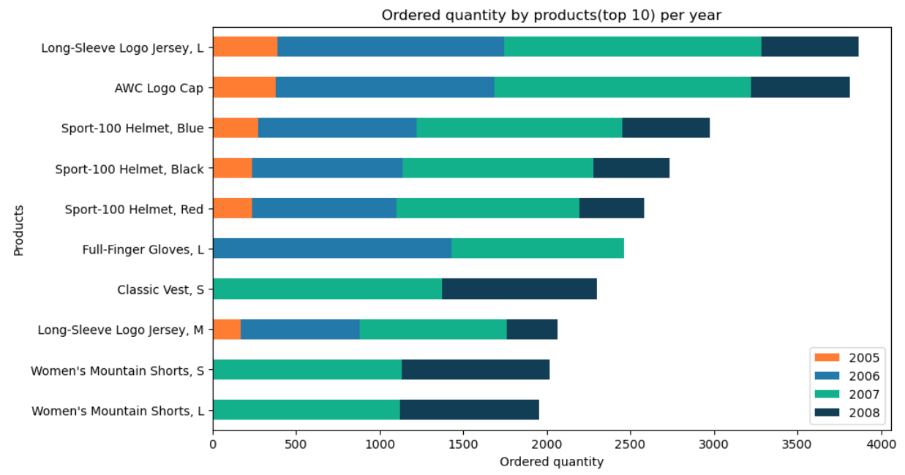
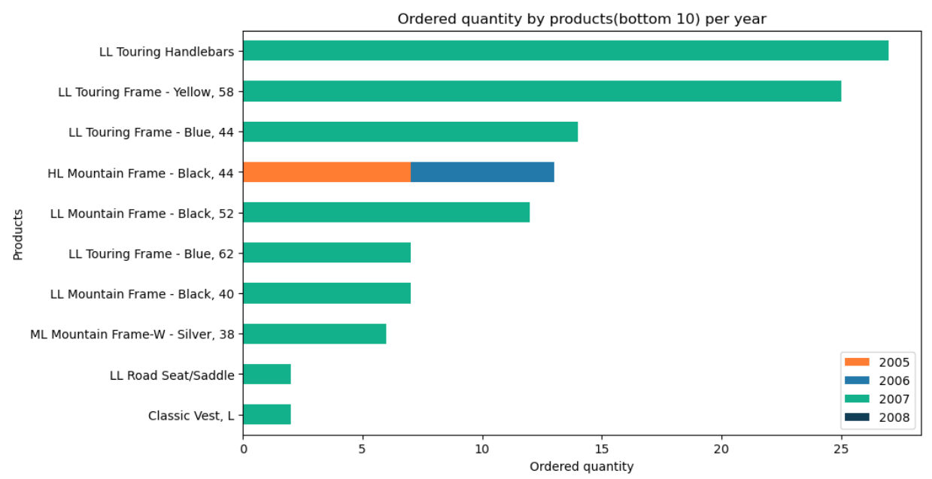
Top and bottom 10 selling products need to be looked into to understand customer demands and come up with new or updated products
Like for Full-Finger Gloves being in top 10 had no sales in 2008

Slide 11


