Slide 1

Document heading three lines
Replace the cover image in one of two ways.
Delete existing image, click the picture icon to navigate to a new image and ‘click’ insert.
Select the image, ‘right click’, and select Change Picture. Browse to a new image and ‘click’ Insert.
If needed, resize or reposition images within the area by using the crop tool. Select the image, go to Picture Tools > Format > Crop tool. Hold down the shift key to ensure the image is not stretched or distorted and then use the anchor points to resize the image.
Once the image has been inserted on this slide, make sure to right-click and choose “Send to back”.
Deloitte’s identity system and corresponding templates have been created in alignment with Web Content Accessibility Guidelines version 2.1, AA compliance level. Based on how and where the templates may be used, each individual user is responsible for meeting local accessibility standards. Visit the accessibility page on Brand Space for more information or consult with your local legal or risk teams.
Subtitle, date or author second line

Slide 2

Document heading three lines
Replace the cover image in one of two ways.
Delete existing image, click the picture icon to navigate to a new image and ‘click’ insert.
Select the image, ‘right click’, and select Change Picture. Browse to a new image and ‘click’ Insert.
If needed, resize or reposition images within the area by using the crop tool. Select the image, go to Picture Tools > Format > Crop tool. Hold down the shift key to ensure the image is not stretched or distorted and then use the anchor points to resize the image.
Once the image has been inserted on this slide, make sure to right-click and choose “Send to back”.
Deloitte’s identity system and corresponding templates have been created in alignment with Web Content Accessibility Guidelines version 2.1, AA compliance level. Based on how and where the templates may be used, each individual user is responsible for meeting local accessibility standards. Visit the accessibility page on Brand Space for more information or consult with your local legal or risk teams.
Subtitle, date or author second line

Slide 3


Document heading two lines
Replace the cover image in one of two ways.
Delete existing image, click the picture icon to navigate to a new image and ‘click’ insert.
Select the image, ‘right click’, and select Change Picture. Browse to a new image and ‘click’ Insert.
If needed, resize or reposition images within the area by using the crop tool. Select the image, go to Picture Tools > Format > Crop tool. Hold down the shift key to ensure the image is not stretched or distorted and then use the anchor points to resize the image.
Once the image has been inserted on this slide, make sure to right-click and choose “Send to back”.
Deloitte’s identity system and corresponding templates have been created in alignment with Web Content Accessibility Guidelines version 2.1, AA compliance level. Based on how and where the templates may be used, each individual user is responsible for meeting local accessibility standards. Visit the accessibility page on Brand Space for more information or consult with your local legal or risk teams.
Subtitle, date or author second line

Slide 4
Brand basics
Color
Primary palette
White R 255 G 255 B 255 | Black R 0 G 0 B 0 | Deloitte Green R 134 G 188 B 37 | Green 4 R 67 G 176 B 42
Accessible Green R 38 G 137 B 13 | Green 6 R 4 G 106 B 56 | Accessible Teal R 13 G 131 B 144 | Accessible Blue R 0 G 124 B 176
Secondary palette
Green 1 R227 G228 B141 | Green 2 R196 G214 B0 | Green 5 R0 G154 B68 | Green 7 R44 G82 B52 | Blue 1 R160 G220 B255 | Blue 2 R98 G181 B229 | Blue 3 R0 G163 B224
Blue 4 R0 G118 B168 | Blue 5 R0 G85 B135 | Blue 6 R1 G33 B105 | Blue 7 R4 G30 B66 | Teal 1 R221 G239 B232 | Teal 2 R157 G212 B207 | Teal 3 R111 G194 B180
Teal 4 R0 G171 B171 | Teal 5 R0 G151 B169 | Teal 6 R0 G118 B128 | Teal 7 R0 G79 B89 | Cool Gray 2 R208 G208 B206 | Cool Gray 4 R187 G188 B188 | Cool Gray 6 R167 G168 B170
Cool Gray 7 R151 G153 B155 | Cool Gray 9 R117 G120 B123 | Cool Gray 10 R99 G102 B106 | Cool Gray 11 R83 G86 B90 | Bright Green (Limited Use) R13 G242 B0 | Bright Teal (Limited Use) R62 G250 B197 | Bright Blue (Limited Use) R51 G240 B255
Red (Functional Use) R218 G41 B28 | Orange (Functional Use) R237 G139 B0 | Yellow (Functional Use) R255 G205 B0

Slide 5
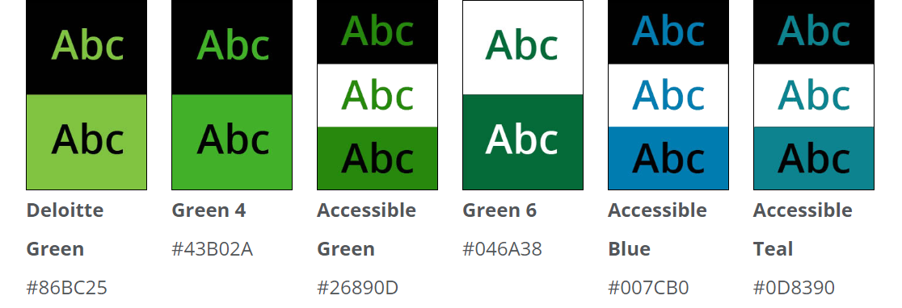
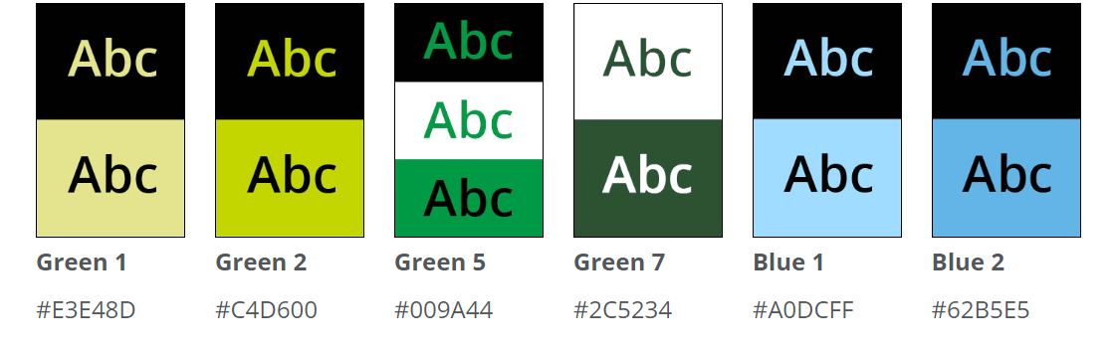
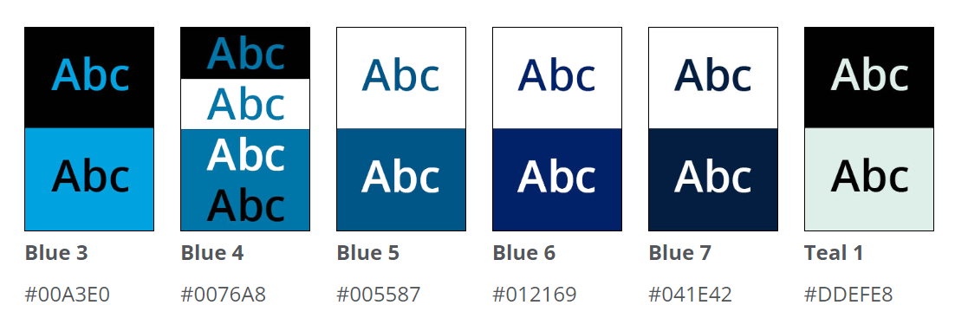
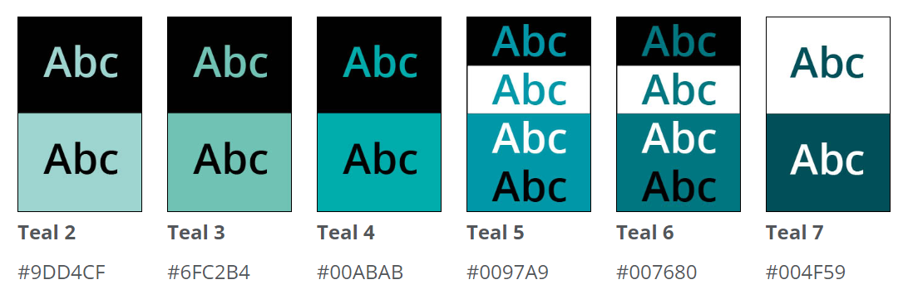
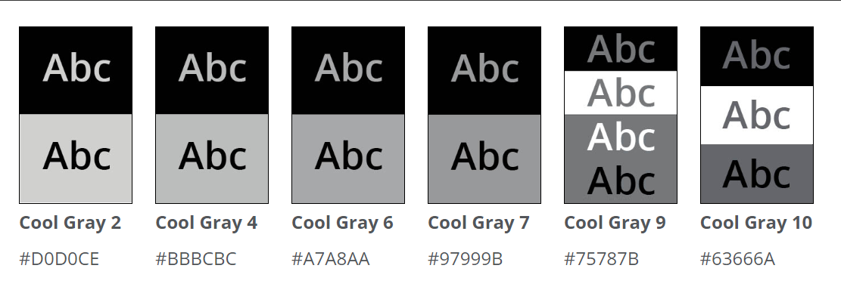
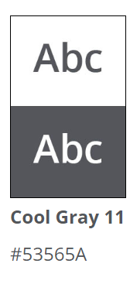
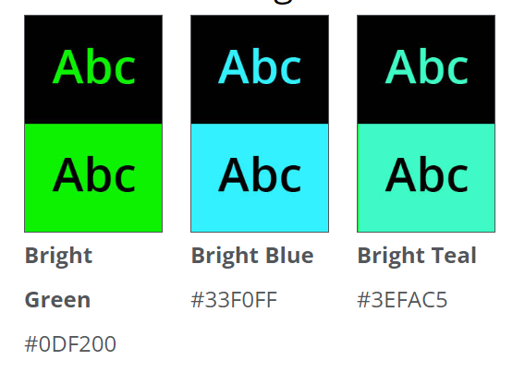
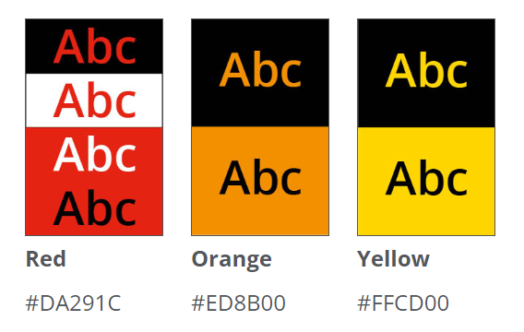
Brand basics
Accessible color combinations
It is important to consider the readability of color combinations when creating slides. The chart to the right gives a basic overview of which color combinations are considered accessible.
Review the complete guidance on how to correctly use color at Brand Space > Guidelines > Elements > Color.

Slide 6

Brand basics
Typography and iconography
Typography
Text size and styles included in the templates are recommendations based on user testing. Text size and style can be adjusted, as desired, according to your content.
Please see Brand Space > Guidelines > Elements > Typography for more detailed information.
For Microsoft Office applications, the required font is:
Aptos
Aptos Italic
Aptos Bold
Aptos Bold Italic
Iconography
Deloitte's line-based icon suite helps to create a consistent style with a distinctive and ownable character that is clear and simple.
Please Brand Space > Guidelines > Elements > Icons to download the full suite of icons and learn more about their usage.

Slide 7
















Brand basics
Imagery style overview: primary techniques
To learn more about acceptable image styles, visit Brand Space > Creative Resources > Image Library. To learn more about where to purchase images outside of Brand Space, contact your local brand team or visit Brand Space > Creative Resources > Support > Global vendor imagery agreements.
Cut-out objects | Single image many parts | Single illustration many parts | Concentric | Portal | Cut-out illustration
Interacting with the circle (people) | Cut-out objects with typography | New positioning of cut-out imagery | Incomplete circle in motion | Full bleed (people) | Full bleed
Full bleed negative space | Magnify | People breaking out of the circle | Hoop (people)

Slide 8









Brand basics
Imagery style overview: secondary techniques
To learn more about acceptable image styles, visit Brand Space > Creative Resources > Image Library. To learn more about where to purchase images outside of Brand Space, contact your local brand team or visit Brand Space > Creative Resources > Support > Global vendor imagery agreements.
Full bleed people photography | People on black/white backgrounds | Light and dark backgrounds | Black and white mood imagery | Green accent within an image | Green backgrounds
Green/black textures | Focus on technology/ product | Industry sector imagery

Slide 9
Brand basics
Data-driven best practices for effective presentations
These data-driven best practices for building effective and compelling presentations were developed by US Neuroscience of Winning (NoW), a multidisciplinary team of neuroscientists and pursuit professionals dedicated to improving sales performance with data-driven neuroscience insights. They use neuroscience to help practitioners win more deals and help influence how you communicate to your clients. Contact the team to learn how they can help you create more memorable presentations.
Remote and hybrid presentations require more surprises Participants in remote presentations are more easily distracted and need surprise to stay engaged. Establish a pattern and break it; take something usual and make it unusual; help the audience see something ordinary through an unexpected lens. WHY? Data on attention suggests that monotony is a serious threat to audience engagement and neuroscience studies show that surprise is linked to the formation of new memories.
Reserve bold, high-contrast design for a few key messages Bold design draws attention—use it only for important content. WHY? Data shows that overuse lessens the impact of high-contrast design elements.
For presentations in English, put important content on the top-left side of the slide English-speaking viewers automatically read from top left to bottom right and tend to fade by the bottom right, so don’t use the bottom right of the slide for key content. WHY? Data shows that viewers spend the least amount of time reading the lower right corner of a slide, unless specifically guided.
If you must present busy slides, build in content gradually and guide viewers Presenting one text section at a time and guiding your viewers through the slide vocally and with gestures prevents cognitive dissonance—a disconnect between what the audience sees and hears. Use slide builds and animations to present the content piecemeal. WHY? Data shows that animation helps focus attention on key messages.
Highlight statistics Call out names and numbers to make the story real (and show why it matters to the client). WHY? Data shows that calling out specific facts and numbers increases attention.
Use fewer words and larger fonts Keep text light. Text-heavy pages and tiny text is the #1 stressor for audiences. Use fewer words and larger fonts; break up content with slide builds or animation. WHY? Biometric data shows that dense slides create stress; eye-tracking data shows that attention wanders on busy slides.
Use more visuals Add images. WHY? Experiments showed that 90% of participants preferred the visual version over the text-heavy version; memory and attention did not decrease in the visual version. Caveat: Make sure the visuals reflect and reinforce your key message, or they may become distracting.

Slide 10

Page title
Page subtitle
There are five predefined text levels in the main text area on a standard slide. However, text can be customized using different formatting or type sizes, depending on the needs of the document.
First level
Second level
Third level
Fourth level
Fifth level
You can move up or down the type levels using the increase or decrease list level buttons on the Paragraph section of the Home menu.

Slide 11

Contents
Page subtitle
Item 1 X
Item 2 X
Item 3 X
Item 4 X
Sub item text runs here X
Sub item text runs here X
Sub item text runs here X
Image for illustrative purposes only.
To change the secondary images, select the image, ‘right click’, and select Change Picture. Browse to a new image and ‘click’ Insert. To resize or crop the image, select the image, go to Picture Format > Crop and crop to fit or hold the shift key down and use the corner anchors to resize.

Slide 12
Agenda
Page subtitle
Topic | Content | Person responsible | Timing
Subject | Bullet level 1 Bullet level 1 | Name | 0:00 a.m. – 0:00 a.m.
Subject | Bullet level 1 Bullet level 1 | Name | 0:00 a.m. – 0:00 a.m.
Break
Subject | Bullet level 1 Bullet level 1 | Name | 0:00 a.m. – 0:00 a.m.
Lunch
Subject | Bullet level 1 Bullet level 1 | Name | 0:00 p.m. – 0:00 p.m.
Subject | Bullet level 1 Bullet level 1 | Name | 0:00 p.m. – 0:00 p.m.

Slide 13
Page title
Page subtitle
There are five predefined text levels in the main text area on a standard slide. However, text can be customized using different formatting or type sizes, depending on the needs of the document.
First level
Second level
Third level
Fourth level
Fifth level
This is dummy text it is not here to be read it is here to show how this document will look.

Slide 14
Page title
Page subtitle
There are five predefined text levels in the main text area on a standard slide. However, text can be customized using different formatting or type sizes, depending on the needs of the document.
First level
Second level
Third level
Fourth level
Fifth level
There are five predefined text levels in the main text area on a standard slide. However, text can be customized using different formatting or type sizes, depending on the needs of the document.
First level
Second level
Third level
Fourth level
Fifth level

Slide 15

Page title
Page subtitle
Title Bold: this is dummy text it is not here to be read it is here to show how this document will look.
Title Bold: this is dummy text it is not here to be read it is here to show how this document will look.
Title Bold: this is dummy text it is not here to be read it is here to show how this document will look.
Image for illustrative purposes only.
To change the secondary images, select the image, ‘right click’, and select Change Picture. Browse to a new image and ‘click’ Insert. To resize or crop the image, select the image, go to Picture Format > Crop and crop to fit or hold the shift key down and use the corner anchors to resize.

Slide 16
Section heading
Section subheading

Slide 17
Section heading
Section subheading

Slide 18
Section heading
Section subheading

Slide 19
Section heading
Section subheading

Slide 20
Section heading
Section subheading

Slide 21

Section subheading
01
02
03
04

Slide 22
Key statement slide this text is not here to be read highlight key text in another color this text is not here to be read it is here to show how this document will look when filled with real text

Slide 23
Text and chart slide
Page subtitle
There are five predefined text levels in the main text area on a standard slide. However, text can be customized using different formatting or type sizes, depending on the needs of the document.
First level
Second level
Third level
Fourth level
Fifth level
Chart title

Slide 24
Text and chart slide
Page subtitle
Americas
Asia
Europe
21%
27%
15%

Slide 25
Text and stacked bar chart
Page subtitle
There are five predefined text levels in the main text area on a standard slide. However, text can be customized using different formatting or type sizes, depending on the needs of the document.
First level
Second level
Third level
Fourth level
Fifth level
Chart title

Slide 26
Text and stacked bar chart
Page subtitle
Chart title
Chart title

Slide 27
Bar chart with infographics
Page subtitle
There are five predefined text levels in the main text area on a standard slide. However, text can be customized using different formatting or type sizes, depending on the needs of the document.
First level
Second level
Third level
Fourth level
Fifth level
Chart title

Slide 28
Horizontal stacked bar chart
Page subtitle
Chart title

Slide 29
Tornado chart
Page subtitle
Chart title
Label on the outside
Label on the outside
Label on the outside
Label on the outside
Label on the outside
Label on the outside
Label on the outside
Label on the outside

Slide 30
Line title
Page subtitle
Chart title

Slide 31
Line title
Page subtitle
There are five predefined text levels in the main text area on a standard slide. However, text can be customized using different formatting or type sizes, depending on the needs of the document.
First level
Second level
Third level
Fourth level
Fifth level
Chart title

Slide 32
Scatter chart
Page subtitle
Chart title

Slide 33
Page title
Page subtitle
Chart title
Section 1 | Section 2 | Section 3 | Section 4
Text here | Text here | Text here | Text here
Text here | Text here | Text here | Text here
Text here | Text here | Text here | Text here
Text here | Text here | Text here | Text here
Text here | Text here | Text here | Text here
Text here | Text here | Text here | Text here
Result 1 | Result 2 | Result 3 | Result 4

Slide 34
Text boxes with arrows
Page subtitle
Text runs here
This is dummy text it is not here to be read
This is dummy text it is not here to be read
This is dummy text it is not here to be read
Text runs here
This is dummy text it is not here to be read
This is dummy text it is not here to be read
This is dummy text it is not here to be read
Text runs here
This is dummy text it is not here to be read
This is dummy text it is not here to be read
This is dummy text it is not here to be read
Text runs here
This is dummy text it is not here to be read
This is dummy text it is not here to be read
This is dummy text it is not here to be read

Slide 35
Three text boxes
Page subtitle
Text box title runs here
There are five predefined text levels in the main text area on a standard slide. However, text can be customized using different formatting or type sizes, depending on the needs of the document.
First level
Second level
Third level
Fourth level
Fifth level
Text box title runs here
There are five predefined text levels in the main text area on a standard slide. However, text can be customized using different formatting or type sizes, depending on the needs of the document.
First level
Second level
Third level
Fourth level
Fifth level
Text box title runs here
There are five predefined text levels in the main text area on a standard slide. However, text can be customized using different formatting or type sizes, depending on the needs of the document.
First level
Second level
Third level
Fourth level
Fifth level

Slide 36
Icon use
Page subtitle
Text box title runs here
There are five predefined text levels in the main text area on a standard slide. However, text can be customized using different formatting or type sizes, depending on the needs of the document.
First level
Second level
Third level
Fourth level
Fifth level
Text box title runs here
There are five predefined text levels in the main text area on a standard slide. However, text can be customized using different formatting or type sizes, depending on the needs of the document.
First level
Second level
Third level
Fourth level
Fifth level
Text box title runs here
There are five predefined text levels in the main text area on a standard slide. However, text can be customized using different formatting or type sizes, depending on the needs of the document.
First level
Second level
Third level
Fourth level
Fifth level
Text box title runs here
There are five predefined text levels in the main text area on a standard slide. However, text can be customized using different formatting or type sizes, depending on the needs of the document.
First level
Second level
Third level
Fourth level
Fifth level

Slide 37
Slide with table
Page subtitle
Table title
Column heading | Column heading
Row title | This is dummy text it is not here to be read this is dummy text This is dummy text it is not here to be read this is dummy text
Row title | This is dummy text it is not here to be read this is dummy text This is dummy text it is not here to be read this is dummy text
Row title | This is dummy text it is not here to be read this is dummy text This is dummy text it is not here to be read this is dummy text
Row title | This is dummy text it is not here to be read this is dummy text This is dummy text it is not here to be read this is dummy text

Slide 38
Data table
Page subtitle
Table title
 | Column header | Column header | Column header | Column header
Row title | xx | xx | xx | xx
Row title | xx | xx | xx | xx
Subtotal | xx | xx | xx | xx
Row title | xx | xx | xx | xx
Row title | xx | xx | xx | xx
Subtitle | xx | xx | xx | xx
Total | xx | xx | xx | xx

Slide 39
Flow table
Page subtitle
Table title
Name of phase
Name of phase
Name of phase
Name of phase
Activity #1 | Text here | Text here | Text here | Text here
Activity #2 | Text here | Text here | Text here | Text here
Activity #3 | Text here | Text here | Text here | Text here
Activity #4 | Text here | Text here | Text here | Text here
Activity #5 | Text here | Text here | Text here | Text here

Slide 40
Project timeline
Page subtitle
Table title
 | August |  |  |  | September |  |  |  | October |  |  |  |  | November |  |  |  | December |  |  | January
 | 8 | 15 | 22 | 29 | 5 | 12 | 19 | 26 | 3 | 10 | 17 | 24 | 31 | 7 | 14 | 21 | 28 | 5 | 12 | 19 | 2 | 9 | 16 | 23
Stage 1: Stage description
Activity detail
Activity detail
Stage 2: Stage description
Activity detail
Activity detail
Stage 3: Stage description
Activity detail
Activity detail
Stage 4: Stage description
Activity detail
Activity detail
Stage 5: Stage description
Activity detail
Activity detail
Milestone

Slide 41
Page title
Page subtitle
Text runs here
Text runs here
Text runs here
Text runs here
Text runs here
Text runs here
Text runs here
Text runs here
Text runs here
Text runs here

Slide 42


Team
Page subtitle
Role
Name surname
Job title
Country or Office
Profile description here.
Role
Name surname
Job title
Country or Office
Profile description here.
Role
Name surname
Job title
Country or Office
Profile description here.
Role
Name surname
Job title
Country or Office
Profile description here.

Slide 43
Curriculum vitae
Page subtitle
Name Surname
Position
Tel. +49 [XX XXX XXX XXX]
Mobile +49 [XX XXX XXX XXX]
Fax +49 [XX XXX XXX XXX]
Mail xxx@email.com
Name Surname
Position
Tel. +49 [XX XXX XXX XXX]
Mobile +49 [XX XXX XXX XXX]
Fax +49 [XX XXX XXX XXX]
Mail xxx@email.com
[XXX] is this is dummy text and not here to be read. This is dummy text and not here to be read. This is dummy text and not here to be read.
Education and professional exams
This is dummy text and not here to be read.
This is dummy text and not here to be read.
This is dummy text and not here to be read.
Selection of Project Experiences
This is dummy text and not here to be read.
This is dummy text and not here to be read.
This is dummy text and not here to be read.
[XXX] is this is dummy text and not here to be read. This is dummy text and not here to be read. This is dummy text and not here to be read.
Education and professional exams
This is dummy text and not here to be read.
This is dummy text and not here to be read.
This is dummy text and not here to be read.
Selection of Project Experiences
This is dummy text and not here to be read.
This is dummy text and not here to be read.
This is dummy text and not here to be read.

Slide 44
Organizational chart
Page subtitle
Chart title
Sponsor
Name Surname
Name Surname
Name Surname
Management
Name Surname
Name Surname
Name Surname
QA
Name Surname
Name Surname
Name Surname
Subject experts
Name Surname
Name Surname
Name Surname
Management
Name Surname
Name Surname
Name Surname
PMO
Name Surname
Name Surname
Name Surname
Workstream
Name Surname
Name Surname
Name Surname
Workstream
Name Surname
Name Surname
Name Surname
Workstream
Name Surname
Name Surname
Name Surname
Workstream
Name Surname
Name Surname
Name Surname
Workstream
Name Surname
Name Surname
Name Surname

Slide 45
Proposed team structure and responsibilities
Example
Role
Responsibilities
Steering committee
Name Surname
Name Surname
Steering committee
Make key decisions, sign-off on major deliverables and act on recommendations
Identify and assign appropriate resources to the project
Project management
Name Surname
Name Surname
Project management
Ensure objectives are met within timing and scope outlined by the Steering Committee
Manage day-to-day activities — project committee
Subject experts
Name Surname
Name Surname
Subject experts
Provide insight into ...
Support team on ...
Project team
Name Surname
Name Surname
Project team
Interface with ...
Analyze ...
Prepare deliverables draft recommendations

Slide 46
Team structure chart
Page subtitle
Chart title
Text
Text
Text
Text
Text
Text
Text
Text
Text
Text
Text
Text
Text

Slide 47
Pyramid diagrams
Page subtitle
Chart title
Chart title
Text
Text
Text
Text
Text
Text
Text
Text

Slide 48
Quotation boxes
Page subtitle
This is dummy text it is not here to be read it is here to show how this document will look when populated with real text.
This is dummy text it is not here to be read it is here to show how this document will look when populated with real text. This is dummy text it is not here to be read it is here to show how this document will look
This is dummy text it is not here to be read it is here to show how this document will look when populated.

Slide 49
[To find the current required language, visit DTTL Language and Style Guide]
[Insert the Standard legal description] Caption vel doloreet wisit acincil iquatem dio odigna feugiamcommy nim vulput adip exerosto essi. Rud min ver sed magna ate tat, vendigna conulputat. Ulput pratie ming et, commy nos et nim il et at. Ut aliquipit amcommy nullaore endrem er incilla conse feu facin venisi.
[Insert the Deloitte local profile] Met prat, venim estrud modignibh eumsan vel dolore coreetuercin venibh eugait nonsed magna conum ad tio od et, consequis amconsequat
[Insert the appropriate internal / external disclaimer]
Ut iustionulput endre cor ilis ent accum vullan voluptate feui tat. Tionsed dolor irilis elit dolumsan velent praesse quisci tatet, volessi blan vel eui eniam vullaortisi bla faccum vel utet aut iriure eu faccum adigniat, core te do dionsenisim erciliquatue te ming ea facincillut lan henim
[For MF communications, please consult with your internal risk or legal teams as to what additional language is appropriate.]
© [Year] [Legal entity name].

