Slide 1

Digital Asset Register & Regulatory Affairs Deliverables
October 2024

Slide 2

Typical Utility Requirements for Asset Management

Slide 3
Utility Requirements for Capital Assets Management
Typical Challenges faced by organizations
Regulatory / Statutory Compliance
Presentation in Financial Statements
Management Information System
Asset Management Policy and Process Framework
IT Solution Design and Integration
Requirement of expert knowledge and resources to manage regulatory compliance
Normative allowances for Fixed Assets management costs (O&M) used by Regulators tend to be significantly different from actuals and lead to disallowances
Critical to reflect appropriate asset classification / componentization based on useful life as per applicable Accounting Standards
Need for detailed fixed asset register, with physical verification carried out
Depiction of asset value and depreciation
Identification of any ghost assets
Unstructured maintenance planning because of poor asset inventory management leads to increased capital and operational expenditure.
Difficulty in financial planning – capex, budgets, allocations, and finances.
Spare parts management for critical assets becomes difficult.
Inadequate asset management policies, processes, and controls across the asset value chain.
In particular, processes and policies need to be in place for asset removals, movements, condition assessment, replacement plans, asset verification and retirement.
Is a pre-requisite before implementation of any Asset Management Software
Capital project monitoring, operations & maintenance, sustenance of a reliable asset register define the type of IT solution to be procured.
Selection of the appropriate asset management IT tool is critical for utilities
Huge asset data is a major hurdle for Asset Management Software implementation
Integration of Tool with Accounting Software

Slide 4
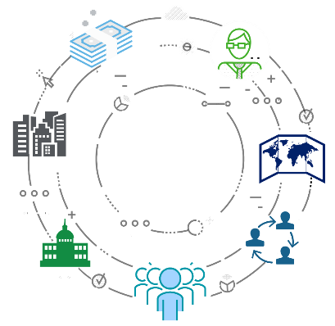
Deloitte Global Network
Deloitte is amongst the largest professional services firm worldwide and provides audit, tax, consulting, and financial advisory services to public and private sector clients spanning across multiple industries and diverse geographies. In overall terms, Deloitte member firms serve over 390+ of Fortune Global 500 companies and 100+ National Governments. Deloitte had a total turnover of $64.9 billion in 2023.
REVENUE
US$64.9B
HEADCOUNT
457,000
COUNTRIES AND TERRITORIES
150+
DELOITTE FY2023
OFFICES
700
SOCIETAL IMPACT CONTRIBUTIONS
US$284M+
DELOITTE PROFESSIONALS WHO EXPERIENCED DELOITTE UNIVERSITY
114,000+
NEW HIRES
156,430
Deloitte member firms serve 84% of the 2021 Fortune 500 companies

Slide 5
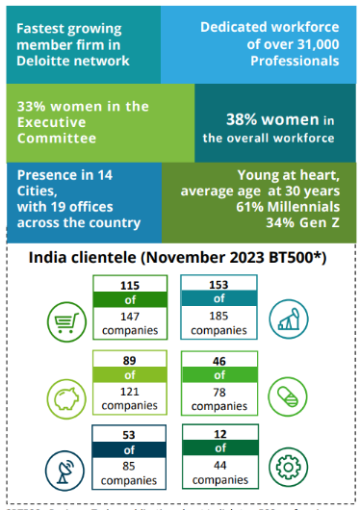

Deloitte India Network
Deloitte India’s Power, Utilities and Renewable Energy is a 250+ strong multi- disciplinary team of industry specialists in. The Indian practice has significant experience in the energy sector with focus on financing projects, regulatory assistance, conducting feasibility studies, development of business/ strategic plans, accounting advisory, business process improvement and due diligence for various public sector and private sector.
17000+
New Delhi
Professionals
spread across
Ahmedabad
Jamshedpur
Kolkata
Bhubaneswar
12
Mumbai
Hyderabad
Pune
Goa
Bengaluru
Chennai
Cities
Kochi
Coimbatore

Slide 6
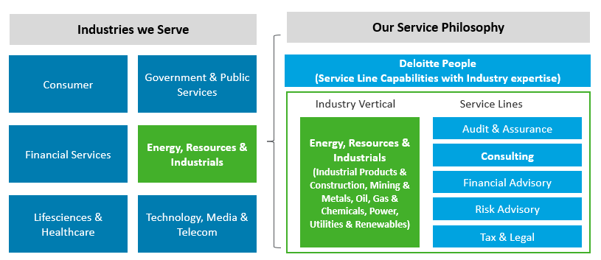
Deloitte Offerings
Business Units
Tax & Legal
Audit & Assurance
Strategy, Risk & Transactions
Technology & Transformation
Deloitte is well-equipped to deliver solutions to the complex challenges faced by organisations across the public and private sectors. Being one of the largest organisations, our edge lies in our ability to draw upon well-equipped and customised services.
Deloitte’s Global Energy, Resources, and Industrials (ERI) specialists provide integrated solutions to the Industrial Products & Construction, Mining & Metals, Oil, Gas & Chemicals, Power, Utilities & Renewables sectors offering deep industry knowledge and a global network.
The ERI team has over 300+ professionals in India well acquainted and experienced in executing a widespread variety of engagements.

Slide 7







Deloitte Offerings & Credentials - Market & Regulatory Reforms
Market and Regulatory Reforms
Ministry of Power,
Government of India
Department of Power,
West Bengal, India
Evolving Role of Market Players & Market Reforms
Privatization of power distribution function of electricity department of Union Territories in India
Strategic Planning Unit for the Department of Power, Government of West Bengal
Generation
Transmission
Distribution
Retail
Consumers
Fossil
Base-load
One-Way
Provider
Consumers
Now
Renewable
Balancing
Two-Way
Facilitator
Prosumers
APGCL, Assam, India
WBSETCL, India
Future
Regulatory Consultancy Services for Tariff filing to Assam Power Generation Corporation Ltd (APGCL)
Tariff Regulatory Support to West Bengal State Electricity Transmission Company
Policy & Regulatory Reforms
Sectoral Reforms
Policy Review and Development
Increasing Role of Regulator
WBSEDCL, India
MSERC, Meghalaya India
Setting up of new entities
Restructuring of existing utilities
Financial Viability Plan & Financing Facility Development
Integrated Planning
Transaction and PPP
Power TradeRenewable Energy Policy
PPP Policy
IPP Policy
Energy Security Policy
ICT Policy
Restructuring Policy
Cross Border
Cost Reflective Tariff
Performance-based regulation
Licensing & Market regulation
FiT, Renewable purchase regulation
Open Access, Balancing and settlement
Tariff Regulatory Support to West Bengal State Electricity Distribution Company Limited
Regulatory Support Meghalaya State Electricity Regulatory Commission
Bangladesh Power Development
Board
WBSEDCL, India
Institutional, Financial and Regulatory Analysis
Stakeholder Consultation
Reform of Bangladesh Power Development Board as a Holding Company
Advisory Services for Preparation of MYT Petition to West Bengal State Electricity Distribution Company Limited
National Policy & Vision Development
International Benchmark and Peer Reviews

Slide 8




Deloitte Offerings & Credentials - Future of Utility / Emerging Technologies / IT Transformation
Generation
The Future Grid
JBVNL, Jharkhand, India
DPL, West Bengal, India
Generation will evolve toward a more diverse and decentralized network of lower capacity, more flexible units with intelligence
The future grid will be a communications-enabled self-healing network, able to increasingly act as a balancing entity
Central Project Monitoring Unit (CPMU) at JBVNL (Retainership)
Consultancy support for ERP Implementation at Durgapur Projects Limited
Storage and Urban Mobility
Digital Utility
Energy storage is key to enable current energy transition towards electric mobility, integration of cleaner fuels and increase energy access around the world
The utility will be a digitally-enabled shared services organization that will provide fully automated and integrated corporate services
JBVNL, Jharkhand, India
The World Bank
IT-PMO cum ICT Management Support in JBVNL (Retainership)
DPR for Smart Grid Deployment in Udaipur Smart City
Key Offerings
WBSEDCL, West Bengal, India
JBVNL, Jharkhand, India
Studies to support seamless renewables and DER integration
Benefits modelling and simulation of ESS value streams
Cost efficiency through digital tools
Consumer centric business models
Project Management Consultancy for implementation of Smart Meter (AMI-SP)
Preparation of a Fixed Asset Register (FAR) for Jharkhand Bijli Vitran Nigam Limited (JBVNL)
Power Cell,
Government of Bangladesh
Jharkhand, India
Support seamless communication with consumers
Planning for emerging technologies
Developing EV ecosystem
Digital & Technology Roadmap
ICT Roadmap for all the power utilities in Bangladesh
Transaction advisory and monitoring of implementation of smart metering in the state of Jharkhand,

Slide 9




Deloitte Offerings & Credentials - Utility Restructuring
Utility Restructuring
WBPDCL, India
Market Reforms Unit, India
Utility Reforms & Strategy Development
Utility Unbundling & Formation of New Utilities
Business Planning & Process Re-engineering
Market Assessment
Operating Model Development
Assessment of Institutional Development and Human Resource Management of West Bengal Power Development Corporation Limited (WBPDCL)
Institutional Strengthening & Capacity Building of Successor Entities of Jharkhand State Electricity Board, India
Social Objective Management
Growth of electricity access
Affordability of electricity tariff
Increase in per capita electricity consumption
DVC, West Bengal
DPL, West Bengal
Financial Plan
Financial Viability Planning
Financial Restructuring
Forecasting Model Development
Customer Satisfaction
Improve Consumer focus
Increase service quality & feedback management
Customer Outreach Management
Due Diligence Assistance to Damodar Valley Corporation (DVC) Raghunathpur Plant
Strategy Roadmap 2030 for Durgapur Projects Limited
Technical Performance Improvement
Demand-supply gap mgmt.
Reduction of technical losses
Growth of supply capacity
Generation Mix Diversification
Reliability and quality of electricity supply
Power Cell, Bangladesh
Digitization
Smart Grid & Network Management
Utility of Tomorrow Strategy
MIS Strengthening & Business Intelligence
World Bank
Advanced Metering Infrastructure and Analytics Guidance Study for South Asian Power Distribution Utilities
ICT Roadmap for Bangladesh Power Sector (All Public Utilities)
Commercial Performance Improvement
Rationalization of tariff
Cost Reflective Tarif
Fuel Management
Cost Optimization Strategy
Bid Advisory
Institutional Strengthening
Skill Gap Assessment
Training Plan in line with sectoral evolution & market requirement
Change Management
USAID, Nepal
DVC, West Bengal
URJA Nepal – Utility performance & Policies improvement, Advanced energy systems deployment
Tariff and Utility Regulatory support to Damodar Valley Corporation (DVC)

Slide 10





Deloitte Offerings & Credentials - Energy Efficiency
Orchestrating end-to-end success
Bureau of Energy Efficiency
International Finance Corporation
BEE Energy Efficiency programme in SME cluster Mangalore Tile Cluster & Muzaffarnagar Paper Cluster
Enabling green building financing under the EU-India Cooperation for Clean Technologies and Energy Efficiency
International Finance Corporation
World Bank
Policy
development
Strategy
preparation
Project
management
Distributed Solar PPP Project (Gujarat and Odisha), Power Policy and Capacity Building Initiatives
Review of National Solar Mission Phase 1 & 2 Setting up National Solar Energy Technology Centre
Climate change mitigation
Building energy efficiency
Project management support for implementing state action plan on climate change
Development of market-based mechanisms for states
Energy cost optimization and project implementation
Renewable options
Asian Development Bank
ONGC
Deploying Solar Systems at Scale (Development of Solar Roadmap for Assam, India)
Advisory Services for Energy Efficiency Improvement
Industrial energy efficiency
Utility demand side management
Energy cost optimization and project implementation
PAT facilitation and support
Energy Efficiency benchmarking
Renewable options
Market assessment
Impact assessment and scoping
DSM design and support
Capacity building programme
Asian Development Bank
International Finance Corporation
Consultancy services for Power Sector Transformation of Sikkim state
Future of Urban Mobility in India

Slide 11
Our Service Offerings
Statutory / Regulatory Compliance
Asset Management policies and processes
IT Solution / Integration design
Understand legal / statutory requirements
Liaise with regulators
Liaise with internal and external auditors on approach and coverage
Identify data gaps in the asset database
Understand current IT systems, asset management policies and procedures
Identify non-compliance on asset register practices
Financial and management reporting
Tax compliance reporting
Regulatory reporting
Identify accounting policy requirements
Identify asset related movements / events and control requirements
Revise the existing / design new policies keeping in mind O&M requirements
Develop standard operating processes for asset related transactions
Develop delegation of authority and RACI matrix
Accounting asset management life cycle
Operations - Asset management life cycle
IT/ERP Implementation
Develop methodology / roadmap for the IT integration between ERP Accounting software and Asset Management Solution
Suggest best possible asset management solution and its implementation roadmap
Develop asset codification structure
Develop logic for functional integration with accounting system fixed asset register
Operations - Asset Management life cycle
Accounting asset management life cycle
ERP / IT Implementation
Physical verification and Asset register compilation
Historical cost determination
Bid advisory / Program Management
Develop a physical verification plan
Program manage asset verification
Capture asset details during verification
Automatic schematic representation of network
Document key findings / discrepancies
Operations - Asset management life cycle
Finance and Management Reporting
Accounting - asset management life cycle
Populate & document sources of asset cost data
Develop concept note on fixed asset historical cost determination for each asset class.
Obtain acceptability of the historical cost approach from all stakeholders
Carry out high level due diligence on usage rights / liabilities attached to assets
Advise on external valuation if required
Accounting asset management life cycle
Financial & Management reporting
Regulatory reporting
Scoping exercise for selection of IT solution
Development of RFP
Assistance in bid evaluation
Evaluation of the solution and service provider
Program Management of the actual implementation
Ensure implementation benefits
Help manage huge data migration
Assist in integration
Operations - Asset Management life cycle
Accounting asset management life cycle
ERP / IT Implementation

Slide 12
Asset Register Tool

Slide 13
Asset Register Tool (INSITE)
Organizations are required to track asset inventory and manage all their owned and leased assets, including the need to do annual inventories and report on missing or misplaced assets. Doing this manually via spreadsheets and in-person inventory counts is time consuming and doesn’t help with real-time movement of assets. An asset register tool helps to manage asset life cycle, track operational assets and report quickly. Deloitte has developed an IT Tool - INSITE, features & benefits of which are given below
Features
Asset inventory: Enable rapid capture of asset data via mobile / tablet devices; 3 tier verification process.
Asset Identification & Tracking : Automatic representation of schematic diagram of network using open-source GIS software
Asset management: Identify location and asset custodian, audio / video of the assets on ground, asset condition etc.
Potential Benefits
Quick-to-use asset inventory management capabilities
Visibility into where assets are, their status, usage, and reporting details
Simplified statutory inventory reporting
Asset governance and accountability
Financial and operational efficiency with individual asset cost details, date of capitalization, and usage status
Compliance with government regulations
Reduced cost by avoiding asset duplication, waste, and manual counts
Quick data on asset condition, maintenance details and running hours

Slide 14



Walkthrough of INSITE
This is the welcome screen of the app and shall take the user to the login screen under 3 seconds.
User needs to enter the username and password to enter the application. There is also an option of “Forgot password” to reset the password
INSITE
Welcome
Username:
Password:
INSITE
Login
Forgot Password
© 2024 Deloitte Touche Tohmatsu India LLP.

Slide 15





Walkthrough of INSITE
The Office and Location section enables the user to systematically record asset location information, starting from Area level and progressing hierarchically to the Sub-Division level.
User can capture the GPS location of the place where the Asset is located
INSITE
INSITE
ADD ASSET
ADD ASSET
Office & Location
Asset Details
Add Photos
Office & Location
Asset Details
Add Photos
Area *
Sub-Division/ Office *
Circle *
Location *
Division *
Office Code *
Office Type *
Sub-Division/ Office *
Get GPS Location
Cancel
Next
© 2024 Deloitte Touche Tohmatsu India LLP.

Slide 16
Walkthrough of INSITE
Here the Asset Details like Asset Group, Sub-group etc. is
linked with the accounting software aiding in reconciliation with the accounting system
The fields marked with asterisk (*) are mandatory for the user to fill. However, the user is encouraged to populate other non mandatory fields like manufacturer, model, serial number, etc. which will provide an aging analysis of the Asset
INSITE
INSITE
ADD ASSET
ADD ASSET
Office & Location
Asset Details
Add Photos
Office & Location
Asset Details
Add Photos
Asset Group *
Made in (Country)
Asset Sub-Group *
Manufacturer
Asset Sub-Code *
Model
Serial Number
Asset Name *
Measurement Unit (UoM)
Capacity
© 2024 Deloitte Touche Tohmatsu India LLP.

Slide 17


Walkthrough of INSITE
These fields will enable the user to understand the current condition of the Asset and subsequent repair/maintenance requirements. The user can also capture any additional note into the app.
The Add photos enables the user to capture the image as well as upload videos of the Asse. This will help to build a repository and provide a visual representation of the condition of the Assets over the years.
INSITE
INSITE
ADD ASSET
ADD ASSET
Office & Location
Asset Details
Add Photos
Office & Location
Asset Details
Add Photos
Total Cost of Asset
Choose Image
Choose Image
Running Hours
Choose Image
Last Maintenance Date
Choose Video
Note
Cancel
Next
Cancel
Save as Draft
Next
© 2024 Deloitte Touche Tohmatsu India LLP.

Slide 18
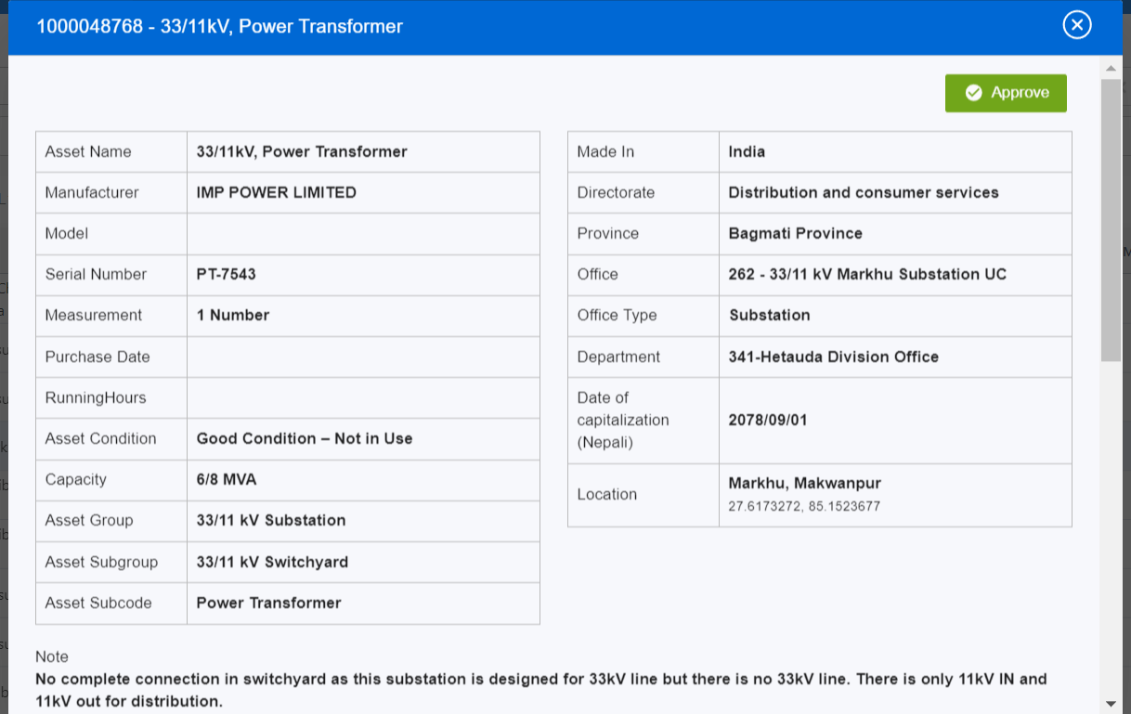
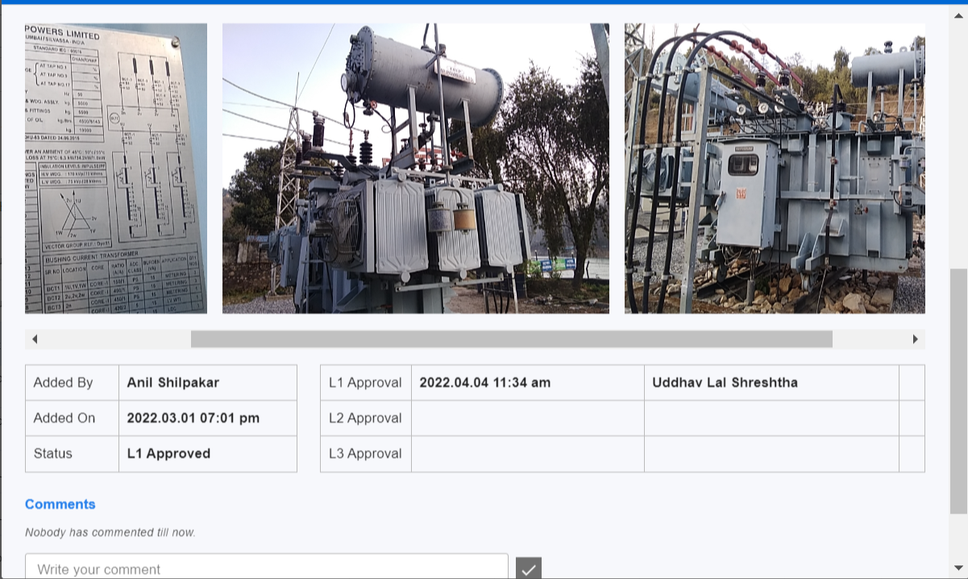
Asset Register Tool Assets Capture and Verification
Walkthrough of Web Portal
The Tool provides for 3 level approval mechanism. Data can be exported to any ERP through excel download
Easy interface for reviewers to review the asset data captured and approve / provide comments.
ILLUSTRATIVE
Every Asset detail synced device will be visible on the web portal for Client to review as the L1 / L2 / L3 Reviewers. They can either approve the details OR provide comments to the asset verification team for any corrections.
On clicking on Details, the concerned L1 / L2 / L3 reviewers can view the asset details including the photographs and provide their comments

Slide 19
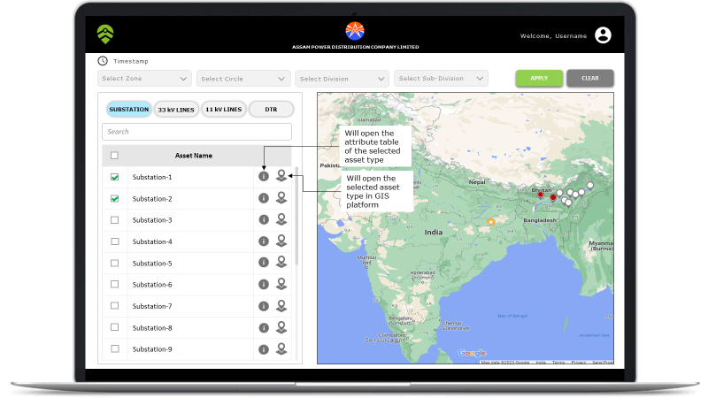
Asset Map - Overview
Walkthrough of Web Portal
The Dashboard opens up with an interactive GIS view and user can select a particular asset type to view. User can view the attribute table of the selected asset type as well as open the same in GIS platform.
ILLUSTRATIVE
User Can select the respective zone, circle, division and sub-division where in the assets are located. Asset types are also classified for easy navigation

Slide 20
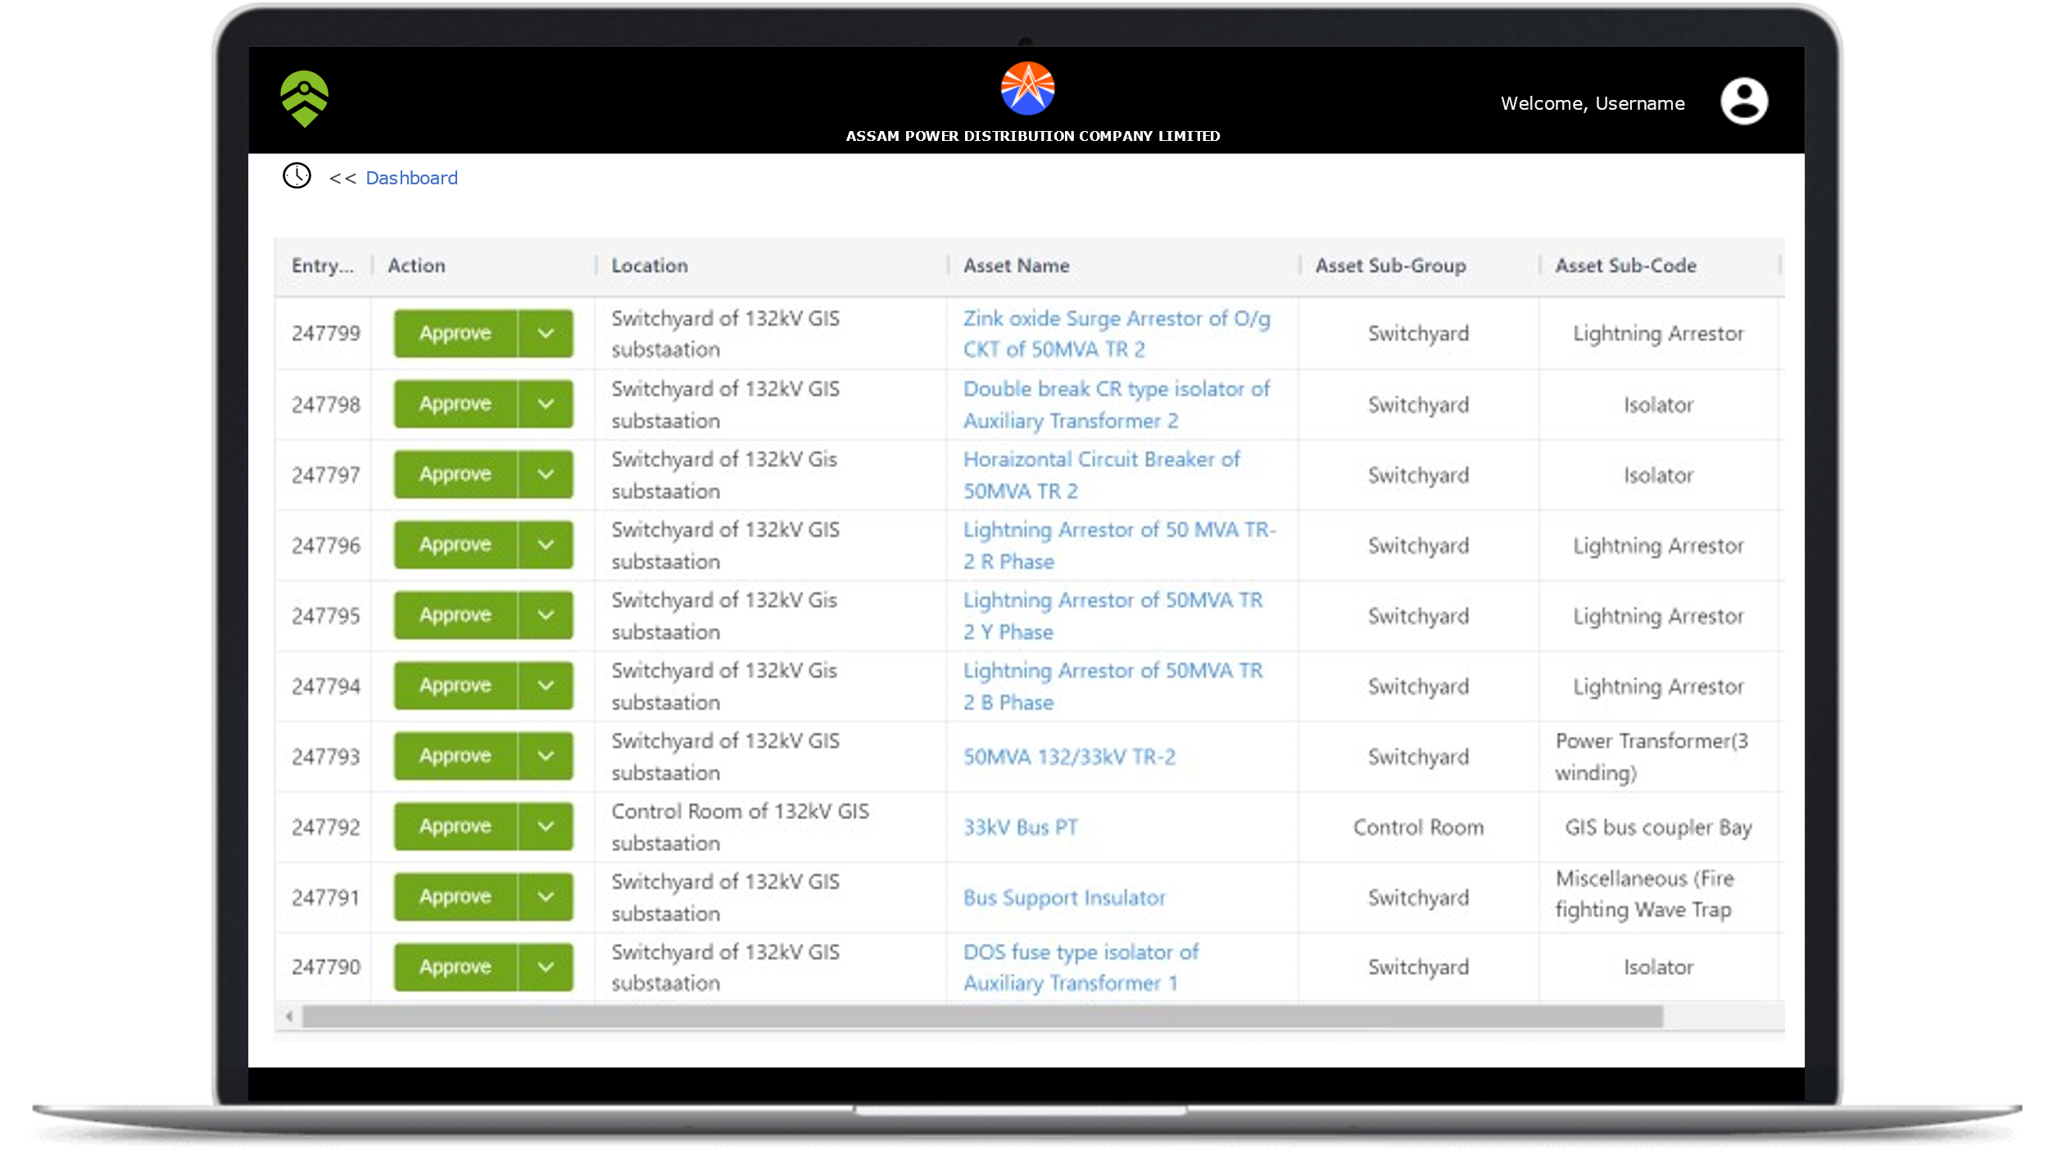

Asset Map - Overview
Walkthrough of Web Portal
On selecting the option as shown previously on the dashboard, Attribute Table of the selected asset type is displayed to the user. User can also select a particular asset and view the captured images of the same.
ILLUSTRATIVE

Slide 21
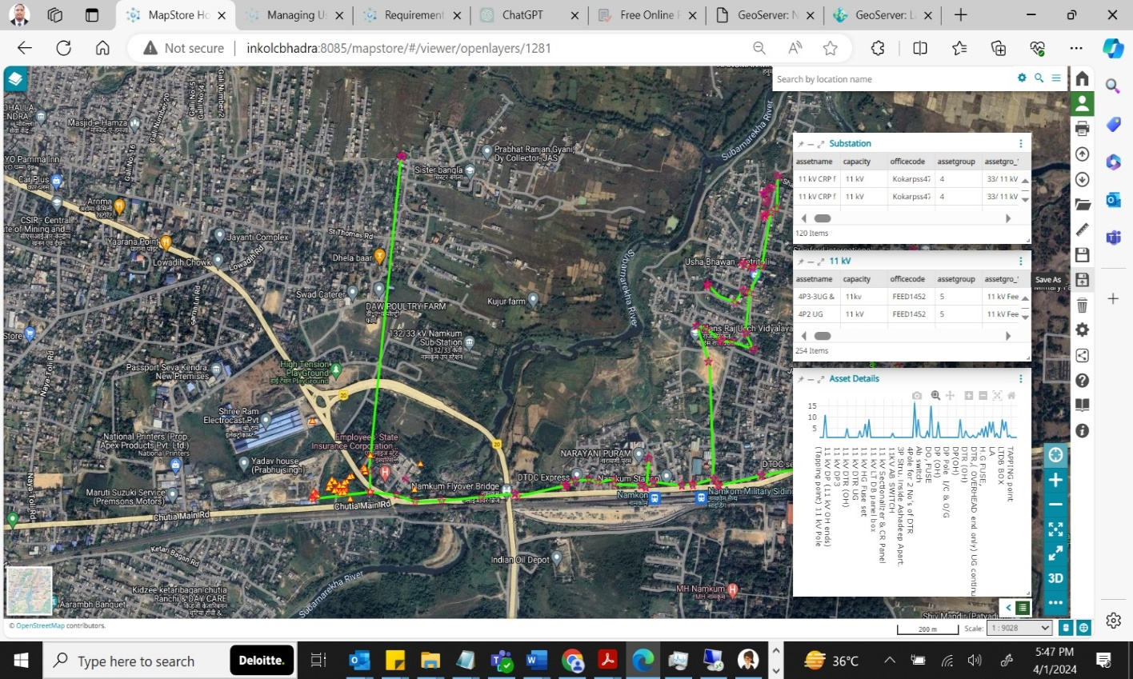
Asset Map using open-source GIS - Overview
ILLUSTRATIVE
Walkthrough of Web Portal
Details of asset under a substation can also be viewed on the map layer
Details of each and every pole under a feeder along with their attributes can also be viewed on the map layer

Slide 22
Success stories of Clients

Slide 23
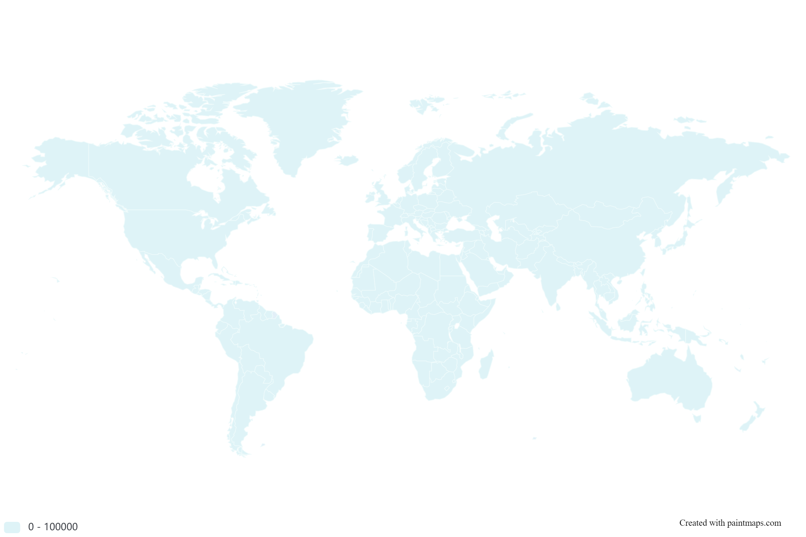
Our experience in Utility Asset Management
We have extensive experience in Asset Management for Indian & Global Utility Clients
Nepal Electricity Authority
Jharkhand Bijli Vitran Nigam Limited
Background
Nepal Electricity Authority (NEA) has engaged Deloitte to carry out a nation-wide asset verification & valuation exercise and develop asset management policies and processes. The project dealt with development of an asset register tool for verification and categorization of utility-based assets. Post verification and valuation, Deloitte shall recommend the adjustments to be made in the Financial Statements.
Scope and Approach
Conducted NEA As-Is analysis to understand the accounting policies and processes, asset listing and processes.
Development of IT database / asset register tool for data capture as well as asset verification including provision for 3 level review
Actual physical verification in over 600 locations of NEA across generation, transmission and distribution for assets and inventories
Development of an asset valuation methodology document
Carrying out the valuation of a sample Hydro power Generation plant, transmission sub stations and distribution centers upto transformer level
Development of asset management policies and processes
Value delivered
Physical verification & Asset register compilation
Statutory / Regulatory Compliance
Asset Management policies & processes
Background
The purpose of the project is to prepare a fixed asset register from scratch. The utility has assets spread all over the state of Jharkhand – which include Power Substations, 33 kV and 11 kV lines including Distribution Transformers. The asset base of JBVNL has almost doubled in the last 5 years. The assignment also includes compiling the historical cost of the assets.
. Scope and Approach
Carrying out a detailed assessment study
Developing a physical verification plan
Carrying out physical verification of the assets involved in power distribution, using an IT Tool developed by the Deloitte Team
Compiling data of costs incurred on assets commissioned till cut-off date and allocating the same to the assets physically verified
Enabling migration of asset register data to SAP ERP and developing a SOP manual for asset management
Value delivered
Physical verification & Asset register compilation
Statutory / Regulatory Compliance
Asset Management policies & processes

Slide 24
Our experience in Utility Asset Management
We have extensive experience in Asset Management for Indian & Global Utility Clients
Electricity Department of Puducherry, India
GIZ - Assam Power Distribution Corporation Limited
Background
The client had mandated Deloitte to develop a Fixed Asset and Depreciation Register acceptable to its Regulatory Commission so that the Department can address the disallowance of the Depreciation costs. Deloitte also assisted the Department in preparing statements of account in line with commercially accepted accounting principles. The Asset Registers were to be compiled based on physical verification of assets at the field locations and Head Office
Scope and Approach
Being a first-time exercise, preparation of the Opening Balance Sheet of the Department required tracing physical and financial records in respect of the assets created long back.
Organized physical verifications, formulated the verification process & prepared physical verification plan, conducting workshop for client team members, circulated the physical verification sheets & program managed the asset verification exercise.
Created fixed assets statement to provide block wise classification of fixed assets based on the capital expenditure incurred by Department.
Value delivered
Physical verification & Asset register compilation
Statutory / Regulatory Compliance
Historical cost determination
Background
Deloitte is assisting GIZ in developing an IT Tool for Asset management, which includes functionalities for asset data capture through mobile devices, including photographs, Geo-tagging of assets, enable schematic representation of assets on GIS map, integrate with different systems such as ERP, Outage Management and other systems, provide review of asset data through dashboards etc. Based on this IT tool, physical verification of 50 Substations will be done for Assam Power Distribution Corporation Limited (APDCL).
. Scope and Approach
Requirements gathering, deployment of wireframes, development of the IT Tool, Testing of the solution, review and finalization of the IT Tool
Deployment of the IT Tool for capturing asset data for 50 Power Substations of APDCL.
Post-Deployment support, Training and hand-over of the IT Tool to APDCL
Value delivered
Physical verification & Asset register compilation
Statutory / Regulatory Compliance
IT Development

Slide 25
Our experience in Utility Asset Management
We have extensive experience in Asset Management for Indian & Global Utility Clients
West Bengal State Electricity Transmission Company
Jharkhand Urja Sancharan Nigam Limited
Background
The client, the State Transmission Utility for West Bengal, has mandated Deloitte to re-develop the Fixed Asset and Depreciation Register acceptable to its Regulatory Commission so that the Department can address the disallowance of the Depreciation costs. Deloitte also assisted the Department in preparing statements of account in line with commercially accepted accounting principles. The Asset Registers are to be compiled based on physical verification of assets at the field locations and Head Office
Scope and Approach
Organize physical verifications using IT Tool, formulate the verification process & prepared physical verification plan, conduct workshop for client team members, circulate the physical verification sheets & program manage the asset verification exercise.
Create fixed assets statement to provide block wise classification of fixed assets based on the capital expenditure incurred by WBSETCL.
Value delivered
Physical verification & Asset register compilation
Statutory / Regulatory Compliance
Historical cost determination
Background
The client, the State Transmission Utility for Jharkhand, has mandated Deloitte to re-develop the Fixed Asset and Depreciation Register acceptable to its Regulatory Commission so that the Department can address the disallowance of the Depreciation costs. Deloitte also assisted the Department in preparing statements of account in line with commercially accepted accounting principles. The Asset Registers are to be compiled based on physical verification of assets at the field locations and Head Office
Scope and Approach
Organize physical verifications using IT Tool, formulate the verification process & prepared physical verification plan, conduct workshop for client team members, circulate the physical verification sheets & program manage the asset verification exercise.
Create fixed assets statement to provide block wise classification of fixed assets based on the capital expenditure incurred by WBSETCL.
Value delivered
Physical verification & Asset register compilation
Statutory / Regulatory Compliance
Historical cost determination

Slide 26
Our experiences in Utility Asset Management
We have extensive experience in Asset Management for Indian & Global Utility Clients
Ministry of Environment and Energy, Govt. of Maldives
Thrissur Municipal Corporation
Background
FENAKA is a state-owned generation and distribution Utility in Maldives that caters to electricity requirements in 153 outer islands. Because of legacy issues, the Utility did not have a Fixed Assets Register which was a major audit comment in their Financial Statements. As a part of an ADB funded project through the Ministry, Deloitte was mandated to advise FENAKA on how they could develop a Fixed Asset Register that can meet the IFRS requirements.
Scope and Approach
Developed an approach paper for asset verification and valuation given the challenges of remotely located islands which make it impossible for a valuer to visit all 153 islands
Develop the Terms of reference and RFP for selection of a fixed asset valuation expert firm and assisted the PMU in the selection process
Provided program management activities for entire physical verification and valuation exercise. Reviewed the deliverables of the valuation firm, and guided FENAKA on how they could make the necessary adjustments in their financial statements to reflect the valuation.
Value delivered
Physical verification & Asset register compilation
Statutory / Regulatory Compliance
Background
Thrissur Municipal Corporation, Electricity Department (TCED) engaged Deloitte to create fixed asset registers to comply with Regulatory directives. The Project envisaged the physical verification of all electricity distribution assets in the city and development of the asset register along with values. This was done at the behest of the State Regulator which required TCED to ensure regulatory compliance on the Asset details
Scope and Approach
Conducted an As-Is analysis to understand the accounting policies and processes, asset listing and processes.
Development of an excel based template for data capture as well as asset verification
Actual physical verification in all locations under TCED license area
Compilation of the Assets as per details obtained from the field offices and the physical verification exercise
Development of an historical cost determination methodology document
Identification of the historical costs for individual assets / asset group.
Value delivered
Physical verification & Asset register compilation
Statutory / Regulatory Compliance

Slide 27
Our experiences in Utility Asset Management
We have extensive experience in Asset Management for Indian & Global Utility Clients
Global Airport - Asset Management IT Solution
Global airport in the aviation sector (airport operator)
Background
The purpose of the project was to help in implementation of asset management policies and processes and help in the functional integration of the summary data available in the accounting and financial records with the detailed data available in the asset management software i.e., Maximo. The project dealt with airport assets such as airport infrastructure, land and real estate development assets such as land and buildings developed as a part of the aviation city.
Scope and Approach
Reviewed the current IT architecture used for recording of assets and its related transactions.
Recommended an integrated roadmap solution that ensures integration between maintenance and accounting functions.
Developed codification structure, accounting policy and process document based on asset classification in accounting.
Developed the policy document in line with IFRS regulations and also developed processes and formats for entire asset life cycle.
Provided training to client staff on new processes and formats.
Value delivered
Statutory / Regulatory Compliance
Asset management Policies and Processes
IT Solution / Integration design
Background
Deloitte was mandated by the airport operator to review the current policies and procedures for maintenance of the fixed assets register, identify gaps and recommend improvements. The key challenge faced by the operator was the multiplicity of agencies involved in asset creation and asset maintenance including critical aspects related to financial reporting.
Scope and Approach
Understand current practices and formats used for transfer of information between units and document the as-is key information flows related to assets between the units / entities
Identify key bottlenecks / gaps in information transfer process and process improvements and agree on process improvement changes with all stakeholders
Draft a Fixed Asset Policy document for the entire fixed assets cycle
Develop process framework document for asset management containing:
listing of all processes,
process flow charts,
identifying system interface requirements,
design of documents and reports.
Value delivered
Asset management Policies and Processes
Statutory / Regulatory Compliance

Slide 28
Our experience in Regulatory Assistance for Utilities
We have extensive experience in Regulatory affairs for Indian & Global Utility Clients
Consultancy work orders (ongoing or completed) in Tariff/Regulatory affairs completed within the purview of CERC on behalf of any Central PSU/ Autonomous body/ ISGS/ISTS in past 5 years (i.e., FY 2018-19 - FY 2022-23)
SI No | Name of the Engagement | Client | Year
1 | Engagement of Tariff consultant firm for preparation of Generation and Transmission Tariff and its True Up to be submitted before CERC and preparation of Distribution Tariff, ARR to be submitted before WBERC and JSERC and other Commercial related matters. | DVC | 2019-2021
2 | Assistance to Forum of Regulators in dissemination of international experience on Aggregators / Qualified Coordinating agency and report on Issues of QCA | FOR-USAID-CERC | 2019-2020
3 | Proposal for consultancy assignment for study of existing Regulated Electricity Pricing and the Way Forward | NTPC | 2023-24 (ongoing)
4 | Preparation of Paper on Open Access in India and retainership support related to Open Access | IEX | 2020-21
5 | Appointment of Consultant firm for Preparation and approval of Tariff Petitions for the existing and new elements owned by the PTCUL before the Hon’ble CERC for the Control Period FY 2019-2024 | PTPL | 2023-24 (Ongoing)
SI No | Name of the Engagement | Client | Year
6 | Engagement of Regulatory Affairs Consultant to prepare forms for filing petitions for POC transmission charges before CERC i.r.o two nos. ISTS lines. | WBSETCL | 2022-2023
7 | Study report on consumer Protection in Electricity sector in India. | FOR | 2020
8 | Corporate consultant to undertake a study on evolving principles of depreciation for distribution assets and Operating and financial norms for Distribution Sector | FOR | 2020
9 | Review of Status of Open Access in Distribution | FOR | 2018-2019
10 | Preparing comments on the Approach Paper and Draft CERC Tariff Regulations 2019-24 | Lalipur Power Gen. Corp. | 2019-2020

Slide 29
Our experience in Regulatory Assistance for Utilities
We have extensive experience in Regulatory affairs for Indian & Global Utility Clients
Consultancy work orders (ongoing or completed) in Tariff/Regulatory affairs completed within the jurisdiction of any SERC on behalf of any State / Private Distribution /Transmission /Generation entity in past 5 years (i.e., FY 2018-19 - FY 2022-23)
SI No | Name of the Engagement | Client | Year
1 | Engagement of Tariff consultant firm for preparation of Distribution Tariff, ARR to be submitted before WBERC and JSERC. | DVC | 2019-2022
2 | Consultancy Services for providing assistance to WBSEDCL in all regulatory areas on Retainership basis | WBSEDL | Oct 2015-Oct 2019
3 | Regulatory support, Diagnostic analysis of revenue cycle, monitoring of MBC of HT consumers and Urja Mitra Program of Jharkhand Bijli Vitran Nigam Limited (JBVNL) | JBVNL | 2018-2021
4 | Preparation of Business Plan Petition and Multi-Year Tariff Petition for UPCL for the Control Period FY 2019-20 to FY 2021-22 | UPCL | 2018-2019
5 | Supporting JUUNL for Filing Petitions for True-up from FY 2016-17 to FY 2020-21 & Business Plan and MYT, ARR for Control Period (FY 2021-22 to FY 2025-26) and subsequent Annual Petitions for True Up from FY 2021-22 to FY 2023-24 with Jharkhand State Electricity Regulatory Commission | JUUNL | 2023-Ongoing
SI No | Name of the Engagement | Client | Year
6 | Engagement of Regulatory Affairs Consultant- WBSETCL | WBSETCL | 2020-2023
7 | Regulatory assistance in preparation of Business Plan and Multi Year Tariff Petition of Tenughat Vidyut Nigam Ltd (TVNL) for the Control Period FY 2021-22 to FY 2025-26 | TVNL | 2021-2023
8 | Regulatory assistance to TVNL in True-Up of FY 13 to FY 16 | TVNL | 2022-2023
9 | Capital Investment Plan and ARR for Control period FY2019-22 and Tariff Petitions for the FYs 2019-20, 2020-21 and 2021-22 | APGCL | 2019-2023
10 | Preparation of petition for Coal Mining Input Price Determination for Pachwara North Coal mine of WBPDCL | WBPDCL | 2022-2024
11 | Preparation of petition for Coal Mining Input Price Determination for Gangaramchak & Gangaramchak Badulia coal mine | WBPDCL | 2023-2024
12 | Consultancy Support and preparation of Business Plan for NESCO, WESCO & SOUTHCO utilities for the 4th control period from FY 2019-20 to FY 20 | GRIDCO Odisha | 2019-2021

Slide 30
Our experiences in Regulatory Assistance to SERCs
We have extensive experience in Regulatory affairs for Indian & Global Utility Clients
Consultancy work orders (ongoing or completed) under any State Regulatory Commission in past 5 years (i.e., FY 2018-19 - FY 2022-23)
SI No | Name of the Engagement | Client | Year
1 | Transaction advisory services to OERC for selection of investor for sale of NESCO Utility | OERC | 2018-2019
2 | Regulatory Assistance to the HPERC on Tariff Related Matters for the 4th Control Period from FY 2019-20 to FY 2023-24 | HPERC | 2019-2023
3 | Regulatory Assistance to the HPERC on Tariff Related Matters for the 3rd Control Period from FY 2014-15 to FY 2018-19 | HPERC | 2014-2019
4 | Transaction advisory services to OERC for selection of investor for sale of SOUTHCO Utility | OERC | 2020-2021
5 | Consultancy services to OERC for framing of new regulations | OERC | 2019-2023
6 | Appointment of Consultant towards works related to True-up, ARR & Tariff Orders of the Power Utilities in Tamil Nadu | TNERC | 2021-2022
SI No | Name of the Engagement | Client | Year
6 | Determination of Retail Supply Tariff for FY 2018-19 for Electricity Department, Lakshadweep Administration - Joint Electricity Regulatory Commission (For the State of Goa and Union Territories) | JERC | 2018-2019
7 | Evolving Principles of Depreciation for Distribution Assets and Operating and Financial norms for Distribution Sector | FOR | April 2020
8 | Review of Status of Open Access in Distribution | FOR | 2018-2019

Slide 31
Our experiences in Regulatory Affairs
We have extensive experience in Regulatory affairs for Indian & Global Utility Clients
Consultancy work orders (ongoing or completed) in determination of Tariff/Regulatory affairs working under CERC in past 5 years (i.e., FY 2018-19 - FY 2022-23)
SI No | Name of the Engagement | Client | Year
1 | Assistance to CERC in design of ancillary service regulations including co-optimization of energy and ancillary services (under the GTG-RISE initiative) | CERC | 2019-20
2 | Assistance to CERC in modelling benefits estimation Real time markets and technical assistance (under the GTG-RISE initiative) | USAID-CERC | 2018-2019
SI No | Name of the Engagement | Client | Year
3 | Assistance to CERC in demonstration of Day ahead Market Based Economic Dispatch (MBED) mechanism (under the GTG-RISE initiative) | USAID CERC | 2019-2020
4 | Assistance to CERC in modelling benefits estimation of Security constrained economic dispatch mechanism for ISGS generators proposed by POSOCO (under the GTG-RISE initiative) | USAID-CERC | 2019-2020

Slide 32
Deloitte refers to one or more of Deloitte Touche Tohmatsu Limited, a UK private company limited by guarantee (“DTTL”), its network of member firms, and their related entities. DTTL and each of its member firms are legally separate and independent entities. DTTL (also referred to as “Deloitte Global”) does not provide services to clients. Please see www.deloitte.com/about for a more detailed description of DTTL and its member firms.
This material has been prepared by Deloitte Touche Tohmatsu India LLP (“DTTILLP”), a member of Deloitte Touche Tohmatsu Limited, on a specific request from you and contains proprietary and confidential information. This material may contain information sourced from publicly available information or other third-party sources. DTTILLP does not independently verify any such sources and is not responsible for any loss whatsoever caused due to reliance placed on information sourced from such sources. The information contained in this material is intended solely for you. Any disclosure, copying or further distribution of this material or its contents is strictly prohibited.
Nothing in this material creates any contractual relationship between DTTILLP and you. Any mutually binding legal obligationsorrights may only be created between you and DTTILLP upon execution of a legally binding contract. By using this material and any information contained in it, the user accepts this entire notice and terms of use.
©2021 Deloitte Touche Tohmatsu India LLP. Member of Deloitte Touche Tohmatsu Limited
Deloitte Touche Tohmatsu India Private Limited (U74140MH199 5PTC093339), a private company limited by shares, was converted into Deloitte Touche Tohmatsu India LLP, a limited liability partnership (LLP Identification No. AAE-8458),with effect from October 1, 2015.

