Slide 1

Design & Development of Web application for Turf Playground Booking
Project By: Prince Singh
PRN - 123M1H058

Slide 2
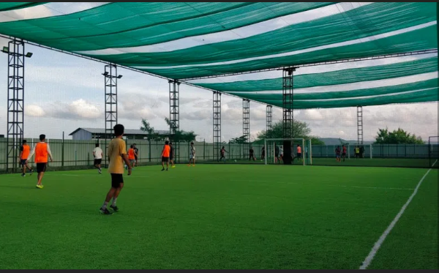
What is Turf ?
Turf playgrounds are used to play various sports like football, tennis, cricket, etc.
People enjoy playing on the turf, it has vibrant environment and very safe to play.
Many school teams and clubs prefer turf playground for practice and training purpose.

Slide 3
ABOUT THE PROJECT
Sometimes it becomes difficult to book turf playground because of timing issue or the slot getting booked previously. This sports ground booking website is proposed for booking the turf in an easy and efficient way.
Admin can login and can add turf locations, assign manager by creating login credentials for manager, add price details for the particular turf, manages turf and view the details of sports venues booking for all locations.
Owners are different for different Turf playground locations. Owners will get login credentials from admin, he/she can login using credentials, he/she can check the rates, view the request for turf booking for the respective location, can accept booking, generate bill and can view the booking history.
Users can check the availability of the turf, select timings, fill personal details, can pay by providing bank details or card details and he/she can also see view previous turf booking history.

Slide 4
Objectives of proposed system : 1) To Design and Develop online web application for Turf Booking. 2) To obtain a simple interface for webpage which helps Turf owners to expand their business through online. 3) To obtain a bug-free Booking System for users which allow them to search and view the information of Turf. 4) To obtain the system that maintains the List of Turf and their Booking History so it will be easy to access 24 * 7.

Slide 5
Scope of proposed system : Booking Facility: Users can search the Turf based on location and see the previous booking details and available slots and timing and Discounted Offers. Users can book the Turf and pay the amount at the time of visit by meeting the owner. Cancellation Facility: Users as well as the owner of the Turf can cancel the booking if they want to. User Registration: New users can sign up on the website and use the application after login with their credentials. Turf Registration: The owner of the Turfs can register their turf to expand their business.

Slide 6
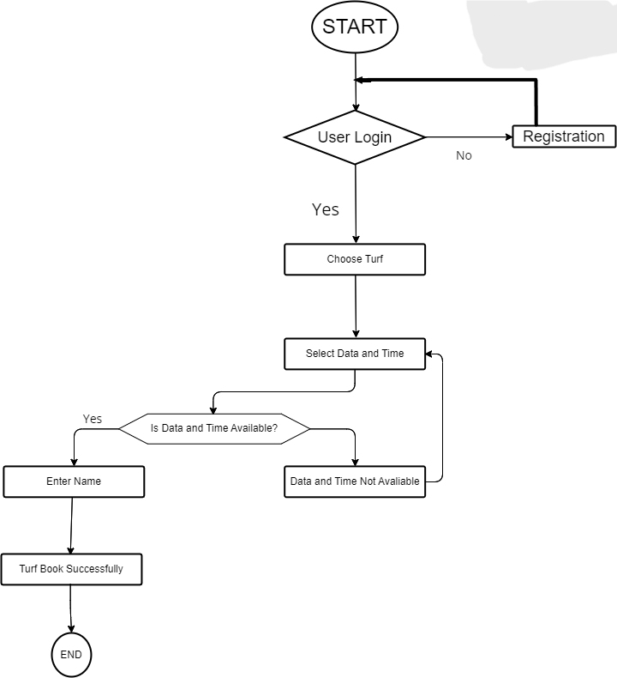
Workflow Diagram :

Slide 7
Insert records: This action is done to add new records into fields. Update records: This event is to modify or update the information on each process. Delete records: This action is to remove records from the system whenever they are no longer needed. Search for records: Whenever the admin wants to search for a record, this action is performed. The validation of data entered should be done. Specific condition has to be met. Highly Securable and Maintainable web application. Good GUI/UX Design.
Requirement's :

Slide 8
Used Technology: HTML CSS JavaScript MySQL PHP Software requirement: Microsoft Visual Studio Code. Any Web Browser. MySQL PHP Servers.
Technical Requirement's :

Slide 9
Web application is develop which can Successfully Book and Cancel the Turf playground online. This application can be used by the Cricket and Football enthusiastic players to book the available turf according to their need. The web based application mainly focuses into the location based service providing such as nearby turfs recommending system and its online booking and registrations. The system also provides its users to view upcoming tournaments hosted on particular locations and its registrations. The system helps out the users to search and find the nearby turfs or the turfs available in the particular location. So, the system studied the existing online turf booking systems and added on the above stated features into the proposed system to provide better user experiences. Overall the application provides a complete solution for the turf booking and its registrations.
Expected Outcomes :

Slide 10
Online Turf Playground Booking System this project Sends message reminders to managers and users whenever slots are booked, cancelled or rescheduled. And your users can easily and securely authenticate themselves by linking their existing service by using a password. Turf Near You, The web based application mainly focuses into the location based service providing such as nearby turfs recommending system and its online booking and registrations. The system also provides its users to view upcoming tournaments hosted on particular locations and its registrations. The system helps out the users to search and find the nearby turfs or the turfs available in the particular location. So, the system studied the existing online turf booking systems and added on the above stated features into the proposed system to provide better user experiences.
Conclusion :

Slide 11
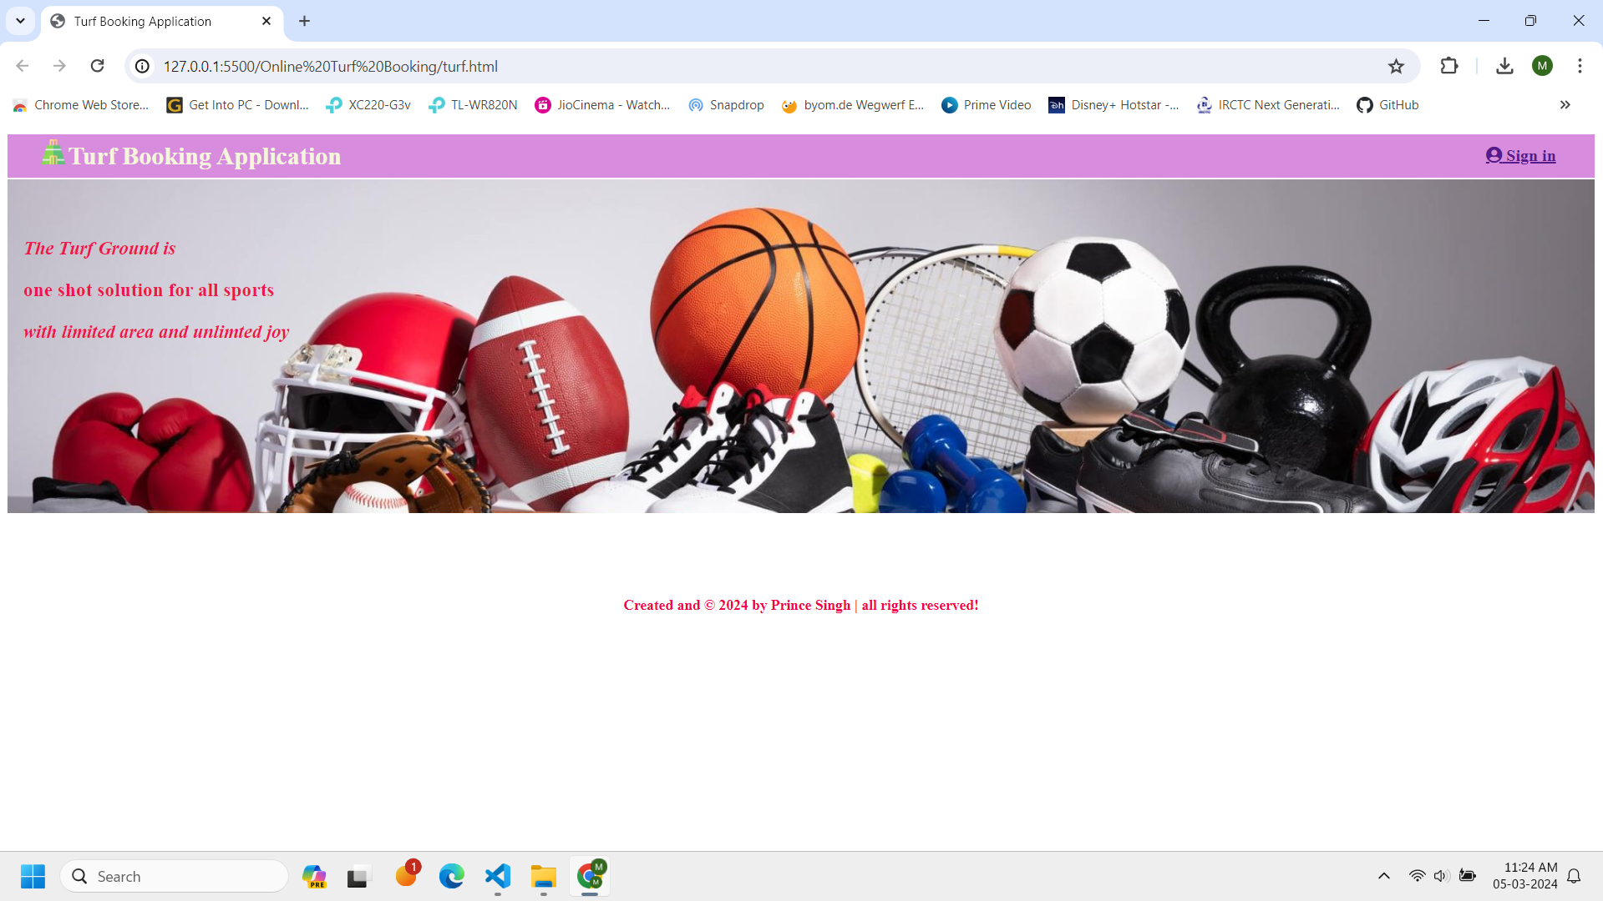

Slide 12
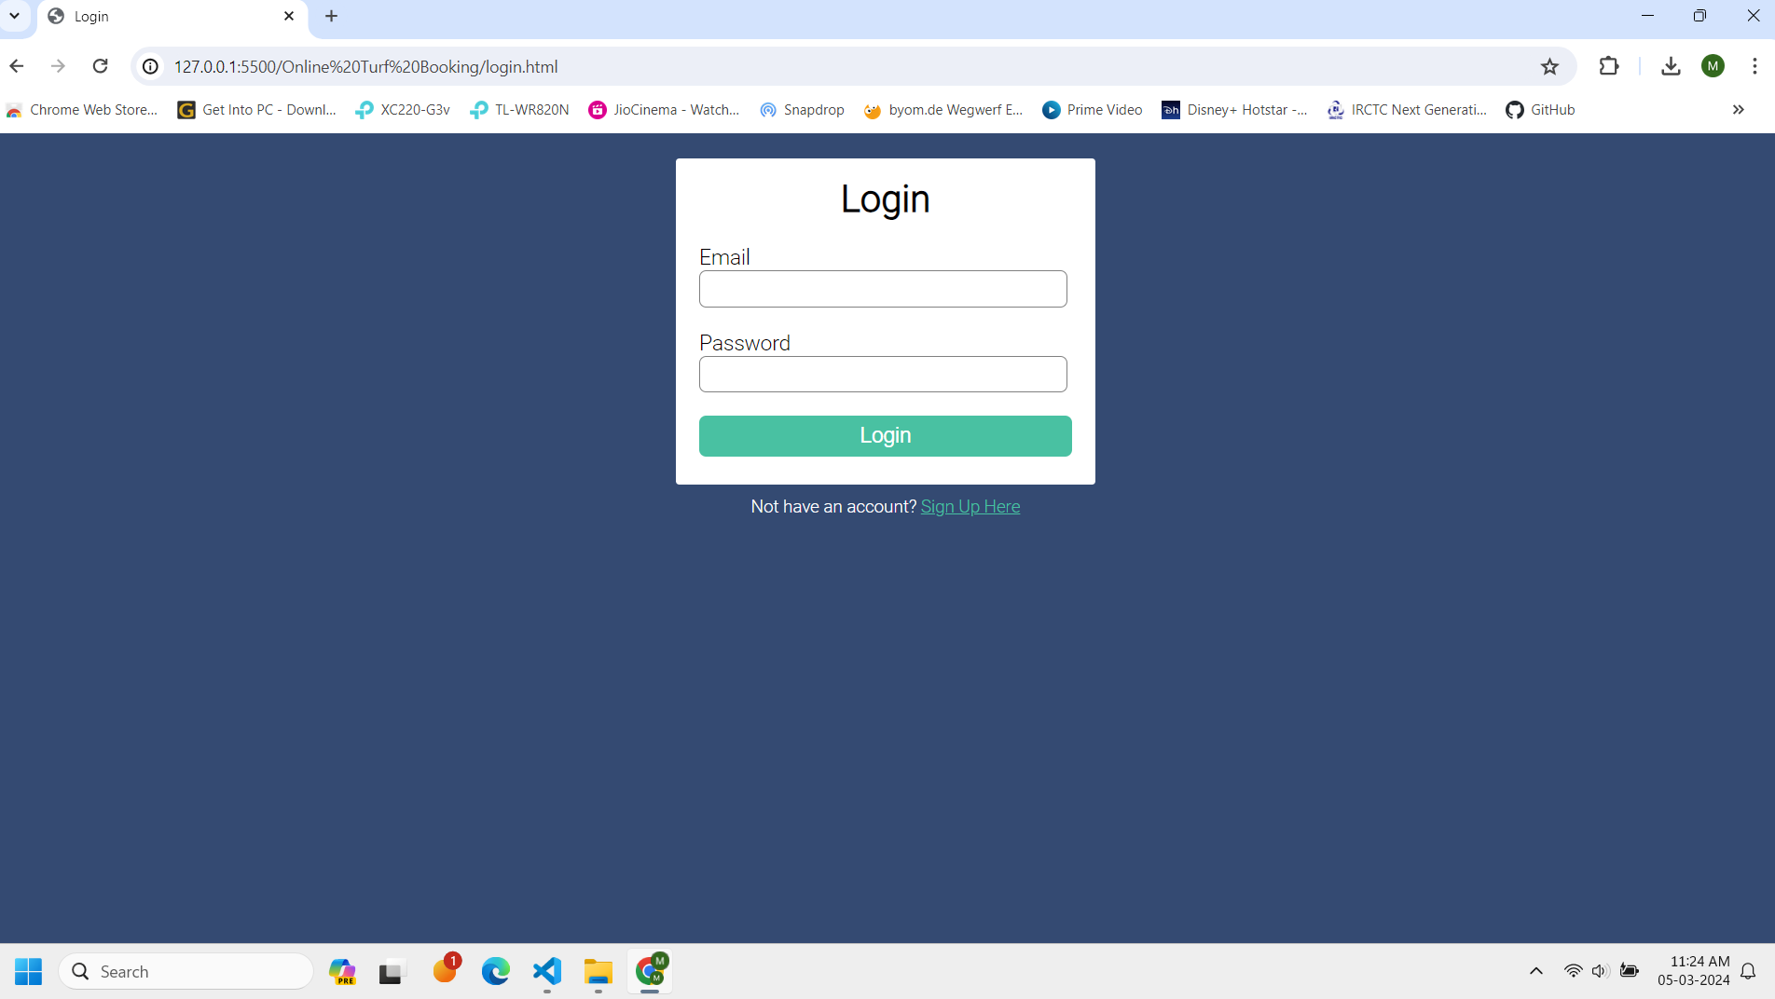

Slide 13
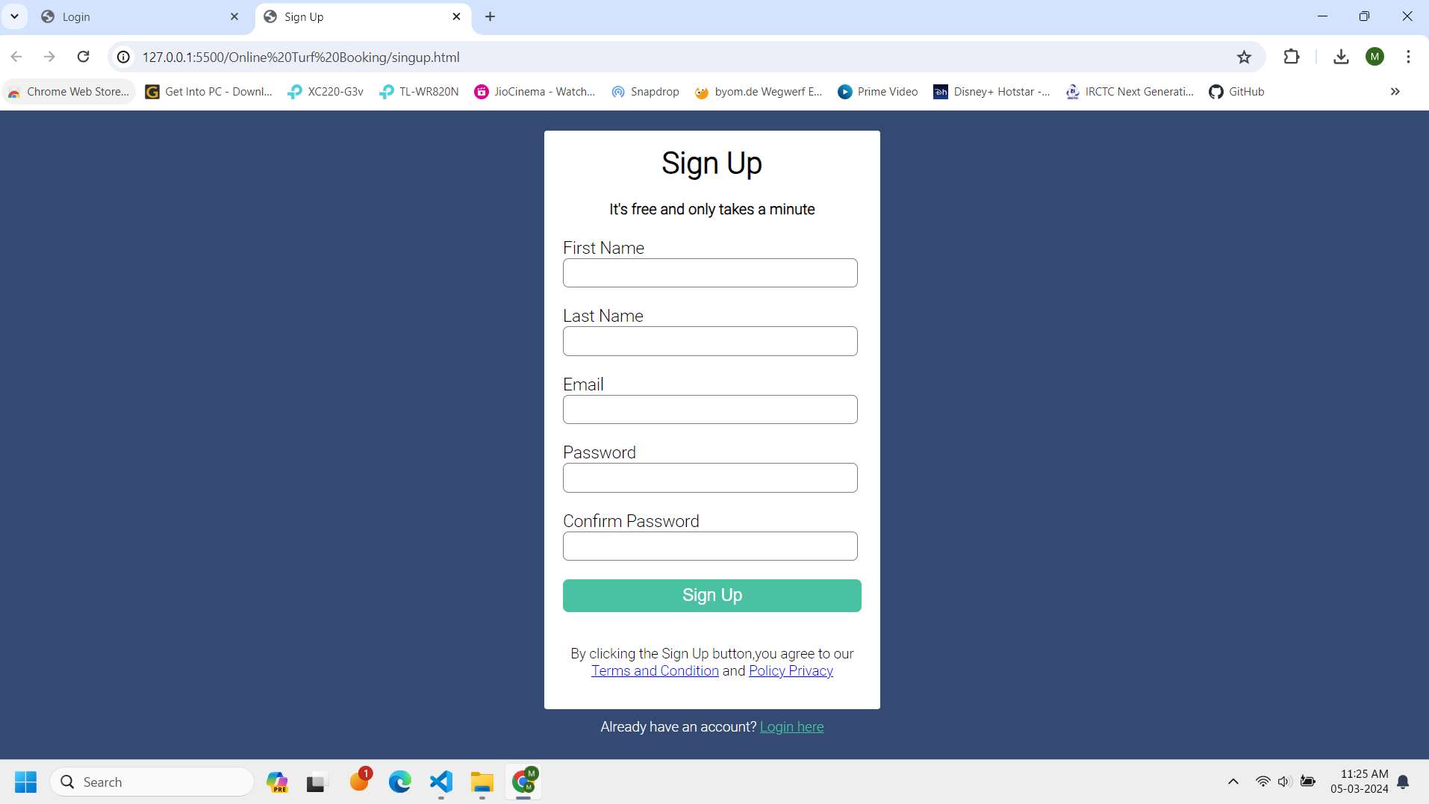

Slide 14
THANKS!!!

