Slide 1
Regression
In regression the output is continuous
Many models could be used – Simplest is linear regression
Fit data with the best hyper-plane which "goes through" the points
y
dependent
variable
(output)
x – independent variable (input)

Slide 2
Types of Regression Models
Regression
1 feature
Models
2+ features
Simple
Multiple
Non-
Non-
Linear
Linear
Linear
Linear
Notes:
24
This teleology is based on the number of explanatory variables & nature of relationship between X & Y.

Slide 3
Linear regression
Given an input x compute an output y
For example:
- Predict height from age
- Predict house price from house area
- Predict distance from wall from sensors
Y
X

Slide 4
Simple Linear Regression Equation
E(y)
Regression line
Intercept
β₀
Slope β₁
x

Slide 5
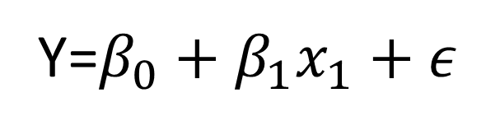
Linear Regression Model
Relationship Between Variables Is a Linear Function
Population Y-Intercept
Population Slope
Random Error
Y=$β_{0}+β_{1}x_{1}+ε$

Slide 6
House Number | Y: Actual Selling Price | X: House Size (100s ft2)
1 | 89.5 | 20.0
2 | 79.9 | 14.8
3 | 83.1 | 20.5
4 | 56.9 | 12.5
5 | 66.6 | 18.0
6 | 82.5 | 14.3
7 | 126.3 | 27.5
8 | 79.3 | 16.5
9 | 119.9 | 24.3
10 | 87.6 | 20.2
11 | 112.6 | 22.0
12 | 120.8 | .019
13 | 78.5 | 12.3
14 | 74.3 | 14.0
15 | 74.8 | 16.7
Averages | 88.84 | 18.17
Sample 15 houses from the region.

Slide 7
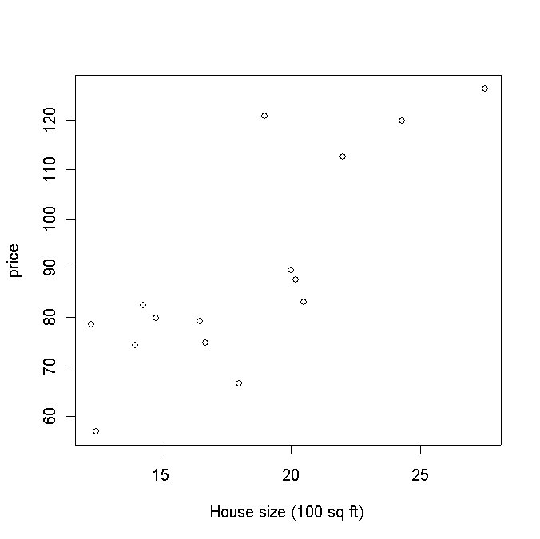
House price vs size

Slide 8
Linear Regression – Multiple Variables
β₀ is the intercept (i.e. the average value for Y if all the X’s are zero), β_{j} is the slope for the jth variable X_{j}

Slide 9
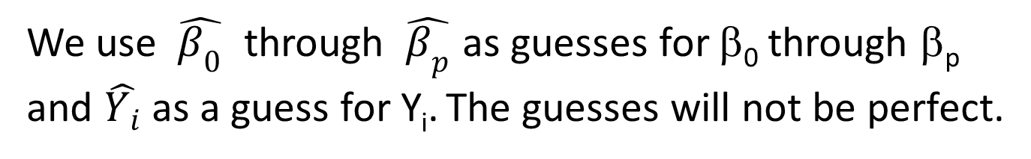
Regression Model
Our model assumes that
E(Y | X = x) = β₀ + β₁x (the “population line”)
Population line
Least Squares line
We use $\hat{β_{0}}$ through $\hat{β_{p}}$ as guesses for β₀ through β_{p} and $\hat{Y_{i}}$ as a guess for Y_{i}. The guesses will not be perfect.

Slide 10
Assumption
The data may not form a perfect line.
When we actually take a measurement (i.e., observe the data), we observe:
Y_{i} = β₀ + β₁X_{i} + ε_{i},
where ε_{i} is the random error associated with the ith observation.

Slide 11
Assumptions about the Error
E(ε_{i} ) = 0 for i = 1, 2,…,n.
σ(ε_{i} ) = σ_{ε} where σ_{ε} is unknown.
The errors are independent.
The ε_{i} are normally distributed (with mean 0 and standard deviation σ_{ε}).

Slide 12
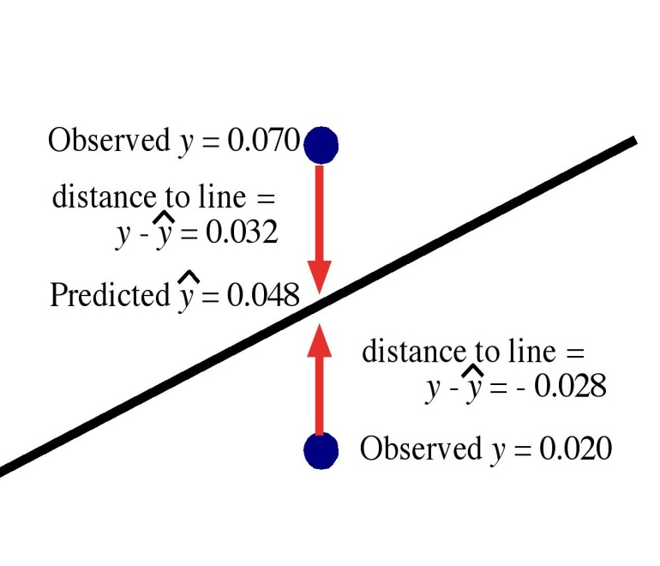
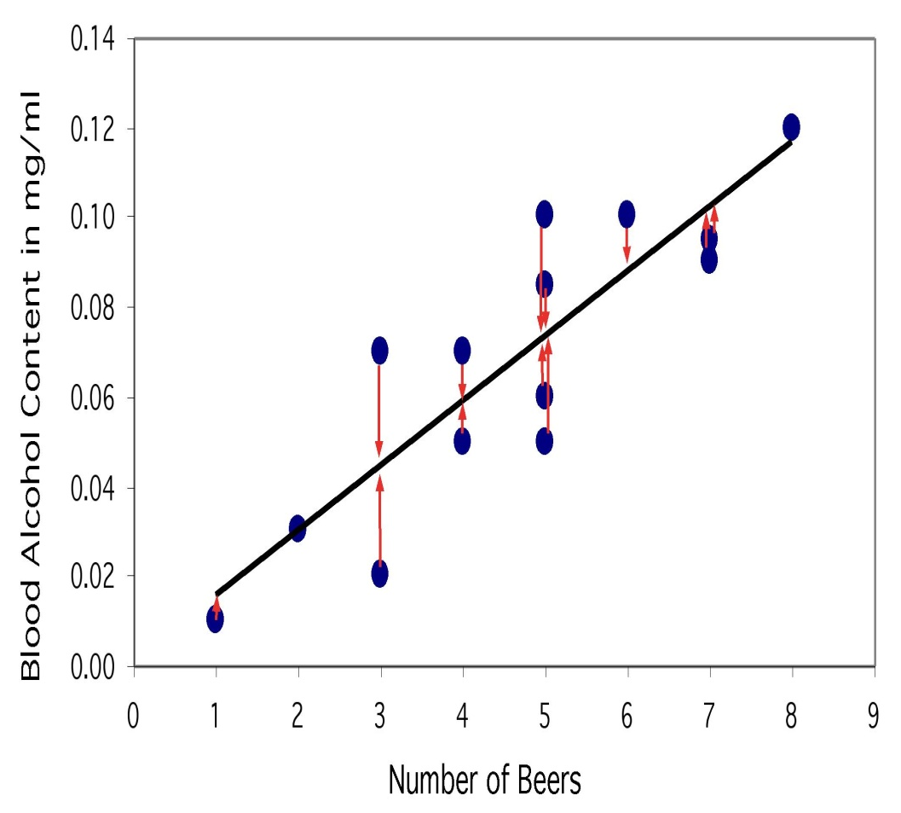
The regression line
The least-squares regression line is the unique line such that the sum of the squared vertical (y) distances between the data points and the line is the smallest possible.

Slide 13

Criterion for choosing what line to draw: method of least squares
The method of least squares chooses the line ( $\hat{β_{0}}$ and $\hat{β_{1}}$ ) that makes the sum of squares of the residuals $\sum{{ℇ_{i}}^{2}}$ as small as possible
Minimizes

Slide 14
How do we "learn" parameters
For the 2-d problem
To find the values for the coefficients which minimize the objective function we take the partial derivates of the objective function (SSE) with respect to the coefficients. Set these to 0, and solve.

Slide 15
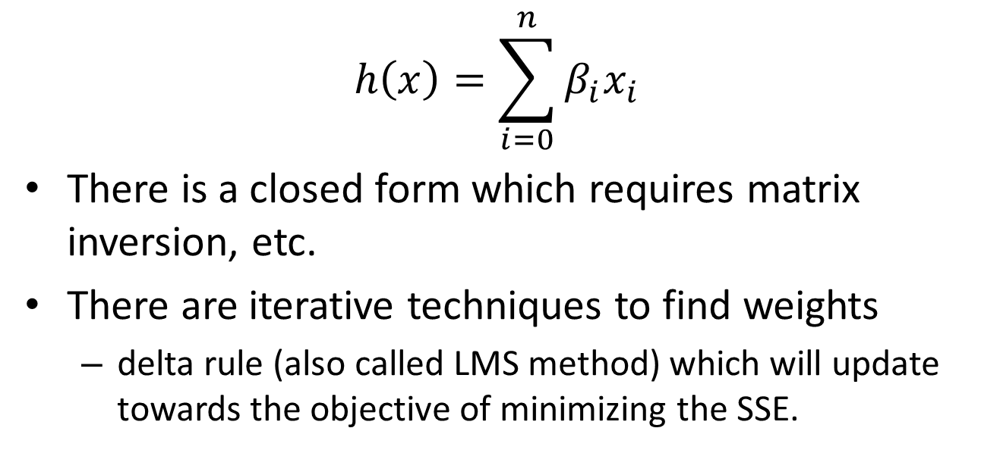
Multiple Linear Regression
$$h\left(x\right)=\sum_{i=0}^{n}{β_{i}x_{i}}$$
There is a closed form which requires matrix inversion, etc.
There are iterative techniques to find weights
delta rule (also called LMS method) which will update towards the objective of minimizing the SSE.
Notes:
Note target really is the point being regressed to each time. Now makes better sense since net is the output and we want to minimize error of the target.

Slide 16
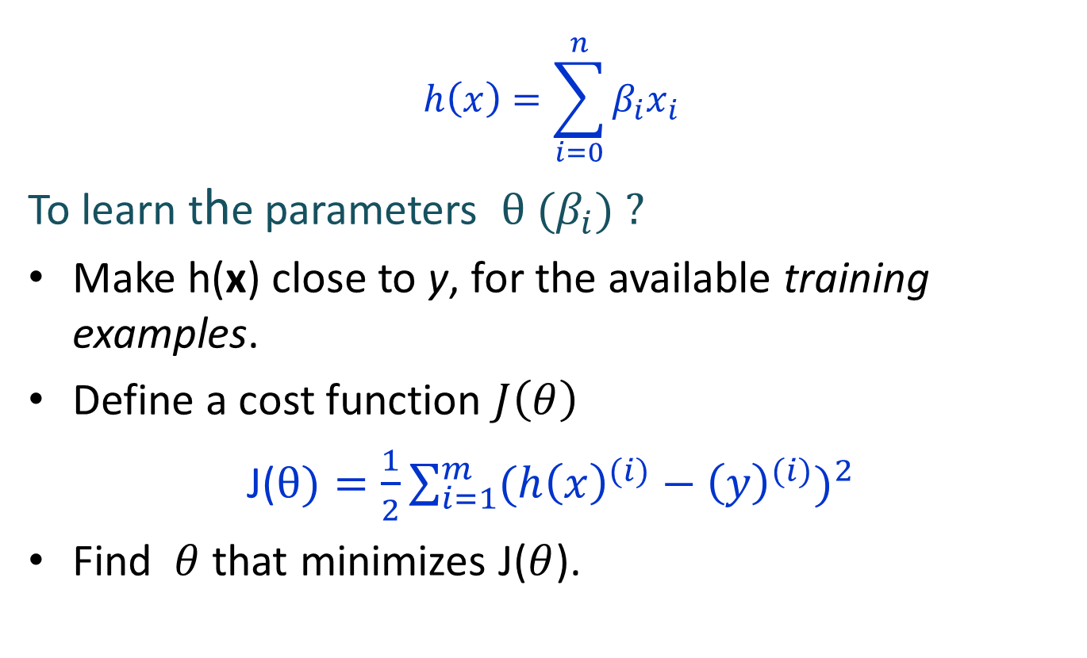
Linear Regression
$$h\left(x\right)=\sum_{i=0}^{n}{β_{i}x_{i}}$$
To learn the parameters $θ (β_{i}) ?$
Make h(x) close to y, for the available training examples.
Define a cost function $J\left(θ\right)$
J($θ)=\frac{1}{2}\sum_{i=1}^{m}{{(h{\left(x\right)}^{(i)}−{\left(y\right)}^{(i)})}^{2}}$
Find $θ$ that minimizes J($θ$).

Slide 17
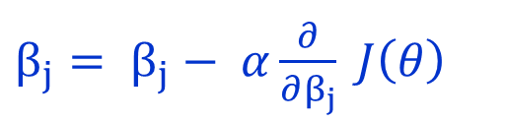
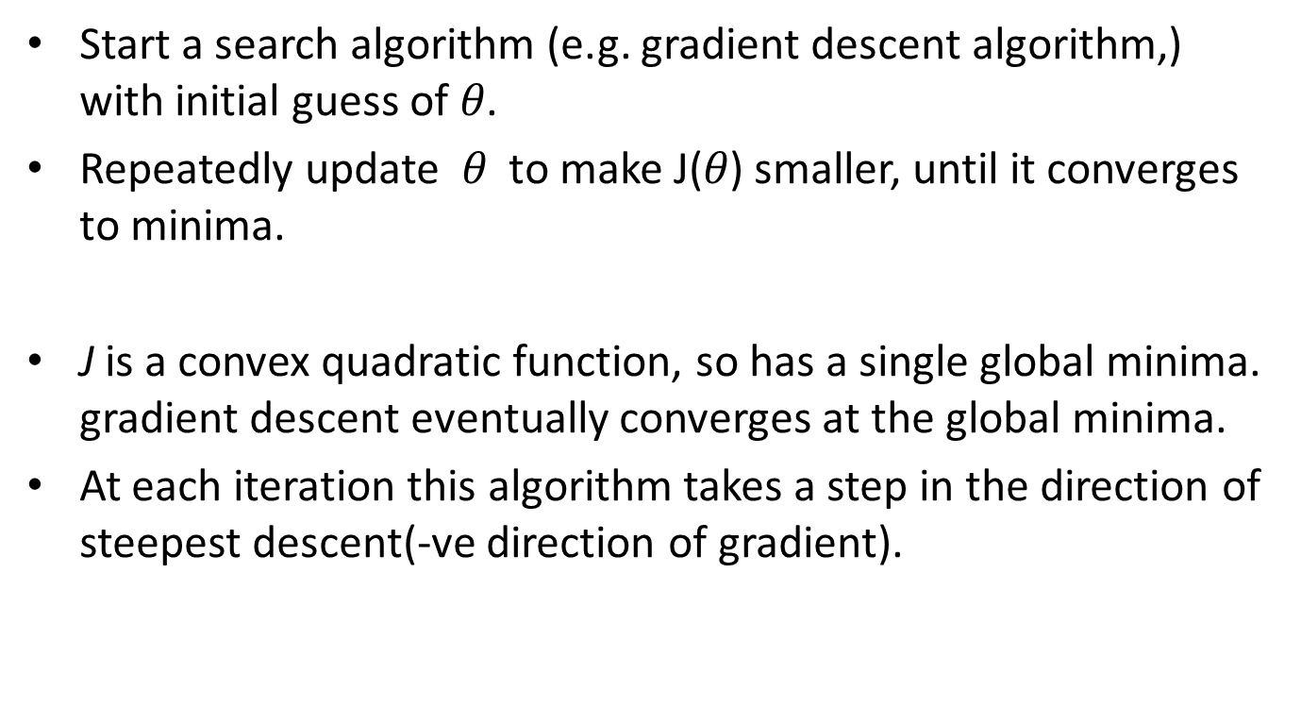
LMS(Least Minimum Slope) Algorithm
Start a search algorithm (e.g. gradient descent algorithm,) with initial guess of $θ$.
Repeatedly update $θ$ to make J($θ$) smaller, until it converges to minima.
J is a convex quadratic function, so has a single global minima. gradient descent eventually converges at the global minima.
At each iteration this algorithm takes a step in the direction of steepest descent(-ve direction of gradient).
$β_{j}= β_{j}− α\frac{∂}{∂β_{j}} J\left(θ\right)$

Slide 18
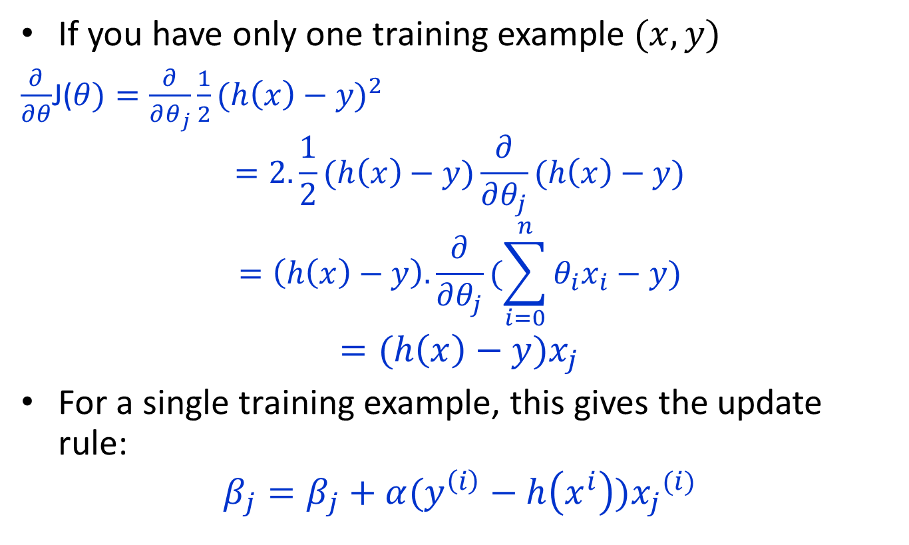
LMS Update Rule
If you have only one training example $(x,y)$
$\frac{∂}{∂θ}$J($θ)=\frac{∂}{∂θ_{j}}\frac{1}{2}{(h\left(x\right)−y)}^{2}$
$$=2.\frac{1}{2}(h\left(x\right)−y)\frac{∂}{∂θ_{j}}(h\left(x\right)−y)$$
$$=\left(h\left(x\right)−y\right).\frac{∂}{∂θ_{j}}(\sum_{i=0}^{n}{θ_{i}x_{i}−y})$$
$$=(h\left(x\right)−y)x_{j}$$
For a single training example, this gives the update rule:
$$β_{j}=β_{j}+α(y^{\left(i\right)}−h\left(x^{i}\right)){x_{j}}^{(i)}$$

Slide 19
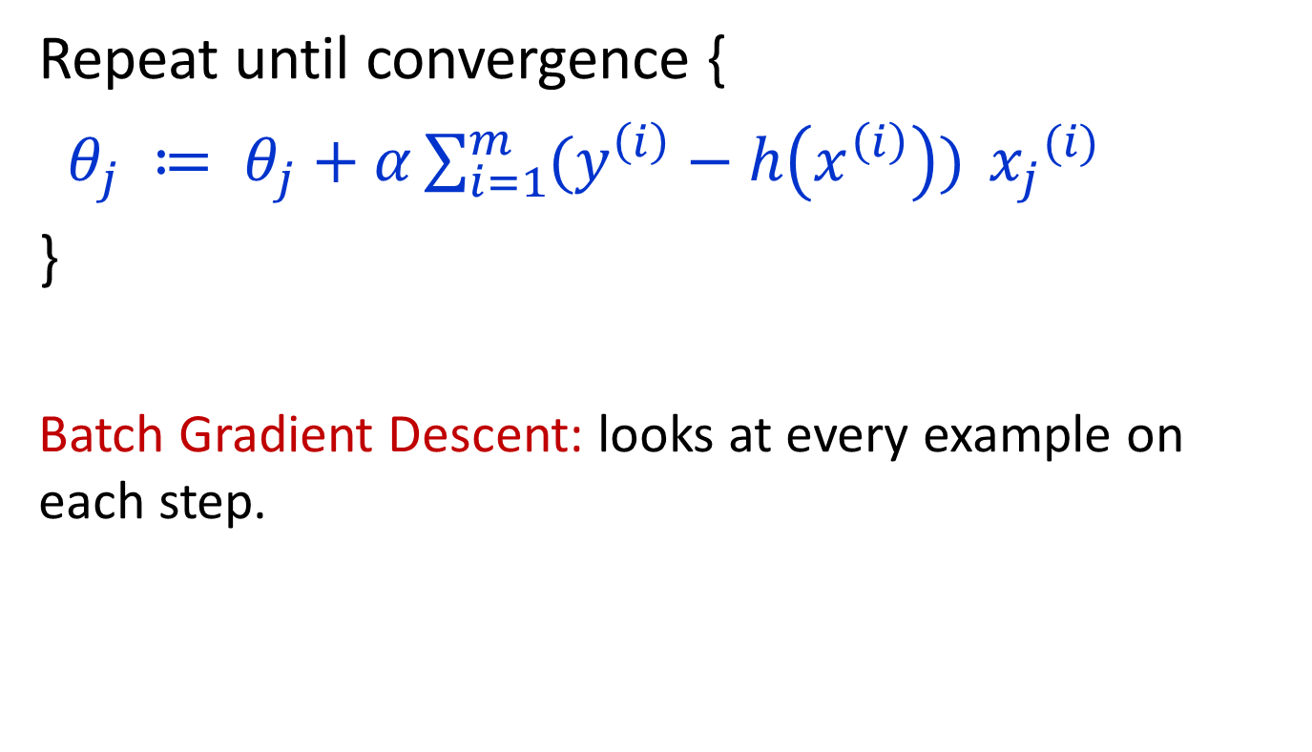
m training examples
Repeat until convergence {
$θ_{j} ≔ θ_{j}+α\sum_{i=1}^{m}{(y^{\left(i\right)}−h\left(x^{\left(i\right)}\right)) }{x_{j}}^{(i)}$
}
Batch Gradient Descent: looks at every example on each step.

Slide 20
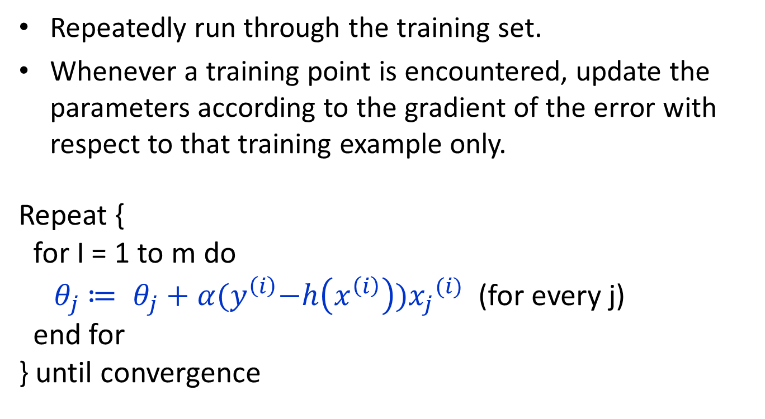
Stochastic gradient descent
Repeatedly run through the training set.
Whenever a training point is encountered, update the parameters according to the gradient of the error with respect to that training example only.
Repeat {
for I = 1 to m do
${ θ}_{j} ≔ θ_{j}+α{(y}^{\left(i\right)}−h\left(x^{\left(i\right)}\right)){x_{j}}^{(i)}$ (for every j)
end for
} until convergence

