Slide 1
Logistic Regression
Used for classification.

Slide 2
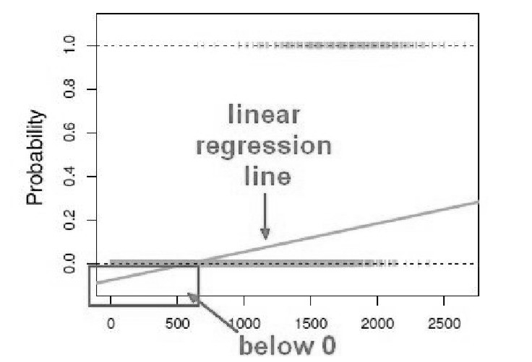

Slide 3
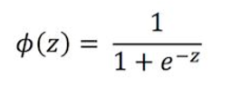
Sigmoid Function
The sigmoid function also known as the logistic function is going to be the key to using logistic regression to perform classification.
The sigmoid function takes in any value and outputs it to be between 0 and 1.

Slide 4
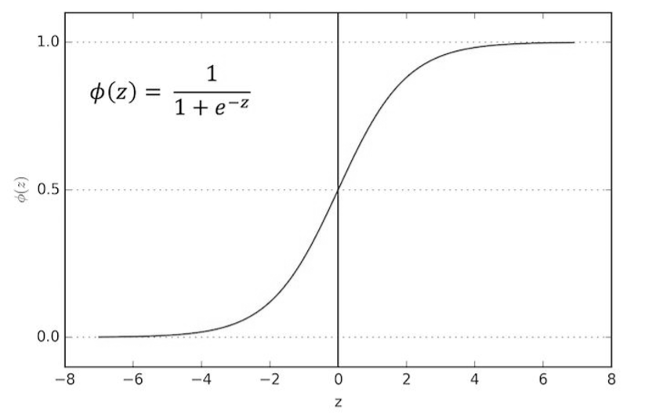

Slide 5
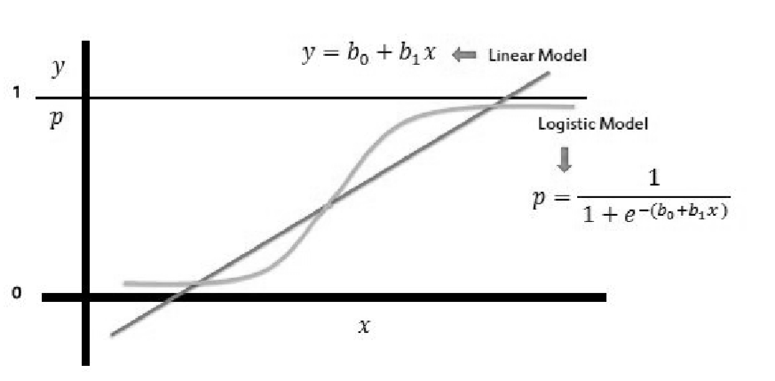
This means we can take our linear regression solution and place it into the sigmoid function and it looks something like this:

Slide 6
If you take that linear model and place it into a sigmoid function then we are finally able to transform linear regression to logistic model meaning it doesn’t matter whatever the value of linear model output actually is it’s always going to be between 0 and 1 when you place it into the sigmoid function.

Slide 7
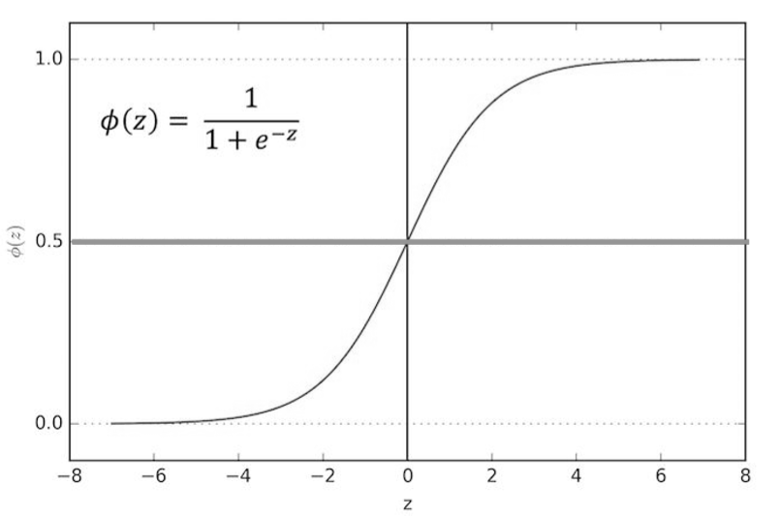
We can set a cutoff point at 0.5and we can say anything below 0.5results in class 0 and anything above 0.5 belongs to class 1.

