Slide 1
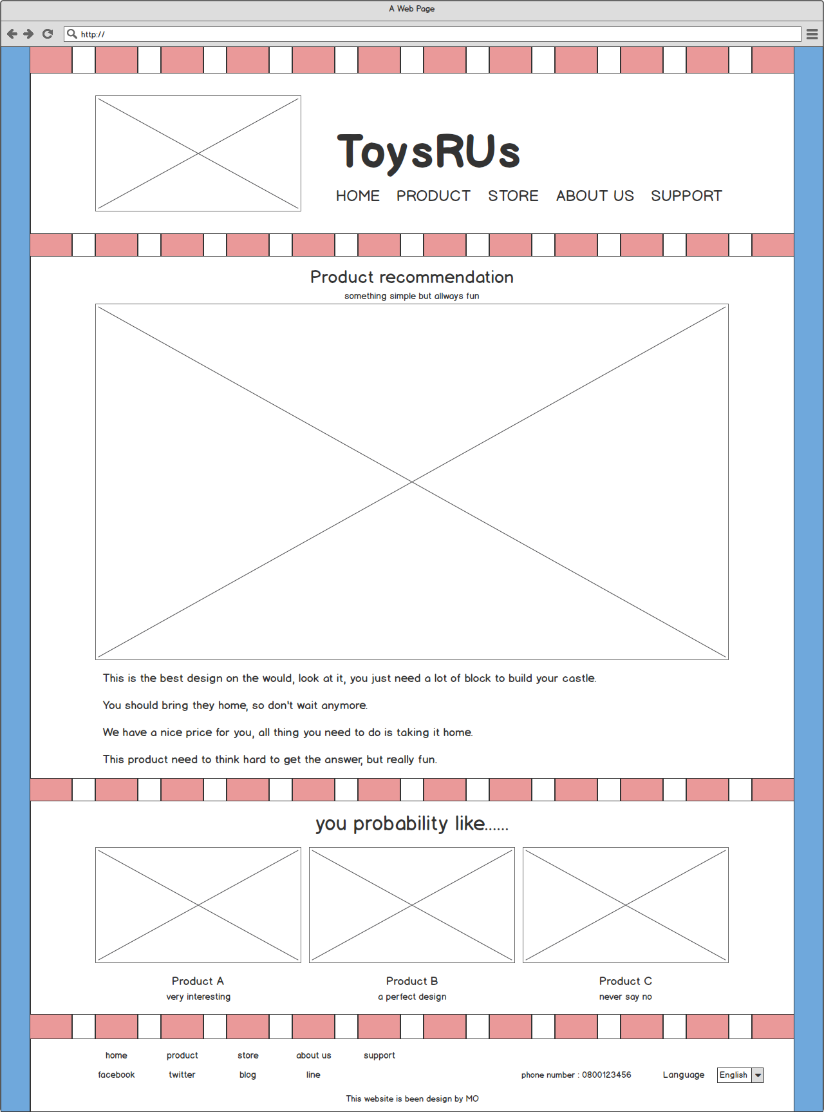
ToysRUs
HOME PRODUCT STORE ABOUT US SUPPORT
Product recommendation
Something simple but always fun
This is the best design on the would, look at it, you just need a lot of block to build your castle
You should bring they home, so don't wait anymore
We have a nice price for you, all thing you need to do is taking it home.
This product need to think hard to get the answer, but really fun.
you probability like……
Product A
Product B
Product C
very interesting
a perfect design
never say no
home
product
store
about us
support
facebook
twitter
blog
line
phone number : 0800123456
Language
This website is been design by MO

Slide 2
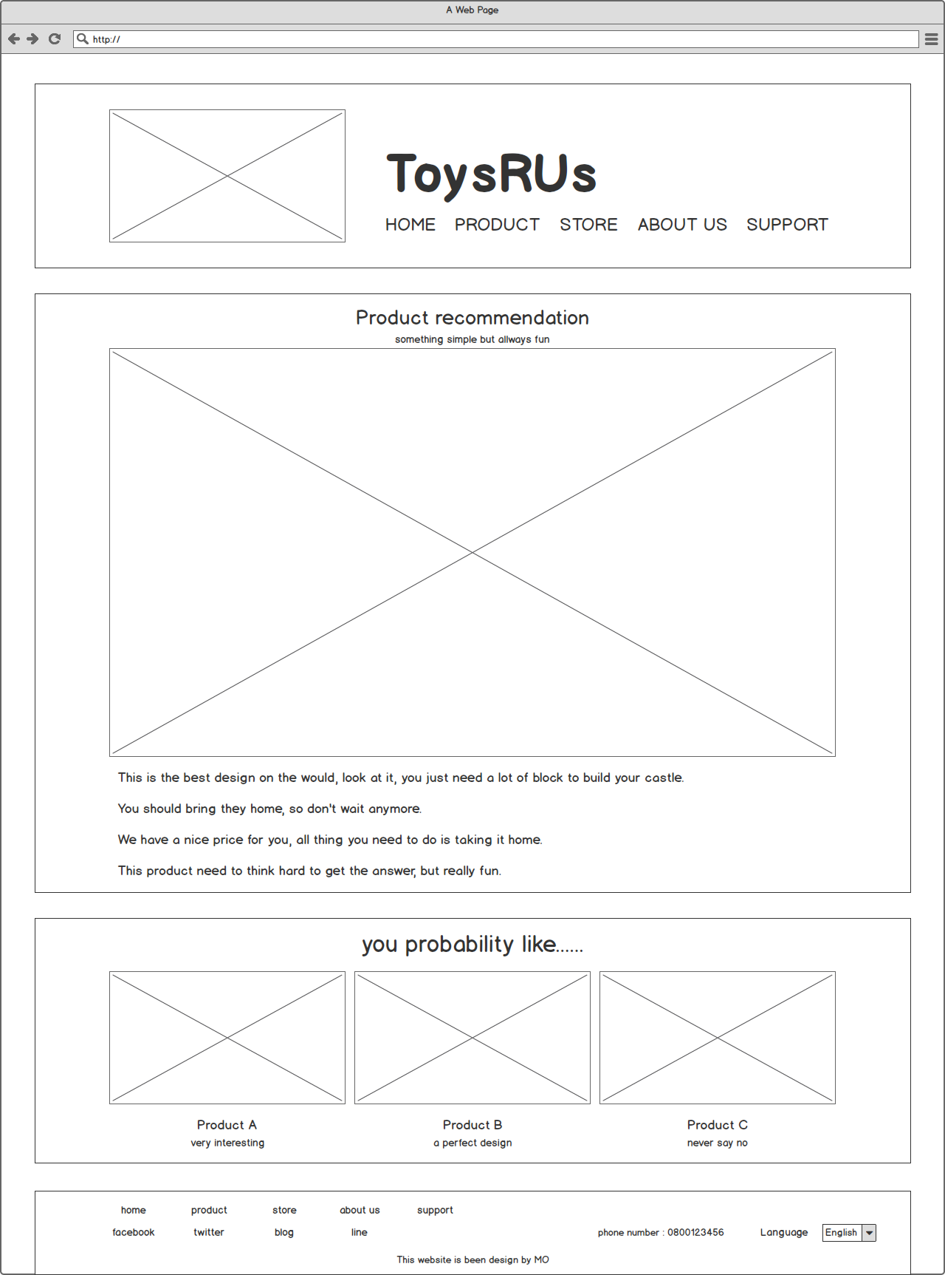
ToysRUs
HOME PRODUCT STORE ABOUT US SUPPORT
Product recommendation
Something simple but always fun
This is the best design on the would, look at it, you just need a lot of block to build your castle
You should bring they home, so don't wait anymore
We have a nice price for you, all thing you need to do is taking it home.
This product need to think hard to get the answer, but really fun.
you probability like……
Product A
Product B
Product C
very interesting
a perfect design
never say no
home
product
store
about us
support
facebook
twitter
blog
line
phone number : 0800123456
Language
This website is been design by MO

Slide 3

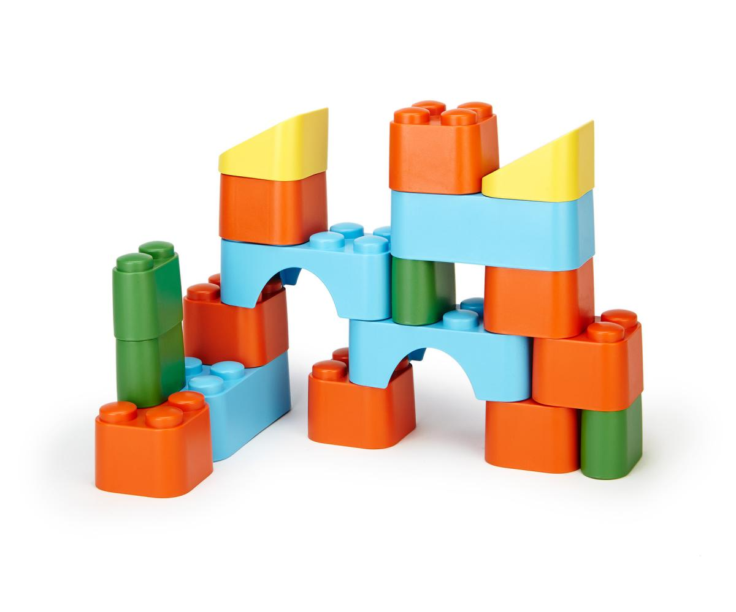

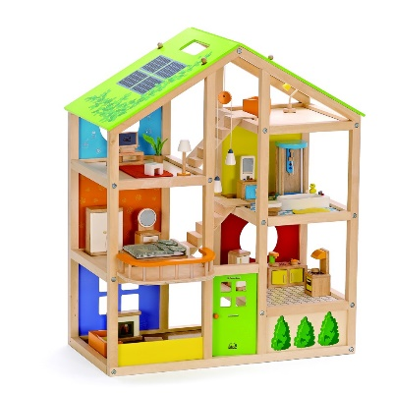
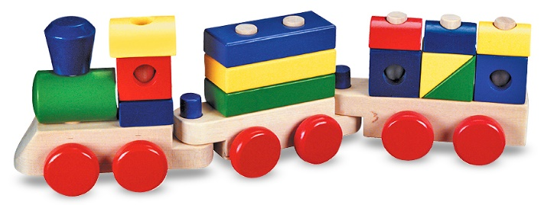
ToysRUs
HOME PRODUCT STORE ABOUT US SUPPORT
Product recommendation
Something simple but always fun
This is the best design on the would, look at it, you just need a lot of block to build your castle
You should bring they home, so don't wait anymore
We have a nice price for you, all thing you need to do is taking it home.
This product need to think hard to get the answer, but really fun.
you probability like……
Product A
Product B
Product C
very interesting
a perfect design
never say no
home
product
store
about us
support
facebook
twitter
blog
line
phone number : 0800123456
Language
This website is been design by MO

