Slide 1
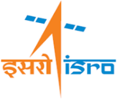
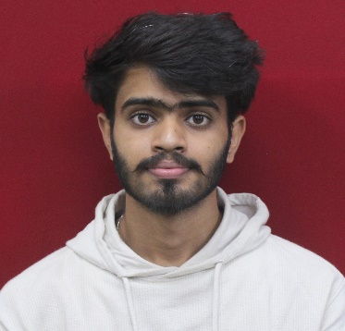
Project Title: FPGA-Controlled Infrared Imaging System
SRTD-RTMG-MISA
Name: Deepak Kumar
Designation: Trainee (Internship)
Institution: National Institute of Technology, Agartala
Guide: Dr. Sandip Paul
Contact e-mail: san@sac.isro.gov.in
PHOTO
MAJOR OBJECTIVES:
To develop an infrared imaging system using the ULIS 03 19 1 micro-bolometer. To design FPGA logic for synchronized control signal generation(RESET, INT, SERDAT, MC) and pixel data acquisition. Developing of Temperature Controlled Electronics Card for controlling detector internal temperature.
20 Jan 2025 to
7 July 2025
METHODOLOGY FLOW CHART:
RESULTS/MAJOR FINDINGS:
1. All nine detector biasing voltages were successfully generated using RHFL4913A LDOs.
2. FPGA logic (VHDL) was successfully implemented for detector interfacing and timing control.
3. Four key clocks—RESET, INT, MC, and SERDAT—were generated with precise synchronization.
4. Successfully captured detector data and reconstructed it into 12-bit per pixel thermal frames.
5. Made Setup of Temperature Control Card using MAX1978 IC for controlling Detector TEC.
IR Detector (ULIS 03 19 1 Micro-bolometer)
Bias and Power Supply Design
RHFL4913A LDOs 9 Voltages
Clock & Control Signal Generation (Using FPGA: MC, INT, RESET, SERDAT)
Detector Data Capture & Demultiplex (12-bit Pixel from 6-bit Bus)
CONCLUSION:
Temperature controlled electronics card Setup
The FPGA-controlled infrared imaging system was successfully implemented with verified biasing, clock generation, and 12-bit pixel reconstruction logic.
The temperature-controlled electronics card for the detector is ready, and the system is prepared for the next stage of offline image reconstruction

