Slide 1


Prioritizing P.B.I.s
A Machine Learning Approach
Written and developed by
Davide Mastricci

Slide 2
Index
Introduction to Scrum
Problem overview
Problem statement
Solution overview
Data Overview
Statistical Analysis
Normalization
Outliers Detection
Correlation
Modelling
Train and Test sets
Features Selection
Perceptron
Multilayer Perceptron
Models Evaluation
Models Comparison
Conclusions
A general approach to explore the dataset and acquiring knowledge

Slide 3
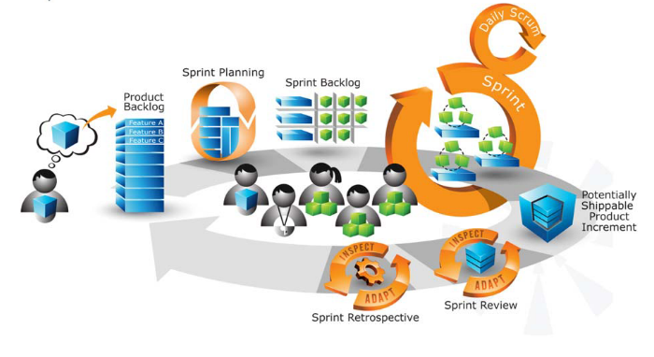
Introduction to Scrum
Agile software development framework
It's successful where classical methods fail
The process:
Product Backlog
Sprint planning
Sprint, Daily scrum
Sprint review
Sprint retrospective
Repeat
Scrum roles:
Product Owner
Scrum Master
Development team

Slide 4
Introduction to Scrum: Problem overview
Product Owner
The empowered central point of product leadership
Needs to look in at least two macro directions
Stakeholders, customers, users
Team
The grooming of the product backlog
Product Backlog
helps the product owner to break down the project
helps the development team and the product owner in planning next sprint
helps the product owner to checks the status of the project to manage economic of the project
Product Backlog Items (PBIs)
Users stories: As a [type of user], I want to [description of functionality]

Slide 5
Introduction to Scrum: Problem overview
The prioritization is a prediction based on a qualitative judgment assigned by the product owner that must be considered by several factors.
Staff involved in Scrum
CEO
Marketing department
Customers
If we go deeper and divide every aspect into its most elementary components…

Slide 6
Introduction to Scrum: Problem overview
Staff involved in Scrum
CEO
Level of understanding
Estimated working time
Technical complexity
Level of dependency with other PBIs
Time constraint
Level of reusability of PBI
Number of PBI priority revisions
Number of similar PBIs accomplished
Return on investment (ROI)
Level of impact on brand or reputation
Level of competitive advantage

Slide 7
Introduction to Scrum: Problem overview
Marketing Department
customers
Level of importance for the market, collected from social networks
Level of importance for the market, collected from interviews
Level of importance for customer 1
…
Level of importance for customer n

Slide 8
Introduction to Scrum: Problem statement
How can Product Owner make a good multidimensional analysis to make a good prioritization ?

Slide 9
Introduction to Scrum: Solution overview
My solution
State of art solutionS
I would propose a semi-automatic solution that combines the product owner's experience with one of :
Single-Layer Perceptron
Multi-Layer Perceptron (2-Layer)
This solution is able to consider n dimensions. The ultimate goal is to shape the thinking of the product owner using a machine learning model.
They use a simple multiplication of 2 or at most 3 features.
These methods put aside many aspects that should be kept in mind during the prioritization

Slide 10

Introduction to Scrum: Solution overview
Warning!
The choice of these models may not be the best, the purpose of this experiment is not to provide the best solution but rather to understand if this approach can produce some results

Slide 11
Data Overview
Dataset:
150 patterns (PBIs)
14 numerical features + 2 descriptive features
5 class (Priorities)
6 projects involved
3 different time periods

Slide 12
Data Overview
projects
Time periods
BANK
CINEMA
COMPANY
SCHOOL
SUPERMARKET
UNIVERISITY
BANK and CINEMA were completed in period t₁
COMPANY was completed in period t₂;
SUPERMARKET, SCHOOL and UNIVERISITY ware completed in period t₃

Slide 13

Data Overview: Features pt.1
NUMBER OF REVISION FOR THAT PBIs: $x≥0, x∈ℕ$
LEVEL OF REUSABILITY: $1≤ x≤\#\text{active} \text{projects}$, $x∈ℕ$
LEVEL OF UNDERSTENDING: $1≤x ≤\text{5}$, $x∈ℕ$
1 -> The PBI was understood at 0%
…
5 -> The PBI was understood at 100%
WORK TIME: $x≥0, x∈ℝ$
TECHINICAL COMPLEXITY: $1≤ x≤\text{5}$, $x∈ℕ$
1 -> VERY LOW, the PBI can be accomplished by beginner new developer without problems
…
5 -> VERY HIGH, the PBI can only be accomplished by senior developer

Slide 14

Data Overview: Features pt.2
TIME CONSTRAINT: $1≤ x≤\text{5}$, $x∈ℕ$
1 -> No urgency
…
5 -> Very high urgency
LEVEL OF DEPENDENCY WITH OTHER PBIs: $1≤ x≤\text{3}$, $x∈ℕ$
1 -> The PBI have not dependency with other PBIs
2 -> The PBI has some dependency with other PBIs bat it can be completed autonomously in large part
3 -> The PBI has a lot of dependency and it can't be completed before other PBIs are completed
NUMBER OF SIMILAR PBIs ACCOMPLISHED: $1≤ x≤\#\text{past} \text{project}\text{′}\text{s} \text{PBIs}$ , $x∈ℕ$
RETURN ON INVESTMENT: $1≤ x≤\text{5}$, $x∈ℕ$
1 -> the PBI has a ROI between 0% and 25%
…
5 -> the PBI has a ROI is over 100%

Slide 15
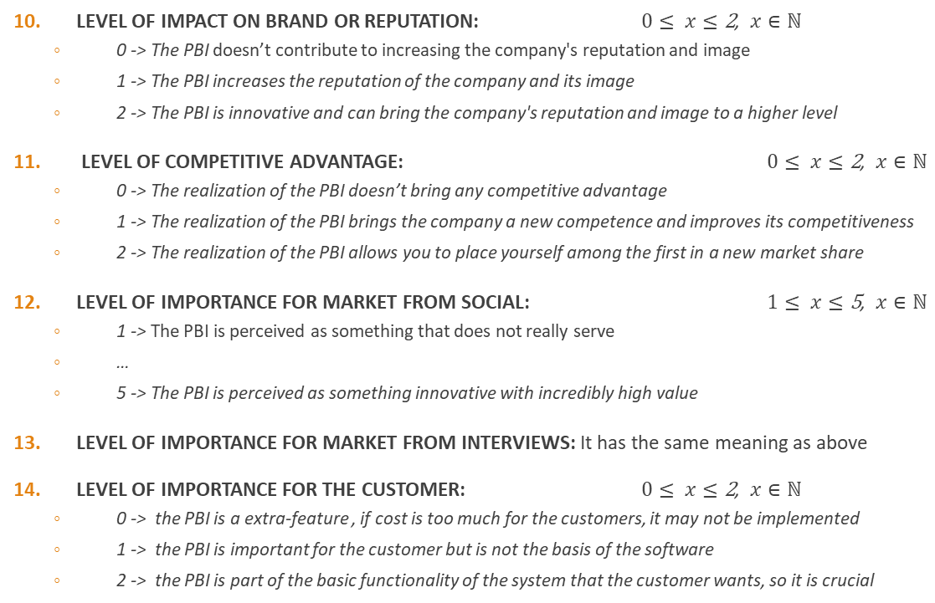
Data Overview: Features pt.3
LEVEL OF IMPACT ON BRAND OR REPUTATION: $0≤ x≤\text{2}$, $x∈ℕ$
0 -> The PBI doesn’t contribute to increasing the company's reputation and image
1 -> The PBI increases the reputation of the company and its image
2 -> The PBI is innovative and can bring the company's reputation and image to a higher level
LEVEL OF COMPETITIVE ADVANTAGE: $0≤ x≤\text{2}$, $x∈ℕ$
0 -> The realization of the PBI doesn’t bring any competitive advantage
1 -> The realization of the PBI brings the company a new competence and improves its competitiveness
2 -> The realization of the PBI allows you to place yourself among the first in a new market share
LEVEL OF IMPORTANCE FOR MARKET FROM SOCIAL: $1≤ x≤\text{5}$, $x∈ℕ$
1 -> The PBI is perceived as something that does not really serve
…
5 -> The PBI is perceived as something innovative with incredibly high value
LEVEL OF IMPORTANCE FOR MARKET FROM INTERVIEWS: It has the same meaning as above
LEVEL OF IMPORTANCE FOR THE CUSTOMER: $0≤ x≤\text{2}$, $x∈ℕ$
0 -> the PBI is a extra-feature , if cost is too much for the customers, it may not be implemented
1 -> the PBI is important for the customer but is not the basis of the software
2 -> the PBI is part of the basic functionality of the system that the customer wants, so it is crucial

Slide 16

Data Overview: Label
PRIORITY: $1≤ x≤\text{5}$, $x∈ℕ$
1 -> VERY LOW -> CLASS 1
…
5 -> VERY HIGH –> CLASS 5

Slide 17
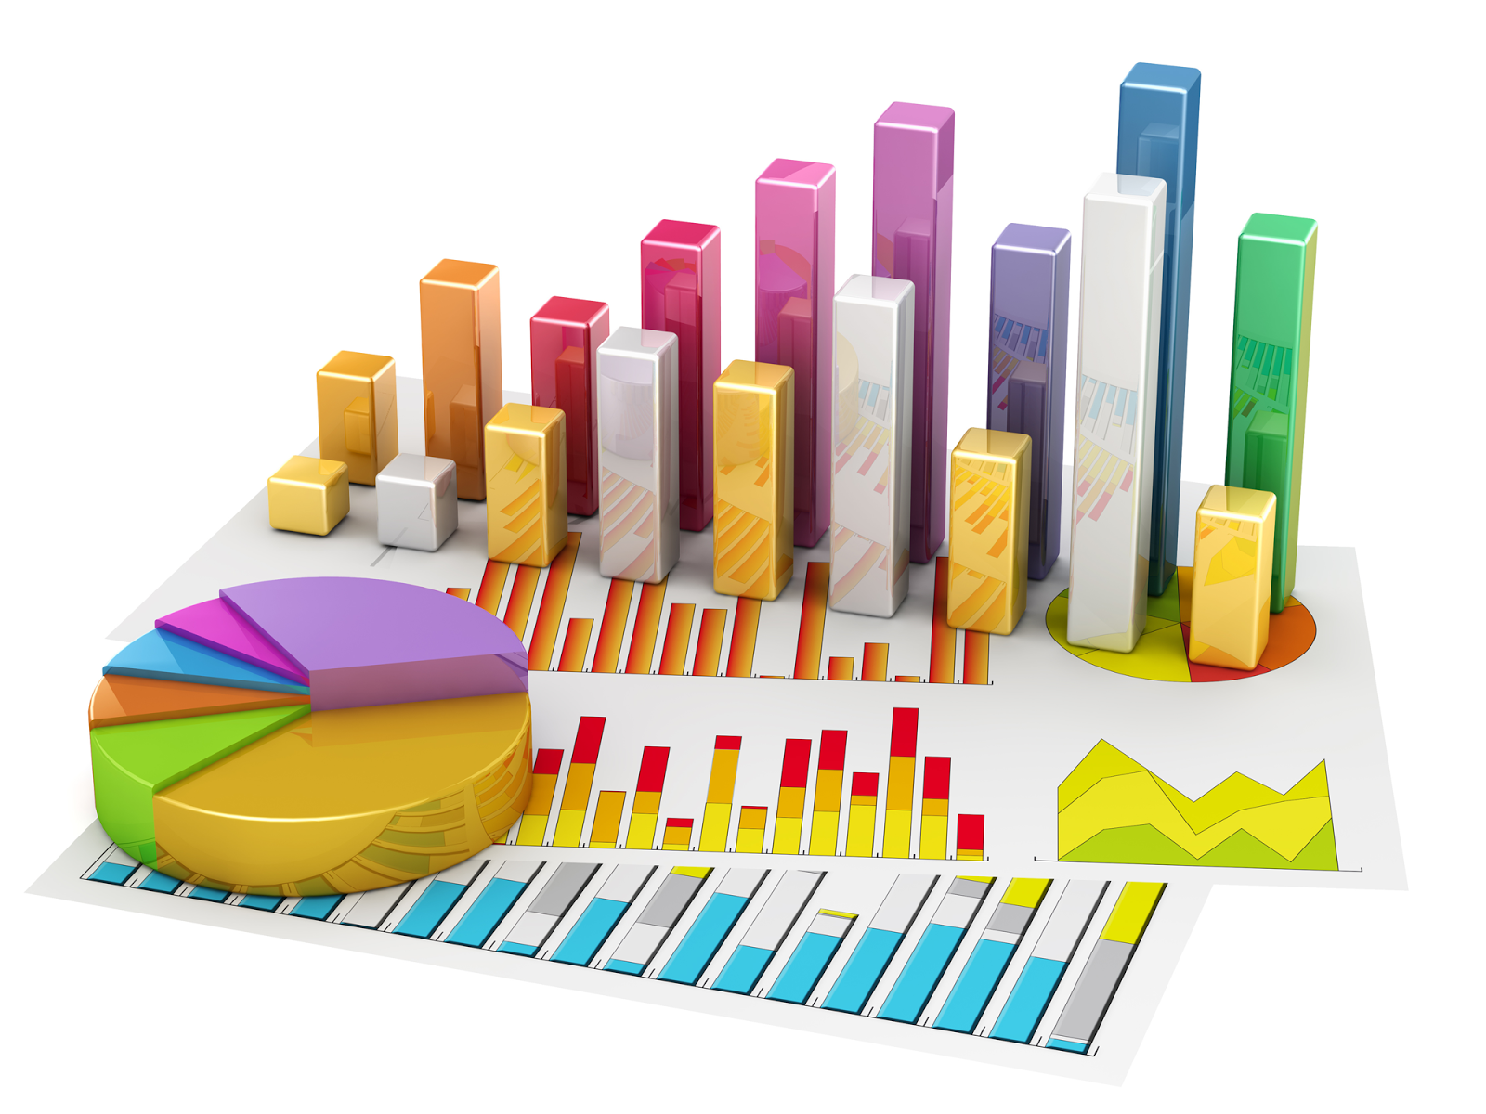
Statistical Analysis
To acquire knowledge exploring the dataset

Slide 18

Statistical Analysis : Normalization
$ẋ=\frac{\left(x −oldMin\right)×\left(newMax −newMin\right)}{oldMax −oldMin}+newMin,$
$x ∈\left[i;j\right],$
$ẋ∈\left[1;5\right],$
$oldMin=i oldMax=j,$
$newMin=1 newMax=5$

Slide 19
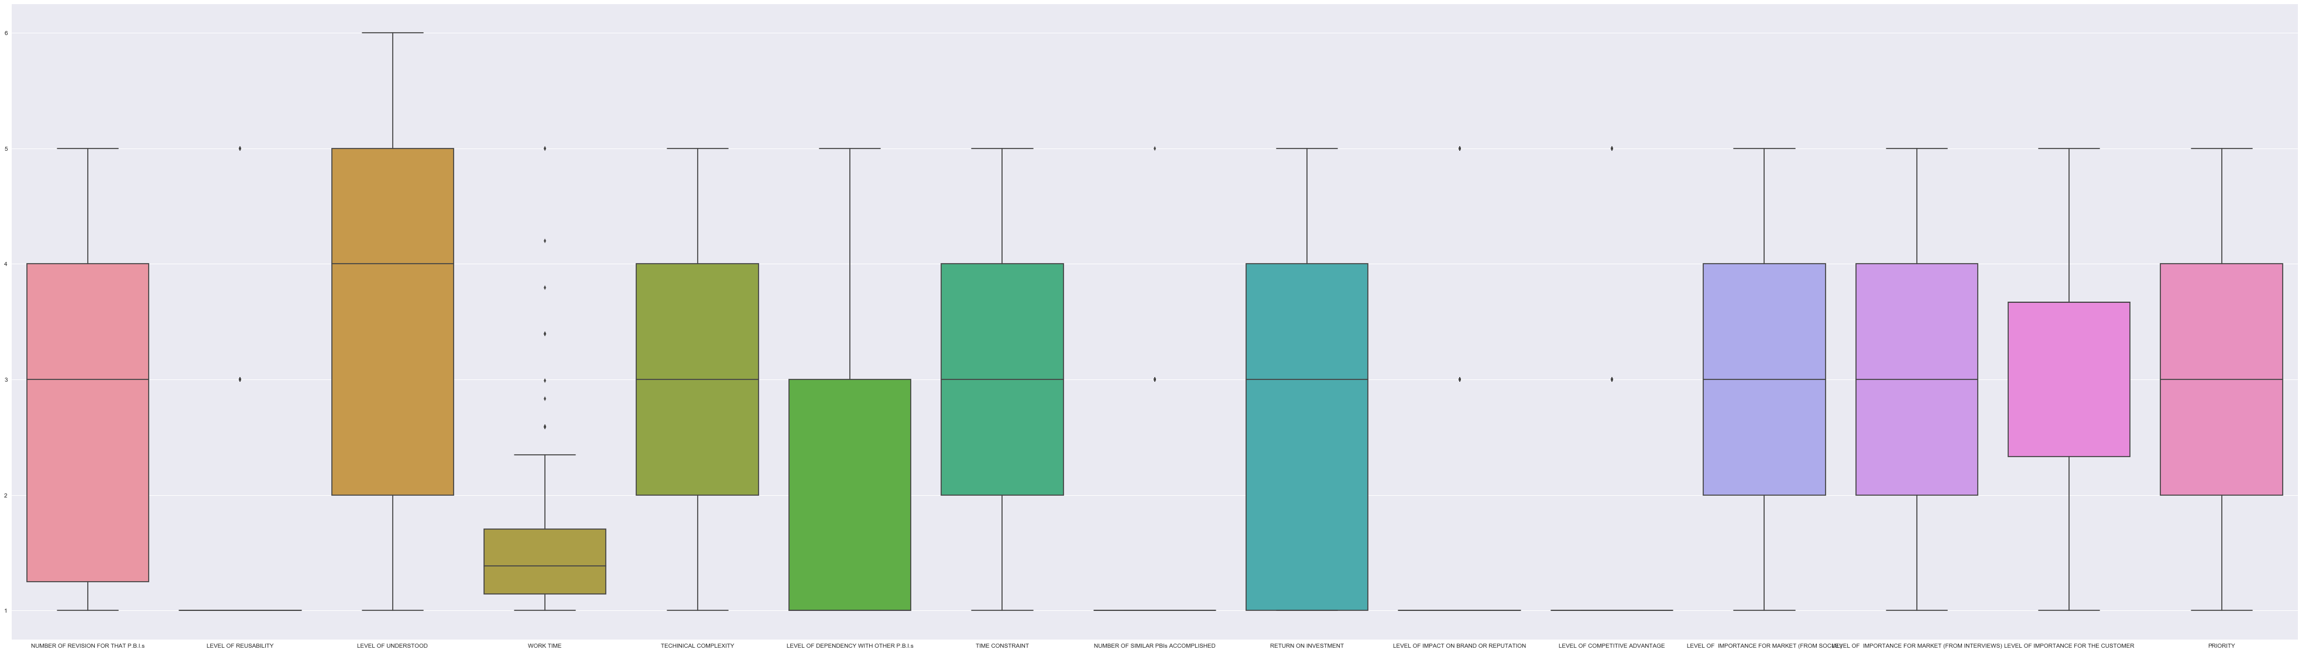
Statistical Analysis : Outliers detection
MOST CRITICAL FEATURES
LEVEL OF REUSABILITY | WORK TIME | NUMBER OF SIMILAR PBIs ACCOMPLISHED | LEVEL OF IMPACT ON BRAND OR REPUTATION | LEVEL OF COMPETITIVE ADVANTAGE

Slide 20
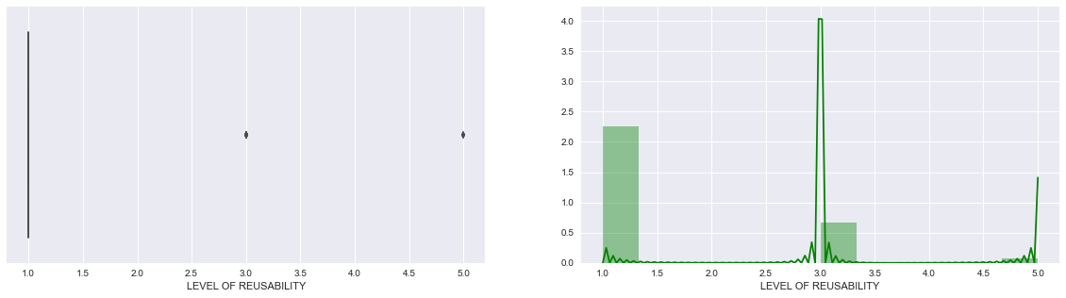
Statistical Analysis : Outliers detection Level of reusability pt.1
The number of PBIs that can be re-used in other projects is very low.

Slide 21
Statistical Analysis : Outliers detection Level of reusability pt.2
Now let's find out in which projects these outliers are present
The projects belong to t₃
It is plausible for SCHOOL and UNIVERSITY projects, which both are part of the educational field
The presence of the SUPERMARKET project indicates that PBIs with LEVEL OF REUSABILITY high aren't domain specifics but are generic.

Slide 22
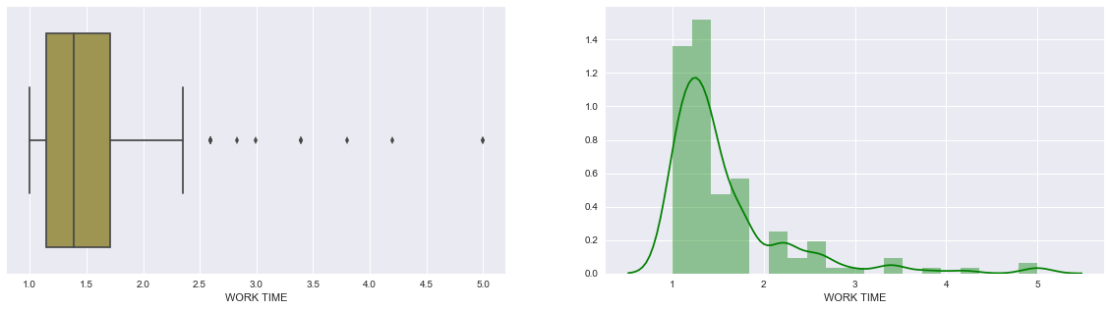
Statistical Analysis : Outliers detection Work time pt.1
These outliers indicate PBIs which require considerable effort to be accomplished

Slide 23
Statistical Analysis : Outliers detection Work time pt.2
The outliers are present in 4 over 6 projects and they belong to different t_{i}, so this may not be an anomaly

Slide 24
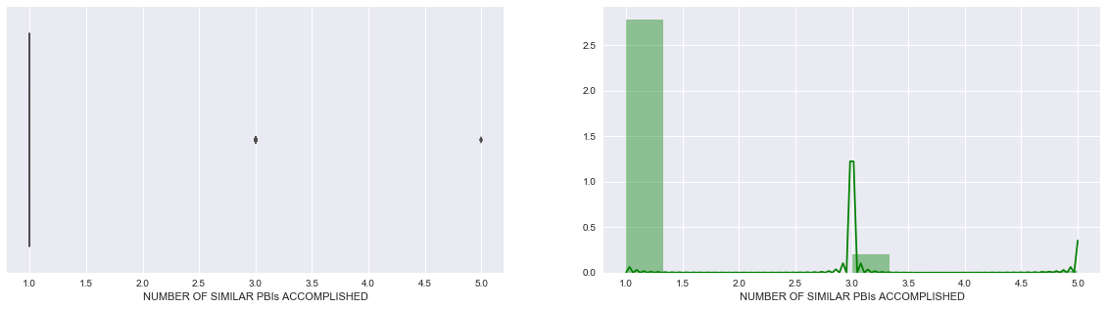
Statistical Analysis : Outliers detection Number of similar PBIs accomplished pt.1
From this plot we can see that are very rarely the cases where the experience matured on a past PBIs has been used to develop a similar PBI in another t_{i}

Slide 25
Statistical Analysis : Outliers detection Number of similar PBIs accomplished pt.2
Let’s see the projects which have been used the experience gained from past PBIs
All other projects appear (different from BANK and CINEMA), so these values aren’t abnormal but are plausible because the projects belonging to t₂ and t₃ have benefited from the past experience

Slide 26
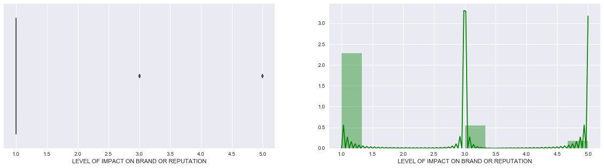
Statistical Analysis : Outliers detection Level of impact on brand or reputation pt.1
The PBIs which have affected the company image and reputation are very low, this is normal because, usually the companies do not have to deal every day with futuristic or incredibly innovative projects.

Slide 27
Statistical Analysis : Outliers detection Level of impact on brand or reputation pt.2
The values grater than 1.0 are present in all projects, this may indicate that the company has succeeded in bringing innovation to every project.
Now it would be interesting to understand which project is the most innovative considering the number of PBIs and hence its size.

Slide 28
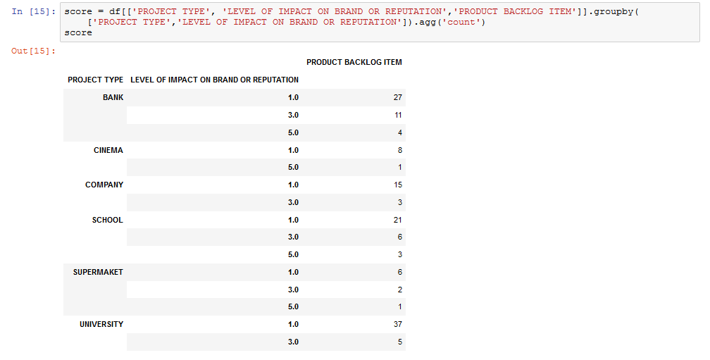

Statistical Analysis : Outliers detection Level of impact on brand or reputation pt.3
BANK with $\frac{15}{42}≈36\%$
SUPERMARKET with $\frac{3}{9}≈33\%$
SCHOOL with $\frac{9}{30}=30\%$
COMPANY with $\frac{3}{18}≈17\%$
UNIVERSITY with $\frac{5}{42}≈12\%$
CINEMA with $\frac{1}{9}≈11\%$

Slide 29
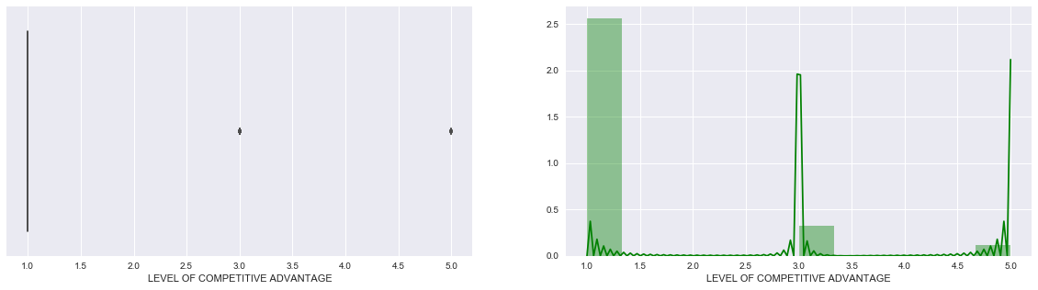
Statistical Analysis : Outliers detection Level of competitive advantage pt.1
The interpretation that we can give to the histogram, is that the number of PBIs, which improve the competitive advantage of the company very low, this is normal because, usually the projects have few incredible functionalities and a lot of common and normal functionalities

Slide 30
Statistical Analysis : Outliers detection Level of competitive advantage pt.2
In this histogram we can see how PBIs that increase the level of competitiveness are present in all projects, with a greater preponderance in the BANK project.
Let's try to understand which project have improved the level of competitiveness

Slide 31
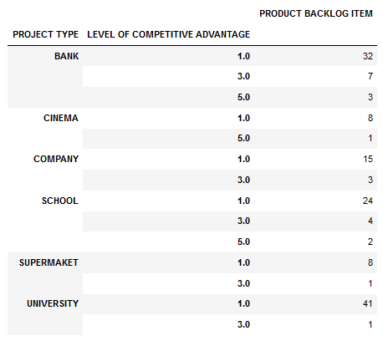

Statistical Analysis : Outliers detection Level of competitive advantage pt.3
BANK with $\frac{10}{42}≈24\%$
SCHOOL with $\frac{6}{30}=20\%$
COMPANY with $\frac{3}{18}≈17\%$
CINEMA and SUPERMARKET with $\frac{1}{9}≈11\%$
UNIVERSITY with $\frac{1}{42}≈2\%$

Slide 32
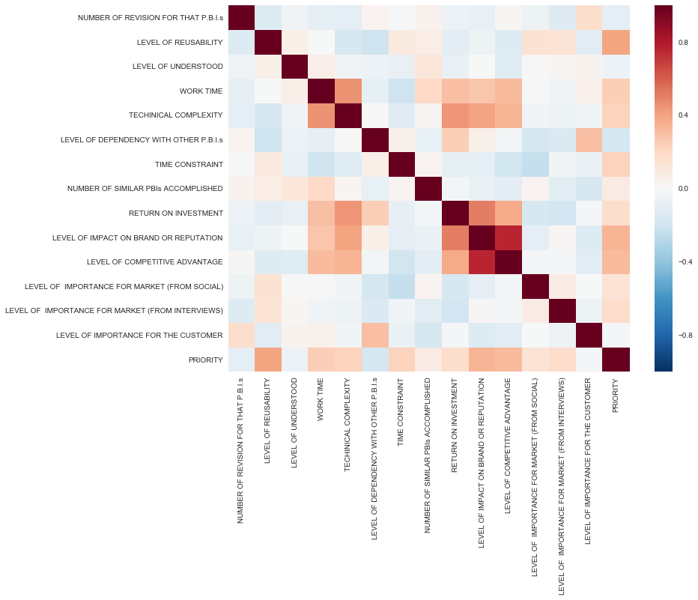
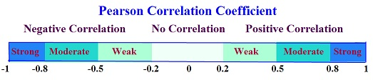
Statistical Analysis : Correlation
FEATURE 1 | FEATURE 2
LEV. OF IMPACT ON BRAND … | LEV. OF COMP. ADVAN. | S
LEV. OF IMPACT ON BRAND … | ROI | M
ROI | TECH. COMP. | M
TECH. COMP. | WORK TIME | M
PRIORITY | LEV. OF REUSABILIY | M

Slide 33

Modelling: Train and Test sets
$Train∩Test=∅$
$Train∪Test=Full Dataset$
$\left|Train\right|=100$ chosen randomly
$\left|Test\right|=50$ chosen randomly

Slide 34
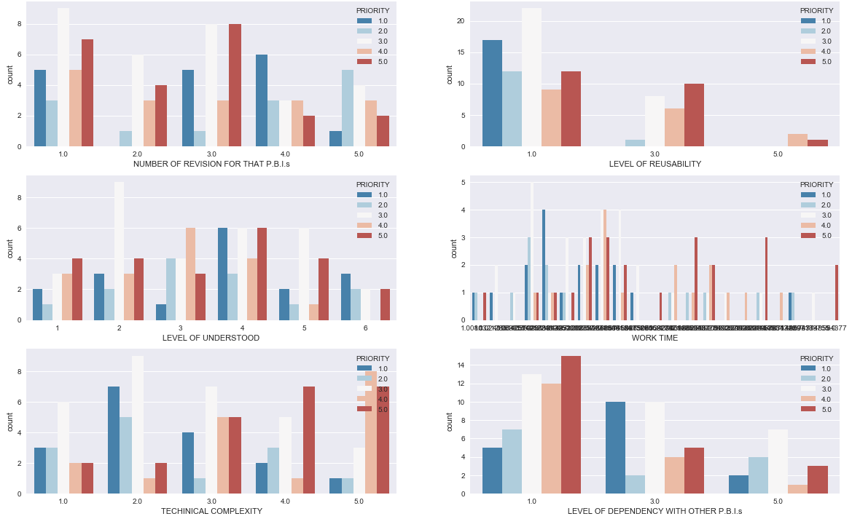
Modelling: Features selection- 1-feature visual selection pt.1
Performed on training set

Slide 35
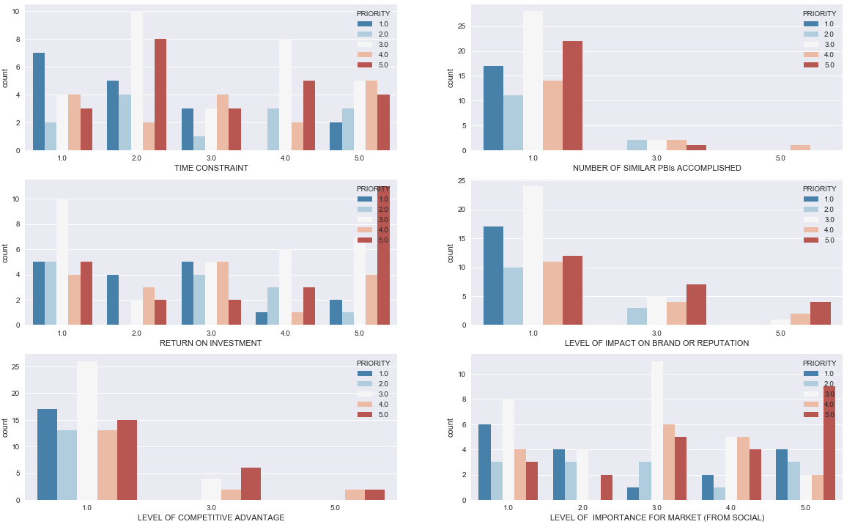
Modelling: Features selection- 1-feature visual selection pt.2

Slide 36
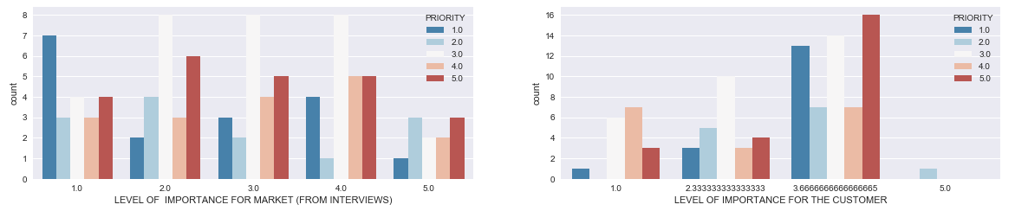
Modelling: Features selection- 1-feature visual selection pt.3

Slide 37
Modelling: Features selection Strategy
The number of plots grows exponentially with the number of features used and we can’t plot over the 3rd dimension, so visual selection can not be used
So, I used recursive feature elimination (RFE) strategy
SVM with linear kernel, is the estimator
The limits of the subset are 3, 7 and 10 to reduce number of experiment
At the end, for each model chosen I have implemented 3 variants, one for each features selection, for a total of 6 models

Slide 38
ALL FEATURES | BEST 3 | BEST 7 | BEST 10
NUMBER OF REVISION FOR THAT PBIs |  |  | X
LEVEL OF REUSABILITY | X | X | X
LEVEL OF UNDERSTENDING
WORK TIME |  | X | X
TECHINICAL COMPLEXITY |  | X | X
TIME CONSTRAINT |  | X | X
LEVEL OF DEPENDENCY WITH OTHER PBIs
NUMBER OF SIMILAR PBIs ACCOMPLISHED |  | X | X
RETURN ON INVESTMENT
LEVEL OF IMPACT ON BRAND OR REPUTATION | X | X | X
LEVEL OF COMPETITIVE ADVANTAGE | X | X | X
LEVEL OF IMPORTANCE FOR MARKET FROM SOCIAL |  |  | X
LEVEL OF IMPORTANCE FOR MARKET FROM INTERVIEWS
LEVEL OF IMPORTANCE FOR THE CUSTOMER |  |  | X

Slide 39
Modelling: Perceptron Pre-processing
ONE-HOT ENCODING
PRIORITY 1 [1,0,0,0,0]
PRIORITY 2 [0,1,0,0,0]
PRIORITY 3 [0,0,1,0,0]
PRIORITY 4 [0,0,0,1,0]
PRIORITY 5 [0,0,0,0,1]

Slide 40
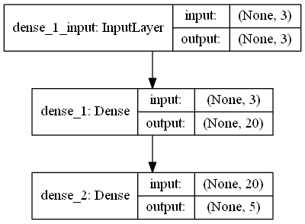
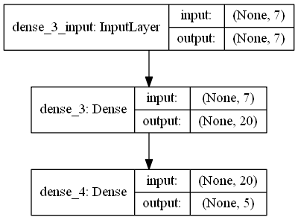
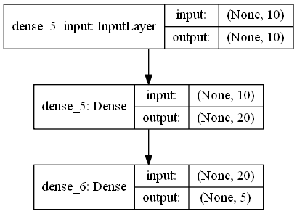
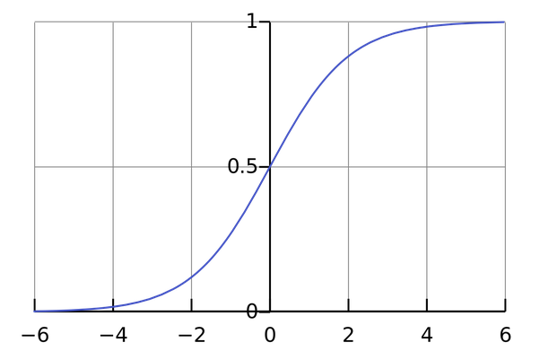
Modelling: Perceptron Models details pt.1

Slide 41
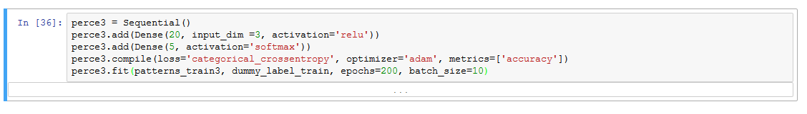
Modelling: Perceptron Models details pt.2

Slide 42
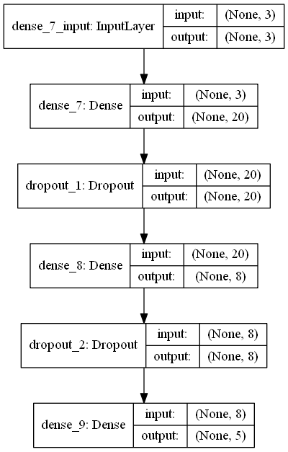
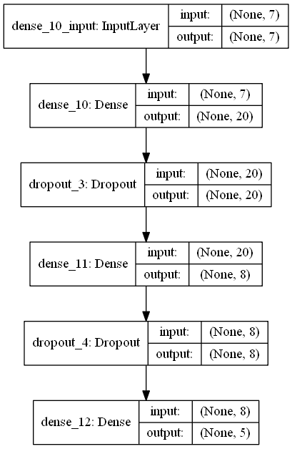
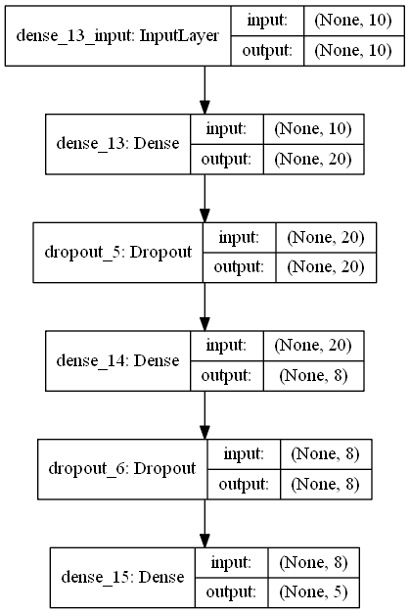
Modelling: Multi-Layer Perceptron Models details pt.1

Slide 43
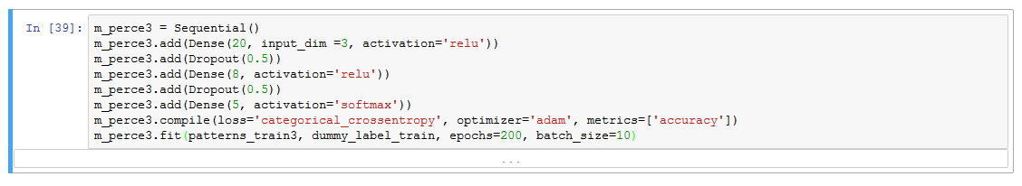
Modelling: Multi-Layer Perceptron Models details pt.2

Slide 44
Modelling: Models Evaluation
MODEL | ACCURACY
3-FEATURES PERCEPTRON | 36%
7-FEATURES PERCEPTRON | 46%
10-FEATURES PERCEPTRON | 38%
3-FEATURES MLP | 30%
7-FEATURES MLP | 34%
10-FEATURES MLP | 32%

Slide 45
Modelling: Models Comparison
In this, case single-layer perceptron has slightly better than MLPs
About the accuracy:
Are present features with outliers
The data are written from scratch
Classical perceptron is a binary classifier
SVM, Random Forest or other multivariate ML could improve accuracy

Slide 46
Modelling: Models Comparison Conclusions
Product Owner can use 7-Features Perceptron:
This process eliminates the first prioritization iteration
46% of PBIs are well-prioritized, but which ones?
The experience of the Product Owner must have the last word
The purpose of this approach wasn't to make the prioritization process automated, but to provide support to the product owner, this help is realized by the creation of a prioritization basis that will be exactly for 46%

Slide 47

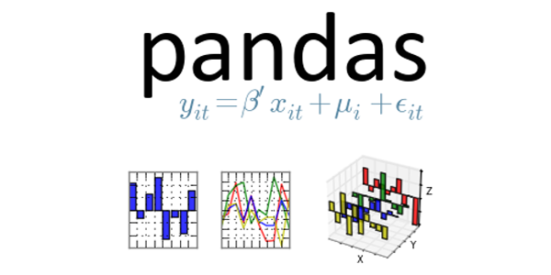
A general approach to explore the dataset and acquiring knowledge pt.1
Have a question to answer
Collect Data
Organization
Sensors or document
Emulate or write the data from scratch
Understand the meaning of the data and acquire knowledge of the domain
Interviews
Read book or document about the domain
Follow courses
Explore the dataset
Normalization
Find out missing or wrong data
Find out outliers (boxplot)
Correct or try to explain outliers
Covariance and Correlation can pull off linear links
Other visualization techniques (look at Seaborn documentation)

Slide 48


A general approach to explore the dataset and acquiring knowledge pt.2
If you have to deal with Machine Learning
Key Slogan: «Test it»
Do Features Selection
Pre-processing
Split the dataset
Choose (and use) a model
Post-processing
Evaluate the model
Arrange all the information in a document to expose the results

Slide 49
Thanks for the attention

