Slide 1
DBMS SYSTEM DESIGN DOCUMENT
PRITHVI CHANCHAL(B200854CS)
DIVYANG JAIN(B200826CS)
LAKSHMI S(B200700CS) FALGUNI BISWAS(B200784CS) NAAZNI YAHYA(B200696CS)
GROUP - 18

Slide 2
Table of Contents
1. Purpose....................................................................................................................
1.1
1.2
1.3
1.4
1.5
Document Objectives....................................................................................................................
Intended Audience........................................................................................................................
Acronyms and Abbreviations ........................................................................................................
Key Personnel ..............................................................................................................................
Data Owners.................................................................................................................................
2. Assumptions, Constraints and Dependencies........................................................
2.1
2.2
Assumptions.............................................................................................................................
Constraints ...................................................................................................................................
3. System Overview ............................................................................................................
3.1
3.2
3.3
Database Management System Configuration ..............................................................................
Database Software Utilities ...........................................................................................................
Support Software ..........................................................................................................................
4. Architecture ...................................................................................................................
4.1
4.2
4.3
Hardware Architecture ..................................................................................................................
Software Architecture....................................................................................................................
Datastores ....................................................................................................................................
5. Database-Wide Design Decisions ...............................................................................................
5.1
5.2
5.3
5.4
5.5
5.6
Interfaces......................................................................................................................................
Key Factors Influencing Design ....................................................................................................
Security and Availability ................................................................................................................
Distribution....................................................................................................................................
Backup and Restore Operations ...................................................................................................
DBMS Platform .............................................................................................................................
6. Database Administrative Functions..................................................................................
6.1
6.2
6.3
6.4
6.5
6.6
Responsibility .............................................................................................................................
Schema Information...................................................................................................................
Schema Description...................................................................................................................
Physical Design ..........................................................................................................................
Physical Structure.......................................................................................................................
Database Identification ...............................................................................................................

Slide 3
6.7
6.8
6.9
Cardinality Ratio / Mapping Rules...............................................................................................
Operational Implications .............................................................................................................
Normalized Schema .............................................................................................................
7. Detailed Database Design...........................................................................................................

Slide 4
1. PURPOSE
The purpose of the Design phase is to plan a solution for the problem specified by the requirements. System design aims to identify the modules that should be in the system, the specification of those modules and how they interact with each other to produce the results. The goal of the design process is to produce a model that can be used later to build that system. The produced model is called design of the system. System design is the process of defining the architecture, components, modules, interfaces and data for a system to satisfy specified requirements. Normally, the design proceeds in two stages:
• Physical design • Database design
1. Document Objectives
The Database Design Document has the following objectives:
To describe the design of a database, that is, a collection of related data stored in one or more computerized files that can be accessed by users or computer developers via a DBMS.
To serve as a basis for implementing the database and related software units. It provides the acquirer visibility into the design and provides information necessary for software development.
2. Intended Audience
This document is intended for the following audiences:
Technical reviewers, who must evaluate the quality of this document.
Developers including:
Architects, whose overall architecture design must meet the requirements specified in this document.
Designers, whose design must meet the requirements specified in this document.
Developers, whose software must implement the requirements specified in this document.
Quality Assurance personnel, whose test cases must validate the requirements specified in this document.
3. Acronyms and Abbreviations
Acronym / Abbreviation | Meaning
RDMS | Relational Database Management System
DBA | Database Administrator

Slide 5
4. Key Personnel
Role | Name | Email Address | Phone Number
DBA | Prithvi Chanchal | prithvi23@gmail.com | 6345275639
DBA | Divyang Jain | divyang12@gmail.com | 8107052862
5. Data Owners
Type of Data | Name | Email Address | Phone Number
MYSQL | Naazni Yahya | naazni1@gmail.com | 3456543748
MYSQL | Falguni Biswas | falguni11@gmail.com | 7865436785
MYSQL | Lakshmi S | lakshmi221@gmail.com | 6576578678
2. Assumptions, Constraints and Dependencies
1. Assumptions
Offline patients will be taken care separately and there is different system to manage data of the offline patient.
Offline patient's database will be managed by the staff of the Hospital itself.
If a patient comes directly to doctor in offline mode i.e. without prior appointment then it is up to the doctor to accept them and it won’t affect the online appointment.
Patients will apply for an appointment and doctor will get the request, after that he will decide whether to accept it or not.
Doctor will finalise the appointments only if he has free slots. Appointments will be finalise by doctor itself. There is no role of third party into that.
As the appointment is confirmed, it is assumed that the patient has paid the money and it will be recorded in the database.
Adding/deleting/updating entries in the database will be done by Admin only.
Admin is handling entries of departments, doctors and patients.
Every Doctor has fix consultation charge which is 500RS per appointment.
Account section handles if a patient has paid for the appointment or not.
An admin is there in the hospital which is managing the Hard Copy of the database.
2. Constraints
Payment and billing is not handled in our database
Appointments are handled by Doctors, not by receptionist.

Slide 6
3. System Overview
1. Database Management System Configuration
Vendor | Product | Version
Intel | Processor | Intel core i7
Asus | RAM | 16 GB
Seagate | Hard disk | 1TB
2. Database Software Utilities
Vendor | Product | Function
IBM | SQL | Manages data in the Relational Database Management System
3. Support Software
Vendor | Product | Function
MIT | Express.js | backend development JavaScript Framework
Meta | React.js | front-end JavaScript library for building user interfaces based on UI components.
MIT | Node.js | back-end JavaScript runtime environment that runs on a JavaScript Engine

Slide 7
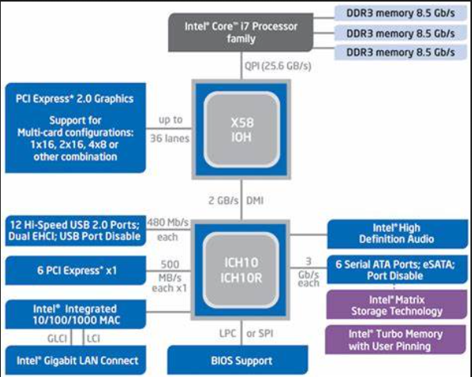
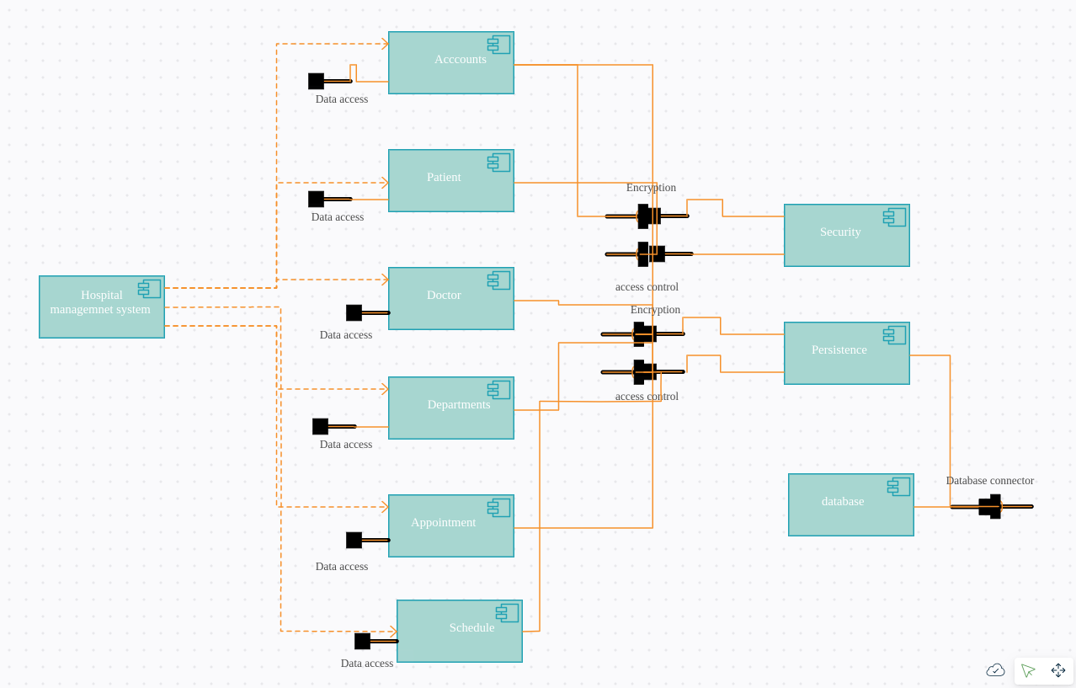
4. Architecture
1. Hardware Architecture
Windows 11 Home
Intel® Core™ i7-11800H processor
16 GB standard memory
512GB solid state drive
15.6" Full HD (1920 x 1080) resolution IPS display
NVIDIA GeForce RTX 3060
2. Software Architecture
Component Diagram for Hospital Management System - The diagram showcase how the
hospital management is linked within the system

Slide 8
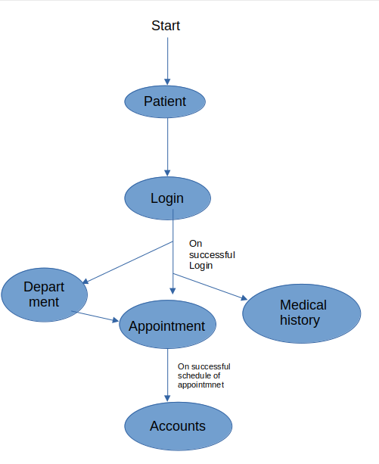
3. Datastores
NTFS or New Technology File System. NTFS supports disk usage quotas. These quotas are set by an administrator to restrict the amount of disk space that a user can take up. It's used mainly to control the amount of shared space someone can use, usually on a network drive.
5. Database-Wide Design Decisions
1. Interfaces

Slide 9
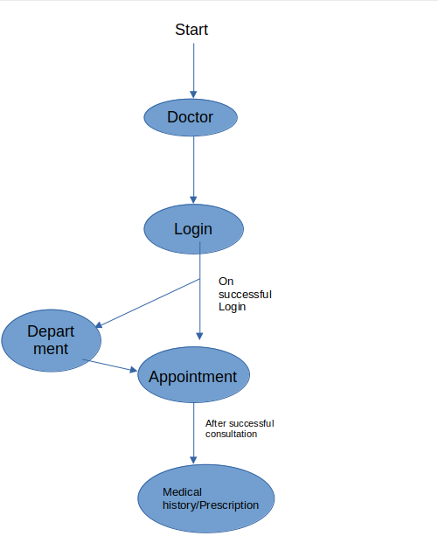
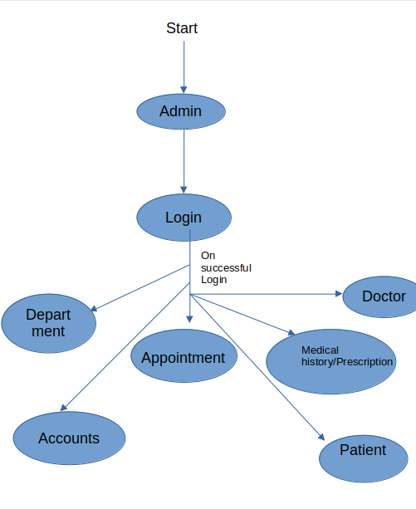

Slide 10
2. Key Factors Influencing Design
The Hospital Database Management system aims to target 3 modules :
User Module
The User registers in the portal and maintains his profile. User can access his/her medical history. The appointments can be booked according to doctor’s schedule.
Doctor Module
Every Doctor is registered in their concerned department. The diagnosis and prescription for every appointment is duly maintained.
Admin Module
The Admin maintains the registry of all Doctors, Departments and Patients.
Account Module
For every successful appointment, an account is created for the patient in which his payment will be recorded as paid.
The non-functional requirements for the database is as follows:
1. The database shall be able to accommodate around thousand records to store.
2. The software shall support the use of multiple users at a time.
3.The database may get crashed at any certain time due to viruses or operating system failure. Therefore, it is required to take the Database Backup.
To protect the software from accidental or malicious access, use, modification, destruction, or disclosure;
1. Keep a specific log or history of data sets
2. Restrict communications between some areas of the program
3. Check data integrity for critical variables
4. Later version of the software will incorporate encryption
5. Techniques in the user/license authentication process.

Slide 11
3. Security and Availability
ACCESS CONTROL
Doctors can’t access payment of a patient.
Admin manages the whole database.
If Appointment Status if true then only the patient can see doctor and the have to pay fees which is handled by accountant.
Domain Constraint
Entity Integrity Constraints
Referential Integrity Constraints
Key Constraints
INTEGRITY CONSTRAINT
4. Distribution
Our Database is a centralized Database. A Centralized Database is basically a type of database that is stored ,located as well as maintained at a single location only.
5. Backup and Restore Operations
The database is backed up on weekly basis on the centralized server of the hospital with encryption. If we want to restore any data from this backed up database we have to know the encryption key.
6. DBMS Platform
SQL(MySQL)
6. Database Administrative Functions
1. Responsibility
Role | Name | Responsibility | Email Address
Database Administrator | Akash Chopra | Maintains the database and is responsible for change in the structure. | akashchopra@gmail.com
System Administrator | Edward Steward | He is responsible for maintaining the central server where the database is stored. | edward123@gmail.com
Security Administrator | Abhay Sethhy |  | abhaygalaxy21@gmail.com

Slide 12
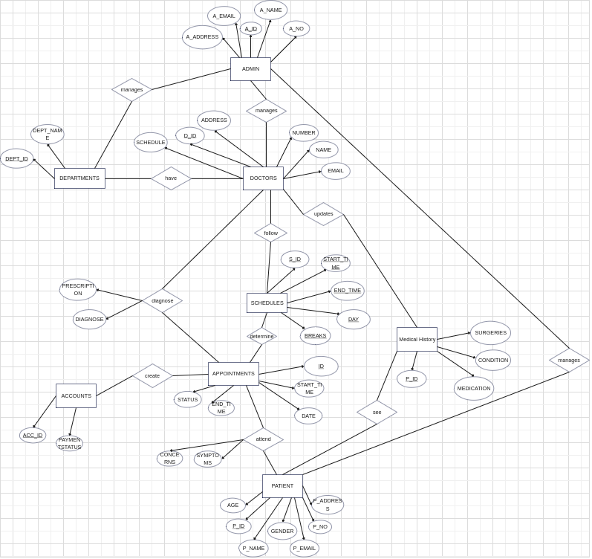
2. Schema Information
1
1
1
1
1
1
N
N
1
1
1
M
M
N
N
1
N
1
N
1
1
1
Cardinality is specified in CARDINALITY RATIO point.

Slide 13
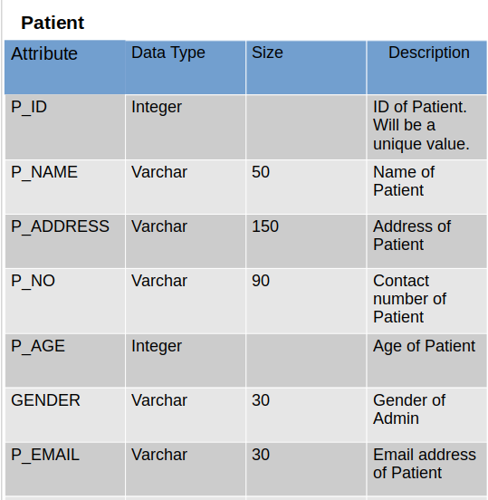
3. Schema Description
a)

Slide 14
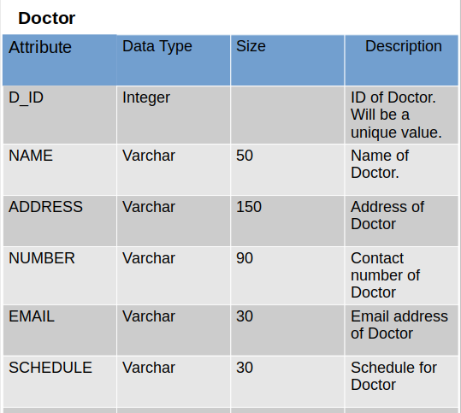
b)

Slide 15
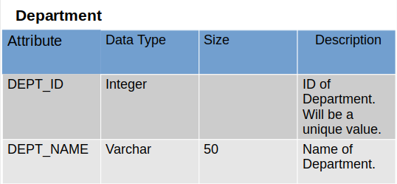
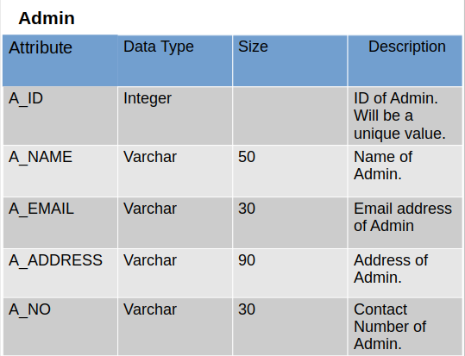
c)
d)

Slide 16
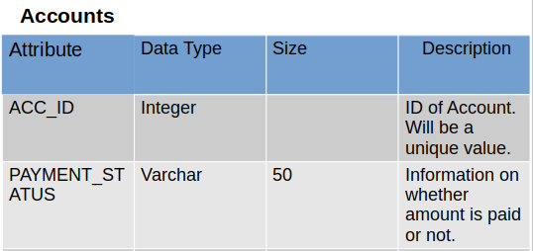
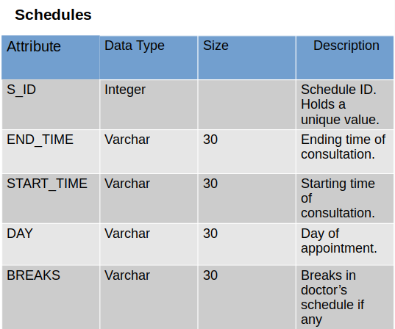
e)
f)

Slide 17
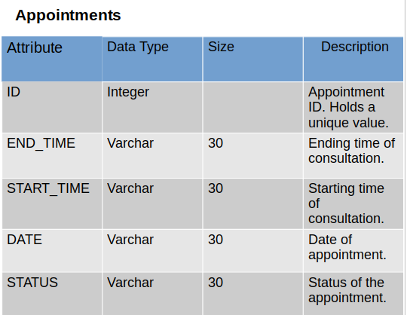
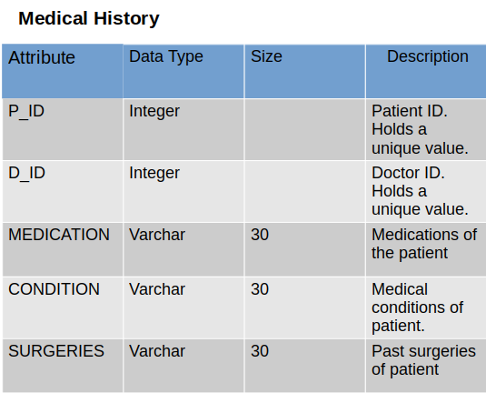
g)
h)

Slide 18
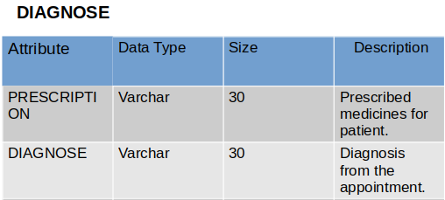
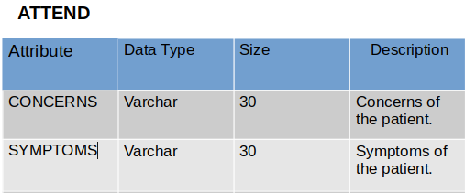
i)
j)

Slide 19
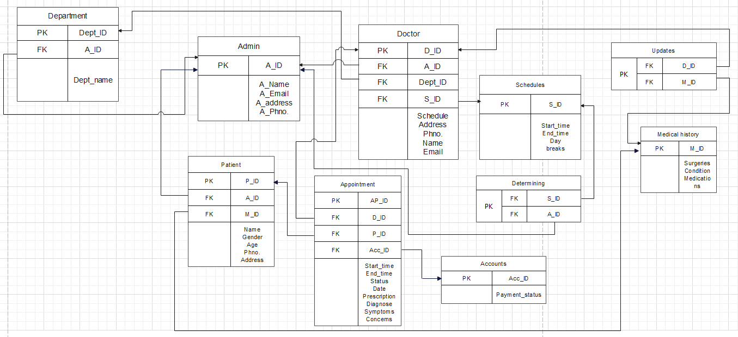
4. Physical Design

Slide 20
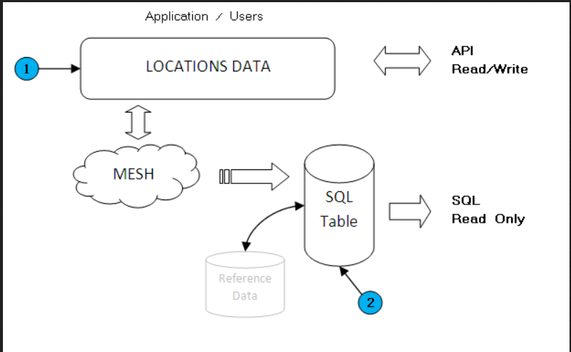
5. Physical Structure
6. Database Identification
Element | Element Name | Description
HMS | Hospital Management System | The name the database was given as it is based on the Hospital Management System.

Slide 21
7. Cardinality Ratio / Mapping Rules
Admin : Department = 1 : 1
Admin : Doctor = 1 : 1
Admin : Patient = 1 : 1
Department : Doctor = 1: N
Doctor : Appointments = 1: N
Doctor : Schedule = 1 : 1
Schedule : Appointments = M : N
Doctor: Medical History = M : N
Patient: Medical History = 1 : 1
Patient : Appointments = 1 : N
Account : Appointments = 1 : N
8. Operational Implications
Database will be well maintained and updated on a weekly basis.
It is secured by a encrypted key within the hospital server.
As the entry is stored, it will be updated immediately.
A hard copy of the database will be stored in the server and will be maintained by the Hospital Server management Admin.
We can recover the database by using the hard copy.
The storage capacity will be determined on the basis of number of entries in all the mentioned entities.
9. Normalized Schema
1NF : This relation is in 1NF Because it contains an atomic value.
2NF : This relation will be in 2NF because it is in 1NF and all non-key
attributes are fully functional dependent on the primary key.
3NF : This relation is in 3NF because it is in 2NF and no transition
dependency exists.
BCNF : The relation is in 3NF, and for every FD, LHS is super key.

Slide 22
7. Detailed Database Design
A hospital management information system (HMIS) is an element of health informatics that focuses mainly on the administration needs of hospitals. The database has 8 entities - Patient, Doctor, Admin, Account, Appointments, Schedule, Departments, and Medical History. The entity Patient holds basic information about all registered patients. The entity includes attributes - Name, Age, P_ID, Gender, Email, Phone number, and Address. The next entity is Doctor. This entity holds information about all doctors working at the hospital. Information includes name, contact details, and a unique ID. The third entity is the Department, which lists all the hospital's departments. There is an entity for Admins also and it holds information about the staff working in administration. The entity Schedules helps schedule appointments, and the entity Appointment contains details about each appointment. The entity accounts manage the finance side of the hospital. There is also a separate entity to hold each Patient’s medical history which can be edited by doctors as needed. The Doctor has relations with the Department, Medical History , Schedules, and Appointment. This helps schedule appointments with patients and record diagnosis and any remarks after consultation. The accounts entity has a relation with appointments to be able to bill each successful consultation.
.

