Slide 1







Processing
Analysis
Selection
Result
Discussion
PIXNET
林冠宇F14046012 吳竣淵 C54051178

Slide 2
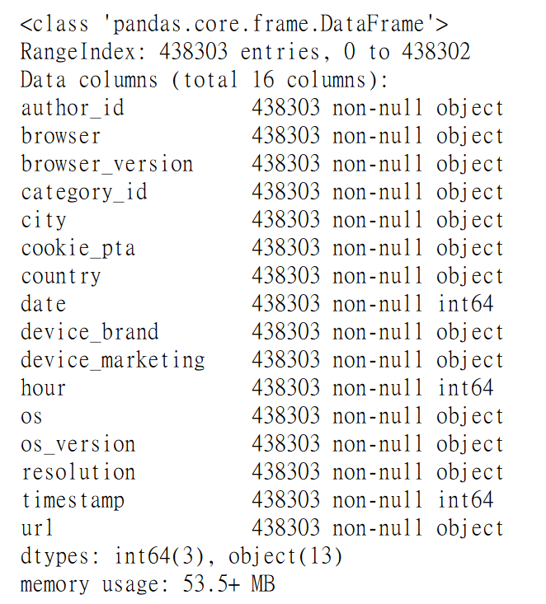
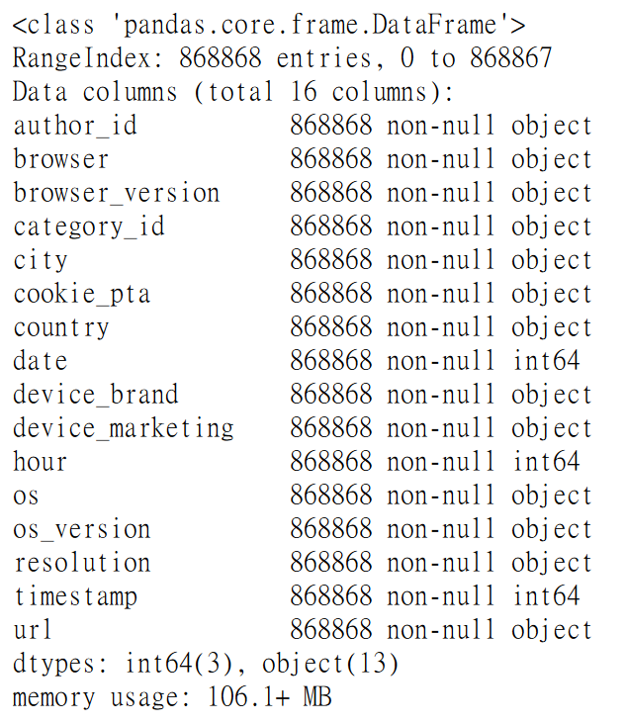
Processing
Analysis
Selection
Result
Discussion
Load files
browser_version, cookie_pta, device_marketing,
os_version, resolution, url
Notes:
24 files in total
"resolution","browser_version","cookie_pta","os_version","device_marketing","url"

Slide 3
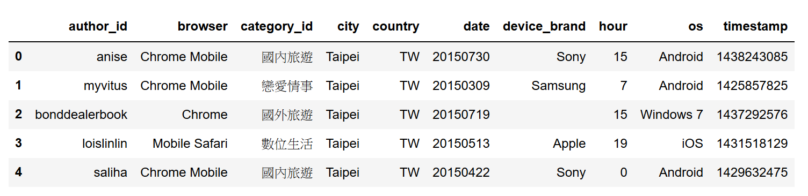
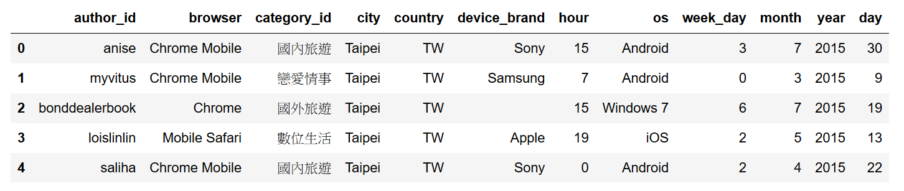



Processing
Analysis
Selection
Result
Discussion
Increase columns
year
month
timestamp
day
week_day
Notes:
24 files in total
"resolution","browser_version","cookie_pta","os_version","device_marketing","url"

Slide 4
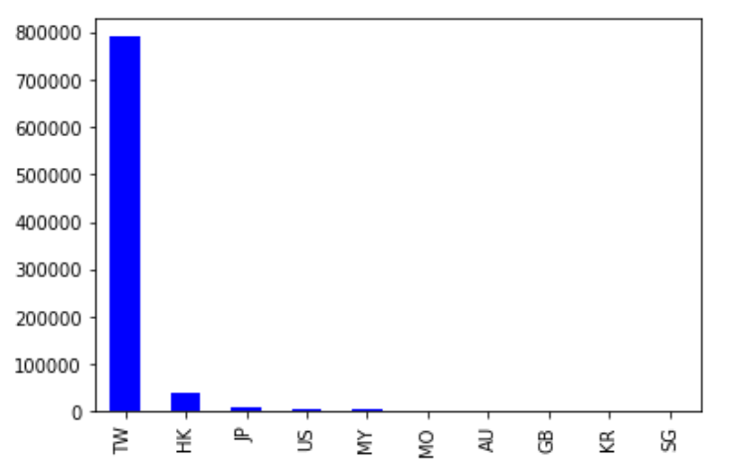
Processing
Analysis
Selection
Result
Discussion
Country
．86 countries
．TW no. 1

Slide 5
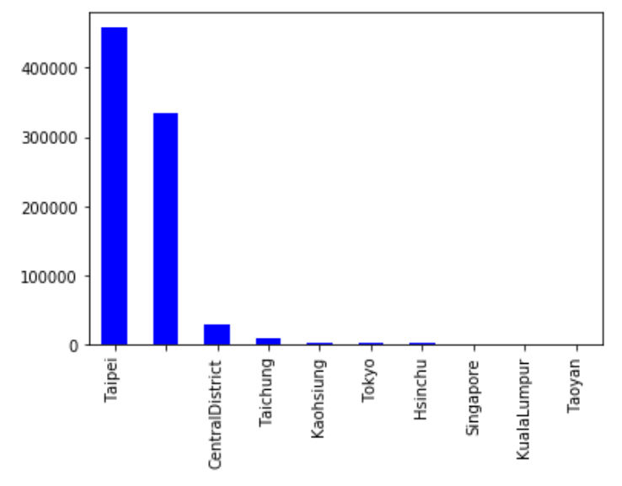

Processing
Analysis
Selection
Result
Discussion
City
．969 cities
．Taipei no 1
．Many unidentified

Slide 6
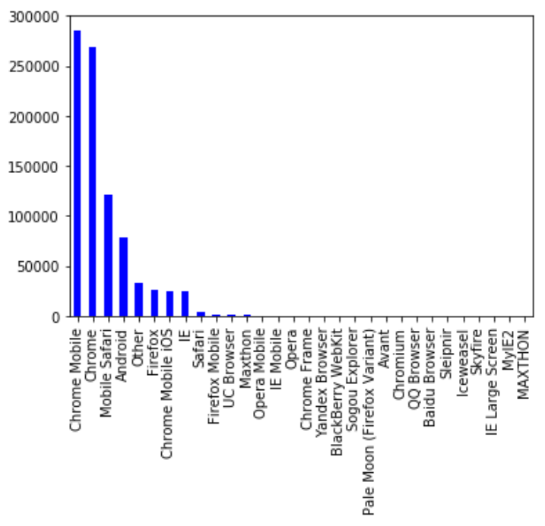


Processing
Analysis
Selection
Result
Discussion
Browser
．Chrome and Chrome related browsers dominate

Slide 7
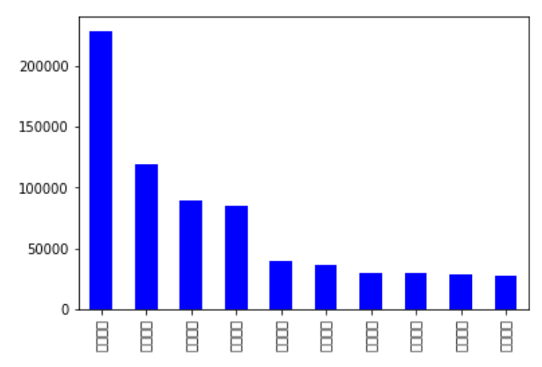
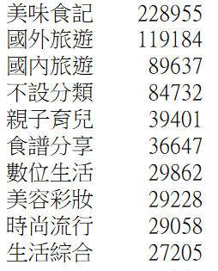
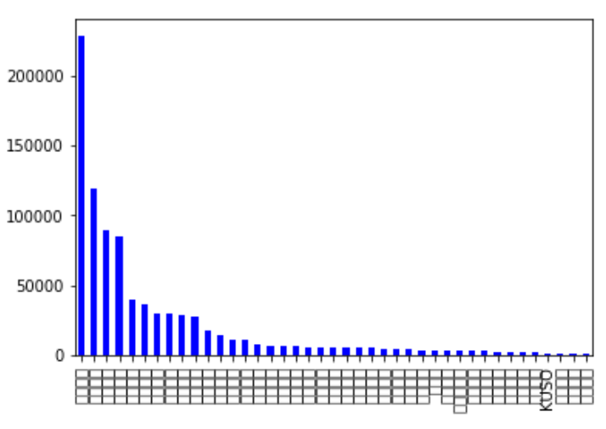

Processing
Analysis
Selection
Result
Discussion
Category id
．41 categories in total

Slide 8
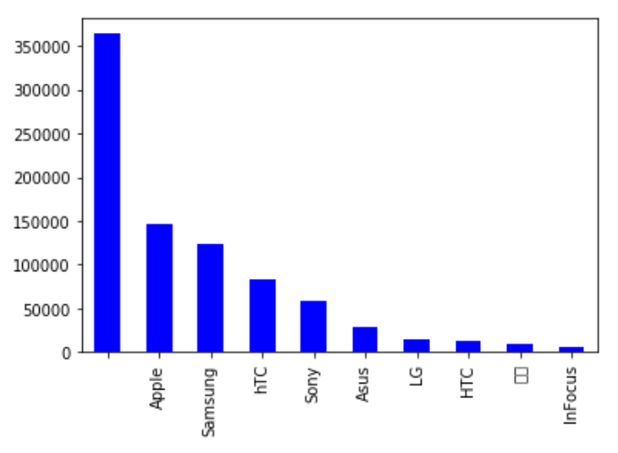
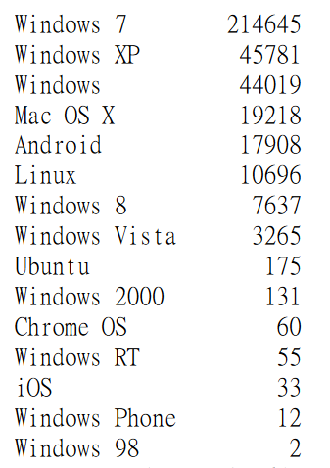

Processing
Analysis
Selection
Result
Discussion
Device brand
．At least 145 brands
．Unidentified dominate
Notes:
Google #14

Slide 9
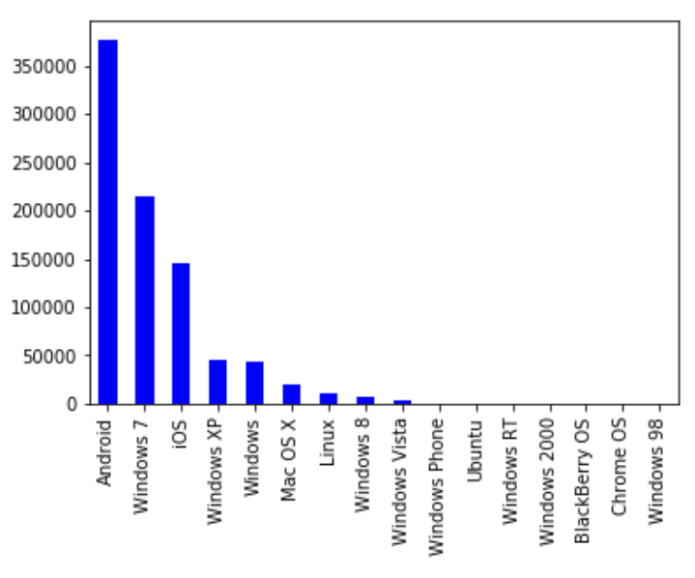

Processing
Analysis
Selection
Result
Discussion
Os
．Android no. 1
．Windows 98 still alive!!
Notes:
Google #14

Slide 10
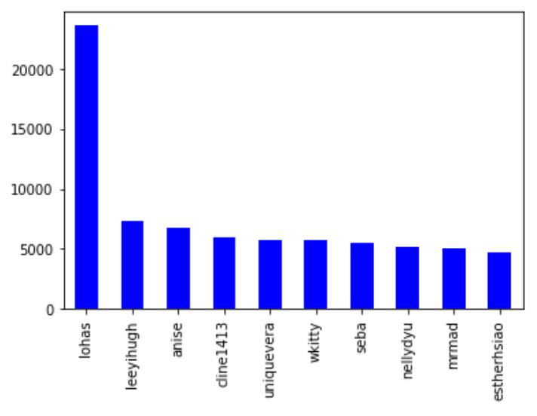
Processing
Analysis
Selection
Result
Discussion
Author id
．3039 authors
．Top 10 listed
Notes:
Google #14

Slide 11
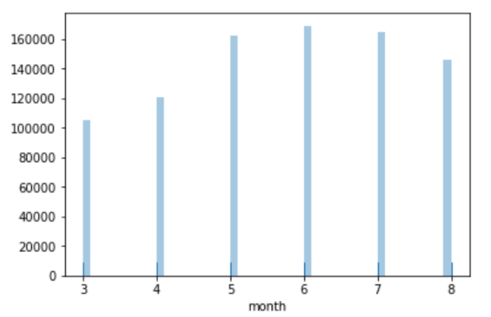
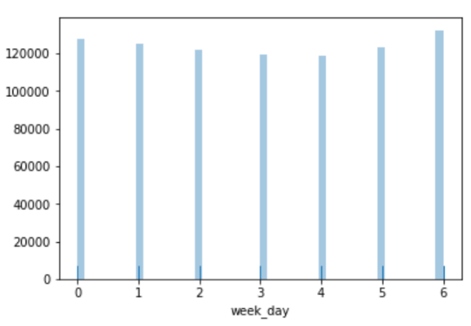
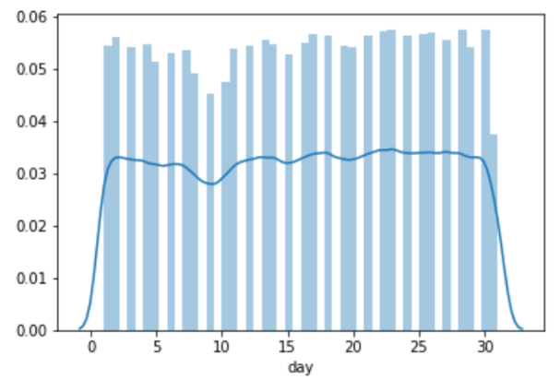
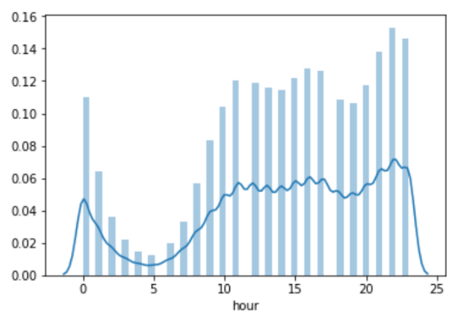


Processing
Analysis
Selection
Result
Discussion
Time

Slide 12
Processing
Analysis
Selection
Result
Discussion
What we think
Identity
Behavior
Country
City
Browser
Category id
Device brand
Os
Month
Week day
Day
Hour
Notes:
'author_id', 'browser', 'category_id', 'city', 'country', 'device_brand', 'os', 'dayofweek'

Slide 13

Processing
Analysis
Selection
Result
Discussion
Data selection
Identity
Behavior
Country
City
Browser
Category id
Device brand
Os
Author id
Week day
Month
Week day
Day
Hour
Notes:
'author_id', 'browser', 'category_id', 'city', 'country', 'device_brand', 'os', 'dayofweek'

Slide 14
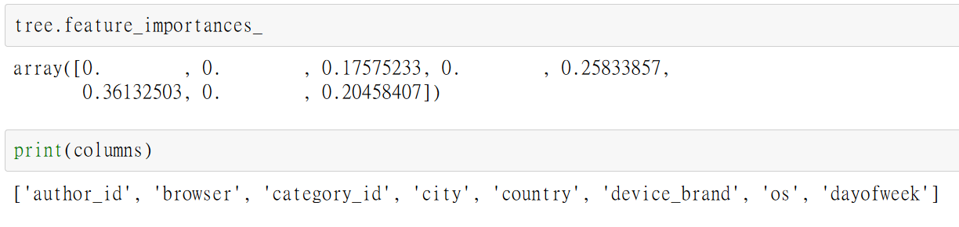
Processing
Analysis
Selection
Result
Discussion
Decision tree – Trail 1
Criterion = entropy
Max depth = 3
Accuracy = 7.48％
Baseline = 7.12％
Notes:
No adjustment

Slide 15
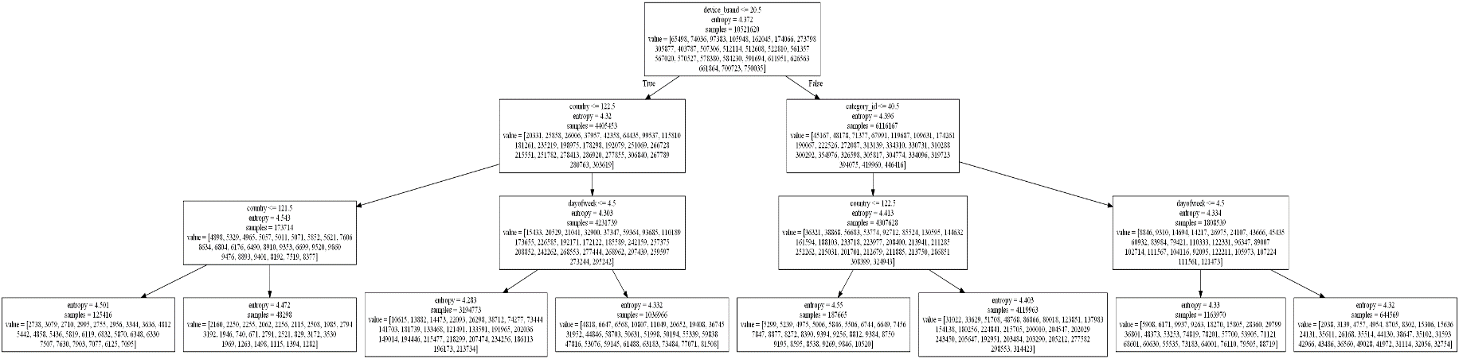
Processing
Analysis
Selection
Result
Discussion
Decision tree – Trail 1
Notes:
No adjustment

Slide 16
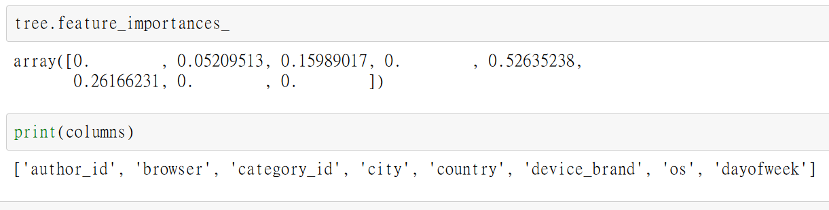
Processing
Analysis
Selection
Result
Discussion
Decision tree – Trail 2
Criterion = entropy
Max depth = 3
Further classification of “Hour” => 6 groups
Accuracy = 24.77％
Baseline = 25.46％
Notes:
0~3, 4~7, 8~11, 12~15, 16~19, 20~23. 6 groups
2~7, 8~13, 14~19, 20~1. 4 groups

Slide 17
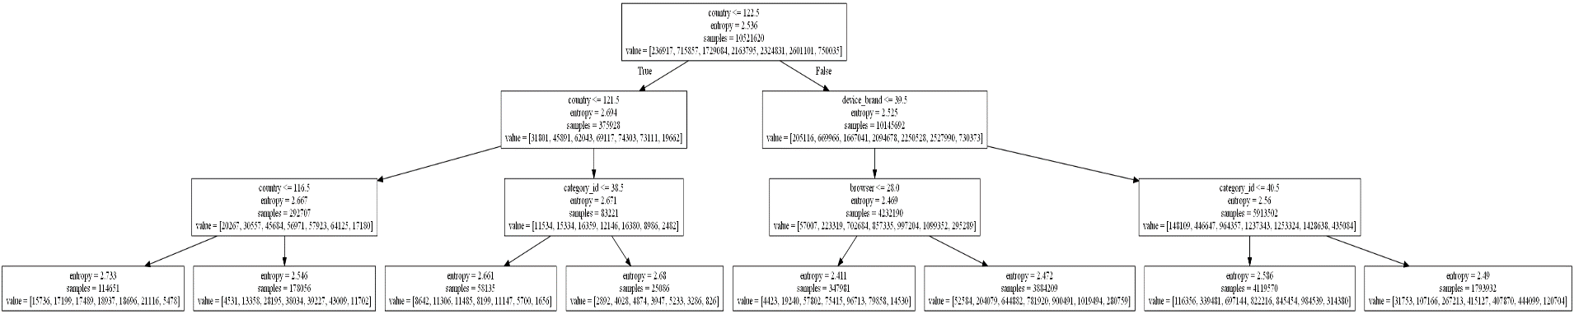
Processing
Analysis
Selection
Result
Discussion
Decision tree – Trail 2
Notes:
0~3, 4~7, 8~11, 12~15, 16~19, 20~23. 6 groups
2~7, 8~13, 14~19, 20~1. 4 groups

Slide 18
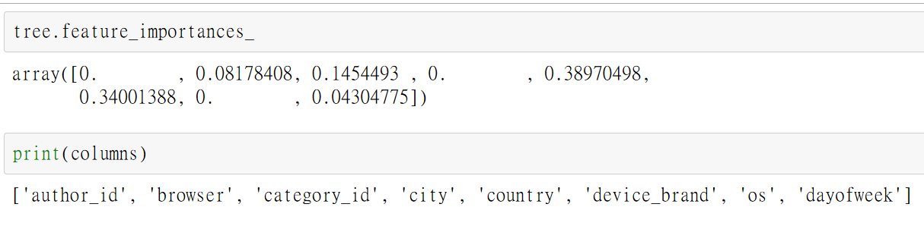
Processing
Analysis
Selection
Result
Discussion
Decision tree – Trail 3
Criterion = entropy
Max depth = 3
Further classification of “Hour” => 4 groups
Accuracy = 32.87％
Baseline = 33.22％
Notes:
0~3, 4~7, 8~11, 12~15, 16~19, 20~23. 6 groups
2~7, 8~13, 14~19, 20~1. 4 groups

Slide 19
Processing
Analysis
Selection
Result
Discussion
Neural network
Unweighted
Criterion = entropy
Max depth = 3
Weighted , according to DT
Criterion = entropy
Max depth = 3
ungrouped hour
Accuracy = 34.06％
Baseline = 33.22％
Accuracy = 34.68％
Baseline = 33.22％
Accuracy = 7.68％
Baseline = 7.12％

Slide 20
Processing
Analysis
Selection
Result
Discussion
Accuracy improvement
=>Hour grouping didn’t work
=>NN performed better than DT
Further analysis

