Slide 1
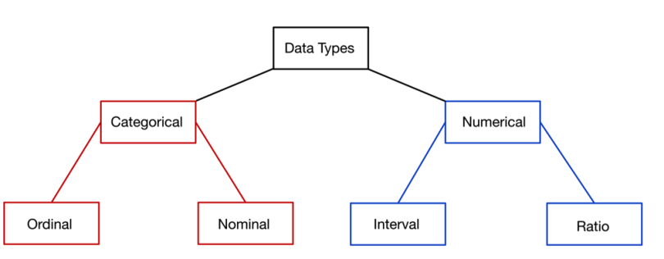
What are Types of Data in Statistics?
The data is classified into majorly four categories:
Nominal data
Ordinal data
Discrete data
Continuous data

Slide 2
Measures of Central Tendency:
The central tendency of the dataset can be found out using the three important measures namely mean, median and mode.
Mean
The mean represents the average value of the dataset. It can be calculated as the sum of all the values in the dataset divided by the number of values. In general, it is considered as the arithmetic mean. Some other measures of mean used to find the central tendency are as follows:
Geometric Mean
Harmonic Mean
Weighted Mean
It is observed that if all the values in the dataset are the same, then all geometric, arithmetic and harmonic mean values are the same. If there is variability in the data, then the mean value differs. Calculating the mean value is completely easy.

Slide 3
Median
Median is the middle value of the dataset in which the dataset is arranged in the ascending order or in descending order. When the dataset contains an even number of values, then the median value of the dataset can be found by taking the mean of the middle two values.
Consider the given dataset with the odd number of observations arranged in descending order – 23, 21, 18, 16, 15, 13, 12, 10, 9, 7, 6, 5, and 2
Mode
The mode represents the frequently occurring value in the dataset. Sometimes the dataset may contain multiple modes and in some cases, it does not contain any mode at all.
Consider the given dataset 5, 4, 2, 3, 2, 1, 5, 4, 5

Slide 4
Types of Measures of Dispersion:
There are two main types of dispersion methods in statistics which are:
Absolute Measure of Dispersion
Relative Measure of Dispersion
An absolute measure of dispersion contains the same unit as the original data set. The absolute dispersion method expresses the variations in terms of the average of deviations of observations like standard or means deviations. It includes range, standard deviation, quartile deviation, etc.
The types of absolute measures of dispersion are:
Range: It is simply the difference between the maximum value and the minimum value given in a data set. Example: 1, 3,5, 6, 7 => Range = 7 -1= 6
Variance: Deduct the mean from each data in the set, square each of them and add each square and finally divide them by the total no of values in the data set to get the variance. Variance (σ2) = ∑(X−μ)2/N

Slide 5
Standard Deviation: The square root of the variance is known as the standard deviation i.e. S.D. = √σ.
Quartiles and Quartile Deviation: The quartiles are values that divide a list of numbers into quarters. The quartile deviation is half of the distance between the third and the first quartile.
Mean and Mean Deviation: The average of numbers is known as the mean and the arithmetic mean of the absolute deviations of the observations from a measure of central tendency is known as the mean deviation (also called mean absolute deviation).
Relative Measure of Dispersion:
The relative measures of dispersion are used to compare the distribution of two or more data sets. This measure compares values without units. Common relative dispersion methods include:
Co-efficient of Range
Co-efficient of Variation
Co-efficient of Standard Deviation
Co-efficient of Quartile Deviation
Co-efficient of Mean Deviation

