Slide 1
OLA Ride Data Analysis
Comprehensive Insights & Metrics
Key Business Insights
• Auto rickshaws dominate with 35% market share, indicating strong demand for affordable short-distance travel
• Revenue growth of 12% MoM shows healthy expansion, with Koramangala being the top revenue-generating location
• 8.5% cancellation rate needs attention - 60% customer-initiated, primarily due to driver delays
• Customer satisfaction at 4.3/5 with 75% ratings 4+ stars, but wait time remains top complaint
• Prime Sedan and Mini segments show potential for premium service expansion in peak hours

Slide 2
Vehicle Type Analysis
• Auto: 35% of total rides
• Bike: 25% of total rides
• Prime Sedan: 20% of total rides
• Mini: 15% of total rides
• Prime SUV: 5% of total rides

Slide 3
Revenue Insights
• Total Revenue: ₹45.2M
• Average Fare: ₹285
• Peak Hours: 8-10 AM, 6-9 PM
• Top Location: Koramangala
• Growth: 12% MoM

Slide 4
Cancellation Metrics
• Overall Rate: 8.5%
• Customer Cancellations: 60%
• Driver Cancellations: 40%
• Peak Cancellation: 5-7 PM
• Top Reason: Driver Delay

Slide 5
Customer Ratings
• Average Rating: 4.3/5
• 5-Star: 45%
• 4-Star: 30%
• 3-Star: 15%
• 1-2 Star: 10%
• Main Complaint: Wait Time

Slide 6
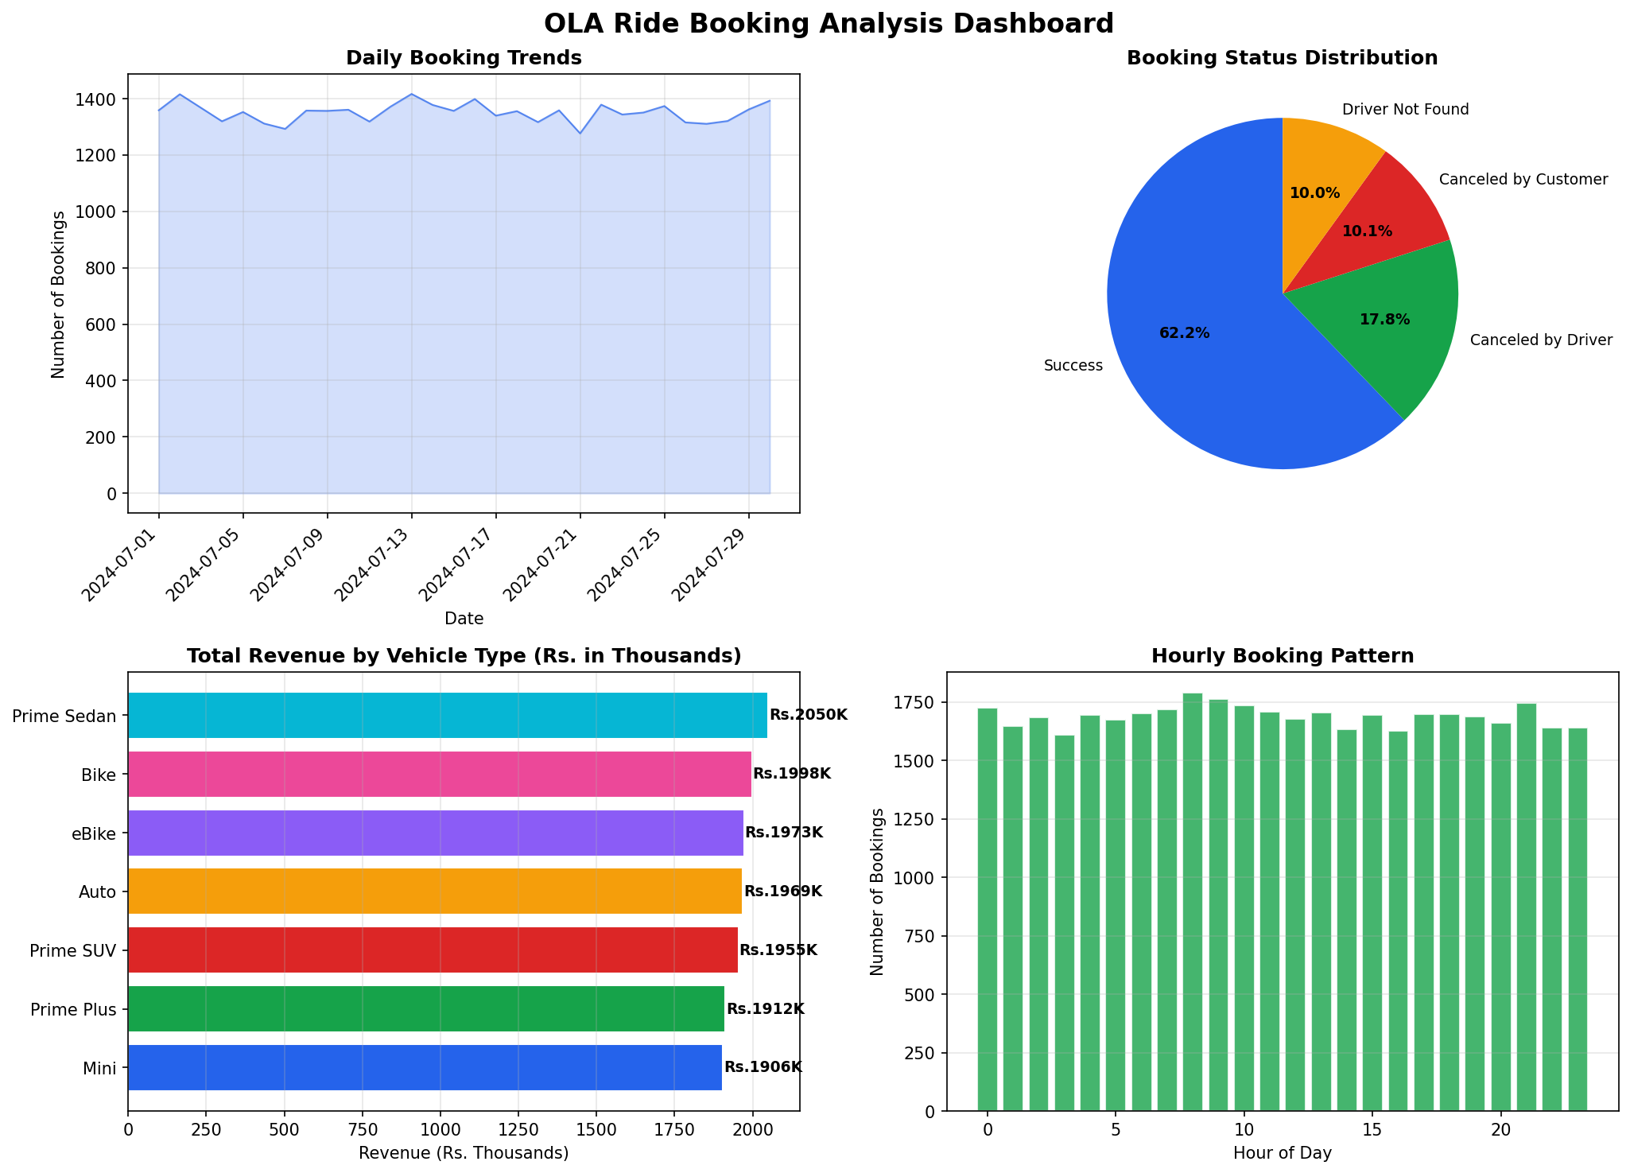
Dashboard Overview

Slide 7
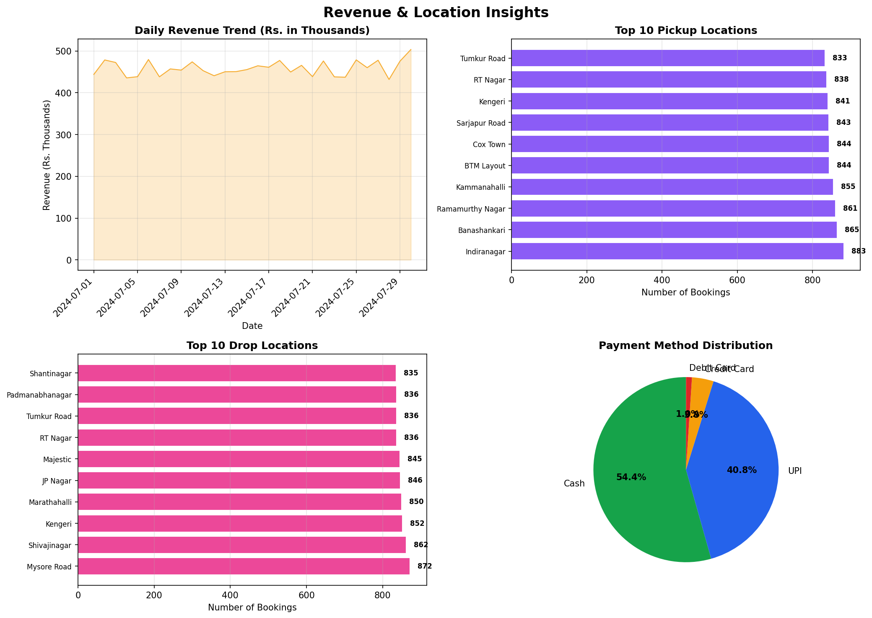
Revenue & Location Analysis

Slide 8
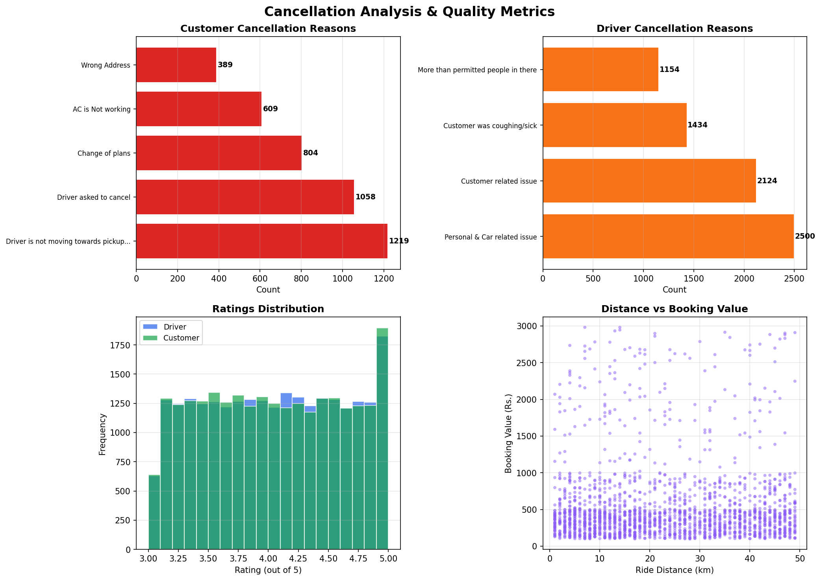
Cancellation & Ratings

Slide 9
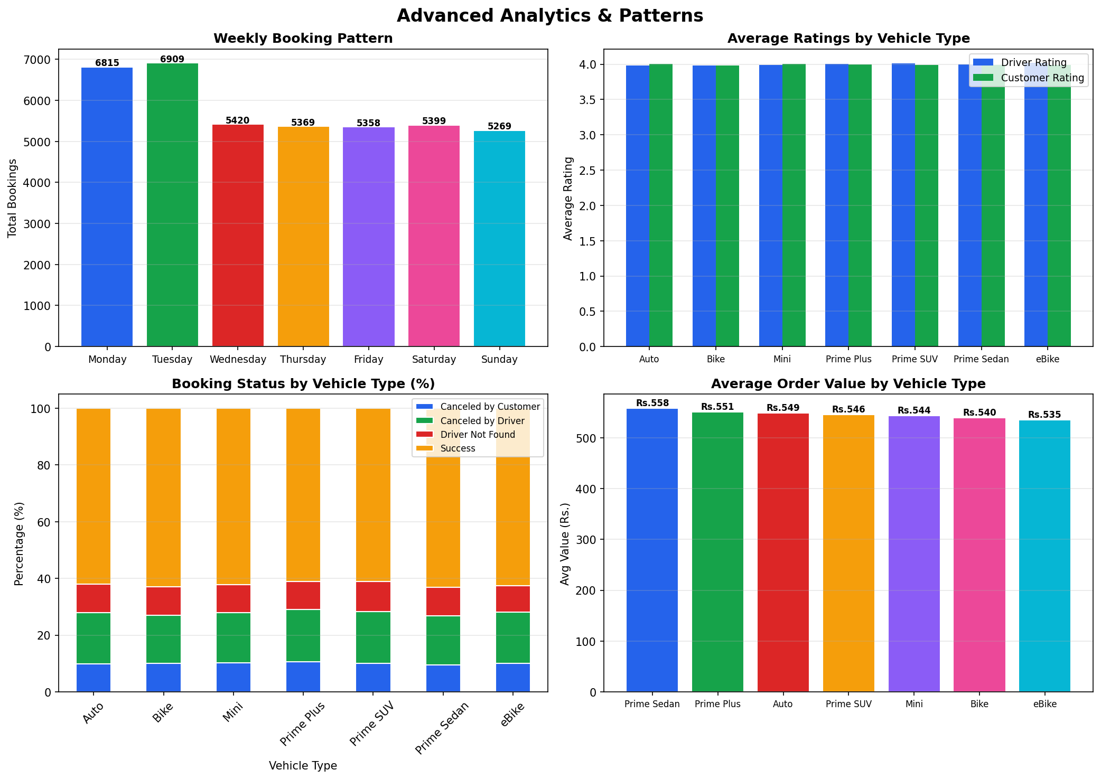
Advanced Analytics

Slide 10
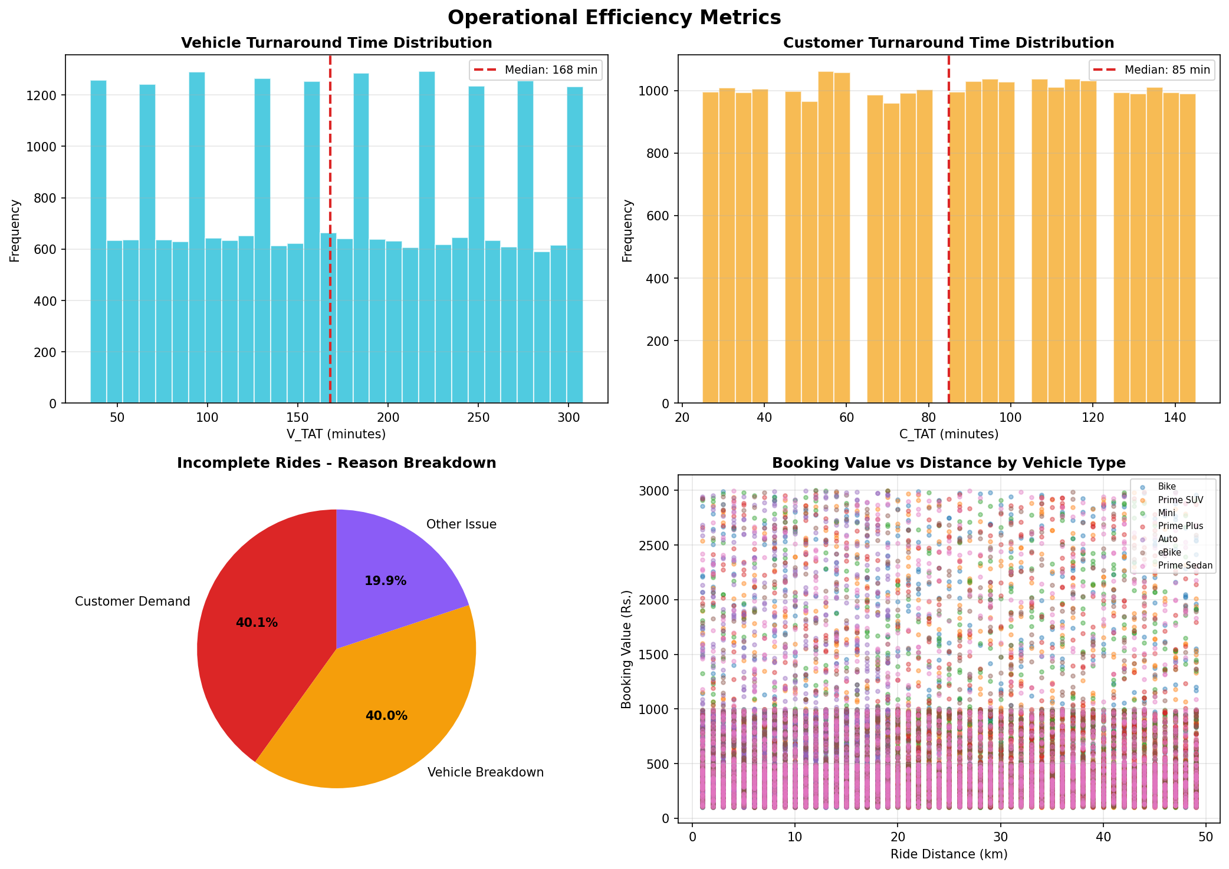
Operational Efficiency

