Slide 1

PIZZA SALES
SQL ANALYSIS PROJECT
Tool Used: MySQL Workbench
Database: orders, order_details, pizzas, pizza_types
Objective: Extract key business insights from pizza sales data
Queries Covered: 10 SQL Queries | Revenue, Trends, Top Performers
MySQL | Data Analysis | Business Intelligence

Slide 2
PROJECT OVERVIEW
📋 Project
🗄️ Tables Used
Pizza Sales Data Analysis
orders • order_details
using MySQL Workbench
pizzas • pizza_types
🎯 Goal
📊 Skills Used
Answer business questions
JOINs • Aggregations
via structured SQL queries
Subqueries • GROUP BY
21,350 Orders
$817,860 Revenue
4 Categories
10 Queries Analyzed

Slide 3


Q1
Total Number of Orders Placed
SQL
OUTPUT
💡 Insight:
A total of 21,350 orders were placed — indicating strong sales volume for the pizza business.
Pizza Sales SQL Analysis | MySQL Project

Slide 4
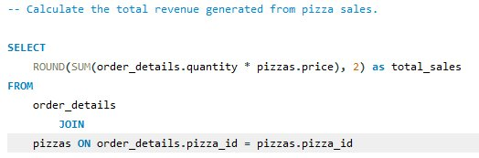

Q2
Total Revenue Generated from Pizza Sales
SQL
OUTPUT
💡 Insight:
Total revenue stands at $817,860.05, calculated by joining order_details with pizzas and summing (quantity × price).
Pizza Sales SQL Analysis | MySQL Project

Slide 5
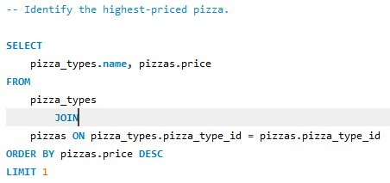

Q3
Highest Priced Pizza on the Menu
SQL
OUTPUT
💡 Insight:
The Greek Pizza is the most premium item at $35.95 — identified using ORDER BY price DESC with LIMIT 1.
Pizza Sales SQL Analysis | MySQL Project

Slide 6
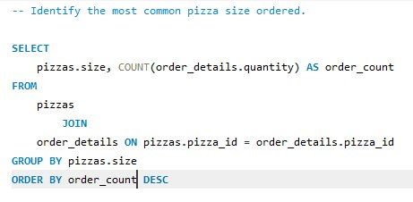
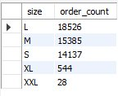
Q4
Most Common Pizza Size Ordered
SQL
OUTPUT
💡 Insight:
Large (L) is the most popular size with 18,526 orders, followed by Medium (15,385). XXL is rarely ordered (28 orders).
Pizza Sales SQL Analysis | MySQL Project

Slide 7
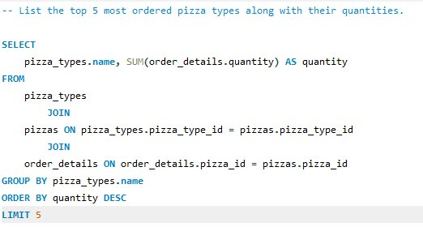
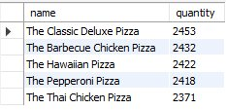
Q5
Top 5 Most Ordered Pizza Types
SQL
OUTPUT
💡 Insight:
Classic Deluxe Pizza leads with 2,453 orders. The top 5 are dominated by Chicken and Classic varieties.
Pizza Sales SQL Analysis | MySQL Project

Slide 8
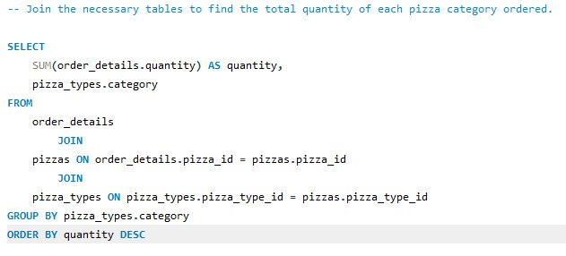

Q6
Total Quantity Ordered by Pizza Category
SQL
OUTPUT
💡 Insight:
Classic pizzas top all categories at 14,888 units. Chicken is the least ordered category with 11,050 units.
Pizza Sales SQL Analysis | MySQL Project

Slide 9

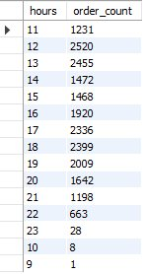
Q7
Distribution of Orders by Hour of Day
SQL
OUTPUT
💡 Insight:
Peak ordering time is 12 PM (noon) with 2,520 orders. Business is very slow at 9 AM (1 order) and 11 PM (28 orders).
Pizza Sales SQL Analysis | MySQL Project

Slide 10

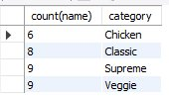
Q8
Category-wise Distribution of Pizza Types
SQL
OUTPUT
💡 Insight:
Supreme and Veggie categories each have 9 pizza varieties. Chicken has the fewest with only 6 types.
Pizza Sales SQL Analysis | MySQL Project

Slide 11
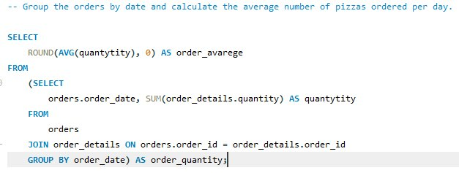

Q9
Average Number of Pizzas Ordered Per Day
SQL
OUTPUT
💡 Insight:
On average, 138 pizzas are ordered every day — derived using a subquery to first group totals by date, then averaging.
Pizza Sales SQL Analysis | MySQL Project

Slide 12
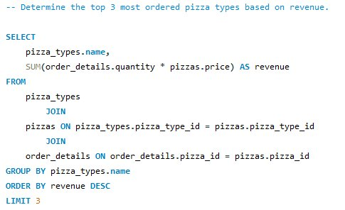

Q10
Top 3 Pizza Types by Revenue
SQL
OUTPUT
💡 Insight:
Thai Chicken Pizza generates the highest revenue at $43,434.25, followed by Barbecue Chicken ($42,768) and California Chicken ($41,409.50).
Pizza Sales SQL Analysis | MySQL Project

Slide 13
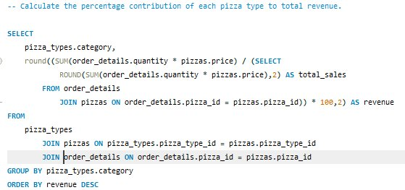
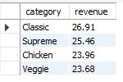
Q11
Percentage Contribution of Each Category to Revenue
SQL
OUTPUT
💡 Insight:
Classic pizzas contribute the most at 26.62% of total revenue. All four categories are fairly balanced, between 23-27%.
Pizza Sales SQL Analysis | MySQL Project

Slide 14
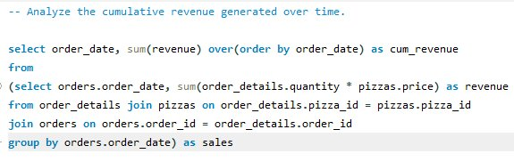
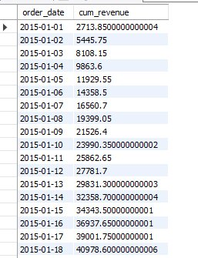
Q12
Cumulative Revenue Generated Over Time
SQL
OUTPUT
💡 Insight:
Revenue grows steadily day by day using a window function (SUM OVER ORDER BY date), reaching $40,978+ by Jan 18, 2015 alone.
Pizza Sales SQL Analysis | MySQL Project

Slide 15
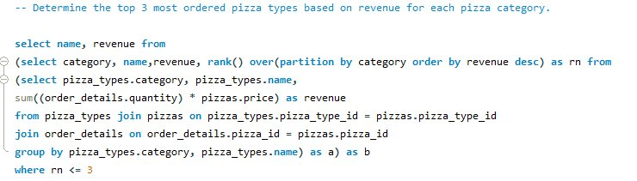
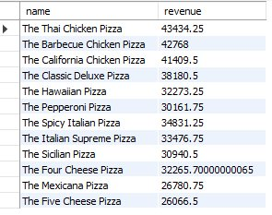
Q13
Top 3 Pizza Types by Revenue for Each Category
SQL
OUTPUT
💡 Insight:
Used RANK() window function with PARTITION BY category. Thai Chicken leads at $43,434. Classic Deluxe tops the Classic category at $38,180.
Pizza Sales SQL Analysis | MySQL Project

Slide 16
KEY INSIGHTS & SUMMARY
📦
💰
⏰
21,350
$817,860
12 PM – 1 PM
Total Orders
Total Revenue
Peak Hour
🍕
🏆
📈
Large (L)
Classic Deluxe
138 Pizzas
Popular Size
Top Pizza
Avg Daily Orders
Skills: MySQL • JOINs • Aggregate Functions • Subqueries • GROUP BY • ORDER BY • Data Analysis

