Slide 1

CS 7642 – Project 1
Replicating Soccer Game Experiments
Georgia Tech CS7642 – Project 3
Summer, 2017
Author: Zhi Chen (ID: zchen482)

Slide 2
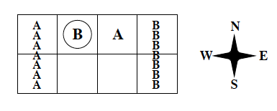
Environment – Soccer Game
Implementation
Problem: Zero-sum Markov game of 2 x 4 grid
States: 0 – 177
(ball possession, player B pos, player A pos)
Actions: 0-4
(N, S, E, W, Stick)
Rules:
Action orders are random
If player with ball moves to opponent, ball possession changes; player doesn’t move
Player scores if any player delivers ball to his goal; player +100 and opponent -100
Game is restarted at random states when any one scores
Author: Zhi Chen (ID: zchen482)

Slide 3

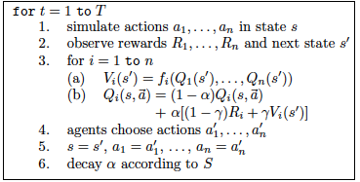
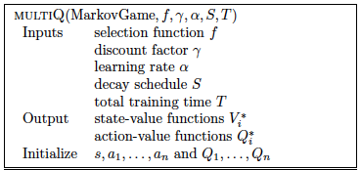
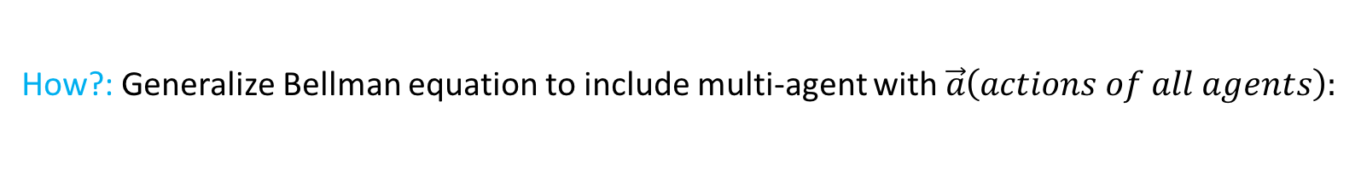
Algorithms – Recipe
General method: Value Iteration
How?: Generalize Bellman equation to include multi-agent with $\vec{a}\left(actions of all agents\right):$
Algorithms differ in selection of value function (V)!
Author: Zhi Chen (ID: zchen482)

Slide 4




Algorithms - Implementation
Friend-Q:
Assume opponent helps maximize reward (optimistic)
Foe-Q:
Assume opponent sabotages reward (pessimistic)
CE-Q:
Choose strategy that neither player would deviate from (N.E.) given joint action space (dependency in actions)
QL:
Choose value greedily
Author: Zhi Chen (ID: zchen482)

Slide 5
Algorithm - Implementation
QL:
On-policy: select action using ℇ-greedy (ℇ=0.01)
Uses 2 independent Q-tables, each of size = (177, 5)
Foe-Q | Friend-Q | CE-Q:
Off-policy: select players’ actions at random
Uses only Player A Q-table of size = (177, 5, 5) b/c off-policy
All algorithms:
α decay function of 1 / (1+t/N) :
t = step, N = 5000, 5000, 2000, and 100 for Foe-Q, CE-Q, QL, and Friend-Q
α → 0.005, 0.005, 0.002, and 0.0001
Author: Zhi Chen (ID: zchen482)

Slide 6
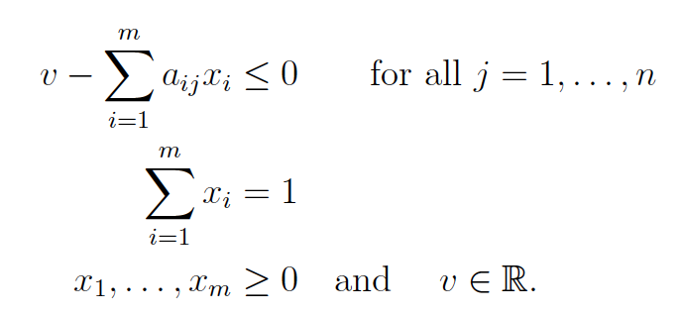



Algorithm – Linear Programming
Solving Foe-Q & CE-Q requires Linear Programming (CVXOPT)
Foe-Q Constraints:
Maximize v given upper bound by opponent’s action j
Solve 12 inequalities with 6 variables (v & actions)
CE-Q Constraints:
$$Σ{R_{i,j}∗π}_{i,j}≥Σ{R_{i′,j}∗π}_{i′,j}$$
Choose strategy of highest reward for both players
Where i, j are players’ actions and i’ is all first player’s action i != i’
Solve 68 inequalities with 26 variables (v & all strategies)
$$Σπ_{i,j}=1$$
$$π_{i,j}≥0$$
Author: Zhi Chen (ID: zchen482)

Slide 7
Experiment & Algo - Implementation
Experiment:
Examine convergence of Player A’s Q-value difference between each step when A moves “S” and B “Sticks” at following state “s”:
Monitor Q-value difference for 10⁶ steps for each algorithm
Author: Zhi Chen (ID: zchen482)

Slide 8
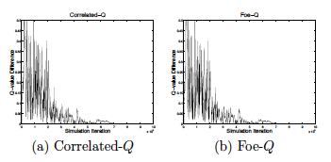
Experiment – Result 1
Implemented CE-Q and Foe-Q are relatively identical (e.g. slight difference due to randomness)
Because zero-sum game, so CE-Q’s joint action space computes same prob. dist. as Foe-Q / Minimax
Agrees with Greenwald’s
Differ slightly from Greenwald with less (~0.05) fluctuation
Due to slight different α decay and/or different random restart conditions
Author: Zhi Chen (ID: zchen482)

Slide 9
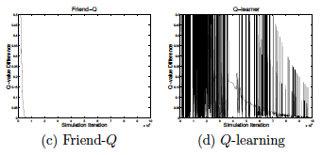
Experiment – Result 2
Implemented Friend-Q converges quickly and monotonically like Greenwald’s
Likely quickly finds irrational policy that passes ball to opponent
Converges 10⁵ steps slower than Greenwald due to different α decay form
Implemented QL diverges like Greenwald’s
Oscillation mean curve and shape also identical to reference
Slight difference (less sharp oscillation) likely due to different α decay form
Author: Zhi Chen (ID: zchen482)

Slide 10
Experiment – Pitfalls
Challenges:
In original paper, α decay function is not explicit, but only mentions α → 0.001
In extended paper, α decay function: 1/n(s,a) is used, but for different experiments
Initial implementation failed replication using this form as α decayed too quickly
State constraint for random restart is not mentioned in original paper
Terminology is unclear
Off-policy means taking actions at random unlike convention (e.g. QL is off-policy)
Assumptions / Resolutions:
Restart states are constrained with players in opposing space
Affects randomness
α decay function can be linear annealing as long as α → ~0.001
Only 1 Q-table is needed for all algorithms but QL due to off-policy
Author: Zhi Chen (ID: zchen482)

Slide 11
Conclusion
All algorithms (Foe-Q, Friend-Q & CE-Q) but QL converges
Foe-Q and CE-Q are identical in zero-sum game
Friend-Q converges to irrational policy
Replicating under-specified experiments requires a lot of verification & assumption
Author: Zhi Chen (ID: zchen482)

