Slide 1

Machine learning
By: Devin Schmidt

Slide 2

What is it and how it differs
Finds patterns in large data
AI vs Machine learning

Slide 3
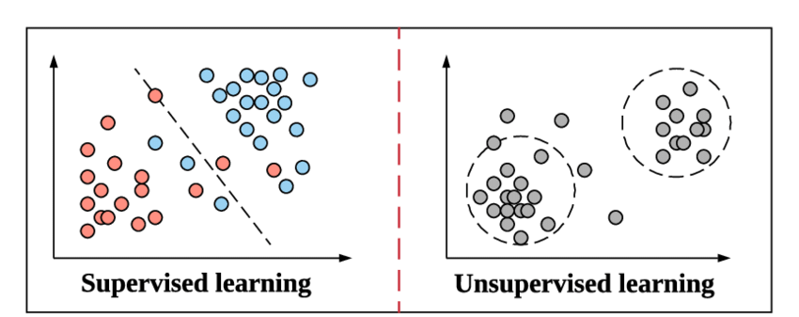

Types of machine learning
Supervised
Unsupervised
Reinforcement

Slide 4

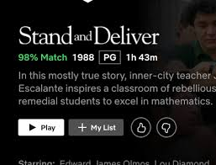
How it affects us!
Things it is used in
We don’t necessarily interact with these algorithms, but they are currently improving daily life in small and underappreciated ways

Slide 5
What I chose
Logistic Regression
Classification
To classify it needs to be between 1 and 0 more towards one will be yes and 0 no

Slide 6
Similarities to
decision tree classification
linear regression

Slide 7
What is it used on?
Medical
Brain tumor
Financial
Passing credit
Image processing
Is it cat or not cat/doggo or not doggo

Slide 8
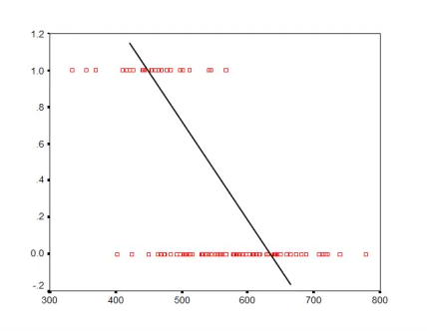

The process
Imagine the data being yes or no
Line does not fit data for accurate prediction

Slide 9
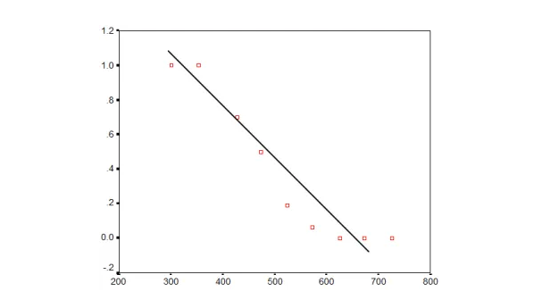

Probability is predicted
Line still does not fit

Slide 10
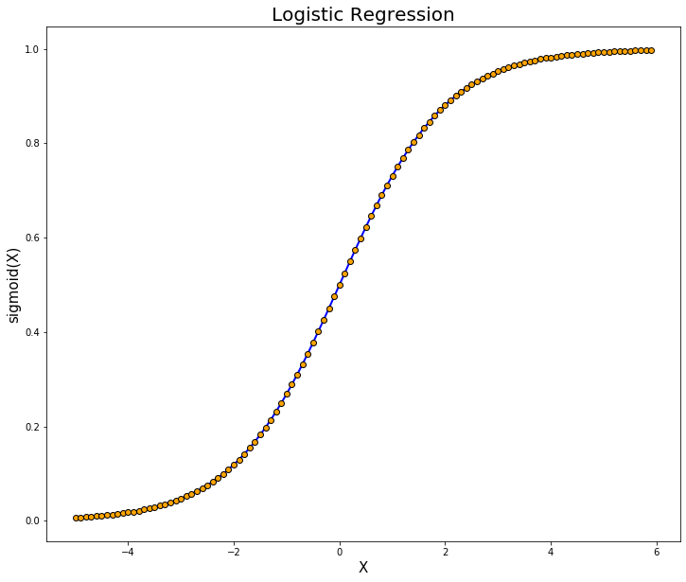
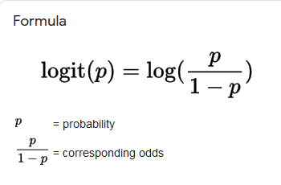
Line now fits

Slide 11

The dataset
Social networking ads and who bought the product based on those ads and their income as well as age
https://www.kaggle.com/dragonheir/logistic-regression

Slide 12

References
https://www.technologyreview.com/2018/11/17/103781/what-is-machine-learning-we-drew-you-another-flowchart/
https://www.technologyreview.com/2018/11/10/139137/is-this-ai-we-drew-you-a-flowchart-to-work-it-out/
https://www.analyticsvidhya.com/blog/2017/09/common-machine-learning-algorithms/
https://machinelearningmastery.com/a-tour-of-machine-learning-algorithms/
https://www.google.com/search?q=logistic+regression&newwindow=1&client=firefox-b-1-d&sxsrf=ALeKk01Vn1lM0NhBGiGpCSVBMJFlrhuCWg:1607213131065&source=lnms&tbm=isch&sa=X&ved=2ahUKEwj9loW-h7jtAhUGwVkKHY1_Aj4Q_AUoAnoECBoQBA&biw=1366&bih=654

Slide 13
References
https://www.guru99.com/unsupervised-machine-learning.html
https://www.theanalysisfactor.com/what-is-logit-function/
https://pandas.pydata.org/docs/reference/frame.html
https://matplotlib.org/3.1.1/api/index.html
https://scikit-learn.org/stable/modules/generated/sklearn.linear_model.LogisticRegression.html

Slide 14

The Code

