Slide 1
Applied Data Science with R Capstone project
Devin Guigley
4/21/2026

Slide 2

Outline
Executive Summary
Introduction
Methodology
Results
Conclusion
Appendix

Slide 3

Executive Summary
From the analysis, it was shown that the following two factors are most important when determining bike sharing demand:
Bike share demand is higher in the summer months because of the better weather; specifically, warmer temperatures and no snow.
Bike share demand is highest in the evening hours between 1700 and 2200. Most likely because this is when temperatures have just finished peaking for the day, and people are finishing work to return home or to go out.

Slide 4

Introduction
The purpose of this analysis was to identify what causes the most demand for users to use bike-share bicycles
The two leading factors looked into were:
Weather
Time of day

Slide 5

Methodology
Perform data collection
Perform data wrangling
Perform exploratory data analysis (EDA) using SQL and visualization
Perform predictive analysis using regression models
How to build the baseline model
How to improve the baseline model
Build a R Shiny dashboard app

Slide 6
Methodology

Slide 7
Data collection
Data was collected by performing web-scraping from Wikipedia to collect tables of information and by importing data from an API to get real-time weather data.

Slide 8
Data wrangling
After collecting data, data had to be cleaned.
Column names were standardized across datasets
Data types had to be corrected and undesired reference links from the Wikipedia page had to be removed
Numeric data had to be cleaned of any extra characters
Missing values were removed from the datasets or replaced with average values
Categorical dummy values were used for categorical columns
Data was normalized to avoid bias

Slide 9
EDA with SQL
SQL database queries were performed to find the following information:
Perform a record count
Determine operational hours
Get the weather outlook in Seoul for the next three hours
Identify the seasons included in the bike sharing dataset
Find the date range in the bike sharing dataset
Find the all-time high for bike rentals at a certain date and time
Find average hourly temperature and bike rentals per hour over each season
Find the average bike count during each season
Determine the average weather each season
Find the total bike count and city info for Seoul
Find all cities with comparable bike rentals to Seoul

Slide 10
EDA with data visualization
Charts were plotted showing the following:
Bike rentals by date
Bike rentals by date and separated by the hour of the bike rental
A histogram of how often a certain number of bicycles were rented within an hour

Slide 11
Predictive analysis
The predictive model was built by determining which coefficients had the most impact (either positively or negatively) on the model.
Once those were determined, several models were developed and tested to determine which model would perform best

Slide 12
Build a R Shiny dashboard
A dashboard was created to allow for interaction to show bike rental demand and weather across several cities.
This dashboard allows for comparison and can show data such as weather, bike-share demand, and predict bike-share demand based on humidity projections.

Slide 13
Results
Exploratory data analysis results
Predictive analysis results
A dashboard demo in screenshots

Slide 14
EDA with SQL

Slide 15
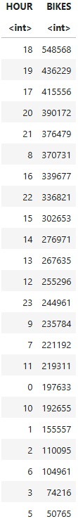
Busiest bike rental times
The busiest hours are shown to the right
Generally, the busiest hour for bike rentals were between 1700-2100

Slide 16
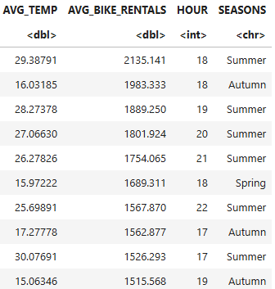
Hourly popularity and temperature by seasons
The most popular times by season are shown.
This shows that bike rentals are most popular in the evening (1700-2200), generally in the summer

Slide 17
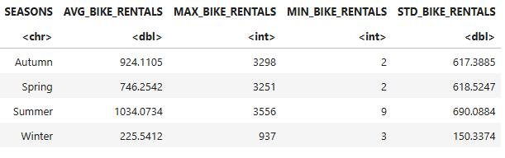
Rental Seasonality
The table below shows rental statistics for each season.
The summer is the most popular, with the highest average bike rentals.

Slide 18
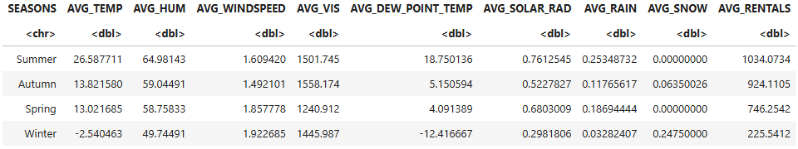
Weather Seasonality
Below is a table of the average rentals and weather by season
The summer is the most popular season for bike rentals, highlighted by the highest average temperature and no snow.

Slide 19

Bike-sharing info in Seoul
Below shows the total rental bikes available in Seoul, as well as some general information about Seoul

Slide 20
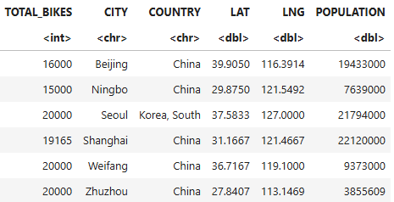
Cities similar to Seoul
This table shows cities comparable to Seoul in terms of bikes available for rental

Slide 21
EDA with Visualization

Slide 22
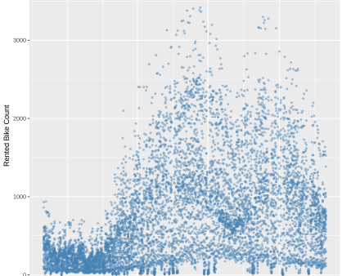
Bike rental vs. Date
From this scatter plot, we can see that rentals are much higher in the summer to early fall, with the lowest rentals occurring between November and April

Slide 23
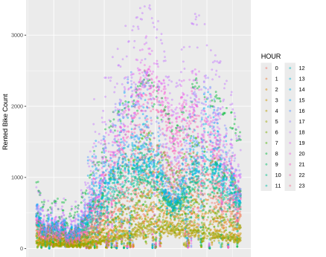
Bike rental vs. Datetime
This plot is the same as the last, but the points are colored by the hour of the rental. Here we can see that rentals are highest for hours between 1500-2000. This is true across all seasons.

Slide 24
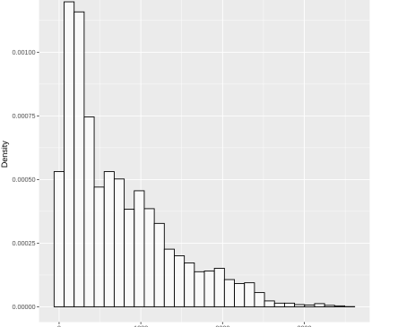
Bike rental histogram
This graph shows that bike rentals are generally much lower by hour. This shows that high rental times are much less common then low rental times.

Slide 25
Predictive analysis

Slide 26
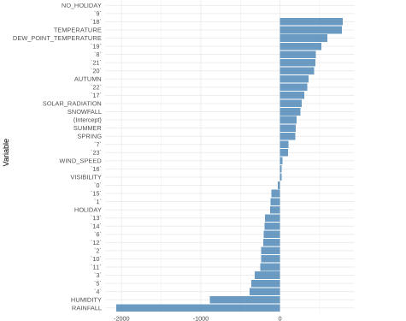
Ranked coefficients
This ranked coefficients bar chart shows which variables had the biggest effect on bike rentals.
From this chart, we can see that Temperature and evening hours generally had the largest positive correlation to bike rentals, where rainfall and humidity had the largest negative correlations to bike rentals.

Slide 27

Find the best performing model
The best performing model tested was the Lasso regression model
The model had a RMSE of 364 and an R2 of 0.669

Slide 28
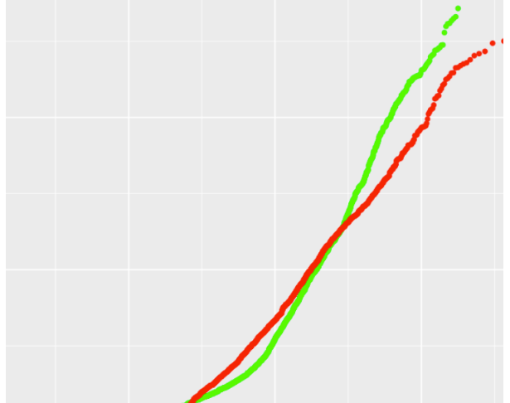
Q-Q plot of the best model

Slide 29
Dashboard

Slide 30
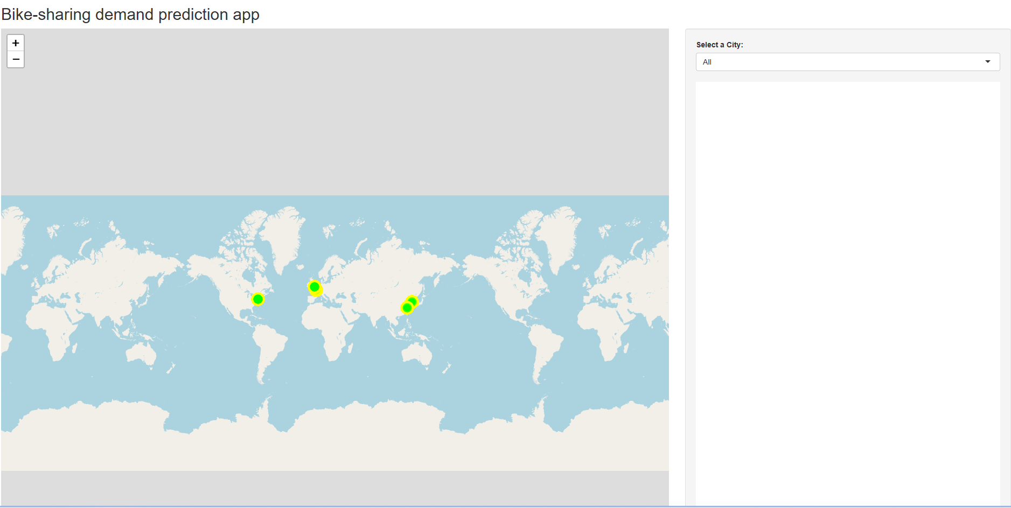
Main page of Bike-sharing demand app
This shows the main page of the bike-sharing application dashboard.
It shows the specific cities, as well as a dropdown on the right hand side to select a specific city

Slide 31
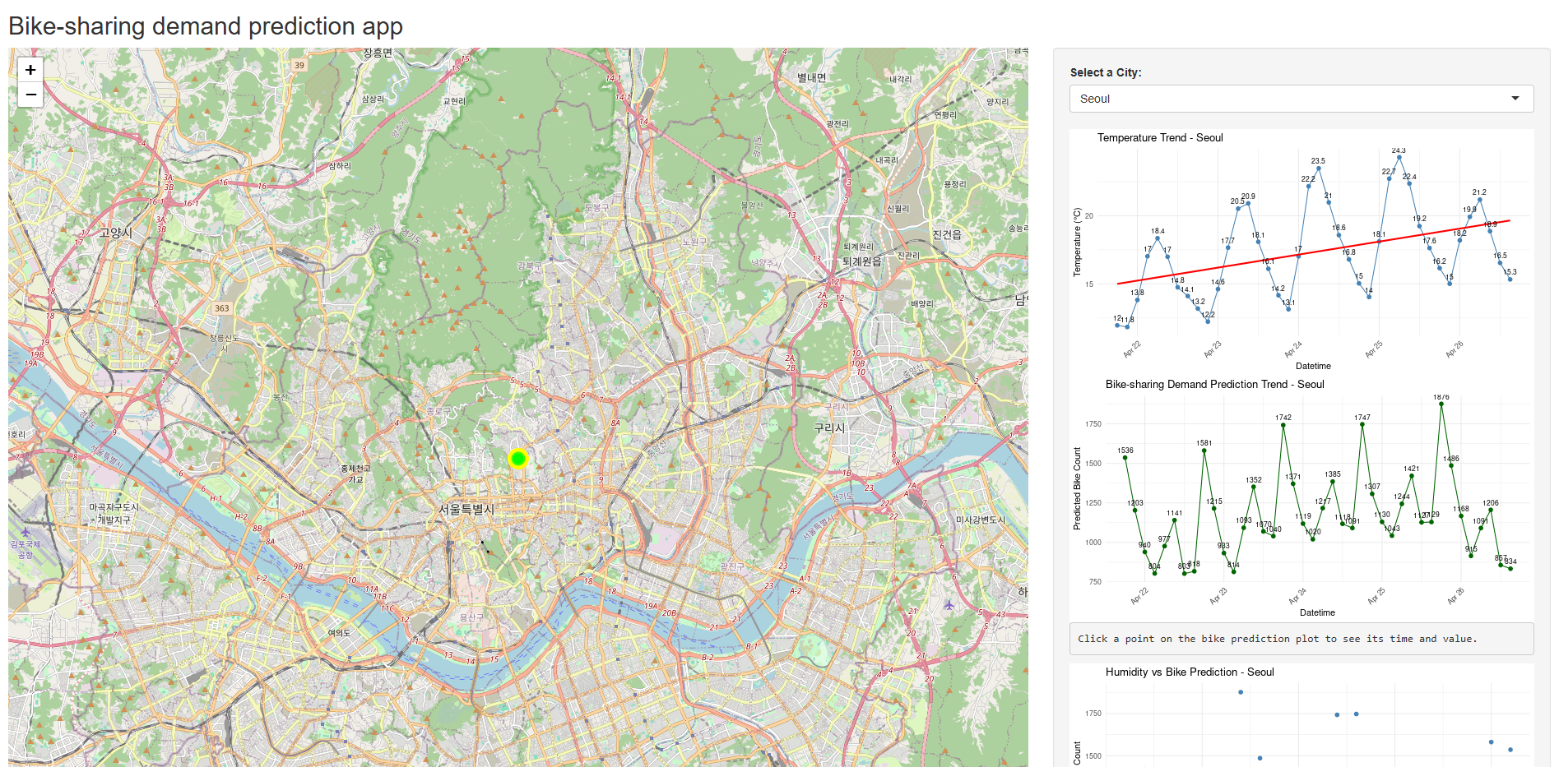
Bike-sharing demand: Seoul
This is a screenshot of the bike sharing demand from Seoul.
It has a map of the city, along with trend lines showing the temperature trend, demand trend, and humidity vs. bike prediction.

Slide 32
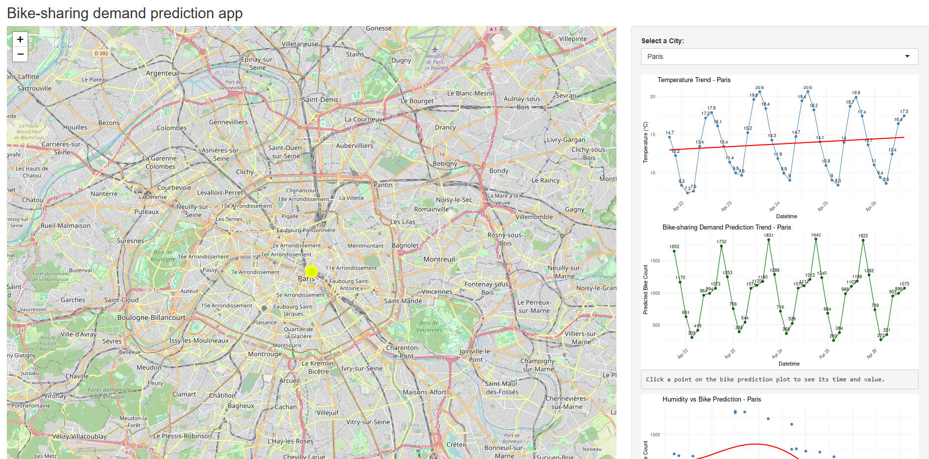
Bike-sharing demand: Paris
This is a similar screenshot showing bike-sharing demand in Paris.
It contains the same tables on the right; temperature trend, demand trend, and humidity vs bike rental prediction

Slide 33

CONCLUSION
Demand for bike sharing is highest in the summer months when the temperatures are warmest and it is not snowing
Rentals are generally most popular during evening hours between 1700-2200.

