Slide 1
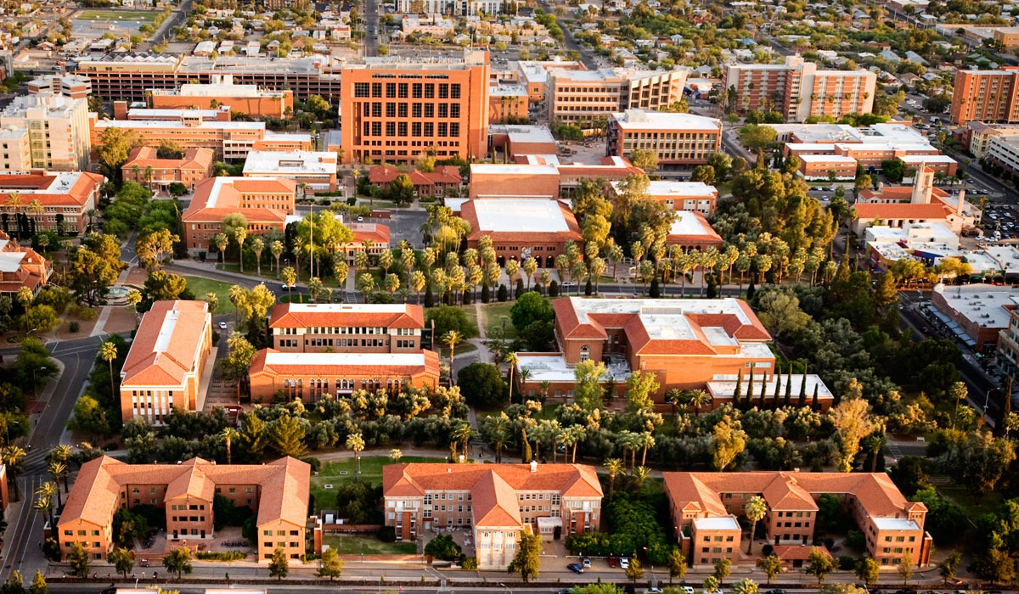

Introduction to Statistics
on HPC Using Matlab

Slide 2


Another Introduction to HPC workshop
Leverages Matlab Statistics Toolbox
Examples shown on HPC
Notes:
This workshop is one in our series of introductory topics using HPC. All the examples can be performed on one of our supercomputers. But they can be equally run on a laptop with Matlab installed

Slide 3
Statistics and AI
Statistics plays a crucial role in AI by providing the foundation for data analysis,
modeling, and decision-making.
Within AI, statistics serves as the backbone for various tasks
such as predictive modeling, pattern recognition, and data interpretation.
By leveraging statistical techniques, AI systems can analyze complex data sets,
identify patterns, and make informed decisions based on empirical evidence.

Slide 4

David Blackwell
Nvidia has named their new GPU after David Blackwell,
an American mathematician and statistician.
Blackwell provided pioneering work in Bayesian statistics.
Bayesian statistics is a powerful framework that uses probability theory
to quantify uncertainty and update beliefs based on new evidence.
In AI applications, Bayesian methods play a crucial role in tasks such as machine learning,
pattern recognition, and probabilistic reasoning.

Slide 5

Campus license
HPC license
Notes:
This is where we introduce Matlab and mention the campus license for all students and faculty. And that it is licensed for use on HPC

Slide 6

Why Use Matlab on HPC?
Use for large datasets
Use for multiple concurrent jobs
Collaboration workspaces
It looks very similar to laptop

Slide 7
Statistics and Machine Learning Toolbox
Use descriptive statistics, visualizations and clustering.
Fit probably distributions to data.
Generate random numbers for:
Monte Carlo simulations
Regression and Classification to draw inferences
Principal Component Analysis, Regularization,
Dimensionality Reduction and Feature Selection
Notes:
Matlab has separate toolboxes. We will be focusing on the Statistics and Machine Learning Toolbox

Slide 8
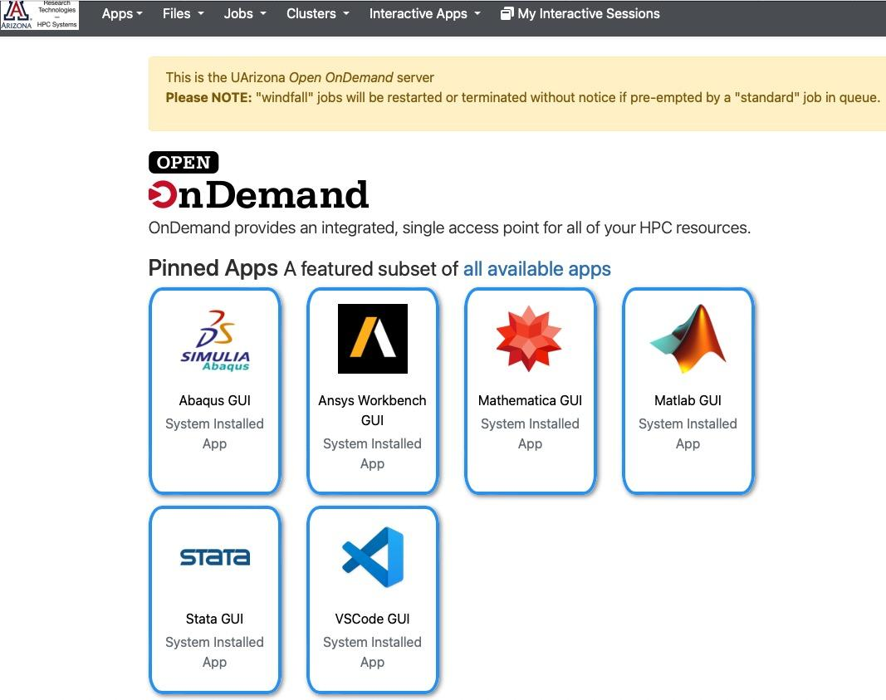
Interactive HPC:
ood.hpc.arizona.edu
Click on Matlab tile

Slide 9
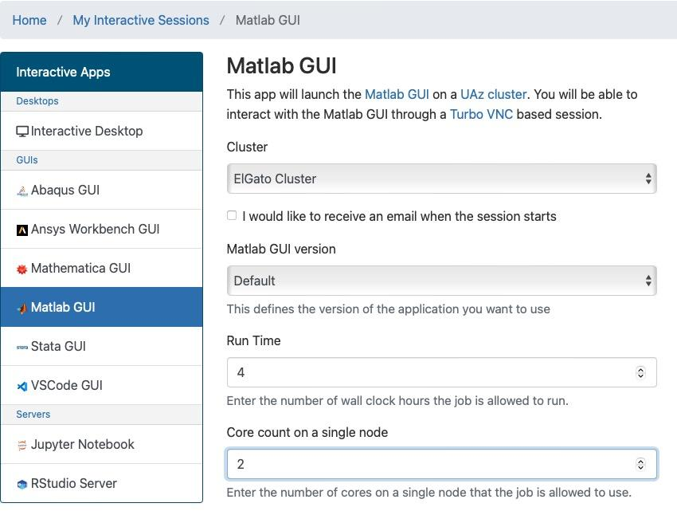
Notes:
After you select the Matlab application, fill out the form. In this example, we chose the ElGato Cluster, 4 hours and 2 cores. Matlab will use the number of cores you select here.

Slide 10
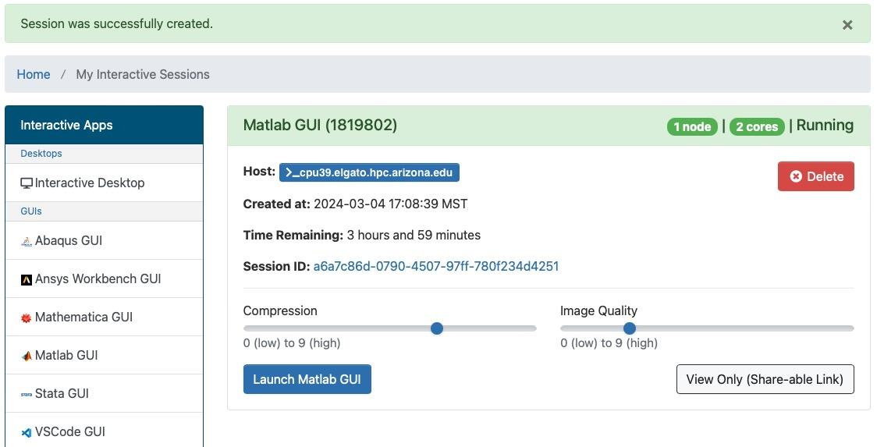
Notes:
After selecting the resources you will see this status screen while you wait for the session to start. How long that takes depends on how long the queue is. When your session has started, it looks like this with the name of the Host (compute node), time remaining, and a button for you to Launch Matlab GUI

Slide 11
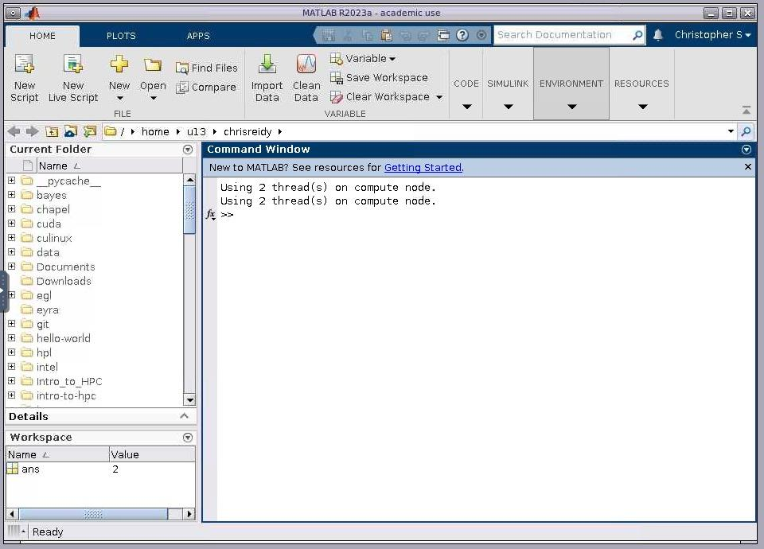
Notes:
The session starts connected to your home directory (top arrow)
And starts with two cores as we requested (bottom arrow)

Slide 12

Descriptive Statistics
Cluster Analysis ANOVA
Regression and Classification
Dimensionality Reduction
Probability Distributions
Hypothesis Tests
Industrial Statistics
Analysis of Big Data
Code Generation

Slide 13
Descriptive Statistics
Visualizing Multivariate Data
Efficiently summarize and validate large datasets using descriptive statistics and frequency distributions, including measures of central tendency and dispersion, stem plots, bar/pie charts and histograms.
Of the available examples we choose Visualizing Multivariate Data using three different statistical plots.

Slide 14
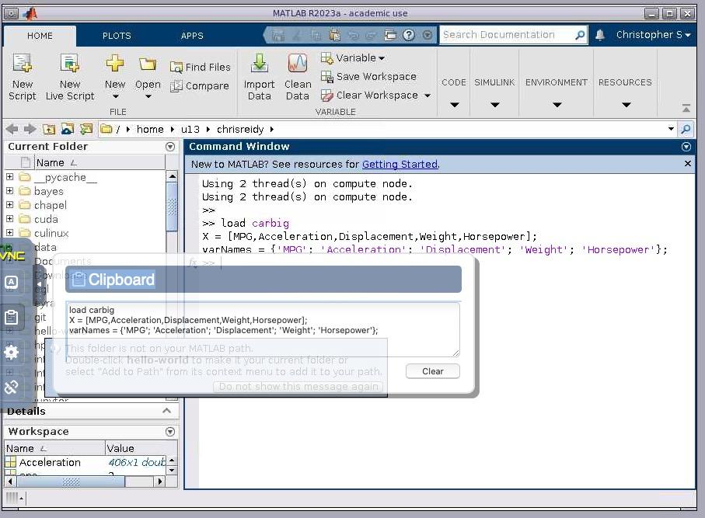
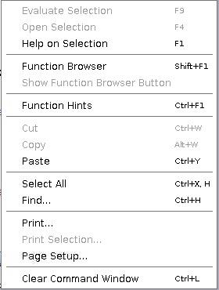
Descriptive Statistics
Visualizing Multivariate Data
To Cut and Paste:
Open Arrow
Select Clipboard
Paste with cmd-V
Right click
Paste
Notes:
This slide has an additional section that shows how to Cut and Paste, which is not intuitive

Slide 15
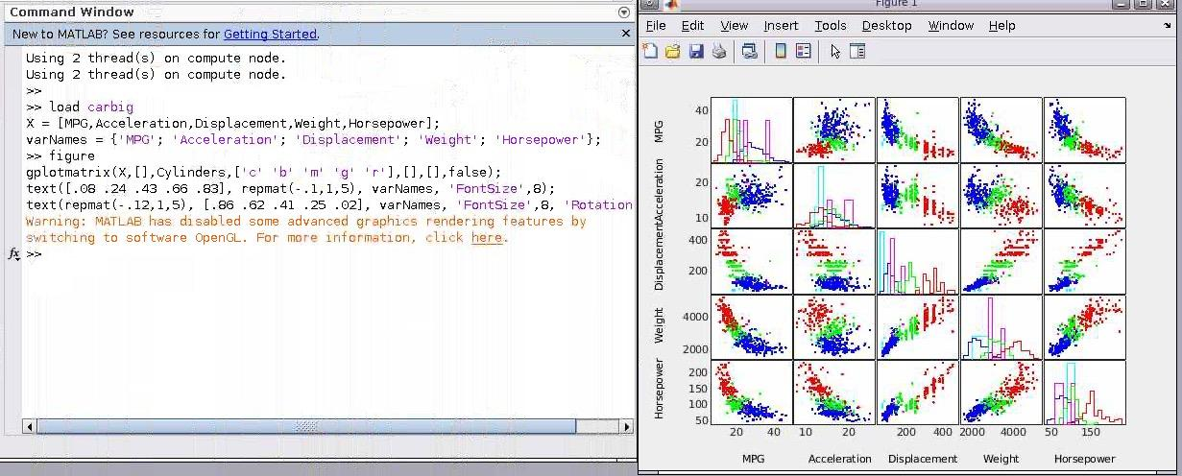
Descriptive Statistics
Visualizing Multivariate Data
Scatter Plot Matrices

Slide 16
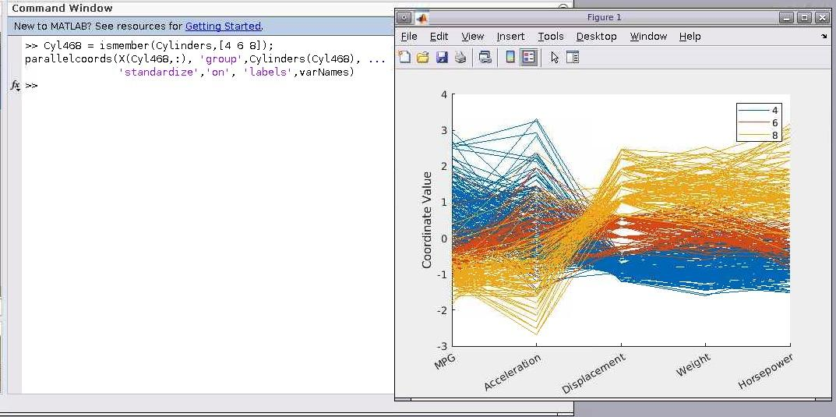
Descriptive Statistics
Visualizing Multivariate Data
Parallel Coordinates Plot

Slide 17
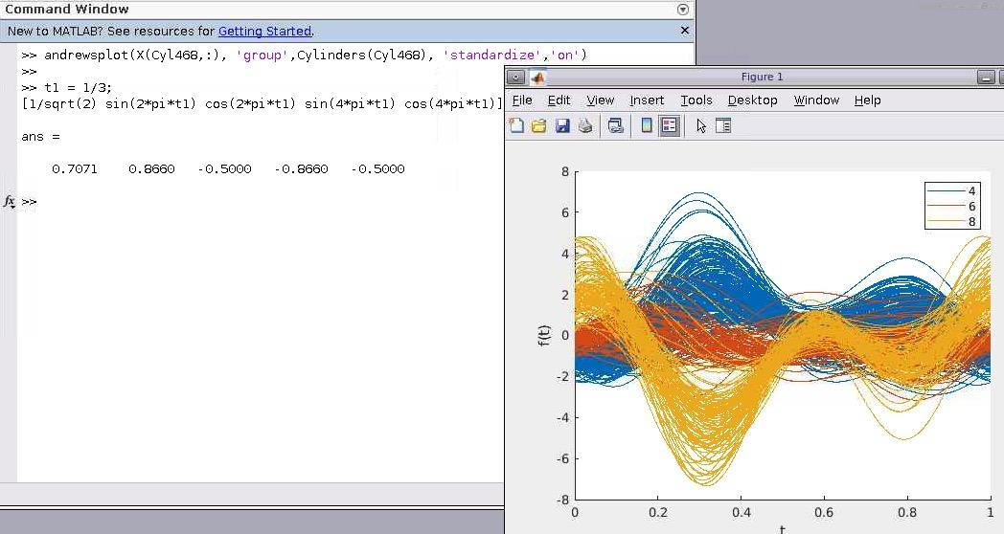
Descriptive Statistics
Visualizing Multivariate Data
Andrews Plot

Slide 18
Cluster Analysis
K-Means Clustering
Data often naturally fall into groups (or clusters) of observations,
where the characteristics of objects in the same cluster are similar.
This K-means example is extensive, and we just demonstrate
the first features.

Slide 19
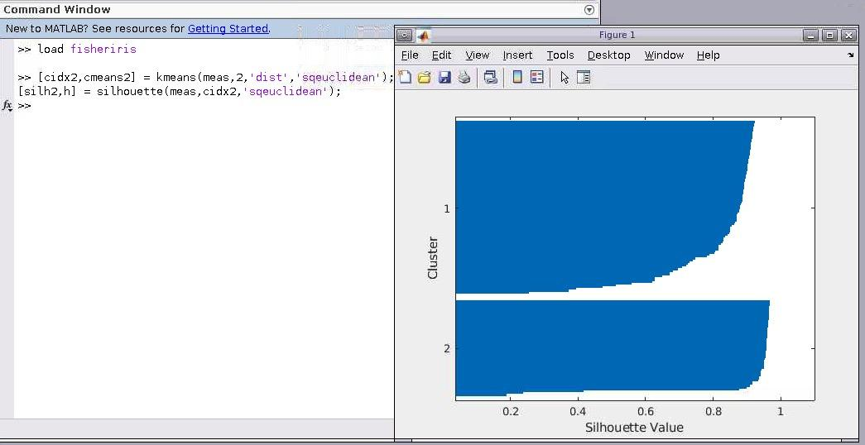
Cluster Analysis
K-Means Clustering

Slide 20
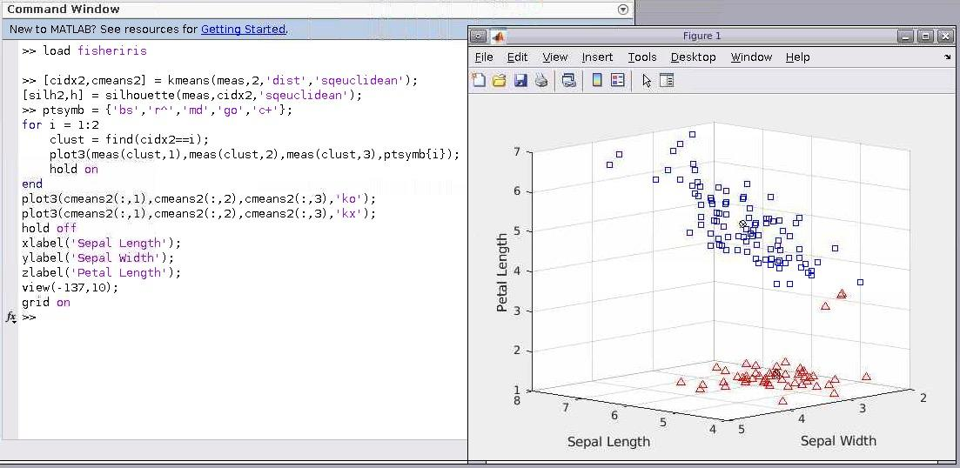
Cluster Analysis
K-Means Clustering

Slide 21
ANOVA
Analysis of Variance
In an ANOVA model, each grouping variable represents a fixed factor.
The levels of that factor are a fixed set of values.
The goal is to determine whether different factor levels lead to significantly different response values or outcomes.
This example starts the ANOVA process.
It continues with F-Statistics and Variance Components
using mean squares and confidence bounds

Slide 22
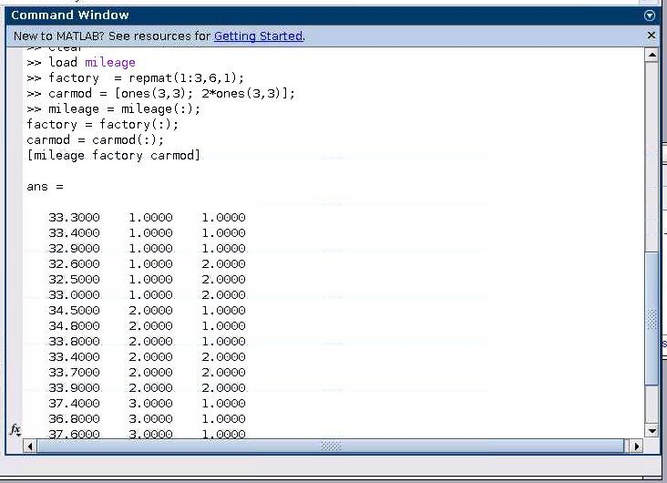
ANOVA
Analysis of Variance
Part 1

Slide 23
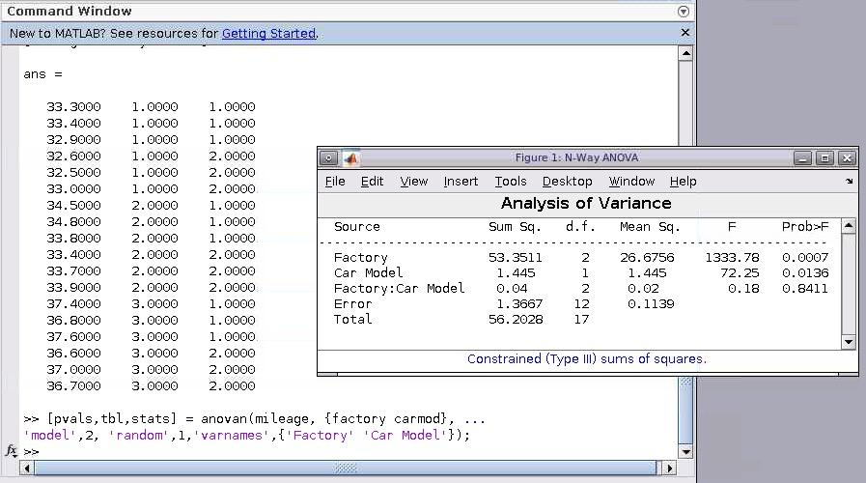
ANOVA
Analysis of Variance
Part 2

Slide 24
Statistics and Machine Learning Toolbox
Regression
Bayesian Analysis for a Logistic Regression Model
Use the Regression Learner app or programmatically train
and assess models such as linear regression,
Gaussian processes, support vector machines,
neural networks, and ensembles.
This example starts on Bayesian inferences
for a logistic regression model. Try the whole example
on your own.

Slide 25
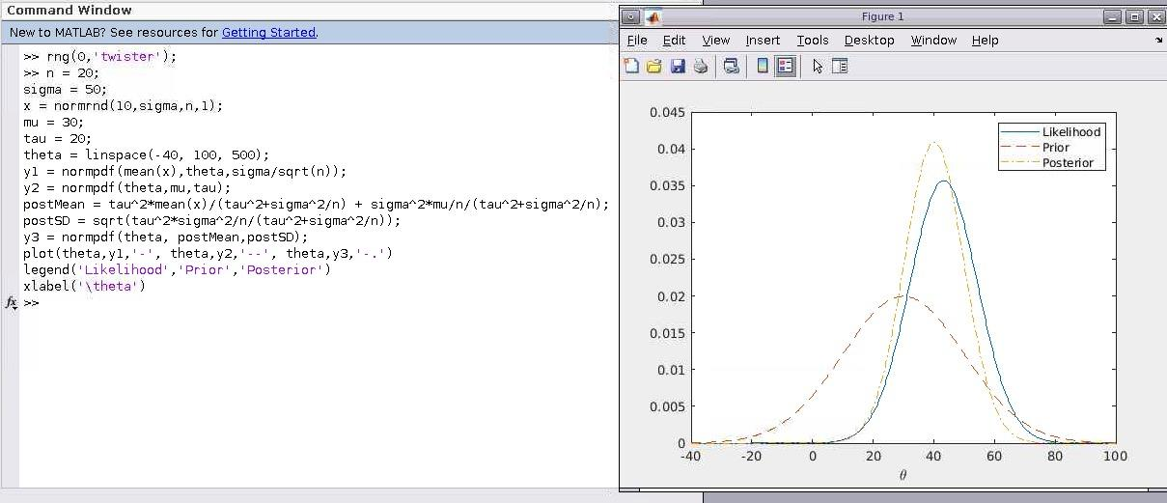
Statistics and Machine Learning Toolbox
Regression
Bayesian Analysis for a Logistic Regression Model

Slide 26
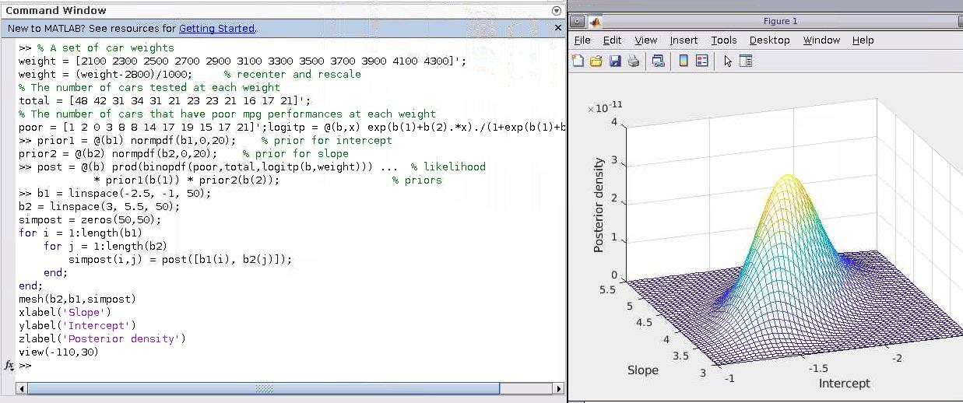
Statistics and Machine Learning Toolbox
Regression
Bayesian Analysis for a Logistic Regression Model

Slide 27
Statistics and Machine Learning Toolbox
Classification
Train Classification Ensemble
Use the Classification Learner app or programmatically train
and validate models such as logistic regression,
support vector machines, boosted trees, and shallow neural networks.
This example shows how to create a classification tree ensemble.

Slide 28
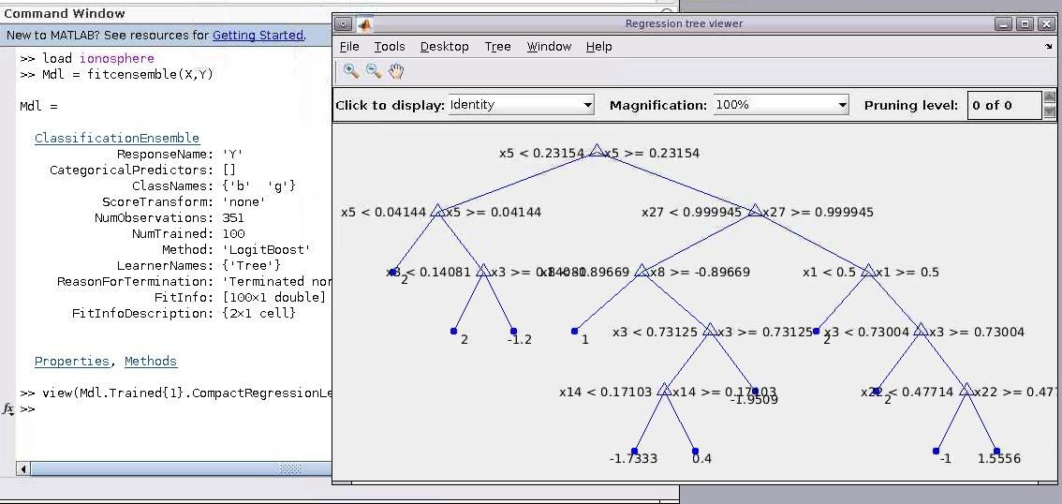
Statistics and Machine Learning Toolbox
Classification
Train Classification Ensemble

Slide 29
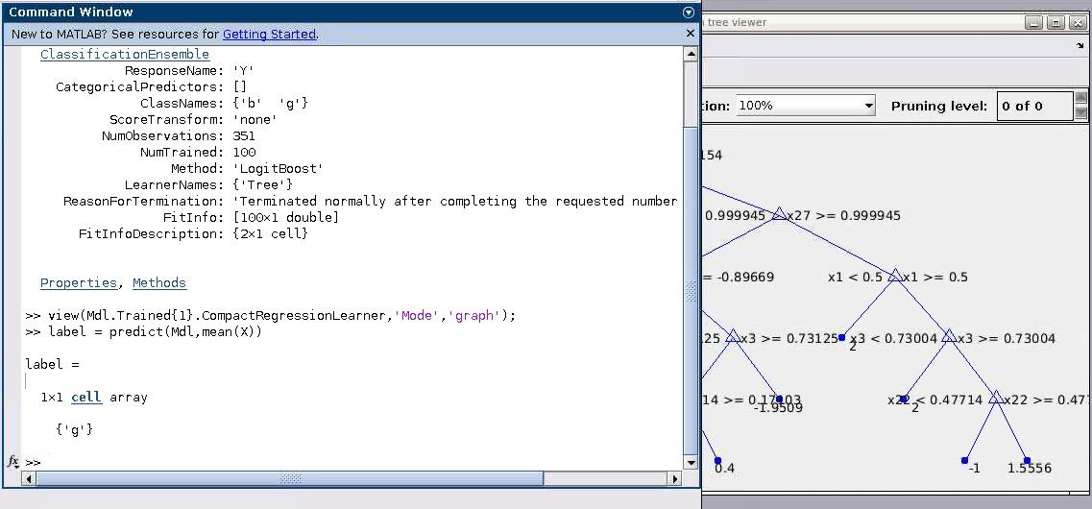
Statistics and Machine Learning Toolbox
Classification
Train Classification Ensemble

Slide 30
Statistics and Machine Learning Toolbox
Dimensionality Reduction and Feature Extraction
This toolbox has many tools including:
Sequential feature selection
Partial least squares regression
Principal components regression
Principal components analysis
Discriminant Analysis Classifier
Random forest predictors
Feature extraction workflow
Extract mixed signals
Visualize high-dimensional data
Factor analysis
Nonnegative matrix factorization
Multidimensional scaling

Slide 31
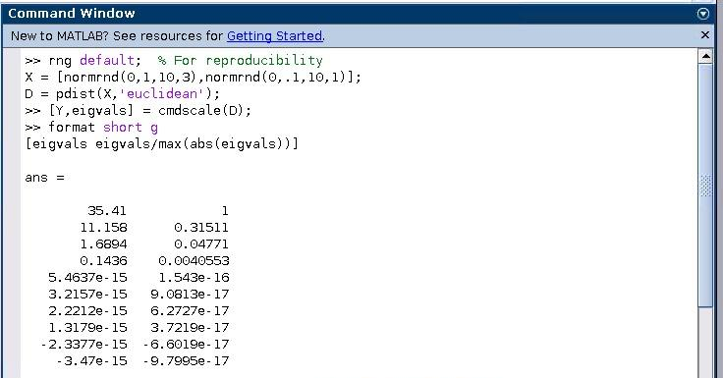
Statistics and Machine Learning Toolbox
Dimensionality Reduction and Feature Extraction
Classical Multidimension Scaling
Part 1

Slide 32
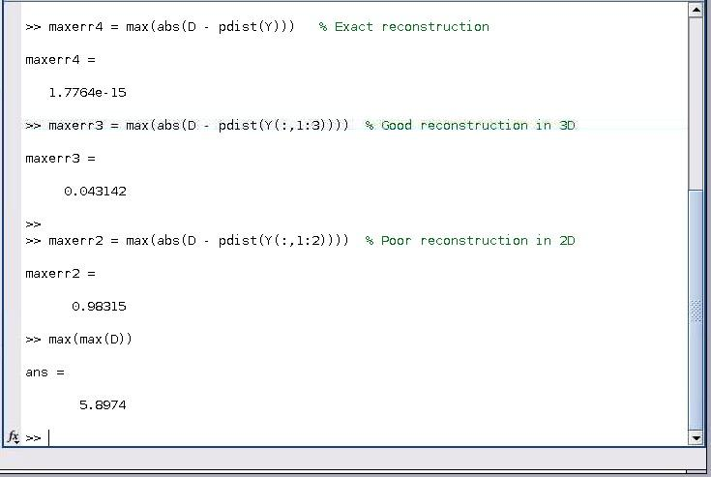
Statistics and Machine Learning Toolbox
Dimensionality Reduction and Feature Extraction
Classical Multidimension Scaling
Part 2

Slide 33
Probability Distributions
Compare Multiple Distribution Fits
Fit continuous and discrete distributions,
use statistical plots to evaluate goodness-of-fit,
and compute probability density functions.
This example shows how to fit multiple probability distribution objects
to the same set of sample data.

Slide 34
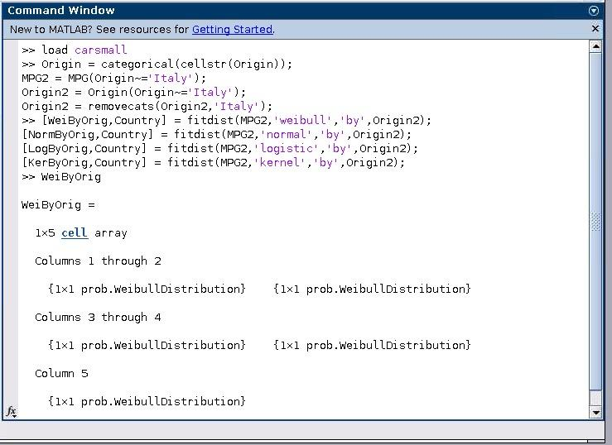
Probability Distributions
Compare Multiple Distribution Fits
Part 1

Slide 35
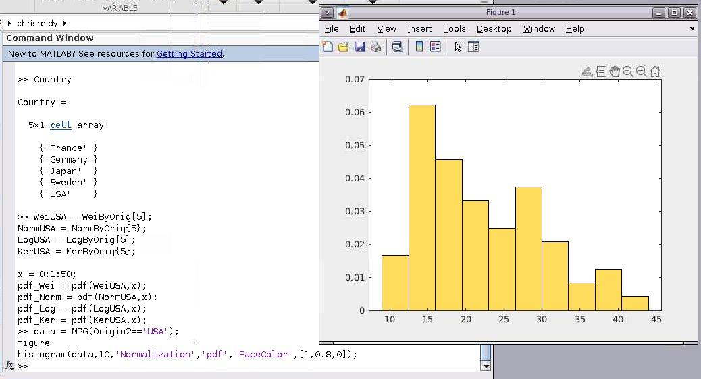
Probability Distributions
Compare Multiple Distribution Fits
Part 2

Slide 36
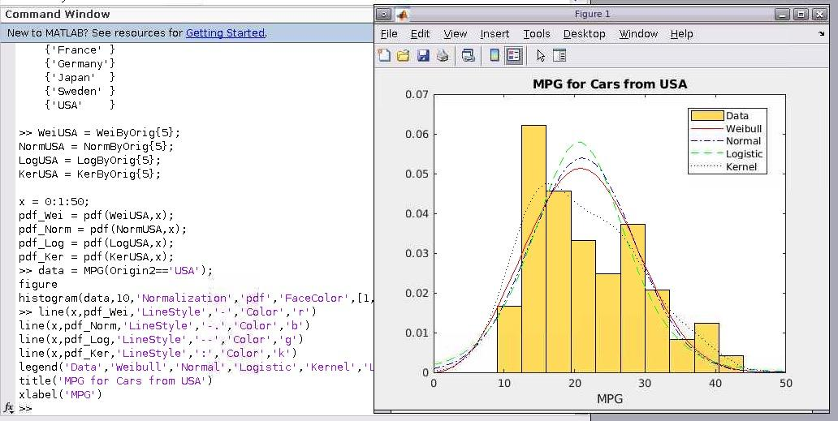
Probability Distributions
Compare Multiple Distribution Fits
Part 3

Slide 37
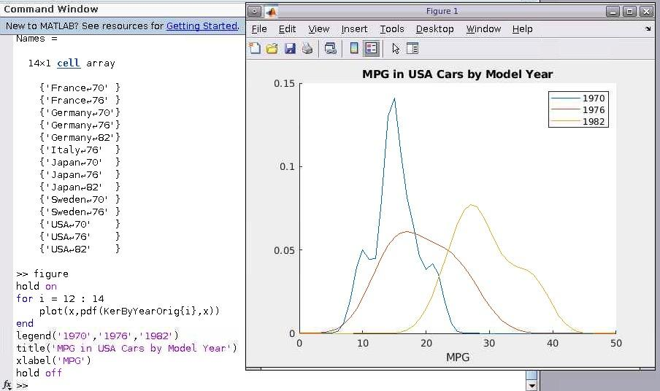
Probability Distributions
Compare Multiple Distribution Fits
Part 4

Slide 38
Hypothesis Testing
Draw inferences about a population
based on statistical evidence from a sample.
Perform parametric and nonparametric tests.
This example shows how to use hypothesis testing
to analyze gas prices measured across the state of Massachusetts
during two separate months.

Slide 39
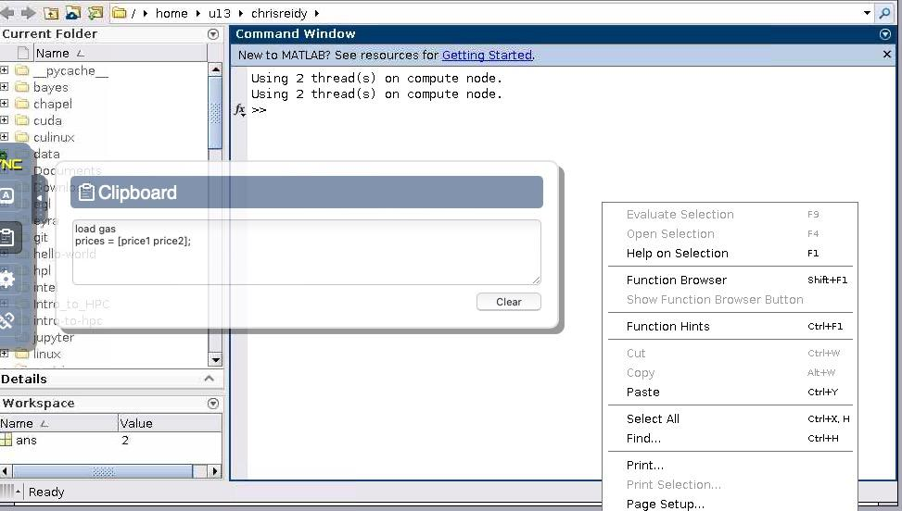
Hypothesis Testing

Slide 40
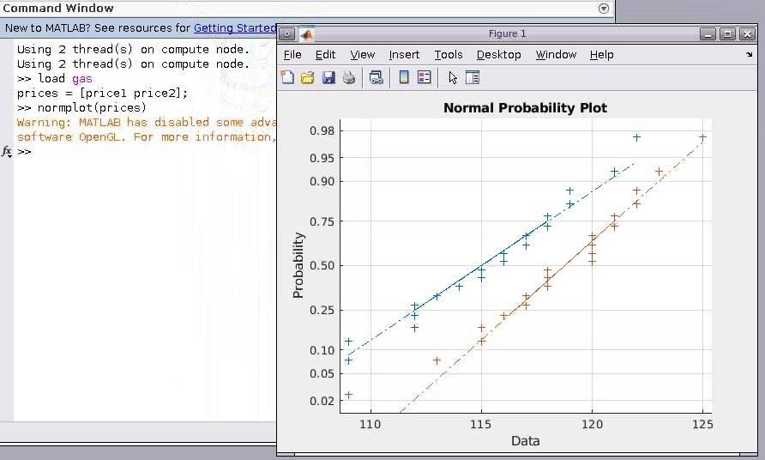
Hypothesis Testing
Part 1

Slide 41
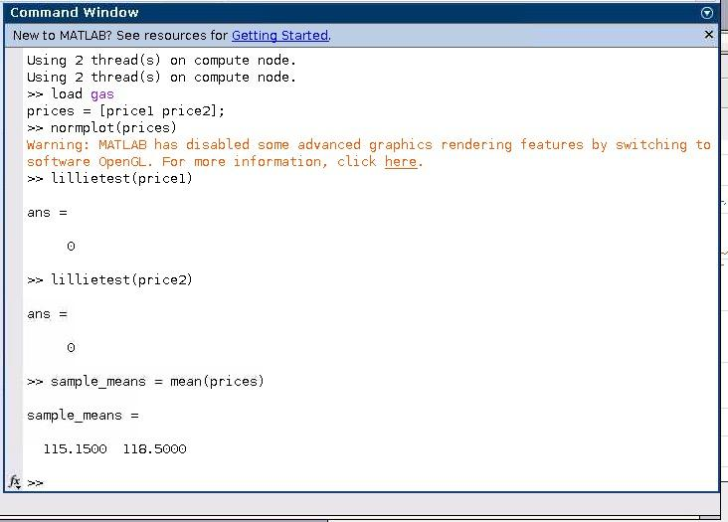
Hypothesis Testing
Part 2

Slide 42
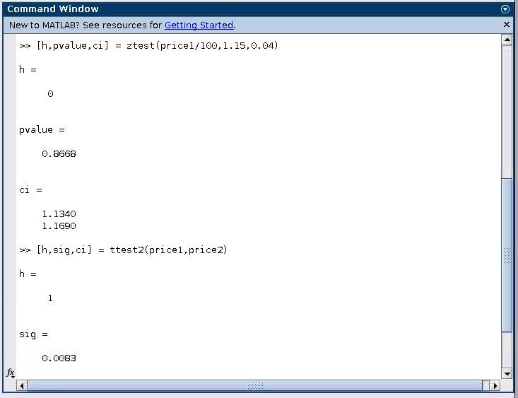
Hypothesis Testing
Part 3

Slide 43
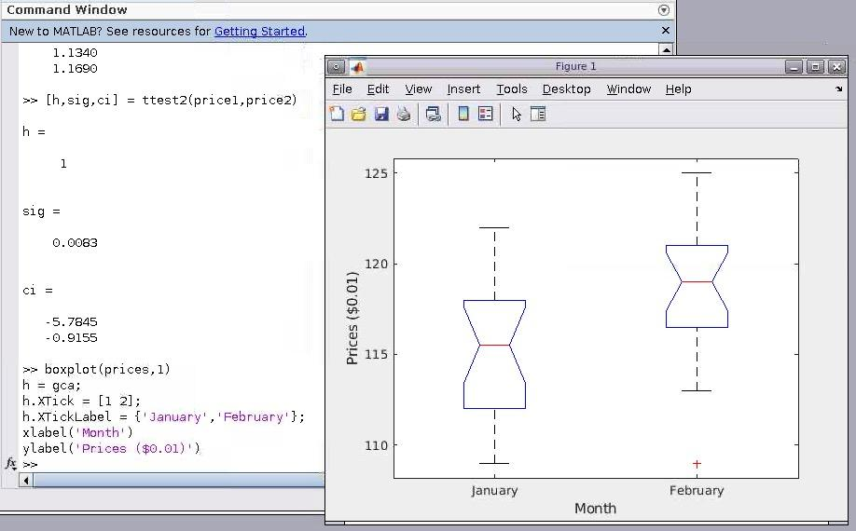
Hypothesis Testing
Part 4

Slide 44
Industrial Statistics
Analyzing Survival or Reliability Data
Survivor Functions for Two Groups
Hazard and Survivor Functions for Different Groups
Cox Proportional Hazards Model Object
Cox Proportional Hazards for Censored Data
Cox Proportional Hazards with Time-Dependent Covariates
Control Charts

Slide 45
Industrial Statistics
Control Charts
Control charts are created with the controlchart function.
Any of the following chart types may be specified:
Xbar or mean
Standard deviation
Range
Exponentially weighted moving average
Individual observation
Moving range of individual observations
Moving average of individual observations
Proportion defective
Number of defectives
Defects per unit
Count of defects

Slide 46
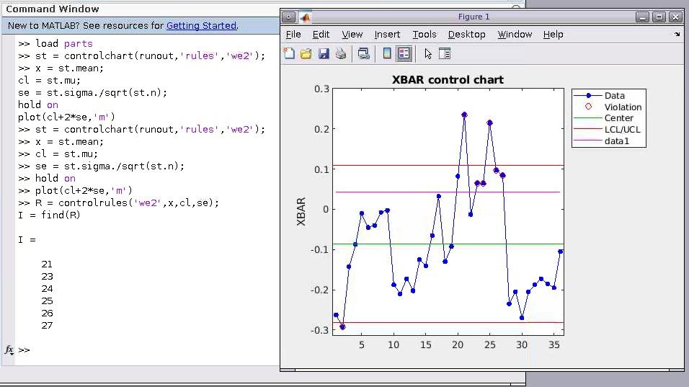
Industrial Statistics
Control Charts

