Slide 1
Performance Analysis and Optimization of 9-Point Stencil Computation
Using POSIX Threads, OpenMP, MPI, and Hybrid MPI+OpenMP

Slide 2
Project Background
Stencil computations are a fundamental algorithm class in scientific computing, used for applications like image processing and numerical simulations.
The study focuses on a 9-point stencil, which computes values based on neighboring elements in a 2D grid. We compare parallelization strategies to optimize performance.

Slide 3
Methods Overview
The project implemented and analyzed the 9-point stencil using:
- Serial Baseline Implementation
- POSIX Threads (Pthreads)
- OpenMP (Shared Memory)
- MPI (Distributed Memory)
- Hybrid MPI+OpenMP
Each method offers unique trade-offs in performance, complexity, and scalability.

Slide 4
Experimental Setup
Experiments were conducted on the Expanse supercomputer with:
- Hardware: AMD EPYC 7742, 256 GB DDR4, HDR-100 InfiniBand
- Matrix Sizes: 5000x5000 to 40000x40000 elements
- Performance Metrics: Execution time, speedup, efficiency, and overhead
Data was collected using high-precision timing methods and analyzed for different configurations.

Slide 5
Performance Metrics
Key metrics analyzed in the study include:
- Speedup: Ratio of serial to parallel execution time.
- Efficiency: Speedup normalized by the number of threads/processes.
- Overhead: Time spent in communication, synchronization, or management.
- Resource Utilization: CPU, memory bandwidth, and network efficiency.

Slide 6
Implementation Details
Each approach followed a common stencil computation algorithm, with differences in parallelization strategy:
- POSIX Threads: Manual thread management and synchronization.
- OpenMP: Simplified directives for shared memory parallelism.
- MPI: Distributed memory with halo exchanges.
- Hybrid MPI+OpenMP: Combines inter-node and intra-node parallelism.

Slide 7
POSIX Threads Implementation
This implementation uses POSIX threads to divide the workload across multiple threads, with explicit synchronization and memory management.
void* stencil_thread_func(void* args) {
ThreadArgs* threadArgs = (ThreadArgs*)args;
for (int iter = 0; iter < threadArgs->numIterations; iter++) {
for (int i = actualStart; i <= actualEnd; i++) {
for (int j = 1; j < cols-1; j++) {
matrix1[i][j] = (matrix[i - 1][j - 1] + ... + matrix[i][j]) / 9.0;
}
}
my_barrier_wait(threadArgs->barrier);
double **temp = matrix1; matrix1 = matrix; matrix = temp;
my_barrier_wait(threadArgs->barrier);
}
}

Slide 8
OpenMP Implementation
The OpenMP implementation simplifies thread management with compiler directives, ensuring efficient parallelization with minimal code complexity.
#pragma omp parallel for
for (int i = 1; i < rows - 1; i++) {
for (int j = 1; j < cols - 1; j++) {
matrix1[i][j] = (matrix[i - 1][j - 1] + ... + matrix[i][j]) / 9.0;
}
}
double **temp = matrix1; matrix1 = matrix; matrix = temp;

Slide 9
MPI Implementation
MPI distributes the matrix rows across processes, with halo exchanges for boundary communication, optimizing performance on distributed memory systems.
void stencil2DMPI(double **subs, double **subs1, MPI_Datatype dtype, int m, int n, MPI_Comm comm) {
for (int i = 1; i < local_rows - 1; i++) {
for (int j = 1; j < n - 1; j++) {
subs1[i][j] = (subs[i - 1][j - 1] + ... + subs[i][j]) / 9.0;
}
}
}

Slide 10
Hybrid MPI+OpenMP Implementation
This implementation combines inter-node MPI communication with intra-node OpenMP parallelization, achieving optimal scalability for large problem sizes.
#pragma omp parallel for
for (int i = 1; i < local_rows - 1; i++) {
for (int j = 1; j < n - 1; j++) {
subs1[i][j] = (subs[i - 1][j - 1] + ... + subs[i][j]) / 9.0;
}
}
MPI_Barrier(comm); // Synchronization across processes

Slide 11


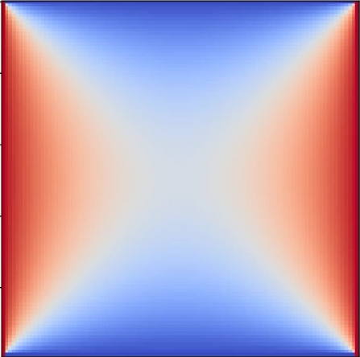
Heat Transfer Plates
Initial State Middle State Final State

Slide 12
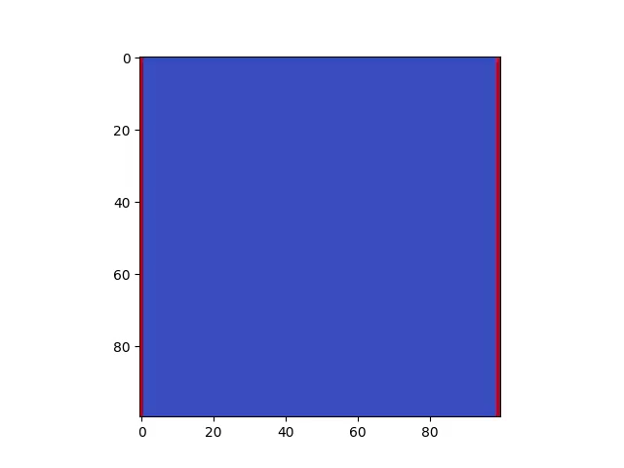
Heat Transfer Movie
100 x 100 Matrix
5000 Iterations

Slide 13
Results and Analysis
Performance comparisons revealed distinct patterns:
- OpenMP and Pthreads showed similar scaling for single-node systems.
- MPI achieved strong scaling across nodes but had communication overhead.
- Hybrid MPI+OpenMP offered the best balance for large problem sizes.
Graphs illustrate speedup, efficiency, and resource utilization trends.

Slide 14
Conclusions
Key Findings:
- Parallelization significantly improves performance for large matrices.
- Hybrid MPI+OpenMP balances computational and communication overhead.
- Resource management and optimization are critical for scalability.
Future Directions:
- Explore GPU acceleration and adaptive load balancing.
- Optimize communication and memory access patterns.

