Slide 1
MPI00
By: Devin Guo

Slide 2

Compilation of Program

Slide 3
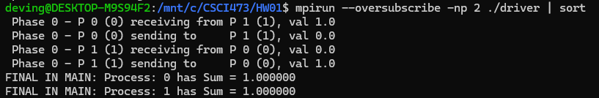
Execution of Program with 2 Processes

Slide 4
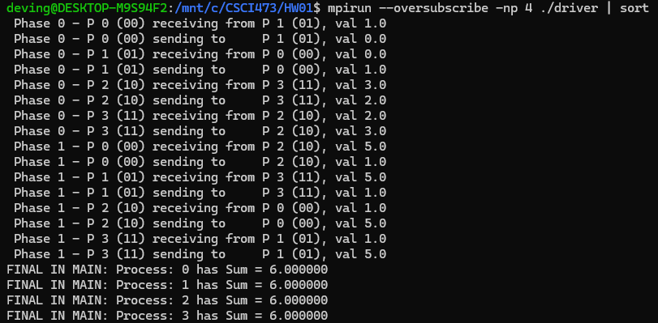
Execution of Program with 4 Processes

Slide 5
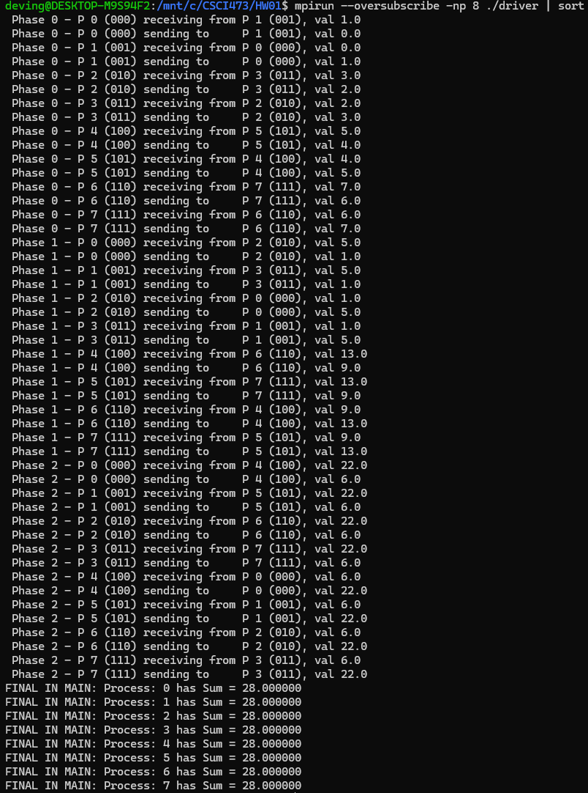
Execution of Program with 8 Processes

Slide 6
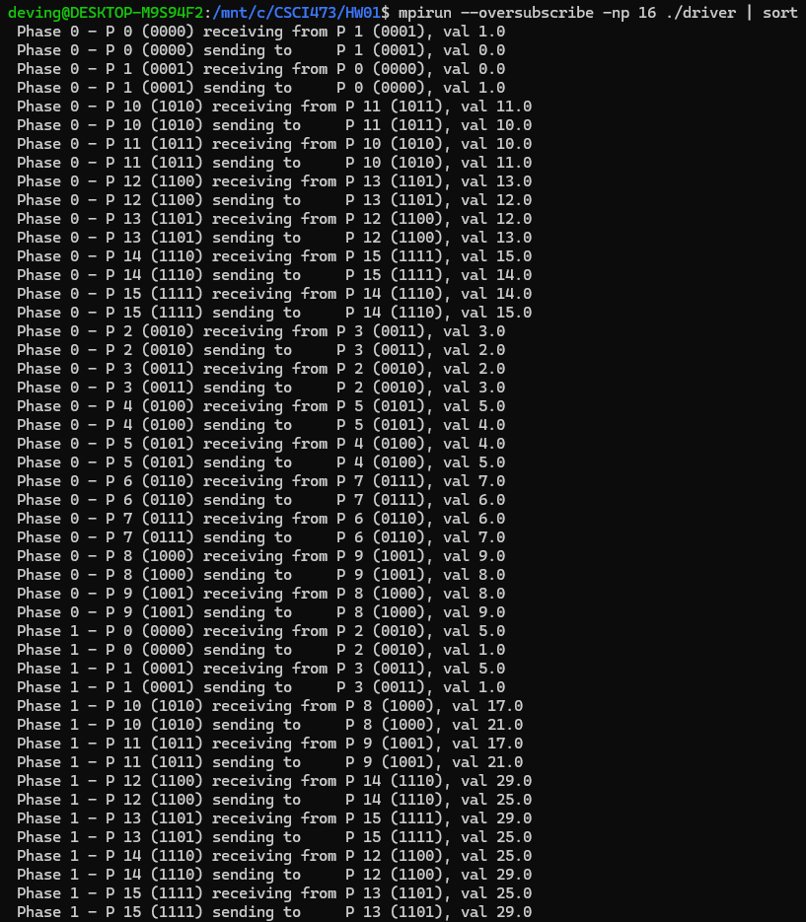
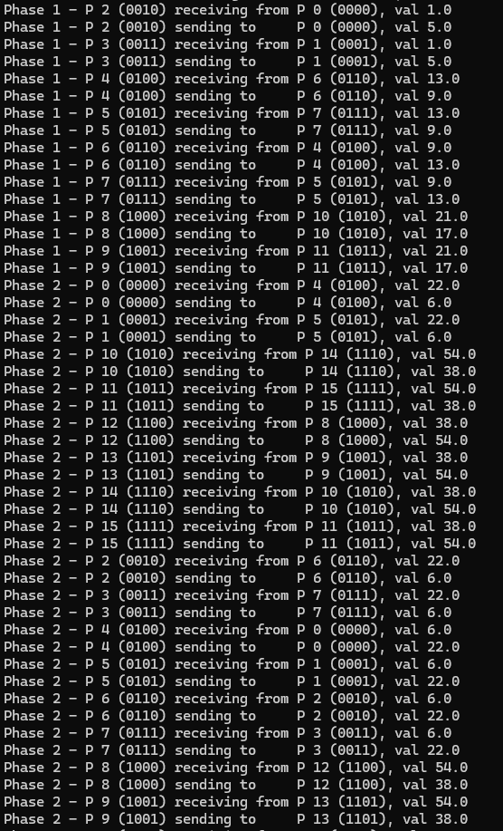
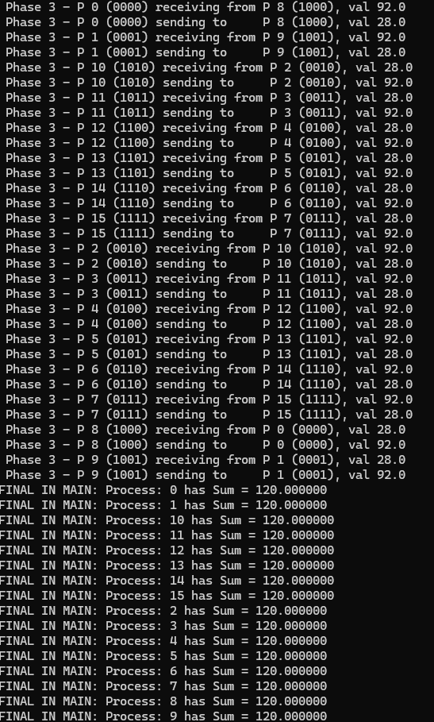
Execution of Program with 16 Processes

Slide 7
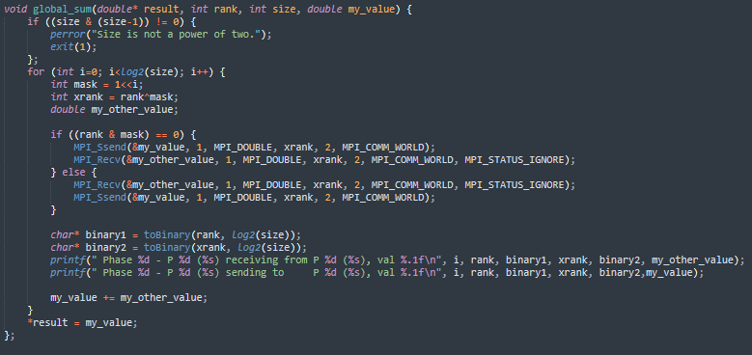
Global_Sum Function

Slide 8
Global_Sum Function Explanation
First checks to make sure the size is a power of 2. The global_sum function computes the total sum of values from multiple MPI processes. It does this by having processes exchange values in several steps. Each step involves pairs of processes communicating with each other, where one sends its value and the other receives it. The decision of who sends and who receives first is based on the bitwise “and” of the rank and mask. The mask is determined by the shifting of 1 to the left every iteration. This pattern ensures that every process gets to share its value and receive others' values. After going through all the steps, the final sum is calculated and stored, with logs printed to show how the data was exchanged.

Slide 9
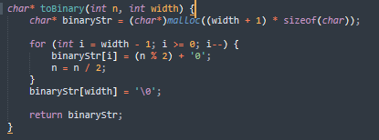
toBinary Function

Slide 10
toBinary Function Explanation
The toBinary function converts an integer n into a binary string with a specified width. It allocates memory for the binary string, which includes space for a null terminator. To determine the binary string, the function repeatedly divides n by 2, recording the remainder for each division as the binary digits. It starts from the least significant bit (rightmost) and converts each remainder to a character ('0' or '1'), then updates n by dividing it by 2. The digits are placed in the string from end to start to ensure the correct order. After processing all bits, the function ensures the string is null-terminated and returns it.

Slide 11
Program Discussion
This program performs a parallel reduction to calculate the global sum of values distributed across multiple MPI processes. The global_sum function uses a binary tree-like communication pattern to get the values. Each process exchanges data with another process determined by the phase number and the binary representation of their ranks. If the process's rank, masked by a bit pattern, matches certain criteria, it either sends or receives a value first. The resulting value is then returned and printed to the console.

