Slide 1
House Prices
The Standard Deviations: Devin Fagan, Jingrou Wei, Doug Devens, Catherine Tang Kim Sin

Slide 2
Flow of Presentation
About the dataset
Data cleaning
Models
Application

Slide 3
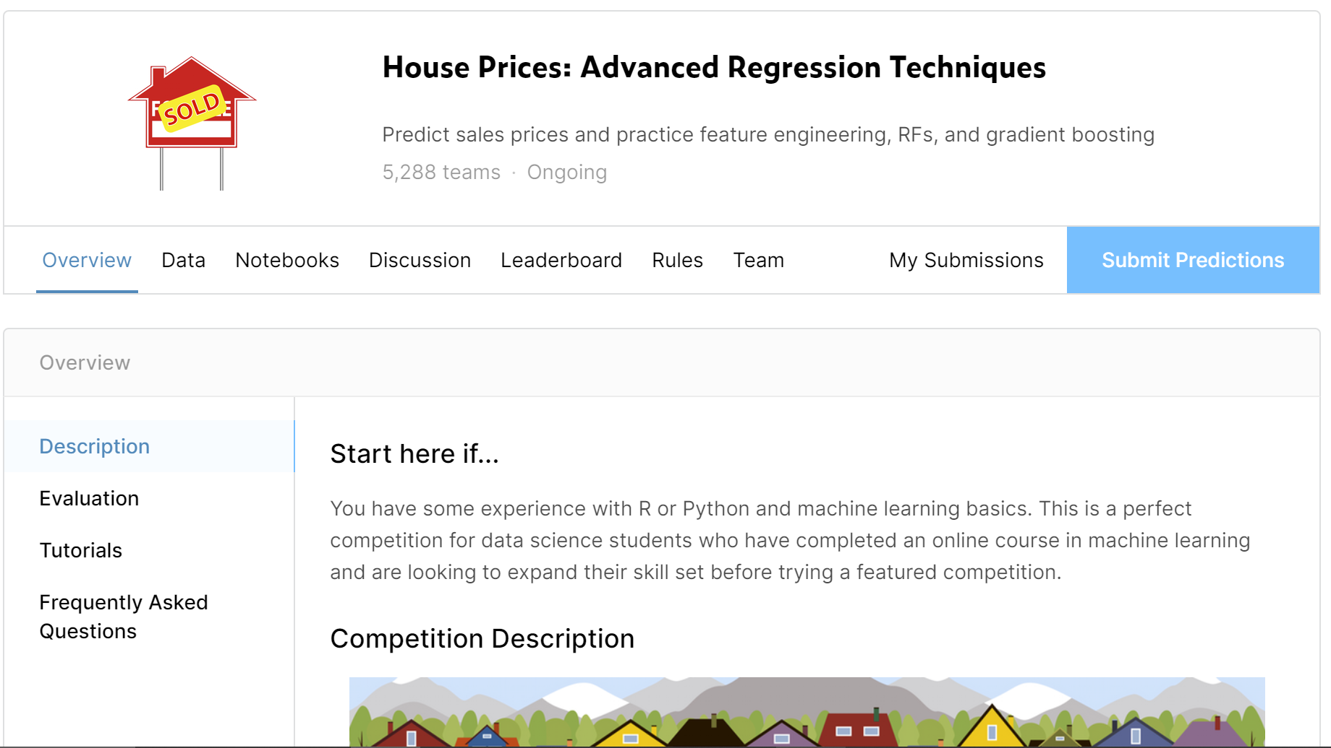
About the Data Set
Data are from Kaggle.com
Residential home sale prices in Ames, Iowa
Modern version of the Boston Housing Data Set
Obtain a training set and a submission/test set
79 features (43 string/ categorical and 38 continuous)
1460 observations per file

Slide 4
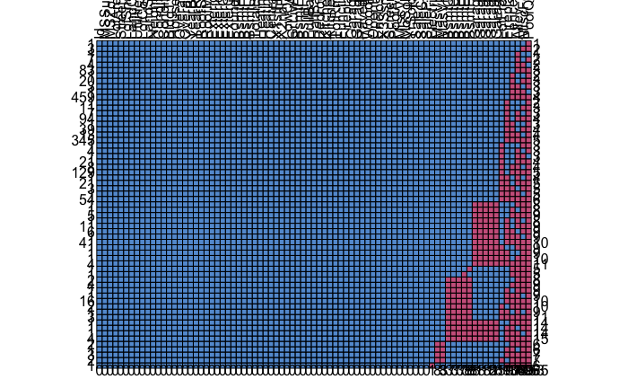
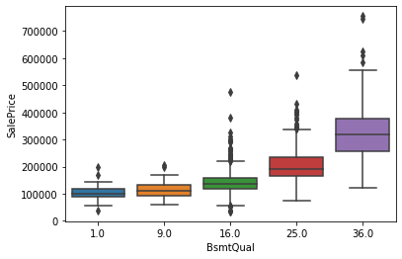
Data preparation and analysis
Fill NA’s and mistypes with random imputation where applicable
Change ordinal rankings to continuous variables, but square them
Notes:
**********

Slide 5
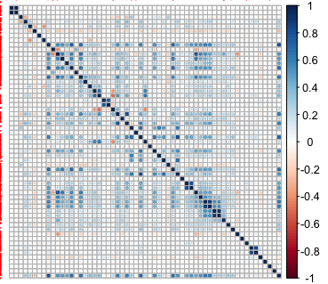
Data preparation and analysis
Find correlations in the data
Examined correlations between continuous variables with Pearson’s R
Used ANOVA for categorical and continuous variables
ChiSquare to identify correlations within categoricals
Ended with:
180 feature variables that we then scaled MinMax to 0 to 1
1460 observations
Scaled Price with log transform
Changed remaining categoricals to continuous variables through dummification

Slide 6
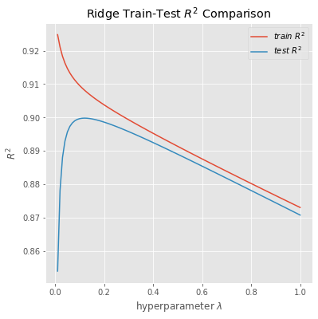
Ridge
Ridge (normalize = True, alpha = 0.1)
Train Score: 0.870
Test Score: 0.854

Slide 7
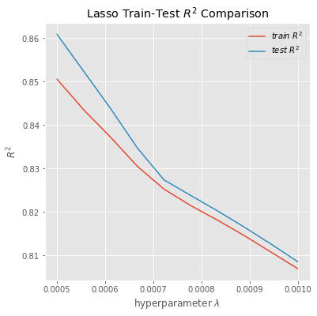
Lasso
Lasso(alpha=0.0007, normalize = True, selection = 'cyclic', max_iter=100000)
Train Score: 0.827
Test Score: 0.829

Slide 8
Elastic Net
ElasticNet(alpha=0.0007, l1_ratio=0.3, fit_intercept=True, normalize=True, precompute=False, max_iter=100000, copy_X=True, tol=0.0001, warm_start=False, positive=False, random_state=None, selection='cyclic')
Train Score: 0.862
Test Score: 0.855

Slide 9
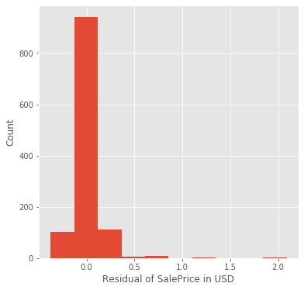
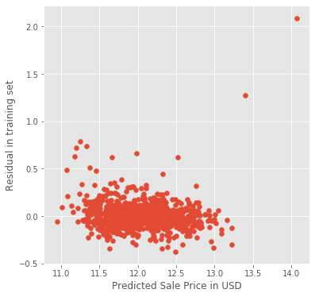
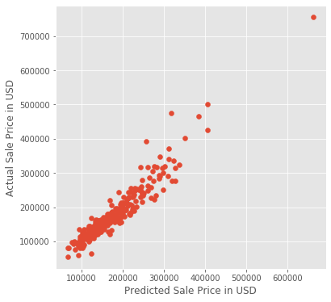
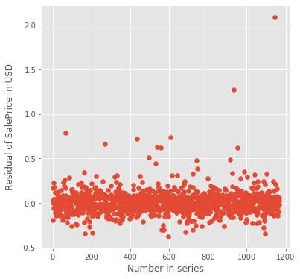
Support Vector Regression
svr = Pipeline([('scaler', preprocessing.MinMaxScaler()), ('svr', SVR())])
svr.set_params(svr_C= 0.045, svrepsilon = 0.06, svr_kernel = 'linear')
Train Score: 0.881
Test Score: 0.875
Nearly normal, but outliers
Nearly constant error with fit
Linear relation
Independent error

Slide 10
Random Forest
randomForest = RandomForestRegressor(n_estimators=1200, max_depth=15, min_samples_split=5, min_samples_leaf=5, max_features=None, oob_score=True, random_state=42)
Train Score: 0.9693484510465388
Test Score: 0.8966620927137744

Slide 11
Gradient Boost
GradientBoostingRegressor(n_estimators=6000, learning_rate=0.01, max_depth=4, max_features='sqrt', min_samples_leaf=15, min_samples_split=10, loss='huber', random_state=42)
Train Score: 0.9365707489895121
Test Score: 0.8664361275667909

Slide 12
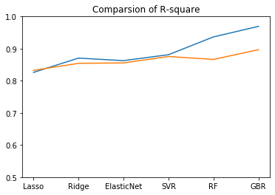
Chosen Model
Reasons for using SVR
The SVR had a small gap between the train and test R2, comparable to other multiple linear regressions
The SVR also had test R2 comparable to the Random Forest and Gradient Boost, but with no overfit.
SVR, like the multiple linear models, allows examination of coefficients for each variable so a quantitative prediction can be made going forward.

Slide 13


Applications
Homeowner
House Flipping

Slide 14
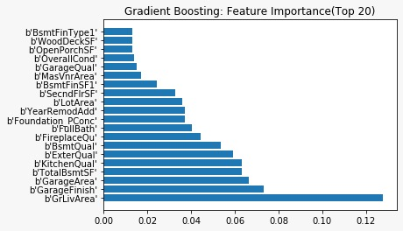
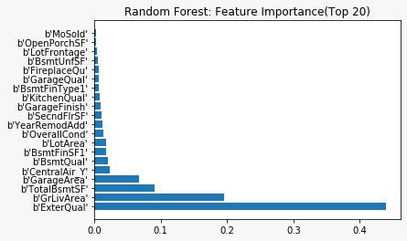
Feature Importance

Slide 15


Example
SalePrice = e^{Yj+ΔYj} = e^{Yj} e^{ΔYj}
Assume e^{Yj} is the median SalePrice, model calculates ΔY_{j}.
The price increase is: Median_SalePrice * (e^{ΔYj} -1)
Median house price : 163,000.00 USD

Slide 16

Basement and Garage
No open and exposed beams, drywalled, textured and painted.
Finished to use as an extra bedroom, a bonus room, or as a rentable space.
- Adding 150 sq ft of garage space by 4,000 USD
- Adding 200 sq ft of basement space by 1,500.00 USD

Slide 17

Kitchen Quality
Cabinets
Kitchen Island
Granite Counters
Stainless Steel Energy Efficient Appliances
- Improving Kitchen Quality from Fair to Good by 8,300.00 USD

Slide 18

Bathroom Quality
2 inch draining pipes
Lighting
Tiles
Windows
- Adding a Full Bathroom by 11,300.00 USD

Slide 19
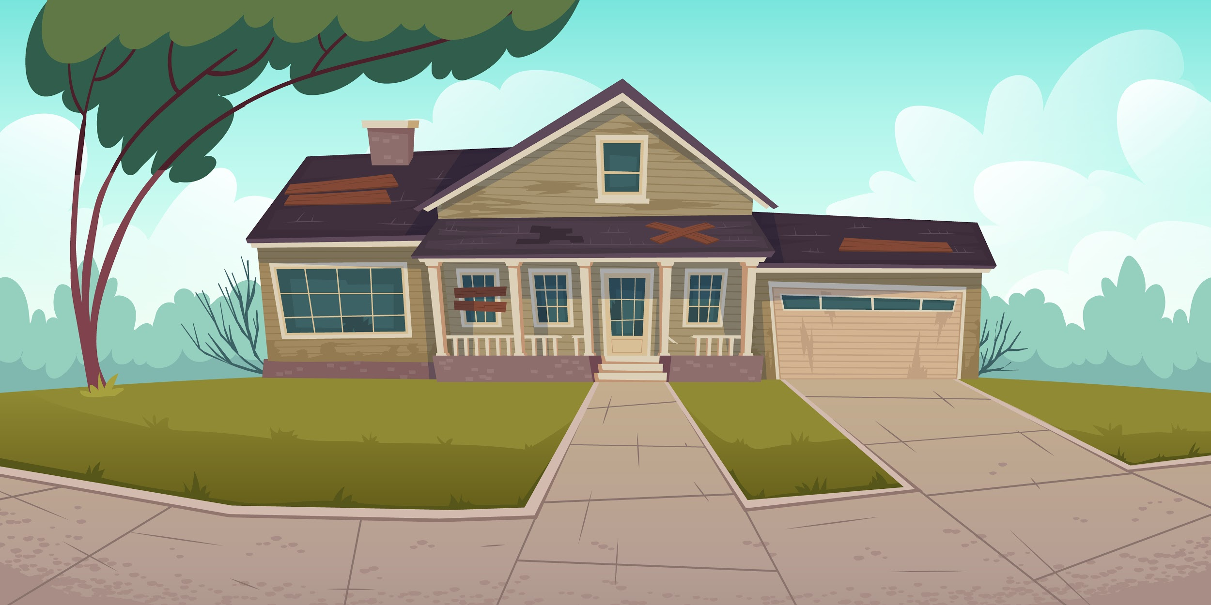
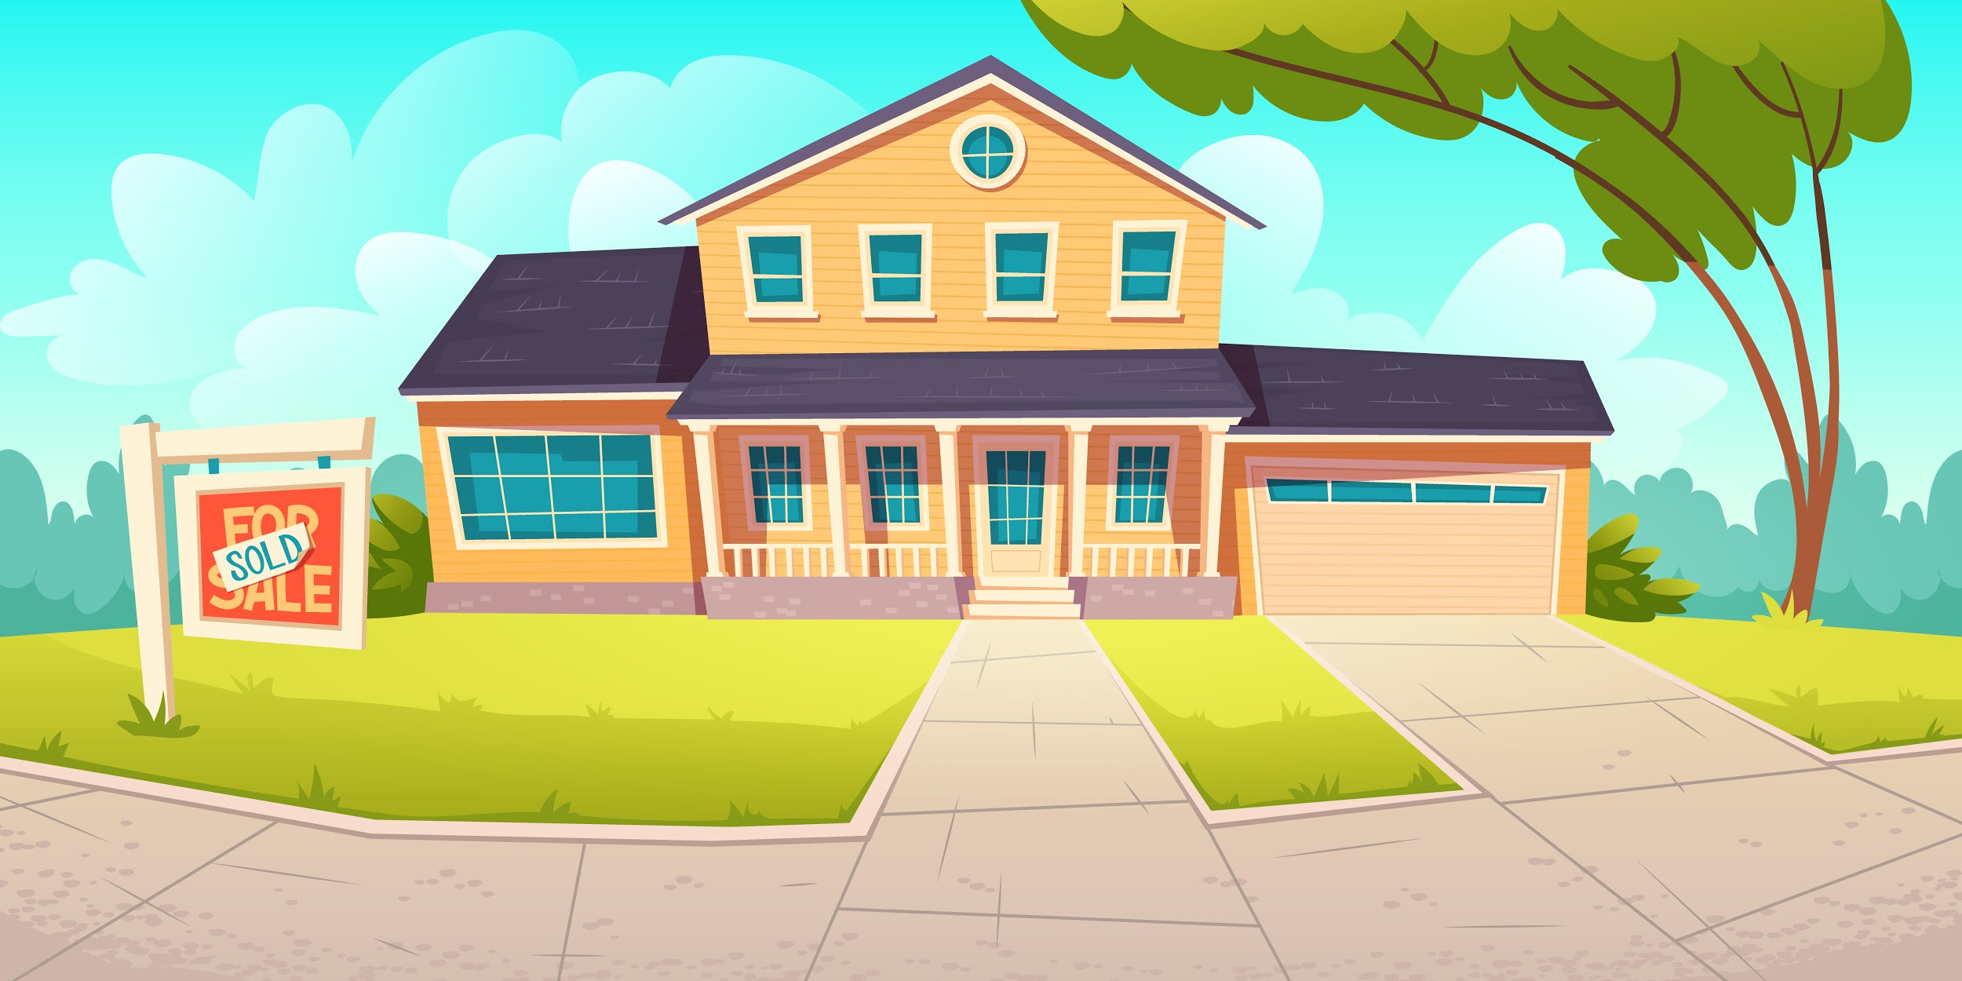
Exterior Quality
Fiber Cement Sidings
Landscape
Fence
Shutters
Garage Doors
- Improving overall condition of the house (Below Average to Above Average) by 6,400.00 USD
- Adding 500 sq ft can increase house price by approximately 7,500.00 USD

