Slide 1



Welcome to
REST API testing and automation using
Java programming
&
Open Source Tools

Slide 2
Agenda
Basics of web application, web service.
REST API and SOAP API, discussion and difference.
REST API testing in general (Why/ How etc).
Richardson Maturity Model for RESTful API.
REST API URL format (in general).
Topics relevant to JAX-RS.
HTTP request/ response parameters.
“User management” - REST API based web application for our demo and it’s specifications.
Testing aspects for this web application.
Testing using programming language.
Testing using open source tools.

Slide 3
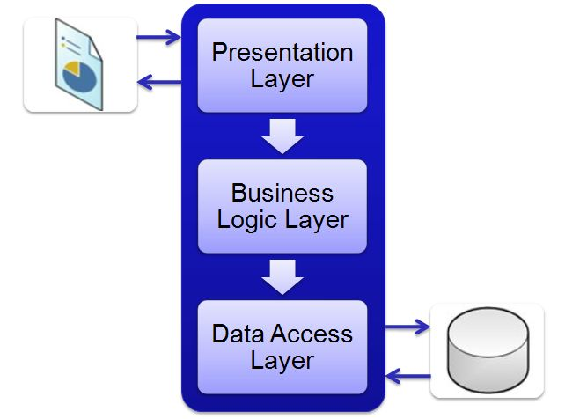
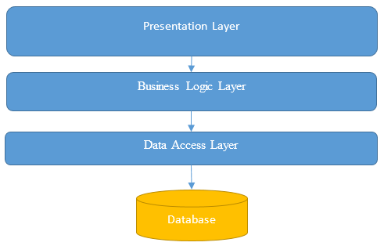
REST API testing in general (Why/ How)
GUI testing
API testing
API testing to verify functionality on cross platform support and multi language support.
GUI tests can't sufficiently verify functional paths and back-end APIs/services associated with multitier architectures.
To determine whether APIs return the correct response (in the expected format).

Slide 4
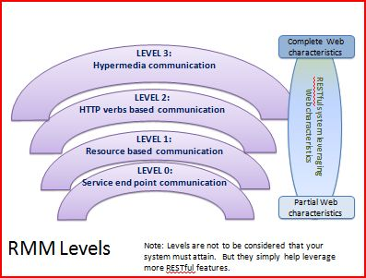
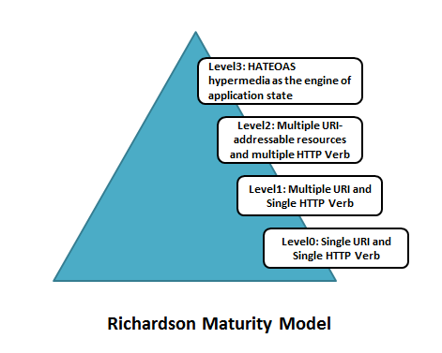
Richardson Maturity Model for RESTful API

Slide 5
Richardson Maturity Model for RESTful API
Ref: https://technobeans.wordpress.com/2012/09/12/maturity-model-of-web-services/
Level 0 - Swamp of POX:
1) This refers to the most elementary level maturity of service. Web Services that use HTTP as tunnel for remote procedure invocation on a single URI come under Level 0 maturity level. Typically only one HTTP Verb (POST or GET) used for communication to the end point. SOAP Web Services that work with XML Payload are an example of this maturity level.
Level 1-Resources:
1) Services at this level of maturity use multiple URIs (logical resources) but use single HTTP Verb (GET or POST). Hence instead of making call to one URIs, call can be made to multiple resources to perform different jobs.
2) Rather than making all our requests to a singular service endpoint, we now start talking to individual resources.
Level 2-HTTP Verbs:
1) At this level, services use multiple logical resources and also multiple HTTP Verbs for communication. 2) Idea is to closely mimic the use of Verbs to the operation being performed. For instance, GET would just read information on a resource, while POST would create new resource. PUT would update and DELETE will remove the resource. CRUD Web services are an excellent example of Level 2 Services.
3) This level suggests that in order to be truly RESTful, your API MUST use HTTP verbs.
Level 3-Hypermedia controls:
1) In this level, services provide links to other resources that client maybe interested in. RESTful Web Services fall under this category.
2) Uses HATEOAS to deal with discovering the possibilities of your API towards the clients.
3) Resources contain links to related resources and collections, and also links to perform actions on the resources themselves.
4) HATEOAS stands for Hypertext As The Engine Of Application State.

Slide 6
REST API URL format (in general)
<protocol>://<uri:port>/<version>/<serviceendpoint>/<parameters>
e.g.
https://github.com:8080/v3/users?id=mademethink
Topics relevant to JAX-RS
Application for demo is designed based on JAX-RS (JAVA API for RESTful Web Services).
Aannotations available from JAX-RS API specification, for sending data from client-side to service endpoint: @BeanParam
@PathParam @FormParam, @MatrixParam
@QueryParam @HeaderParam @CookieParam

Slide 7
Topics relevant to JAX-RS
@BeanParam annotation is added in JAX-RS 2.0 version. This annotation can be used along with a Bean class for using other annotation types such as @FormParam, @HeaderParam etc. as the field level, for using an application specific bean class as argument in the service method, rather than using a long list of argument parameters for each of the different type of attributes used along with a request.
Suppose there is a HTML form with ten fields/attributes that is used to receive input from user, and this data/fields are to be submitted to the service method, then the REST service method would require to define all the ten attributes as arguments for the service method along with @FormParam annotation. Instead @BeanParam can be used to declare an application/user defined bean class with all these ten attributes as fields. This user defined class can be a single argument to the REST service method argument. This way there could be minimal impact when number of fields changes while using POST as HTTP method.

Slide 8
Topics relevant to JAX-RS
Annotations that can be used for specifying content-type that
is supported by any RESTful service?
@Produces("text/xml") and
@Consumes("text/xml")
Encoding media type associated with a FORM data?
application/x-www-form-urlencoded
Other common media type are:
application/json
application/xml

Slide 9
Topics relevant to JAX-RS
Caching – It is the primary header to control caching.
- It refers to storing server response in client itself so that a client needs not to make server request for same resource again and again. A server response should have information about how a caching is to be done so that a client caches response for a period of time or never caches the server response.
- The comma separated directives of Cache-Control headers are
private, public, no-cache, no-store, no-transform, max-age, s-maxage.
- Differences between no-cache, and no-store directives
No-cache can be set in response in order to inform client/browser that this response should not be used for caching content and any of the cache data should not be sent to server without revalidation from server.
While no-store is to inform client/browser as not to store any data in response in local hard disk of the machine that is used for sending the request.

Slide 10
HTTP request parameters
Typical five major parts:
Verb - Indicate HTTP methods such as GET, POST, DELETE, PUT etc.
URI - Uniform Resource Identifier (URI) to identify the resource on server.
HTTP Version - Indicate HTTP version, for example HTTP v1.1.
Request Header - Contains metadata for the HTTP Request message as key
-value pairs. For example, client ( or browser) type, format supported by client,
format of message body, cache settings etc.
Request Body - Message content or Resource representation.
HTTP Request
Param Type:
Query,
Form,
Path,
Matrix,
Bean
Verb
URI
Version
Header
Body
User
Agent
Content
type
Accept
type
Connection
Timeout
Cache
Setting

Slide 11
HTTP response parameters
Typical four major parts -
Status/Response Code - Indicate Server status for the requested resource.
Standard codes and refers to predefined status of task done at server.
HTTP Version - Indicate HTTP version, for example HTTP v1.1.
Response Header - Contains metadata for the HTTP Response message as key
-value pairs. For example, content length, content type, response date, server
type etc.
Response Body - Response message content or Resource representation.
HTTP Response
Status code
Version
Header
Body
Text,
Image,
Link
Content
type
Content
length
Response
date
Cache
setting

Slide 12

User Management – demo web application
Signup
Signin
Signout
Activate
Get Session Key
Get Account
Profile Details
Get
Activation
Key
Modify Account
Profile Details
Activation
Key
Regenerate
User
Management
Forget
Password
Delete
Get Documentation
Reset
Password
List of implemented REST API
Specification Document

Slide 13
Demo application setup/ installation
Download web application (.war) file from Github.
Install tomcat locally to host the application.
Choose port # or let it be default (8080).
Copy .war file in appropriate folder and run/ restart tomcat.
Invoke get documentation API to check if web app is working as expected.
Note – Demo web app can be run using eclipse IDE by installing tomcat plugin.

Slide 14
Testing aspects:
To test APIs (valid input valid output, invalid input invalid output)
To test few typical sequence of user actions.
Sequence-1
Get Signup parameters
Signup
Activate basic account
Sign in
Sign out
Sequence-2
Get Signup parameters
Signup
Activate account
Sign in
Get account profile
Modify Profile
Sign out
Sequence-3
Get Signup parameters
Signup
Activate account
Sign in
Forget password
Reset password
Sign out
Sign in
Sequence-5
Get Signup parameters
Signup
Activate basic account
Sign in
Get account profile
Sign out
Sequence-6
Signup
Sign out
Forget password
Get account profile
Sequence-4
Get Signup parameters
Signup
Sign in

Slide 15
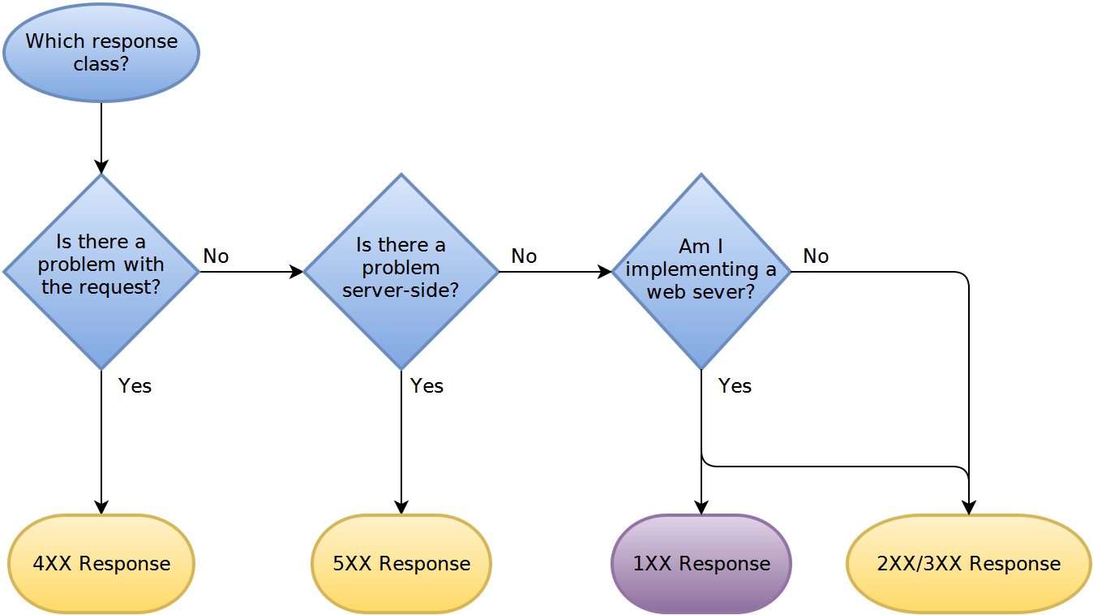
HTTP response handling sequence

Slide 16
REST API testing using GUI client
POSTMAN client.
DHC client.
Advanced REST client.
Apache JMeter.
SOAP UI / Ready API.

Slide 17
REST API testing using JAVA programming
(open source libraries/ framework)
Apache HTTP client
org.apache.http.impl.client.HttpClients
Jay-Way Rest assured client
com.jayway.restassured.specification.RequestSpecification
JAX-RS client
javax.ws.rs.client.Client
Jboss Rest easy client
org.jboss.resteasy.client.jaxrs.ResteasyClient
Simple HTTP url connection
java.net.HttpURLConnection

Slide 18
REST API testing using JAVA programming
Simple HTTP url connection
java.net.HttpURLConnection
Maven dependencies.
GET request example.
POST request example.
Header settings.
Raising HTTP request.
Parameter passing (Query param, Form param).
Response handling.

Slide 19
REST API testing using JAVA programming
Apache HTTP client
org.apache.http.impl.client.HttpClients
Maven dependencies.
GET request example.
POST request example.
Header settings.
Raising HTTP request.
Parameter passing (Query param, Form param).
Response handling.

Slide 20
REST API testing using JAVA programming
Jay-Way Rest assured client
com.jayway.restassured.specification.RequestSpecification
Maven dependencies.
GET request example.
POST request example.
Header settings.
Raising HTTP request.
Parameter passing (Query param, Form param).
Response handling.

Slide 21
REST API testing using JAVA programming
JAX-RS client
javax.ws.rs.client.Client
Maven dependencies.
GET request example.
POST request example.
Header settings.
Raising HTTP request.
Parameter passing (Query param, Form param).
Response handling.

Slide 22
REST API testing using JAVA programming
Jboss Rest easy client
org.jboss.resteasy.client.jaxrs.ResteasyClient
Maven dependencies.
GET request example.
POST request example.
Header settings.
Raising HTTP request.
Parameter passing (Query param, Form param).
Response handling.

Slide 23
Coming soon…
1) Oauth 1.0.
2) Oauth 2.0.
3) Cookies testing (header parameters).
4) Cache relevant testing (header parameters).
5) Proxy handling.
6) More header parameters.
7) Testing other methods such as HEAD, OPTIONS, PATCH, PURGE
8) Chained or multilevel API testing (payment gateway).
All suggestions are welcome.

