Slide 1







Class Name
EECS 835
Interpretable Scorecard Model for Early Diabetes Classification
Devin Setiawan, Sien Gong, Anto Felix, Maisoon Rahman

Slide 2



01
Previously…

Slide 3

Two Big Question
01
Simple Scorecard Model?
How well does a simple scorecard model compares to other machine learning models?
02
Is it actually picking the right features?
Are the features picked by the scorecard model matches with important features in the dataset?

Slide 4

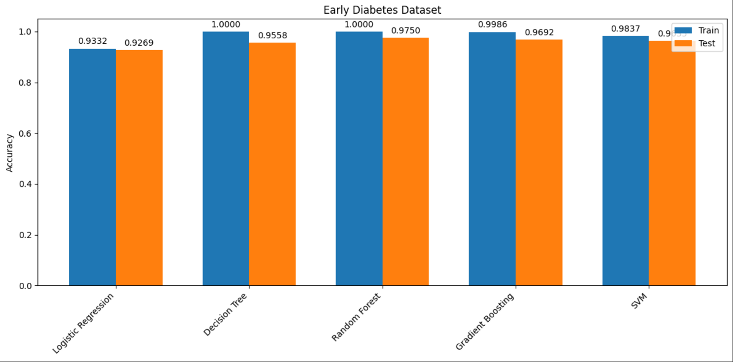

Scorecard Model is Likely Possible!!!!

Slide 5
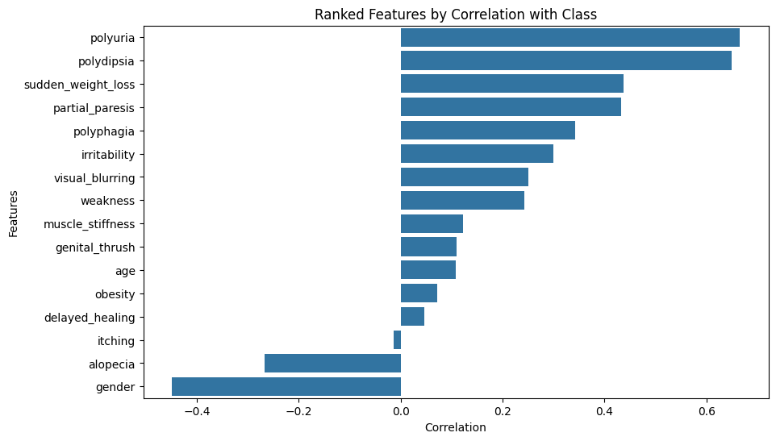
Correlation Based Feature Importance
Important Features:
01
Polyuria
Polydipsia
Gender
02
Unimportant Features:
Itching
Delayed_healing
Obesity

Slide 6
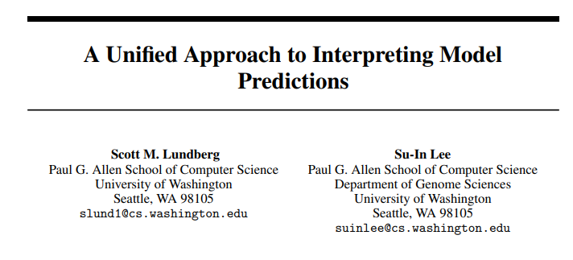
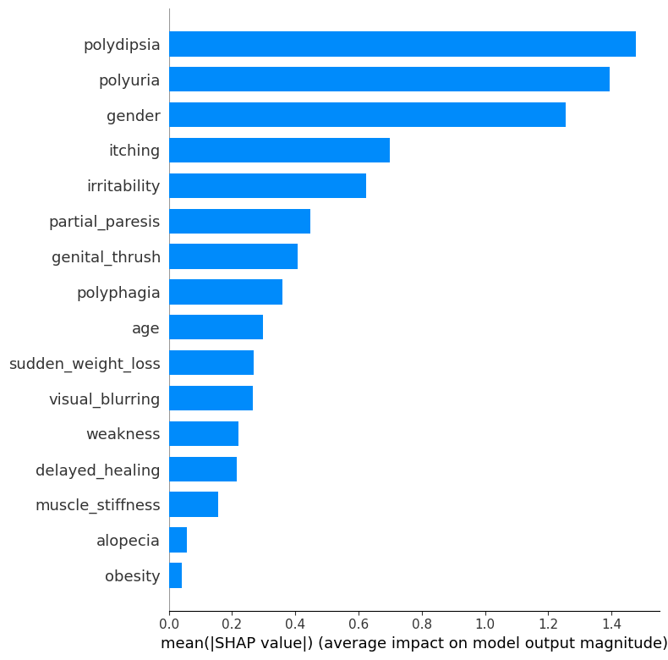
SHAP Feature Importance
Important Features:
01
Polyuria
Polydipsia
Gender
02
Unimportant Features:
muscle_stiffness
alopecia
Obesity

Slide 7


02
FasterRisk Algorithm

Slide 8
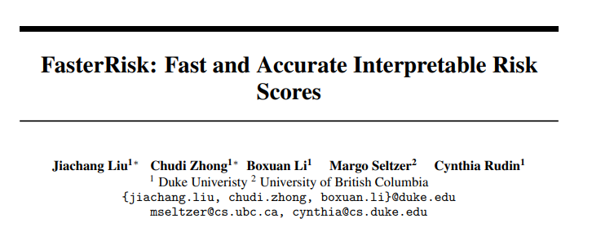

How to generate an accurate scorecard model?

Slide 9
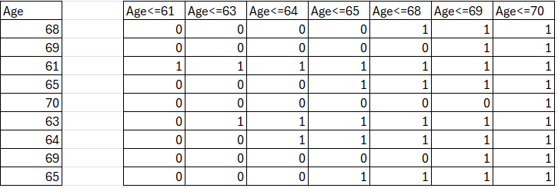
Feature Binarization

Slide 10
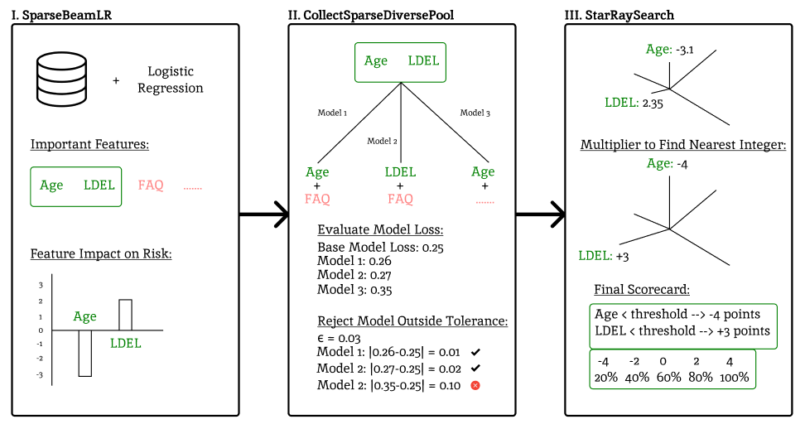
FasterRisk Algorithm

Slide 11

Finding the Best Sparsity

Slide 12
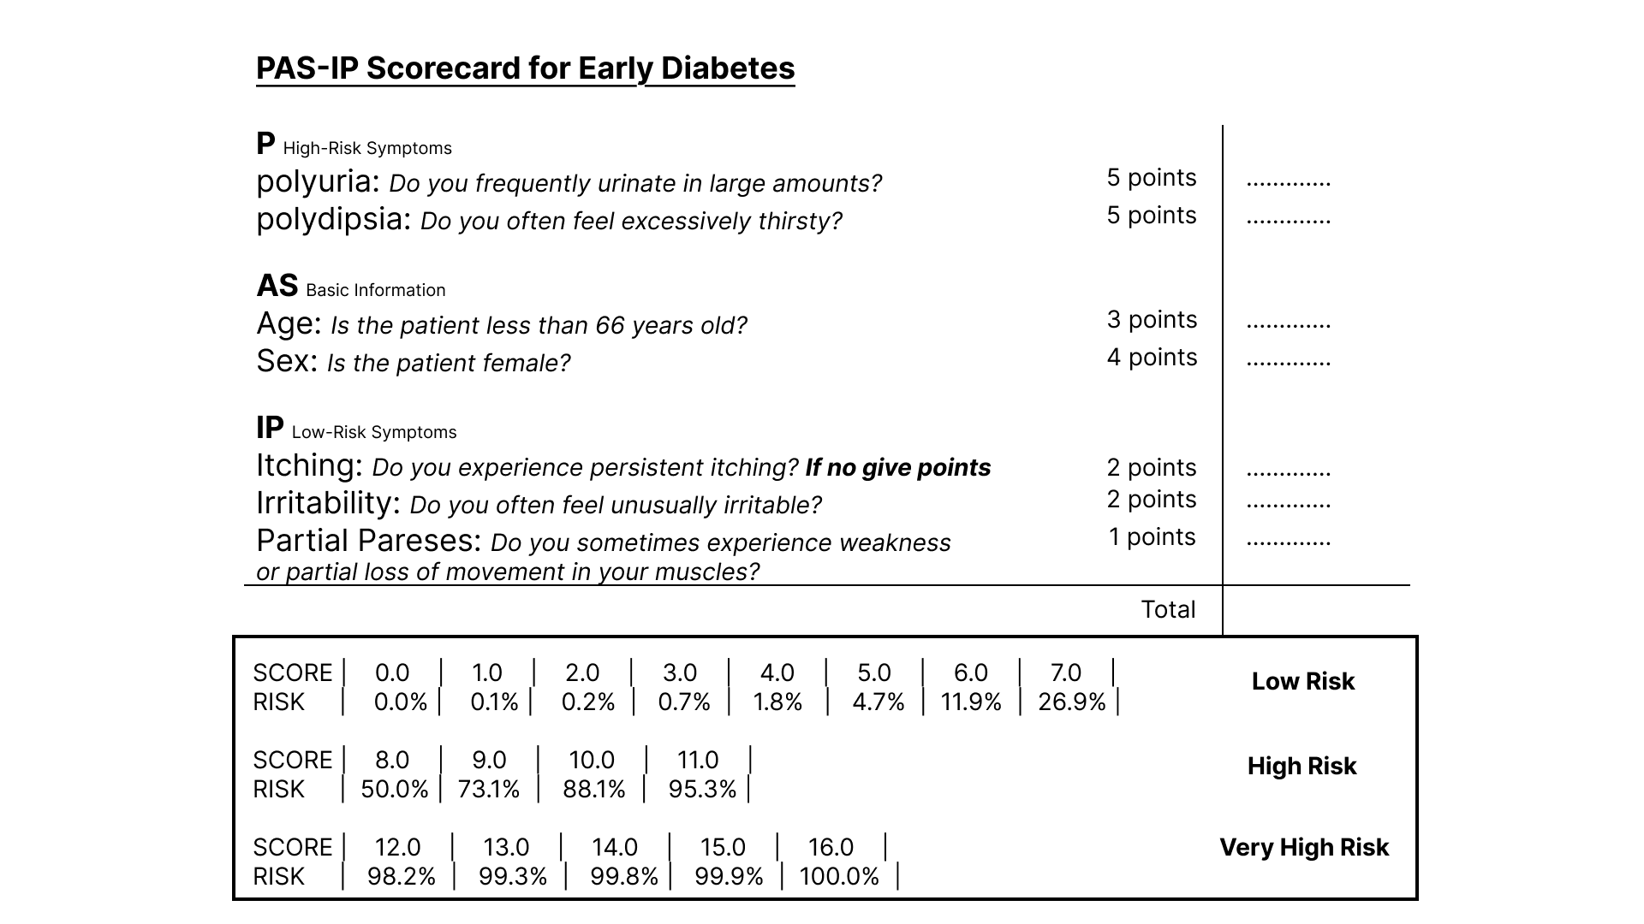
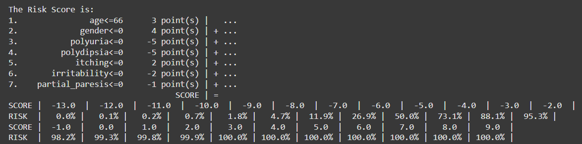
Final Scorecard

Slide 13

03
Performance Analysis

Slide 14

Comparison
ACC: 91.35%
AUC: 0.973
ACC: 92.69%
AUC: 0.970
ACC: 92.69%
AUC: 0.994
Scorecard Model
Logistic Regression (Simplest)
Random Forest (Complex)

Slide 15
SHAP Feature Analysis

