Slide 1







Class Name
EECS 835
Interpretable Scorecard Model for Early Diabetes Classification
Devin Setiawan, Sien Gong, Anto Felix, Maisoon Rahman

Slide 2



01
Background

Slide 3

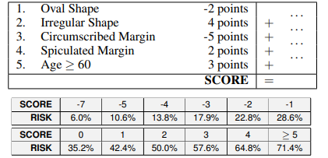
Our Goal
Dataset
Scorecard

Slide 4


Interpretable Model
Models designed to be inherently transparent, allowing humans to directly understand how inputs influence outputs without requiring additional explanations.

Slide 5




Motivation
Medical Decisions
Credit Card Approval
Criminal Justice

Slide 6
High-Stake Decision
When our prediction is wrong, the consequences is really bad

Slide 7


02
Methodology

Slide 8

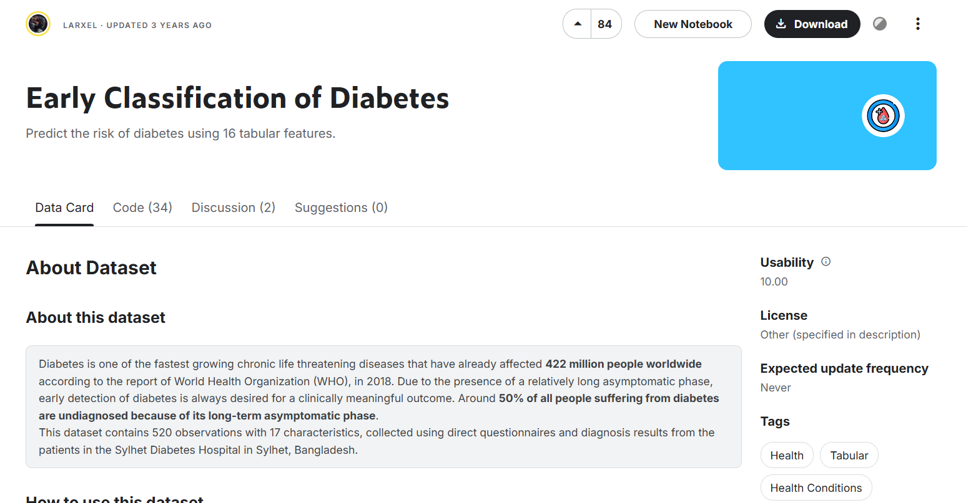


Slide 9

Two Big Question
01
Simple Scorecard Model?
How well does a simple scorecard model compares to other machine learning models?
02
Is it actually picking the right features?
Are the features picked by the scorecard model matches with important features in the dataset?

Slide 10

03
Preliminary Analysis

Slide 11
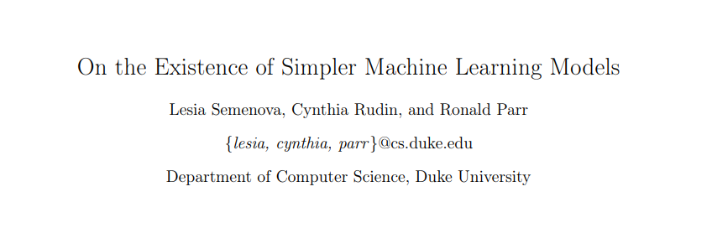

Does a simple model exist in the first place?

Slide 12
Rashomon Set Theory
In the possible scenario where all algorithms perform similarly, and when their models tend to generalize well on validation data, simpler models are likely to exist

Slide 13
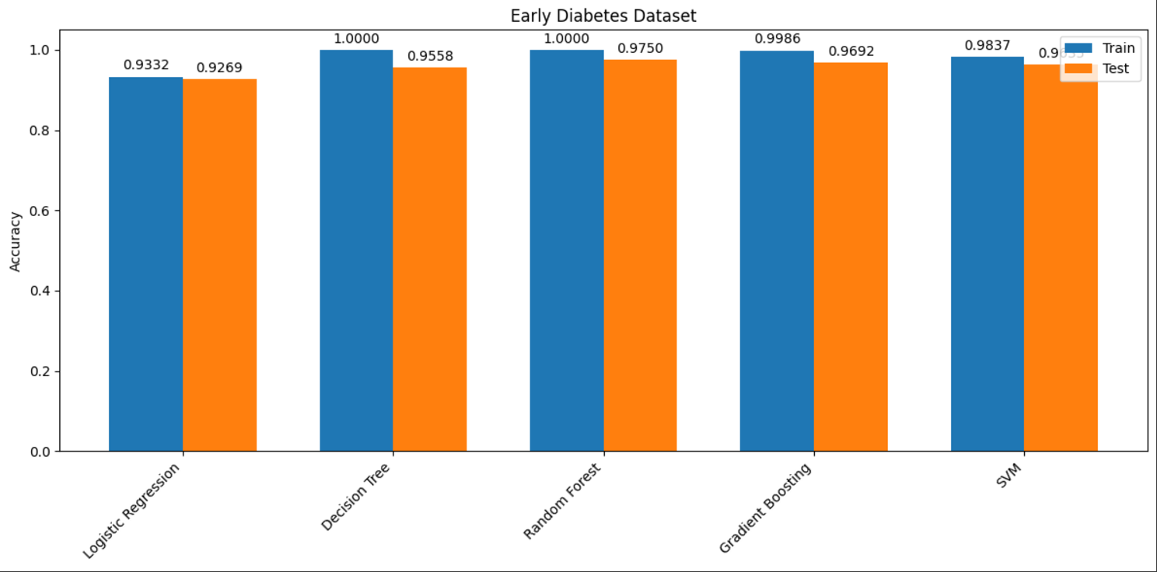
Scorecard Model is Likely Possible!!!!

Slide 14
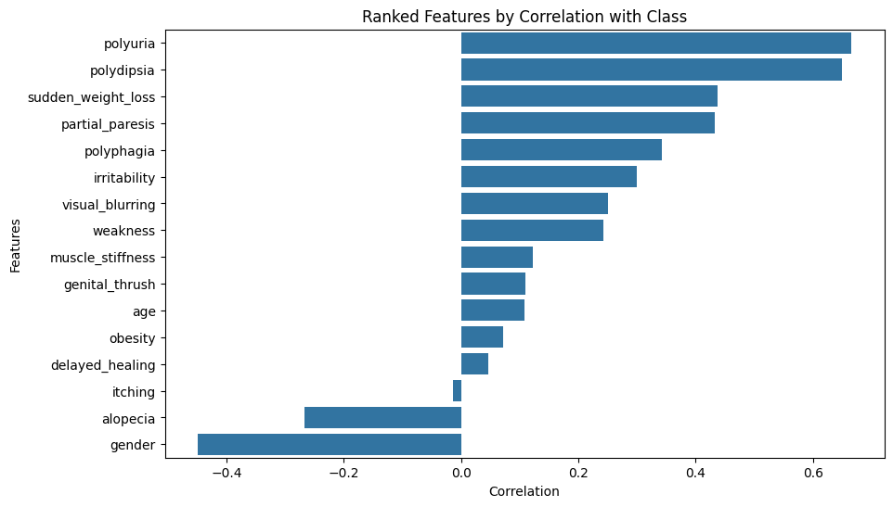
Correlation Based Feature Importance
Important Features:
01
Polyuria
Polydipsia
Gender
02
Unimportant Features:
Itching
Delayed_healing
Obesity

Slide 15
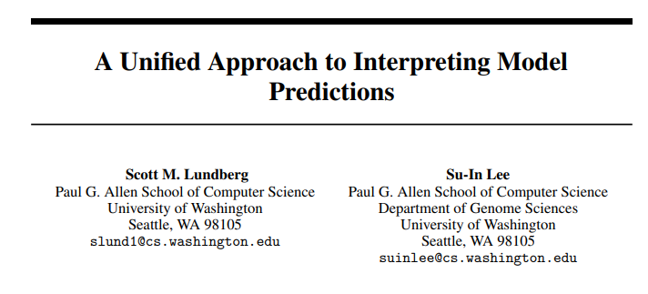
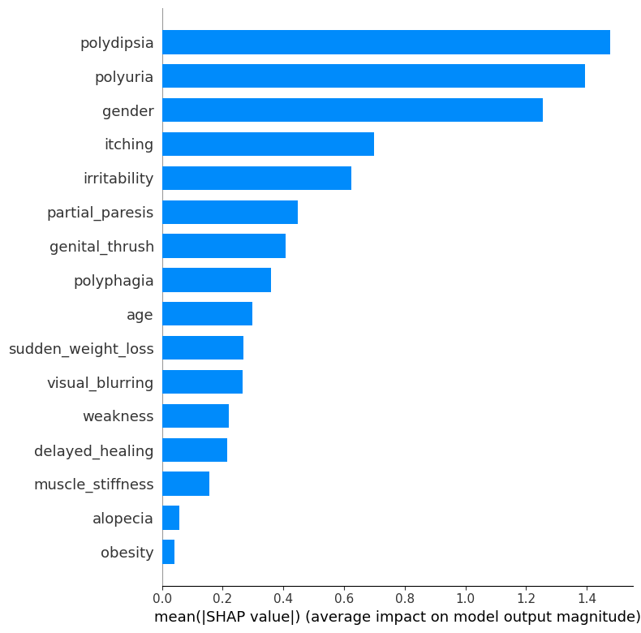
SHAP Feature Importance
Important Features:
01
Polyuria
Polydipsia
Gender
02
Unimportant Features:
muscle_stiffness
alopecia
Obesity

Slide 16
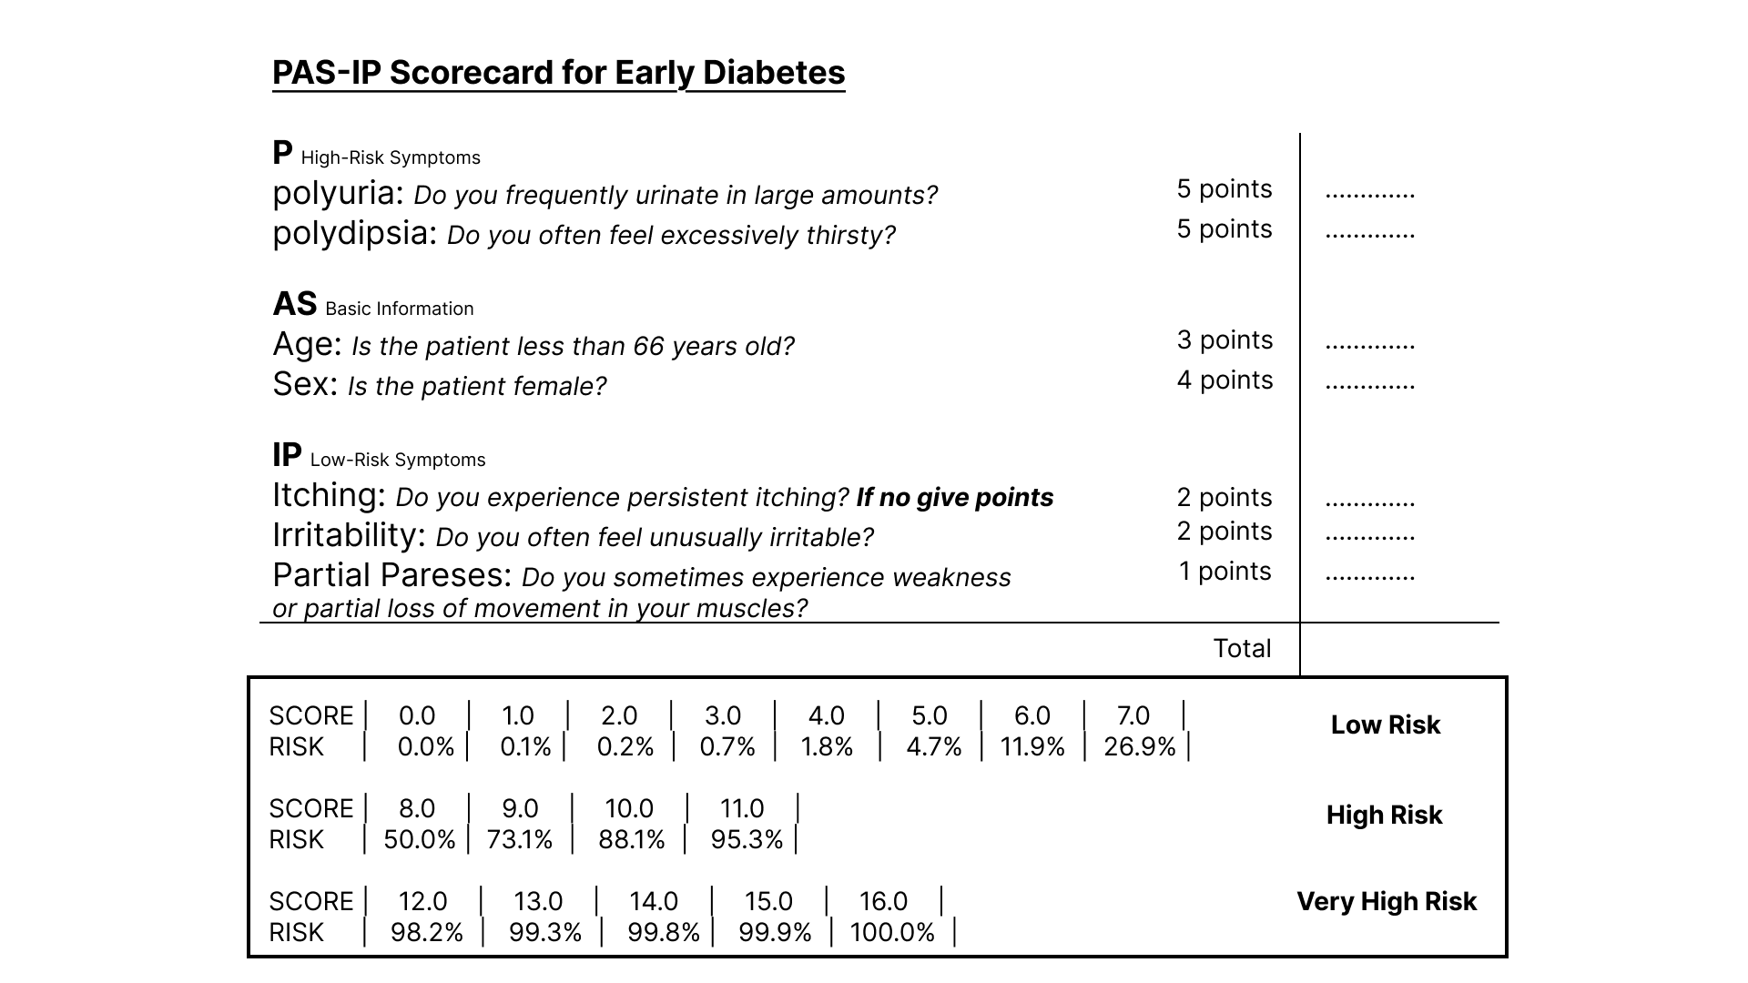
Next Time
How is the scorecard generated? (FasterRisk Algorithm)
How well the scorecard perform compare to other models?
Does the feature identified matches with the important feature identified by other methods?

