Slide 1

Fraud Detection
Using Julia
Frontend: HTML/CSS/JavaScript
Backend: Node.js + Julia
Dataset: PaySim-style CSV
Repo: github.com/DevinW2304/ITCS-4102
Team 10
Rule-based scoring model
Devin Washington · Lavashia Crump · Angel Vilar Nolasco
Dashboard demo
ITCS 4102 / 5102 Final Project
Language feature coverage
ITCS 4102 / 5102 Final Project

Slide 2
Project Purpose / Problem Statement
Problem context
Digital payment systems generate too many transactions for manual review.
Fraud often looks normal unless multiple patterns are considered together.
Our goal was to build a small but complete system that:
reads transaction data,
scores suspicious behavior,
classifies risk,
and displays results in a dashboard.
Fraud reports in 2025
Consumer losses
3.0M
$15.9B
Previous year reports
Previous year losses
2.6M
>$12B
Why Julia
Julia is designed for high-performance numerical work but still feels like a high-level language.
It was a good way to explore a language outside our usual stack while still building a practical project.
We originally hoped to explore larger-scale computing, but kept the semester scope realistic.
These numbers helped motivate the project: fraud is growing, and even a small demo is useful if it shows how transaction patterns can be reviewed automatically.
ITCS 4102 / 5102 Final Project
Notes:
[Sources] - FTC press release, March 25 2026: 3 million fraud reports and $15.9 billion in losses in 2025 (https://www.ftc.gov/news-events/news/press-releases/2026/03/ftc-testifies-joint-economic-committee-agencys-efforts-combat-fraud) - Julia official site: language positioning and parallel/scientific focus (https://julialang.org/) - Julia documentation: optional typing, multiple dispatch, JIT, multi-paradigm (https://docs.julialang.org/en/v1/)

Slide 3
Julia
Why it matched our system
Good for reading and processing structured transaction data
Helpful for repeated scoring logic and condition checks
Flexible, connects with a Node.js backend
Why Julia worked for our project
Our project needed to process transaction data, apply multiple fraud signals, and return results quickly in a usable format.
Julia allows for code that is easy to write/read, while still being strong for numerical and data-heavy work.
It fit our project because the fraud model depends on repeated calculations, transaction comparisons, and rule-based scoring across many rows.
Easy organization with typed structures for transactions, customer history, and destination history.
Typed Structs:
Used to organize transactions, customer stats, and destination stats
Fast Data Processing:
Helpful for repeated scoring across thousands of transaction rows
Readable Logic:
Let us build project logic without the code becoming too hard to follow
Scalable Potential: A good fit for larger data-focused work beyond this semester demo
ITCS 4102 / 5102 Final Project
Notes:
[Sources] - Julia documentation: multi-paradigm, optional typing, JIT, LLVM (https://docs.julialang.org/en/v1/) - Julia official website: multiple dispatch and parallel/scientific positioning (https://julialang.org/) - Julia methods manual: multiple dispatch and specialization (https://docs.julialang.org/en/v1/manual/methods/)
Julia feels a little like Python or MATLAB when you are writing it, but one of its goals is to perform closer to a compiled language like C or C++. That is part of what makes it different from a lot of other high-level languages.

Slide 4
Julia: history and paradigm
History
Motivation
Paradigm
Where Julia started
Why it was created
How to describe Julia
First introduced in 2012
Created by Jeff Bezanson, Stefan Karpinski, Viral Shah, and Alan Edelman
Designed for technical and numerical computing from the beginning
Julia 1.0 was released in 2018, marking a stable major version
A response to the “two-language problem”
Many developers prototype in Python, R, or MATLAB, then rewrite slow parts in C or C++
Julia aimed to combine ease of use with stronger performance in one language
Best described as a multi-paradigm language
Not mainly object-oriented like Java or C++
Built around functions, typed data, and multiple dispatch
Higher performance Python
ITCS 4102 / 5102 Final Project
Notes:
Speaker notes: Julia was first introduced in 2012 and was created by Jeff Bezanson, Stefan Karpinski, Viral Shah, and Alan Edelman. One of the biggest motivations behind the language was the two-language problem, where people often prototype in a high-level language like Python or MATLAB, then rewrite performance-heavy parts in C or C++. Julia was designed to reduce that gap by combining easier syntax with stronger performance for technical and numerical computing. In terms of paradigm, Julia is best described as multi-paradigm. It is not mainly object-oriented in the way Java or C++ are. Instead, it is more centered around functions, typed data, generic programming, and multiple dispatch. [Sources] - https://julialang.org/blog/2012/02/why-we-created-julia/ (Why We Created Julia; introduced in 2012; creators and design motivation) - https://julialang.org/ (official Julia site; states multiple dispatch as a paradigm) - https://julialang.org/blog/2018/08/one-point-zero/ (Julia 1.0 release in 2018) - https://epubs.siam.org/doi/10.1137/141000671 (SIAM Review paper on Julia's design for numerical computing) [/Sources]

Slide 5
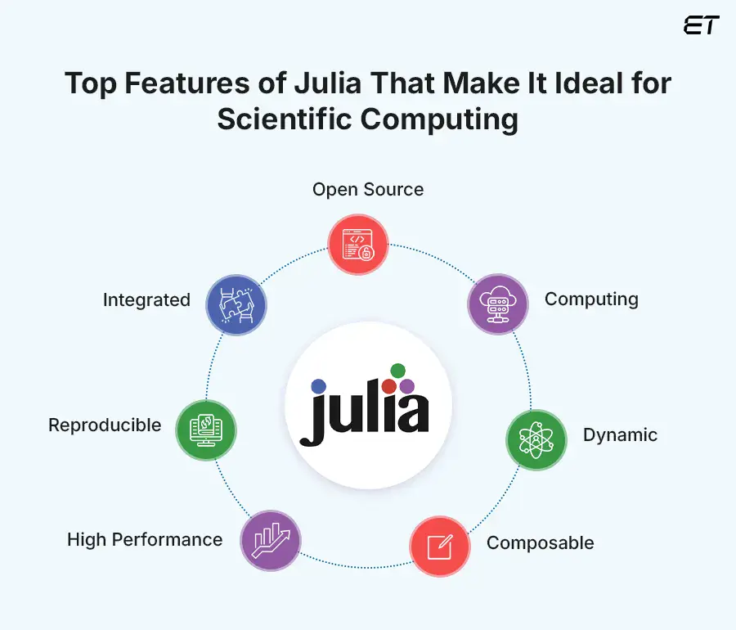
Notes:
First, it’s open‑source, which means the community can continuously improve it and researchers can inspect or modify anything they need.
It’s high‑performance, delivering speeds close to C and Fortran while still feeling like a high‑level language.
Julia is dynamic, so you can experiment interactively, iterate quickly, and prototype without friction.
It’s also composable, meaning packages work together cleanly without the dependency conflicts you see in other ecosystems.
Another major strength is reproducibility, Julia’s environment and package management system make it easy to recreate exact computational setups.
Finally, it’s integrated: Julia brings together numerical computing, data science, visualization, and parallelism in one unified language.

Slide 6
System architecture
How our project works
Frontend
Node.js backend
Julia script
Dataset
HTML/CSS/JS dashboard
Run button→Populates
Summary cards
Table + chart
/analyze route
Runs Julia
Parses output to JSON
Loads CSV
Scores transactions
Prints results + metrics
PaySim-style CSV
20,000-row test run
Route example
Data flow in one sentence
The browser sends a request, Node runs the Julia script on the CSV, the backend parses the output into JSON, and the dashboard updates the table, metrics, and chart.
ITCS 4102 / 5102 Final Project

Slide 7
How Our Project Met Course Requirements
The project combines the three course requirements into one system.
Program 1
Program 2
Program 3
Data types + built-in methods
Data structures + control structures
Exception handling
Demonstrates Int, Float64, String, and Bool, along with built-in methods like abs, round, replace, xor, sum, and mean.
The main program uses structs, mutable structs, vectors, dictionaries, loops, conditionals, and helper functions to manage transactions and account history.
CSV lines are parsed inside a try/catch block so malformed rows can be skipped without stopping the entire run.
# Int
i::Int = -42
println("\n[Int] i = ", i)
println(" abs(i) = ", abs(i)) # method 1
println(" iseven(abs(i)) = ", iseven(abs(i))) # method 2
# Float64
x::Float64 = 123.456
println("\n[Float64] x = ", x)
println(" round(x, digits=1) = ", round(x, digits=1)) # method 1
println(" ceil(x) = ", ceil(x))
# Structure customer stats
mutable struct CustomerStats
count::Int
total_amount::Float64
risky_count::Int
end
try
push!(txns, parse_paysim_line(line))
catch e
println("Skipping bad line: ", e)
end
ITCS 4102 / 5102 Final Project

Slide 8
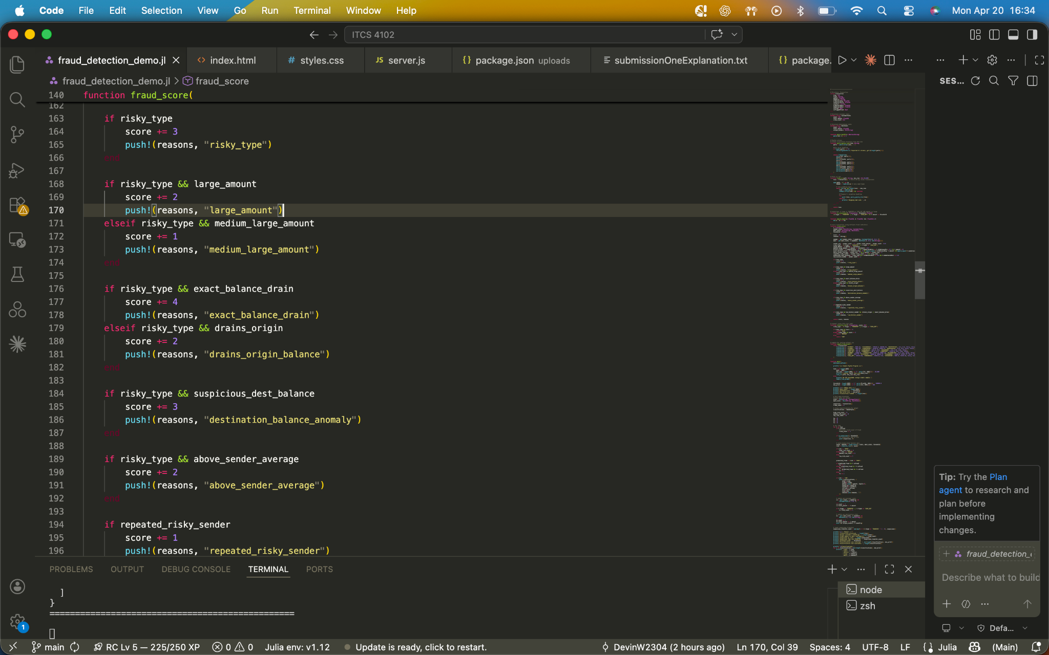
Fraud scoring model
Scores based on weighted signals, then classifies
Signals used in scoring
Ranking logic
Risky transaction type: TRANSFER or CASH_OUT
Large or medium-large transaction amount
Drains origin balance
Exact balance drain
Destination balance anomaly
Prior sender behavior and limited history
sender_avg = sender.count > 0 ? sender.total_amount / sender.count : 0.0
risky_type = (t.ttype == "TRANSFER" || t.ttype == "CASH_OUT")
large_amount = t.amount >= threshold
medium_large_amount = t.amount >= threshold * 0.5
drains_origin = t.oldbalanceOrg > 0 && t.newbalanceOrig <= t.oldbalanceOrg * 0.1 && t.amount > 0
exact_balance_drain = t.oldbalanceOrg > 0 && approx_equal(t.oldbalanceOrg, t.amount) && approx_equal(t.newbalanceOrig, 0.0)
above_sender_average = sender_avg > 0 && t.amount >= sender_avg * 3
repeated_risky_sender = sender.risky_count >= 2 && risky_type
suspicious_dest_balance = risky_type && t.oldbalanceDest == 0.0 && t.newbalanceDest == 0.0
low_history_sender = sender.count <= 1
if risky_type
score += 3
push!(reasons, "risky_type")
end
if risky_type && large_amount
score += 2
push!(reasons, "large_amount")
elseif risky_type && medium_large_amount
score += 1
push!(reasons, "medium_large_amount")
end
MEDIUM = suspicious and worth review, but not strong enough for direct fraud prediction
HIGH = strongest Fraud Prediction
ITCS 4102 / 5102 Final Project
Notes:
This section is where the model creates the main signals that later feed into the fraud score. Instead of making a decision from just one rule, the program first checks a set of conditions that describe how suspicious the transaction looks.
The first line calculates the sender’s average previous transaction amount, if the sender has any history at all. That gives the model a point of comparison for whether the current transaction is unusually large for that specific account.
Next, the code checks whether the transaction is a risky type. In our project, we focused mostly on TRANSFER and CASH_OUT because those are the transaction types most associated with fraudulent movement of money.
After that, the model checks the transaction amount at two levels. One is a large amount, meaning it is above the threshold, and the other is medium-large, meaning it is at least half of the threshold. This gives the scoring system some flexibility instead of forcing every suspicious transaction to be extremely large.
The next two checks focus on balance behavior. drains_origin means the transaction leaves the sender’s account nearly empty, which can be suspicious. exact_balance_drain is even stronger, because it means the transaction amount almost exactly matches the sender’s old balance and leaves the new balance at or near zero.
The code also checks whether the current amount is much larger than the sender’s normal behavior by comparing it to the sender’s average. If it is at least three times larger, that becomes another suspicious signal.
repeated_risky_sender checks whether the sender has already made multiple risky transactions earlier in the data, which can suggest a repeated pattern rather than a one-time event.
suspicious_dest_balance looks for a strange destination pattern where both the old and new destination balances are zero during a risky transaction. That can indicate unusual activity in the transaction record.
Finally, low_history_sender checks whether the sender has little or no prior history. By itself, that is not enough to make something fraudulent, but it can add context when combined with stronger signals.
So overall, this block is not doing the final classification yet. It is building the evidence that the model uses in the next step to decide whether a transaction should be low, medium, or high risk.
Here’s a shorter version if you want something more slide-friendly:
This code creates the main fraud signals used in scoring. It checks whether the transaction is a risky type, whether the amount is unusually large, whether it drains the sender’s balance, whether it matches the sender’s full balance exactly, and whether the sender’s prior behavior makes the transaction stand out. Those signals are then combined later to produce the final risk label.

Slide 9
Current results from the final iteration
20,000 transactions processed from the PaySim dataset.
Transactions
Fraud labels
High risk
Medium risk
Low risk
Precision
Recall
20,000
81
65
4,341
15,594
0.7692
0.6173
Result table
Risk distribution
Rule-flagged
3,941
High risk
65
Direct fraud prediction
Suspicious transfers
1,638
Medium risk
4,341
Needs review, not strong enough for HIGH
Accuracy
0.9977
Low risk
15,594
Not flagged for review
Displayed classifications
186
The final model is more selective about HIGH-risk classifications, but the dataset is imbalanced, so metrics like accuracy should be interpreted carefully. False positives and false negatives still affect reliability.
ITCS 4102 / 5102 Final Project
Notes:
This slide shows the final results from our last version of the fraud detector. In this run, the system processed 20,000 transactions from the PaySim-style dataset. Out of those, 81 were actually labeled as fraud in the dataset.
The model split the transactions into three groups: 65 high risk, 4,341 medium risk, and 15,594 low risk. In our project, high-risk transactions were treated as the model’s strongest fraud predictions. Medium-risk transactions were not counted as direct fraud predictions, but more as transactions that might deserve review. Low-risk transactions were the ones the model did not flag for concern.
The slide also shows the three main evaluation metrics: precision, recall, and accuracy.
Precision tells us how often the model was correct when it made a strong fraud prediction. In our case, the precision was 0.7692, which means that when the model labeled a transaction as high risk, it was correct about 77 percent of the time. So precision is really about the quality of the positive predictions. A higher precision means fewer false alarms.
Recall tells us how many of the actual fraud cases the model was able to catch. Our recall was 0.6173, which means the model caught a little over 61 percent of the real fraud transactions in the dataset. So recall is about coverage. A higher recall means the system is missing fewer fraud cases. In fraud detection, this matters because if recall is too low, the system may look good on paper but still miss too many important cases.
Accuracy measures how often the model was correct overall, across both fraud and non-fraud transactions. Our accuracy was 0.9977, which looks extremely high. But this needs to be interpreted carefully. The dataset is very imbalanced, meaning there are far more normal transactions than fraudulent ones. Because of that, a model can get a very high accuracy score simply by being right on most of the normal cases. So while the accuracy is useful, it is not the best standalone measure for a fraud detection problem like this.
The most meaningful takeaway is really the balance between precision and recall. Our final model was fairly selective, which helped keep the precision reasonably strong, but it still did not catch every fraud case, which is why the recall is lower than the accuracy might suggest. That is one of the tradeoffs in this kind of system. If we made the model more aggressive, recall might go up because it would catch more fraud, but precision could drop because it would also flag more normal transactions by mistake.
So overall, these results show that the model became more controlled and more realistic than the earlier versions. It did not overuse the high-risk label, it still caught real fraud cases, and it gave us a useful separation between direct fraud predictions and transactions that simply looked suspicious enough for review.

Slide 10
Example classifications
Type
Amount
Actual
Model
Why it ranked that way
TRANSFER
$181.00
Fraud
HIGH
risky_type, exact_balance_drain, destination_balance_anomaly, low_history_sender
CASH_OUT
$181.00
Fraud
MEDIUM
risky_type, exact_balance_drain, low_history_sender
CASH_OUT
$229,133.94
Clean
MEDIUM
risky_type, large_amount, drains_origin_balance, low_history_sender
TRANSFER
$215,310.30
Clean
MEDIUM
risky_type, large_amount, drains_origin_balance, low_history_sender
CASH_OUT
$136,872.92
Clean
MEDIUM
risky_type, large_amount
Exact balance drain was one of the strongest fraud indicators. Large amount alone often pushed a transaction to MEDIUM risk, but not always to HIGH risk
ITCS 4102 / 5102 Final Project
Notes:
This slide shows a few example classifications so we can see the model’s logic more clearly. The strongest fraud example here is the 181 dollar transfer, which was correctly labeled high risk because of features like exact balance drain and destination balance anomaly. The clean examples show where the model still struggles, since large risky transactions sometimes get pushed into medium risk even when they are not actually fraud. So overall, these examples show that the balance-based signals helped a lot, but the model can still over-flag some normal transactions.

Slide 11
Helpful Features In Julia
Feature 1
Feature 2
Feature 3
Structs and Data Organization
Built-in Data Structures
AbstractString
We used struct and mutable struct to represent transactions and statistics
The main program uses vectors, dictionaries, loops, conditionals, and helper functions to manage transactions and account history.
AbstractString can be used as a function input, which allows for much more flexibility with type inputs.
# Structure customer stats
mutable struct CustomerStats
count::Int
total_amount::Float64
risky_count::Int
# Structure destination stats
mutable struct DestStats
count::Int
total_amount::Float64
unique_senders::Set{String}
end
# Dict data structure
#tracks data for output
stats = Dict{String, CustomerStats}()
dest_stats = Dict{String, DestStats}()
function parse_bool01(s::AbstractString)
parse(Int, s) == 1
end
ITCS 4102 / 5102 Final Project
Notes:
This slide highlights a few Julia features that were especially useful while we were building the project. The first one is structs and data organization. Since our project depends on processing transaction records and tracking account behavior, it helped a lot to be able to define our own data structures clearly. Instead of working with raw CSV rows the whole time, we could turn each row into something more structured and easier to work with.
The second feature is Julia’s built-in data structures. Things like vectors, dictionaries, and sets fit the project really well. We used vectors to hold lists of transactions, and dictionaries to keep track of account-level information like customer history and destination stats. That made it much easier to update and reference data while each transaction was being scored.
The third feature is AbstractString. This was useful on the parsing side of the project, because the raw CSV data comes in as text first. By using AbstractString in helper functions, we could write code that was a little more flexible and still stayed organized around Julia’s type system. It was a smaller feature, but it showed how Julia lets you write functions in a clean way around the kind of data you expect.
Overall, these features helped make the project easier to structure. Julia gave us a good mix of clear custom data modeling, strong built-in containers, and type-aware function design, which worked well for a fraud detection project like this one.
AbstractString is a good example of how Julia lets you write functions against a broader abstract type instead of only one concrete type. That keeps the function flexible, but still typed and organized.
One smaller Julia feature I found helpful was AbstractString. Since our data starts as raw CSV text, it made sense to write parsing helpers around string-like input instead of only one exact string type. That gave us a cleaner way to handle things like fraud labels, text cleanup, and validation before the data was turned into typed transaction objects.
Multiple dispatch means Julia chooses which function to run based on the types of all the arguments, not just one.
Example:
function greet(x::String)
println("Hello, $x")
end
function greet(x::Int)
println("Your number is $x")
end
Now Julia picks the right version depending on what you pass in:
greet("Devin") # Hello, Devin
greet(7) # Your number is 7
With multiple dispatch, Julia can also look at more than one parameter:
Bioinformatics pipelines Scientists can build workflows for tasks like sequence alignment, variant calling, phylogenetics, and protein analysis. Julia is helpful because it handles heavy numerical work well without being as slow as many scripting languages.
Machine learning in healthcare and biology Julia can train models to predict disease risk, classify medical images, or detect patterns in genetic data. This is useful in precision medicine and biomedical research.
Mathematical modeling of diseases Researchers use Julia to simulate how diseases spread, how tumors grow, or how cells behave over time. Its speed makes it good for running many simulations.
Drug discovery and computational chemistry Julia can help model molecular interactions, optimize chemical compounds, and run simulations used in pharmaceutical research.
Physics simulations It is often used for particle simulations, fluid dynamics, orbital mechanics, and other computational physics problems that need high performance.
Climate and environmental science Julia can model weather systems, pollution spread, ocean behavior, and climate change scenarios using large datasets and numerical equations.
Neuroscience Researchers can use Julia to model neural networks, brain activity, and signal processing from EEG or other brain data.
Astronomy and space science Julia works well for analyzing telescope data, simulating planetary motion, and processing large scientific datasets from observations.

Slide 12
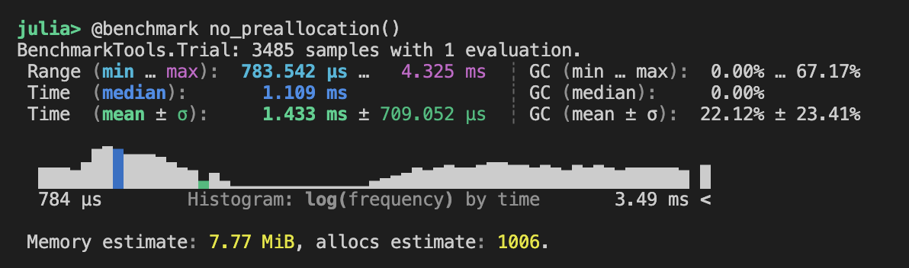
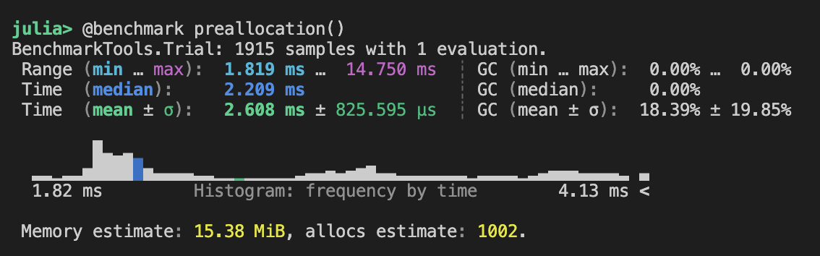
Product Demonstration
VS Code
Node server.js
localhost:3000
Notes:
A big part of Julia’s history is that it was created to address what people call the two-language problem. In a lot of technical fields, developers prototype in an easier language like Python or MATLAB, but then have to rewrite the important parts in C or C++ for speed. Julia was designed to reduce that need by being both high-level and high-performance.
Small “interesting fact” style lines
Julia is newer than languages like Java, Python, and C++, so it comes from a more modern design perspective.
Its creators were especially focused on technical computing, which is why Julia gets talked about so much in math-heavy and research-heavy work.
Julia’s early reputation was strongly tied to scientific computing, but people now use it in more areas like finance, optimization, and machine learning.

Slide 13
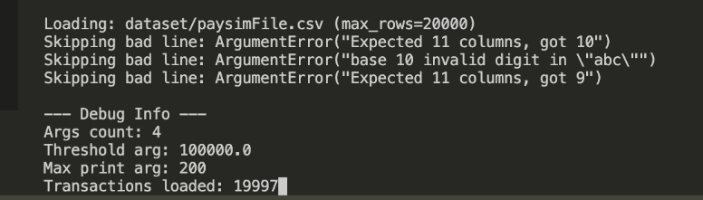
Limitations and next steps
Current limitations
What we would do next
The model still gives a lot of transactions MEDIUM risk just because they are large and risky-type.
Accuracy looks very high, but the dataset is imbalanced, so that metric can be misleading by itself.
The project is rule-based, so it does not adapt automatically the way a trained model could.
Users can’t upload their own custom files.
Files must be formatted exactly as the PaySim files
Tune the weights more carefully using additional validation runs.
Compare the rule-based model against a machine learning baseline on the same dataset.
Expand the frontend with uploaded files, better charts, and saved results.
Create helper functions to read differently structured datasets
Negate the requirement of exact headers for tables and rows
ITCS 4102 / 5102 Final Project

Slide 14

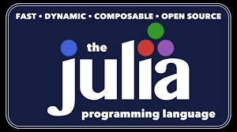
Closing summary
What we built & learned
What we built
What we learned about Julia
Repo
A complete Julia-backed fraud detection demo
A Node.js bridge and JSON parser
A browser dashboard for results, metrics, and review
A report and presentation grounded in the actual code
Julia is similar to Java and JS in syntax
It is very flexible with creating data structures and passing types
Its parallel processing ability reduces run times significantly
Structs, dicts and type manipulation are extremely helpful tools in Julia
It is truly a language built for technical computing
github.com/DevinW2304/ITCS-4102
Questions?

Slide 15
Resources
https://eluminoustechnologies.com/blog/julia-vs-python/
Chesnes, M., & Nguyen, S. T. (2026, March 25). FTC testifies before the Joint Economic Committee on Agency’s efforts to combat fraud. Federal Trade Commission. https://www.ftc.gov/news-events/news/press-releases/2026/03/ftc-testifies-joint-economic-committee-agencys-efforts-combat-fraud?
Holy, T. E., Sargent, T. J., & Steele , G. L. (2016). Juliacon 2016. JuliaCon 2016. https://juliacon.org/2016/
https://www.vecteezy.com/vector-art/17119660-github-logo-git-hub-icon-with-text-on-white-and-black-background
“Julia Documentation · The Julia Language,” docs.julialang.org. https://docs.julialang.org/en/v1/
‌
ITCS 4102 / 5102 Final Project
Notes:
One reason Julia stood out to us is that it was built with performance in mind, including support for parallel and high-performance computing. In larger technical projects, that matters because work can be spread across multiple cores or processes instead of being handled one step at a time. We did not fully use parallel programming in our project, but it was still one of the reasons Julia seemed like a good language to explore for a fraud detection problem.
And here is an even more careful version, in case you want to avoid sounding like your project directly used it:
Julia is often associated with parallel and high-performance computing, which was one of the reasons it interested us as a language. While our fraud detection demo did not end up using a fully parallel implementation, the language’s design around performance and scalability still made it a strong match for a data-heavy problem like this one.
Bioinformatics pipelines Scientists can build workflows for tasks like sequence alignment, variant calling, phylogenetics, and protein analysis. Julia is helpful because it handles heavy numerical work well without being as slow as many scripting languages.
Machine learning in healthcare and biology Julia can train models to predict disease risk, classify medical images, or detect patterns in genetic data. This is useful in precision medicine and biomedical research.
Mathematical modeling of diseases Researchers use Julia to simulate how diseases spread, how tumors grow, or how cells behave over time. Its speed makes it good for running many simulations.
Drug discovery and computational chemistry Julia can help model molecular interactions, optimize chemical compounds, and run simulations used in pharmaceutical research.
Physics simulations It is often used for particle simulations, fluid dynamics, orbital mechanics, and other computational physics problems that need high performance.
Climate and environmental science Julia can model weather systems, pollution spread, ocean behavior, and climate change scenarios using large datasets and numerical equations.
Neuroscience Researchers can use Julia to model neural networks, brain activity, and signal processing from EEG or other brain data.
Astronomy and space science Julia works well for analyzing telescope data, simulating planetary motion, and processing large scientific datasets from observations.
Dynamically typed, checks at runtime
Multiple dispatch means Julia chooses which function to run based on the types of all the arguments, not just one.
Example:
function greet(x::String)
println("Hello, $x")
end
function greet(x::Int)
println("Your number is $x")
end
Now Julia picks the right version depending on what you pass in:
greet("Devin") # Hello, Devin
greet(7) # Your number is 7
With multiple dispatch, Julia can also look at more than one parameter:

