Slide 1
Workshop Preperation
Local install of WordPress 4.7+
Code Editor (I am using Atom)
Node and NPM Installed (node –v and npm –v)
https://github.com/zgordon/a-day-of-javascript
Getting Started

Slide 2
A Day of JavaScript
Welcome To
with Zac Gordon @zgordon
Getting Started
Notes:
- Got into JavaScript around early to mid 2000s,
- Taught it high school, college
- But really it’s been since leaving Treehouse at end of 2016 and working on a JavaScript for WordPress Master Course that I have really had a chance to dive deep into learning and teaching the language comprehensively
- You’re getting my most important takeaways from hundreds if not thousands of hours of study

Slide 3
Oh yes,
JavaScript
Is Important
A Little Context

Slide 4
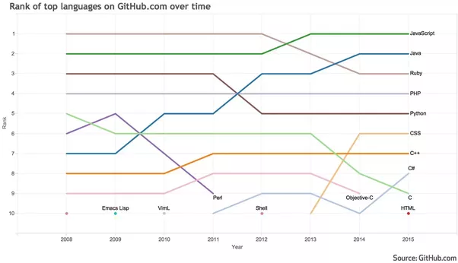
JavaScript #1
A Little Context

Slide 5
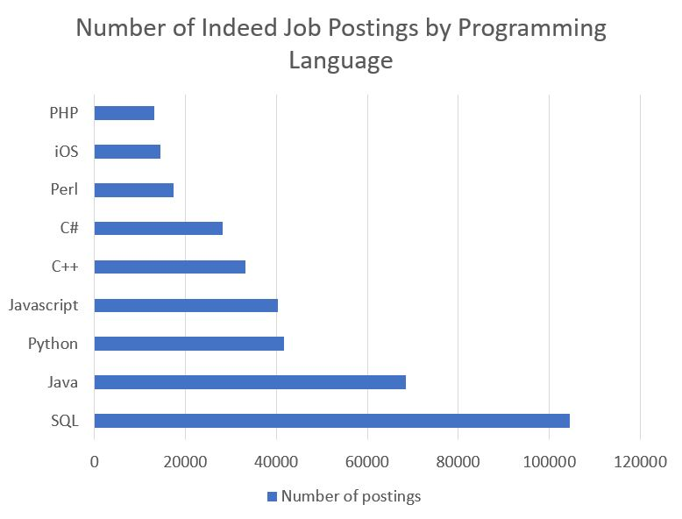
A Little Context
Notes:
Coding Dojo
Missing Swift maybe?

Slide 6
$72,500
glassdoor.com
A Little Context
Notes:
A good amount, but definitely not the highest paying,

Slide 7
WordPress Developers Live in a Bubble
Getting Started

Slide 8
Most Developers Live in a Bubble
Getting Started
Notes:
Have the tools you need to get your job done.
Look outside of that and aware of other technologies.
The average front-end dev today last year was definitely working in a framework, yet many WordPress theme designers are still getting by with jQuery.
For those doing neither, there are more people’s who see JavaScript out there and know it is something they need to know.

Slide 9
API + JS = Bigger Bubble
Getting Started
Notes:
Now that the API is part of core, it is officially part of our bubble.
and one of the best and easiest ways to work with the API is using JavaScript
So now our bubble officially includes, I should probably learn JavaScript as well ;p

Slide 10
What Do You Need to Know?
Getting Started
Notes:
3 Things?
Oh wait…

Slide 11
Wait, Do You Know Programming?
Getting Started
Notes:
If not there are some basic syntax things and explaining concepts like variables, objects, arrays, loops, conditionals and functions that needs to happen. We’ll talk a bit about this today, more as a quick little review at
Can also learn this as you go along, but, really just 3 main things you learn about

Slide 12
1. The DOM
Getting Started
Notes:
The DOM is an API for HTML and CSS. With it we can create, add, access and manipulate pretty much anything on a web page. It is not technically part of the JavaScript language, but we use it all the time

Slide 13
1. The DOM 2. Events
Getting Started
Notes:
The Next important thing to learn is events. This let’s us run our own code based on user interactions. Of course this starts with what to do when someone clicks a page, but we can also do things like figure out what URL was accessed and load content from a WP Post or Page.

Slide 14
1. The DOM 2. Events 3. JSON & HTTP
Getting Started
Notes:
The third important thing again, isn’t necessarily part of the JavaScript language itself, but involves using JavaScript to interact with JSON and making HTTP requests to things like the WordPress REST API.

Slide 15
1. The DOM 2. Events 3. JSON & HTTP
Getting Started

Slide 16
These 3 Things Let us do a lot
Getting Started

Slide 17
Use WP API
Getting Started

Slide 18
Use WP API Build UI/Page w JS
Getting Started

Slide 19
Use WP API Build UI/Page w JS Track User Actions
Getting Started

Slide 20
Use WP API Build UI/Page w JS Track User Actions Do Whatever *
Getting Started

Slide 21
Use WP API JSON/HTTP Build UI/Page w JS DOM Track User Actions Events Do Whatever JavaScript*
Getting Started

Slide 22
1. The DOM 2. Events 3. JSON & HTTP
* Programming Review
* Development Tools
Getting Started

Slide 23
I Love JavaScript And have for a while
For More from Zac
Notes:
- Got into JavaScript around early to mid 2000s,
- Taught it high school, college
- But really it’s been since leaving Treehouse at end of 2016 and working on a JavaScript for WordPress Master Course that I have really had a chance to dive deep into learning and teaching the language comprehensively
- You’re getting my most important takeaways from hundreds if not thousands of hours of study

Slide 24
javascriptforwp.com/courses javascriptforwp.com/blog
For More from Zac
Notes:
https://javascriptforwp.com/courses/
Going to be releasing pieces of my Master Course and if at times during the day you wish I would go into more depth about certain topics, you can keep checking back there for access to everything I’ve covered here and a lot more ☺

Slide 25
Group Up It’s Quiz Time
JavaScript Basics
Notes:
To get started we’re gonna have a little group pop quiz, so introduce yourself to the folks around you and let’s try to form somewhat balanced groups based on skill level with programming in general and background with JavaScript.

Slide 26
What is a variable?
Question 1
Question 1 of 7

Slide 27
What is an array?
Question 2
Question 2 of 7

Slide 28
What is a function?
Question 3
Question 3 of 7

Slide 29
What is an object?
Question 4
Question 4 of 7

Slide 30
What is a loop?
Question 5
Question 5 of 7

Slide 31
What is a conditional?
Question 6
Question 6 of 7

Slide 32
How do you include JavaScript in HTML?
Question 7
Question 7 of 7

Slide 33
Variable
A container for storing values
var username = ‘zgordon’;
let username = ‘zgordon’;
const siteURL = ‘https://site.com’;
JavaScript Basics Review
Notes:
Examples
List at top of code
Store different types of things
Let and Const

Slide 34
Array
A collection of values
let postIds = [1,2,3,5];
let usernames =[
'zgordon',
'’admin'
];
JavaScript Basics Review

Slide 35
Functions
Let us write, call and reuse blocks of code
function getPosts() {
let posts = apiMagic… // Will learn
return posts;
}
getPosts();
JavaScript Basics Review

Slide 36
Function Parameters
Can pass data into functions
function getUser( userId ) {
let user= apiMagic… // Will learn
return user;
}
getUsers( 1 );
JavaScript Basics Review

Slide 37
Objects
Container with properties (values) and methods (functions).
let post = {
id: 1,
title: ‘Hello Object’,
displayTitle: function() {
console.log( this.title );
}
}
post.id;
post.title;
post.displayTitle();
JavaScript Basics Review

Slide 38
Loops
Let us perform an action on a collection of items.
var postIds = [ 1, 7, 14, 34, 88, 117 ];
for ( let i = 0, max = postIds.length; i < max; i++ ) {
console.log( 'Display post #' + postIds[i] );
}
JavaScript Basics Review

Slide 39
For Of Loop
Lets us loop through an array
let postIds = [ 1, 2, 34, 55, 77 ];
for( let id of postIds ) {
console.log( id );
}
JavaScript Basics Review

Slide 40
Conditional Statements
Tests to determine what code to run
var loggedIn = true;
if ( true === loggedIn ) {
console.log( 'Show dashboard' );
} else {
console.log( 'Please login' );
}
JavaScript Basics Review

Slide 41
Including JavaScript
<html>
<head>
</head>
<body>
<script src="index.js"></script>
</body>
</html>
JavaScript Basics Review

Slide 42
Review - How’d you do?
Variable
Array
Function
Object (properties, methods)
Loops
Conditionals
Including JavaScript in HTML
JavaScript Basics Review
Notes:
Could spend a day on this ☺
And have a two hour course you can get on https://javascriptforwp.com/courses that covers all of this and more in quite a bit more depth
For today though, we’re gonna focus on some other important concepts and if this stuff is newer to you, you will pick it up as you go, which is a traditional WordPress Developer learning style.

Slide 43
BREAK
JavaScript Basics Review

Slide 44
The DOM
Nodes
Document Object Methods
Traversal (parents, children, siblings)
Creating and Appending
The Document Object Model
Notes:
Could spend a day on this ☺
And have a two hour course you can get on https://javascriptforwp.com/courses that covers all of this and more in quite a bit more depth
For today though, we’re gonna focus on some other important concepts and if this stuff is newer to you, you will pick it up as you go, which is a traditional WordPress Developer learning style.

Slide 45
The Document Object Model
The Document Object Model

Slide 46
In the DOM,
Everything is a Node
The Document Object Model

Slide 47
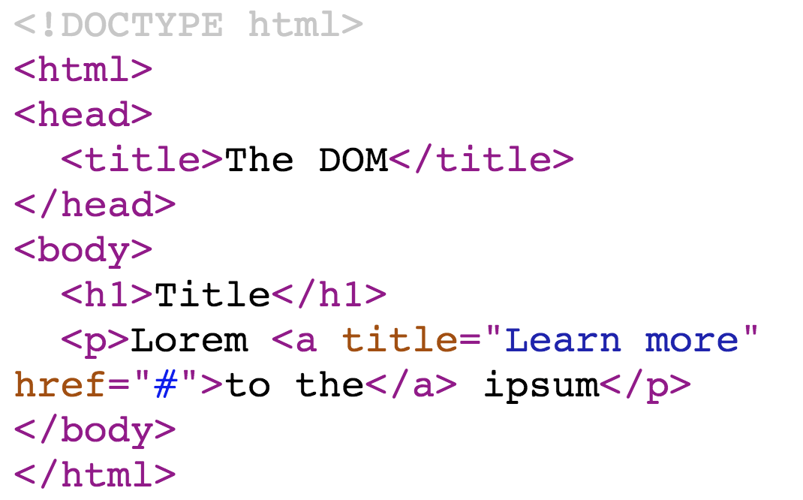
The Document Object Model

Slide 48
9
Document
10
Doctype
1
Root / HTML
1
1
Head
Body
1
Title
1
1
Header
Paragraph
3
Title Text
3
Header Text
3
1
3
Text
Link
3
Link Text
The Document Object Model

Slide 49
Document Object Methods
document.getElementById('main')
document.getElementsByTagName('a')
document.getElementsByClassName('post')
document.querySelector('.entry-title a')
document.querySelectorAll('.entry-title a')
The Document Object Model

Slide 50
DEMO
The Document Object Model

Slide 51
Getting Node Values
el.innerText
el.innerHTML
el.id
el.href
input.value
el.classList.add(‘new’)
el.classList.remove(‘new’)
el.classList.toggle(‘new’)
The Document Object Model

Slide 52
DEMO
The Document Object Model

Slide 53
DOM Traversal
Any Node
.parentNode
.childNodes
.firstChild
.lastChild
.nextSibling
.previousSibling
Element Nodes
.parentElement
.children
.firstElementChild
.lastElementChild
.nextElementSibling
.previousElementSibling
The Document Object Model

Slide 54
DEMO
The Document Object Model

Slide 55
Node Creating, Appending
document.createElement('p')
document.createTextNode('Text')
document.createDocumentFragment()
el.appendChild( child )
parent.insertBefore( childEl, el )
el.innerHTML = '<p>Text</p>';
el.cloneNode( true )
The Document Object Model

Slide 56
DEMO
The Document Object Model

Slide 57
DOM Cheat Sheet
Traversal - Any Node Type
.parentNode .lastChild
.childNodes .nextSibling
.firstChild .previousSibling
Traversal – Element Nodes
.parentElement .lastElementChild
.children .nextElementSibling
.firstElementChild .previousElementSibling
Creating & Appending Nodes
document.createElement('article')
el.appendChild( childEl )
Document Methods
document.getElementById()
document.getElementsByTagName()
document.getElementsByClassName()
document.querySelector()
document.querySelectorAll()
Working with Attributes
el.innerText el.id
el.innerHTML el.href
input.value el.attribute
el.classList.add(‘new’)
The Document Object Model

Slide 58
DOM Practice 01.01
Practice selecting following elements and logging to console
Main content container
First post title
First post content
All post titles

Slide 59
DOM Practice 01.02
Select the parent element for the first post title
Select the first post, then log out next sibling post
Select the main post container and log out it’s children

Slide 60
DOM Practice 01.03
Create a post with markup using JavaScript
Append post to the list of other posts on the page

Slide 61
DOM Practice **
Write a function to append post content to the page
Create a post object with a title and content
Call the function to append posts and pass it the post you created

Slide 62
DOM Practice **
Create a form with preset values
Get the values from the form and log them in the console

Slide 63
A Word on jQuery
The Document Object Model
Notes:
Makes the DOM API way easier to work with. Not going to look at today since we’re focused on working with vanilla JavaScript, but will see it in the while and not too hard to learn, especially once you know this.

Slide 64
Events
Types of Events
Hooking Into Events (inline handlers, event listeners)
The Event Object
Events with JavaScript
Notes:
Could spend a day on this ☺
And have a two hour course you can get on https://javascriptforwp.com/courses that covers all of this and more in quite a bit more depth
For today though, we’re gonna focus on some other important concepts and if this stuff is newer to you, you will pick it up as you go, which is a traditional WordPress Developer learning style.

Slide 65
Types of Events in JavaScript
Mouse events
Keyboard events
Form events
Media events
Drag and Drop events
Window events
Many more….
Events with JavaScript
Notes:
Could spend a day on this ☺
And have a two hour course you can get on https://javascriptforwp.com/courses that covers all of this and more in quite a bit more depth
For today though, we’re gonna focus on some other important concepts and if this stuff is newer to you, you will pick it up as you go, which is a traditional WordPress Developer learning style.
But let’s take a look at the different events available in JavaScript - https://developer.mozilla.org/en-US/docs/Web/Events

Slide 66
DEMO
Events with JavaScript

Slide 67
Hooking Into Events
Inline Event Handler in HTML
<a href="#" onclick="console.log('Clicked');">Link</a>
Event Listener in JS
link.addEventListener( 'click', myFunction, false );
Events with JavaScript

Slide 68
DEMO
Events with JavaScript

Slide 69
The Event Object
link.addEventListener( 'click', sayHi, false );
function sayHi( e ) { // e is the event object
console.log( e );
console.log( e.type );
console.log( e.target );
}
Events with JavaScript

Slide 70
DEMO
Events with JavaScript

Slide 71
Events Cheat Sheet
Inline Event Handler
<a href="#” onclick=”//JS here;">Link</a>
Event Listener
el.addEventListener( ‘event’, function, false)
el.removeEventListener( ‘event’, function, false)
Event Object
e = arguments[0] || events
e.target
e.type
Event Types
load, offline, online, focus, blur, animationstart, animationend, transitionstart, transitionend, submit, resize, scroll, keypress, mousemove, mouseenter, mouseleave, click, dragstart, dragenter, dragend, dragover, drop, timeupdate, hashchange, more!
Events with JavaScript

Slide 72
Events Practice 02.01
Write an inline click event on a link that logs out a message when clicked
Add an event listener to a link that logs out a message when clicked

Slide 73
Events Practice 02.02
Select all post title links on the page
Add an event listener to each link that logs the title of that post when clicked

Slide 74
Events Practice 02.03
Get the values from the form when submitted
Append the new post values as a new post on the page
Clear form values once post is loaded

Slide 75
Events in Different Libraries & Frameworks
Events with JavaScript
Notes:
Makes the DOM API way easier to work with. Not going to look at today since we’re focused on working with vanilla JavaScript, but will see it in the while and not too hard to learn, especially once you know this.

Slide 76
Using the WP API with Native JavaScript
Zac Gordon @zgordon
github.com/zgordon/a-day-of-javascript
JSON & HTTP
Notes:
Makes the DOM API way easier to work with. Not going to look at today since we’re focused on working with vanilla JavaScript, but will see it in the while and not too hard to learn, especially once you know this.

Slide 77
JSON & HTTP
JSON Overview
HTTP Requests with Fetch
Pulling in WordPress API Content
JSON & HTTP

Slide 78
JSON
{
"title": 2,
"title": "Hello JSON!",
"slug": "hello-json",
"content": "Some post content goes here."
}
JSON & HTTP

Slide 79
JSON
[
{
"title": "Hello JSON!",
"content": "Some post content goes here."
},
{
"title": "Hello API!",
"content": "More post content."
},
]
JSON & HTTP

Slide 80
DEMO
JSON & HTTP
Notes:
Show live WordPress JSON

Slide 81
JSON Into JavaScript
let JSONString = '{ "id": 1, "title": "Hello JSON!" }',
post = JSON.parse( JSONString );
console.log( post.title );
JSON & HTTP

Slide 82
JavaScript Into JSON
let post = {
id: 2,
title: "Hello JSON!"
},
postJSON = JSON.stringify( post );
console.log( postJSON );
JSON & HTTP

Slide 83
DEMO
JSON & HTTP
Notes:
Practice

Slide 84
Making HTTP Get Requests with Fetch
fetch( ‘https://site.com/wp-json/wp/v2/posts’ )
.then( response => {
response.json().then( posts => {
console.log( posts );
});
})
.catch( err => {
console.log( err );
});
JSON & HTTP

Slide 85
Making HTTP Post Requests with Fetch
fetch( 'https://site.com/wp-json/wp/v2/posts', {
method: 'POST',
body: JSON.stringify( post ),
headers: new Headers({
'Content-Type' : 'application/json',
'Authorization' : 'Bearer ' + token
}),
credentials: 'include'
})
.then( function( response ) {
if( 201 === response.status ) {
console.log( 'Post Update' );
}
});
JSON & HTTP

Slide 86
DEMO
JSON & HTTP
Notes:
Practice

Slide 87
JSON & HTTP Cheat Sheet
JSON Example
[{ “title” : “Hello” }, { “title” : “JSON” }]
JS JSON Conversion
let posts = JSON.parse( postsJSON );
let postJSON = JSON.stringify( posts );
Fetch with Promises
fetch( ‘https://site.com/posts.json’ )
.then( response => {
response.json().then( posts=> {
console.log( posts );
});
})
.catch( err => {
console.log( err );
});
JSON & HTTP

Slide 88
JSON Practice 03.01
Write a valid JSON file for a post
Validate that JSON file online
JSON & HTTP

Slide 89
JSON Practice 03.02
Make a fetch call to your JSON file
Display the post on the page
JSON & HTTP

Slide 90
JSON Practice 03.03
Make a fetch call to a WP site for posts (5 max)
Display the posts on the page
JSON & HTTP

Slide 91
WP API + JS in a Theme
Add the apidemo.zip theme to your WP site
Functions.php enqueue main.js with dependency of wp-api and jquery
Use new wp.api.collections.Posts() and .fetch to get posts from WP Site
Use JavaScript (and jQuery) to add the posts to the page
WP API + JS in a Theme

Slide 92
A Day of JavaScript
Review
Wrap Up
Notes:
Makes the DOM API way easier to work with. Not going to look at today since we’re focused on working with vanilla JavaScript, but will see it in the while and not too hard to learn, especially once you know this.

Slide 93
A Day of JavaScript Review
Programming Review: variables, arrays, functions, objects, loops, conditional statements
The Document Object Model:
WP API + JS in a Theme

