Slide 1
Sense your salary using classification MACHINE LEARNING ALGORITHM
CAPSTONE PROJECT
Presented By:
Devinandha
STU6772951abef7e1735562522
Amrita Vishwa Vidyapeetham , Coimbatore
B-tech in Computer Science specialization in Cybersecurity

Slide 2
OUTLINE
Problem Statement (Should not include solution)
System Development Approach (Technology Used)
Algorithm & Deployment (Step by Step Procedure)
Result
Conclusion
Future Scope(Optonal)
References

Slide 3
Problem Statement
In the fast evolving era, with growing concerns in the salary disparities and bias in job markets. A salary detection system will be useful for any employee to predict the possible wages he/she deserves for his/her experience and position. The system deployed in a larger scale will help even freshers to understand their role , expected salary range and their worth in job markets. Additionally, the system can also help companies predict appropriate salary offers for new hires .

Slide 4
System Approach
The Salary prediction system uses machine learning algorithms to classify employess either salary >50,000 or <=50,000
System requirements (provided by google collab)
CPU :Intel Xeon
RAM: 12 GB
DISK: Temporary storage
Python 3.10
Library required to build the model

Slide 5
Pandas – Pandas is used for data manipulation ,creating dataframes, uploading data etc
Scikit learn – sklearn is used for preprocessing the data ,encoding both testing and training data and modelling the data.
Encoding-> Onehotencoder , standardencoder , labelencoder
Model split -> Train test split (80% training data, 20% testing data)
Linear model -> Linear Regression model
Pipeline -> Pipeline will join the two models
ColumnTransformer -> does categorical encoding and numeric scaling
Stacking classifier -> to stack multiple models to increase accuracy
metrics -> for calculating accuracy,classification report
xgboost – xgb classifer model

Slide 6
Algorithm & Deployment
The necessary models were called and named(eg: import pandas as pd)
The dataset is uploaded using pandas read_csv function .
.A small part of the dataset is seen to understand and analyse it, find the columns that require preprocessing.
The total number of rows and columns are found using data.shape
Number of zeros is calculated in each column.(For the adult.csv dataset there was no zeroes in any feature)

Slide 7
Value_counts count the unique values in each age category
Pie chart is used for each necessary feature to understand the number of features and their influence on the model
Boxplot is used to visualize the distribution and spread of a numerical.
To find the best model required for the dataset, different machine models are trained on the data ,their accuracy is measured and the model with the highest accuracy is choosen.

Slide 8
Models used and accuracy:
Logistic Regression =86%
Random Forest = 86%
SVM =86%
Gradient Boosting = 87%
XGBoost = 87%
Combining the Logistic Regression and XGBoost

Slide 9
To create a better model ,Logistic Regression is combined with XGBoost
Accuracy = 88%
X is the features
Y is the target
Target can be encoded using label encoder
Categorical columns and numerical columns separately converted into list
For numeric columns ,Standard scaler is used, for categorical columns ,one hot encoder is used for encoding

Slide 10
XGB classifier is called , specifying n_estimators , learning rate, max_deptg, use_label_encoder , eval_metric, random_state.
For logistic regression, maximum iterations is specified
Using stack classifier to stack the models (xgb,lr) ,final estimator is logistic Regression.
Pipeline is used to order the models preprocessing and then stacking the model.
The data is split into training and testing dataset (80% training , 20 % testing)

Slide 11
The model is trained using two classifiers using the stack, accuracy and classification report is calculated
The model is saved and loaded using joblib
A streamlit program is done to deploy the model in streamlit
Pyngrok library is downloaded, the unique authentication token from ngrok is used to deploy the model
Ngrok connects to the local terminal (port 8501) and the page for “Sense your Salary” is created.

Slide 12
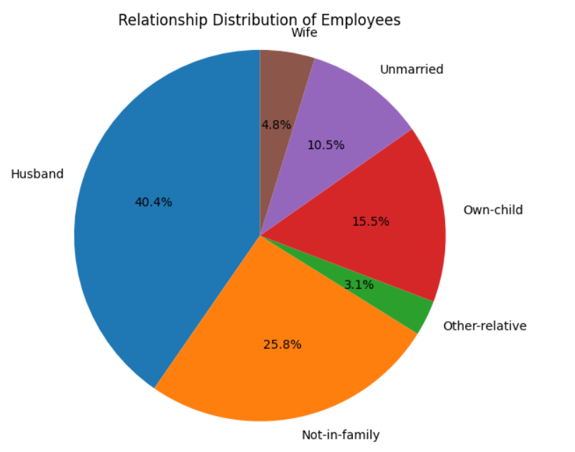
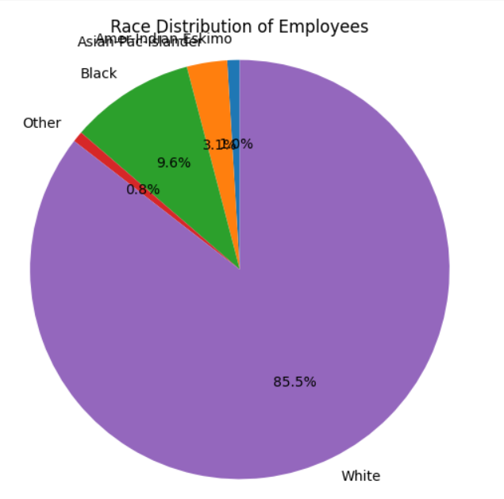
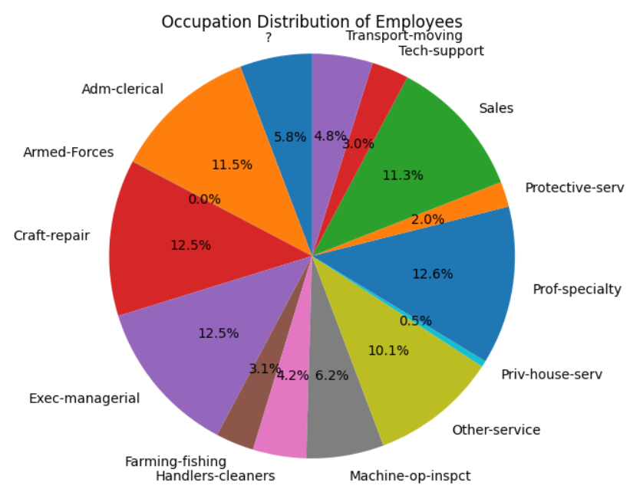
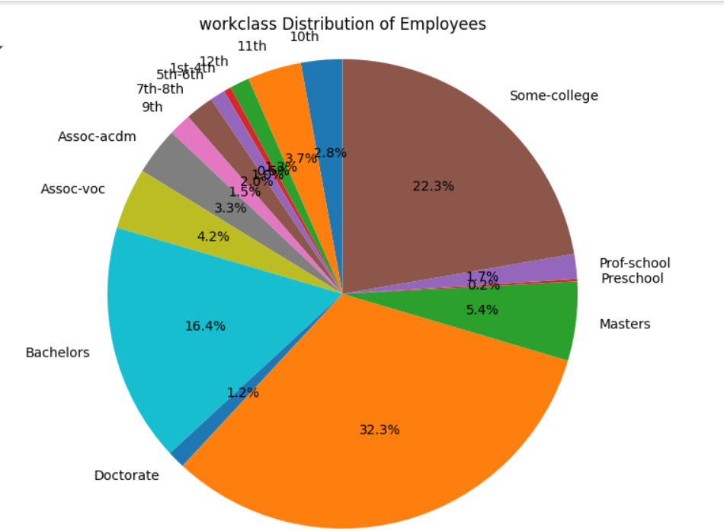
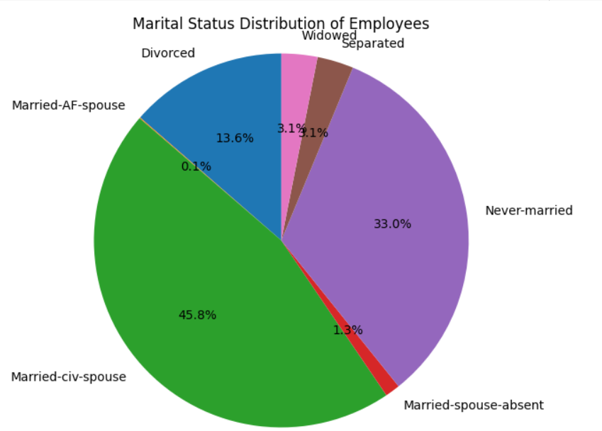
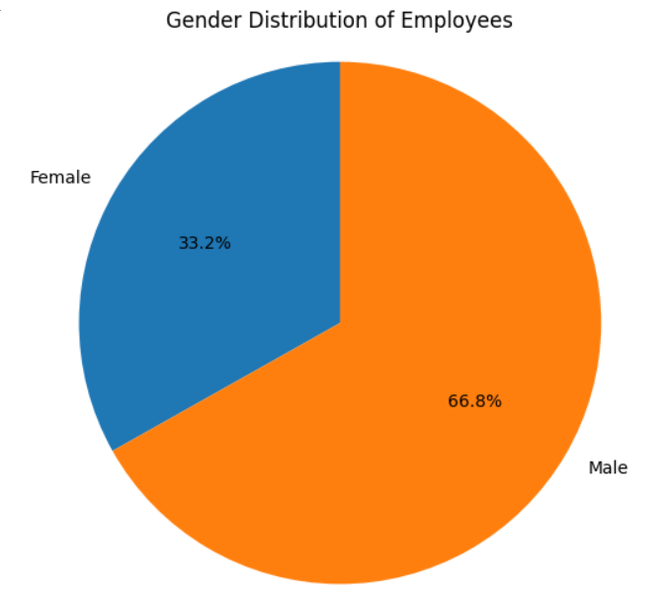
PIE charts for understanding the dataset

Slide 13
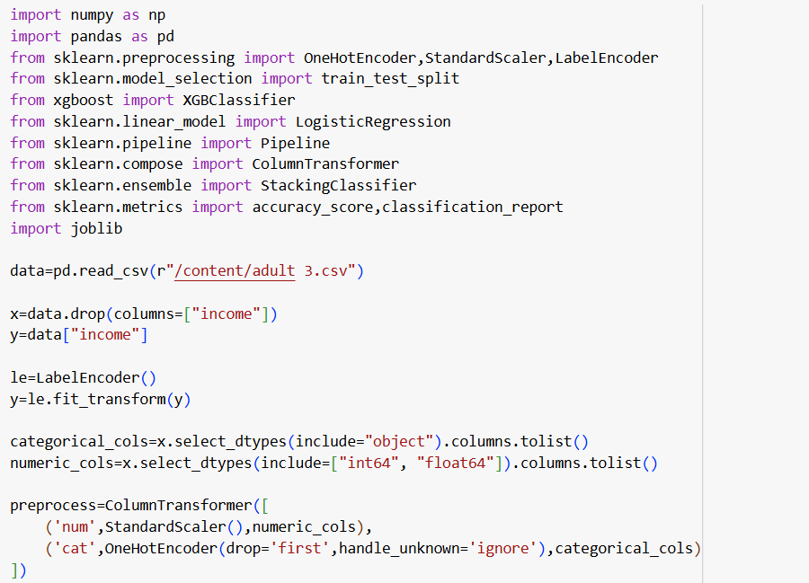
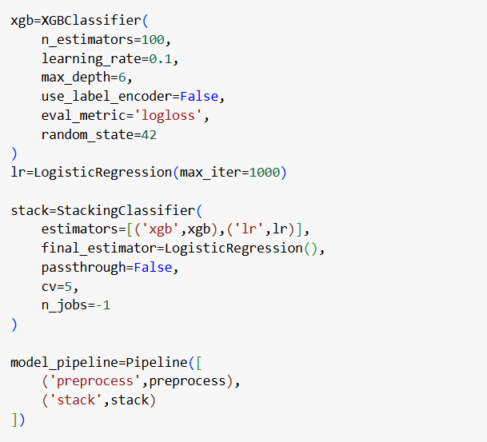

Slide 14
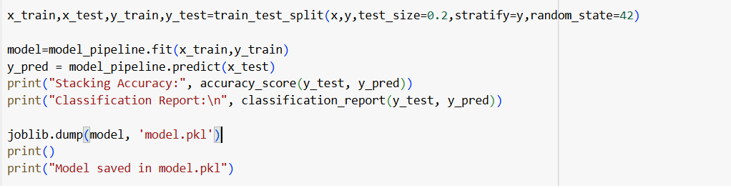

Slide 15
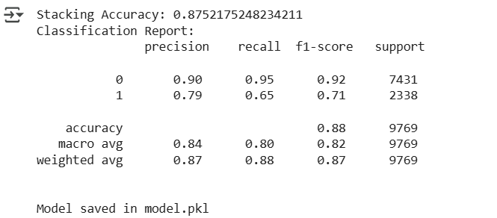

Slide 16
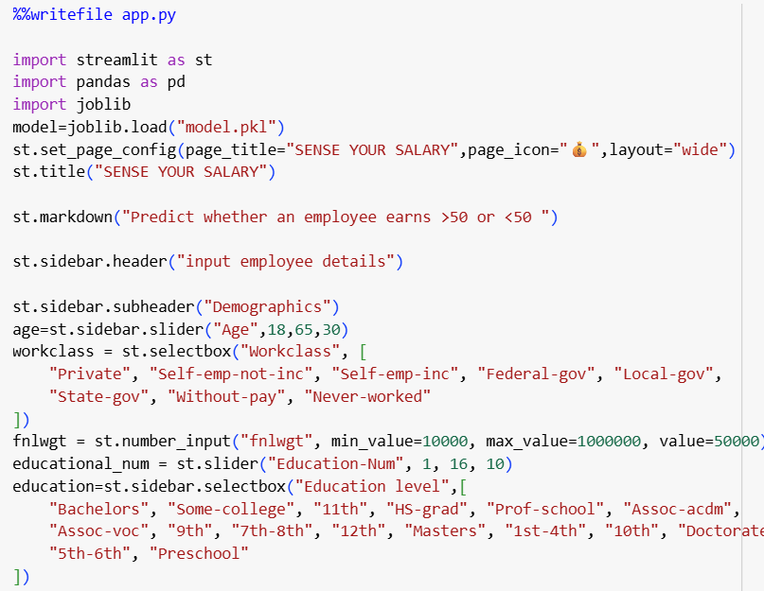
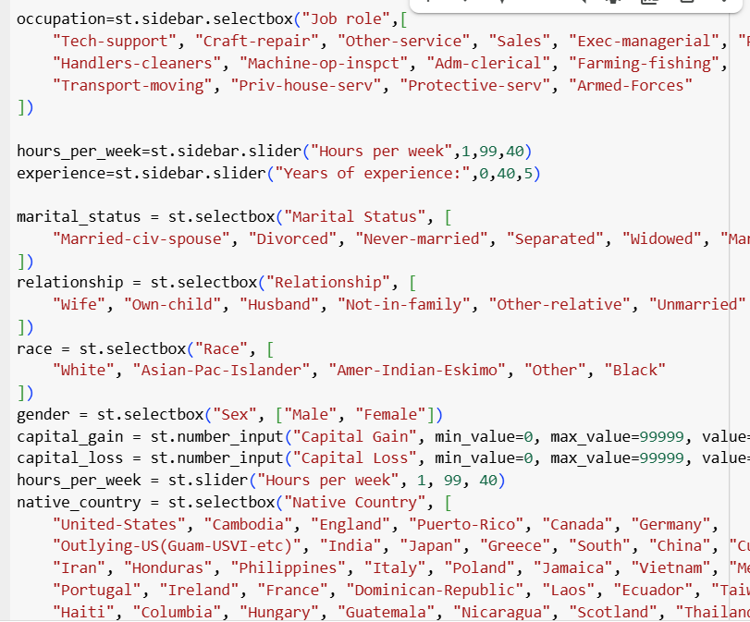

Slide 17
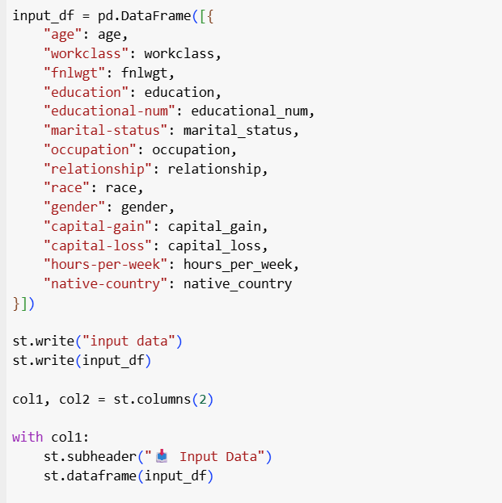
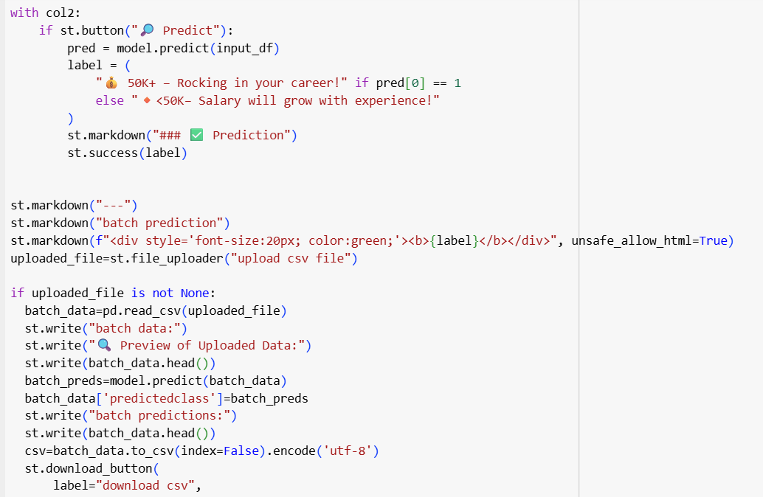

Slide 18
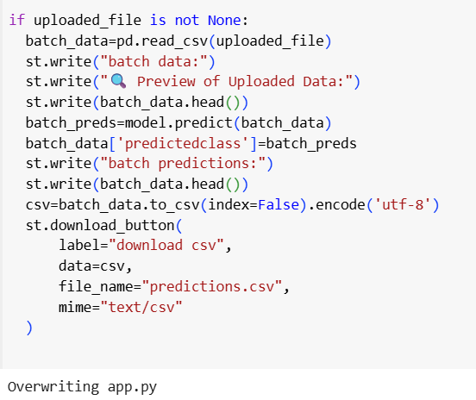

Slide 19
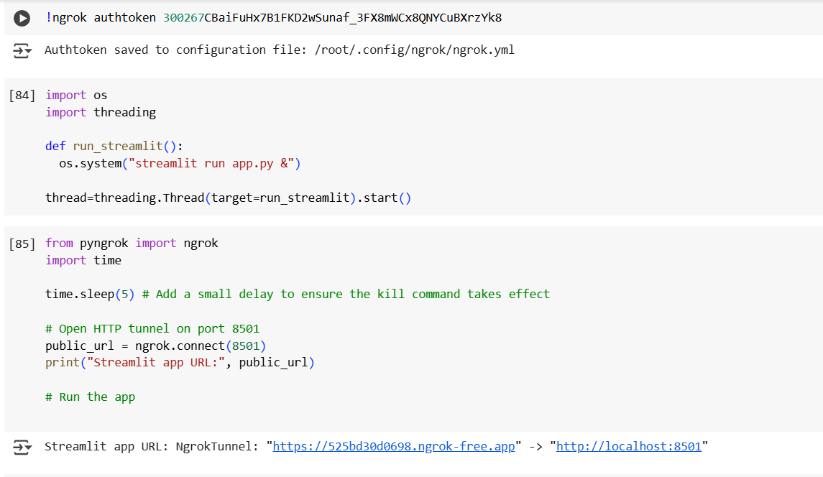

Slide 20
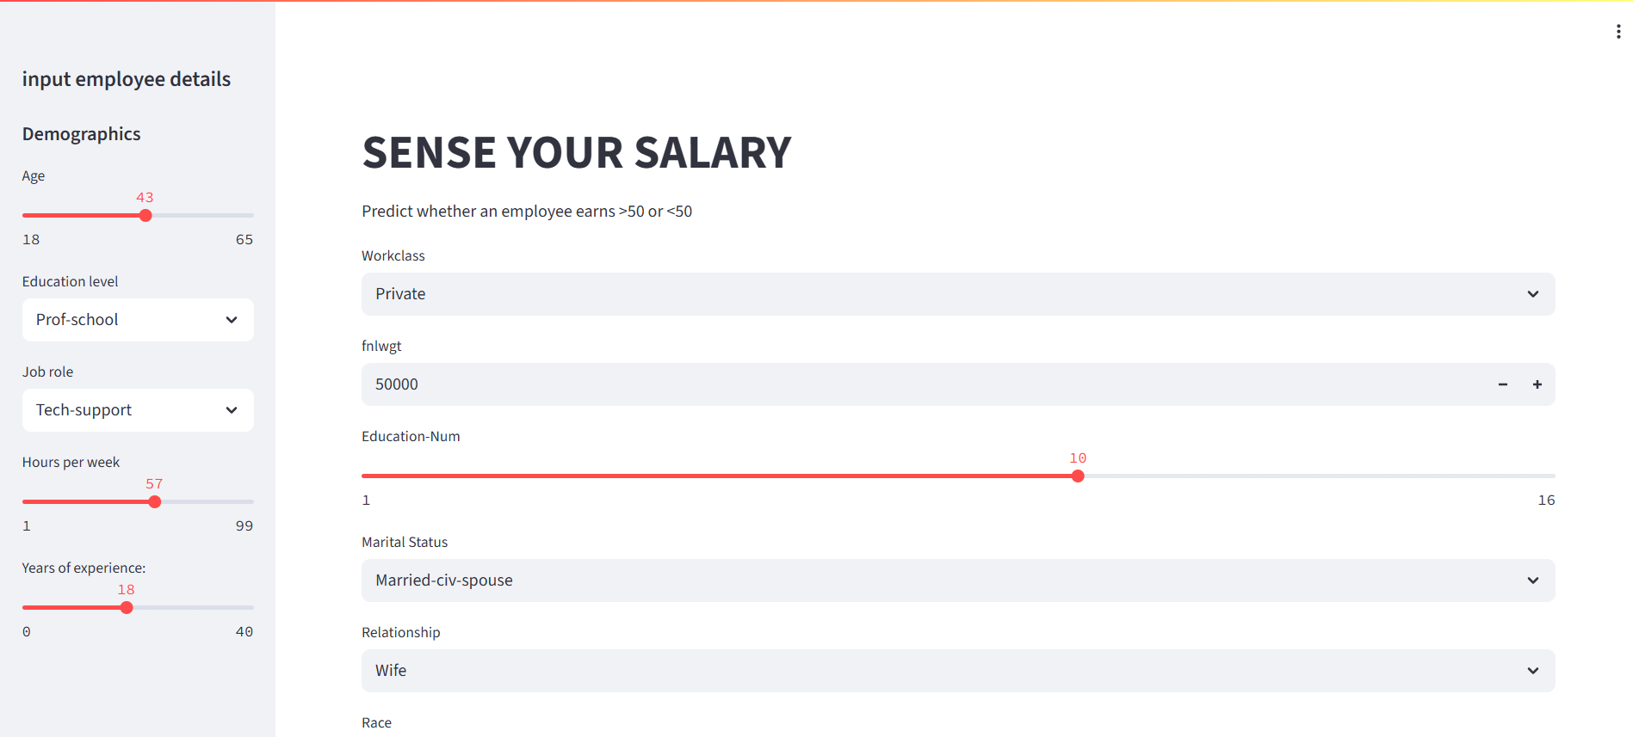

Slide 21
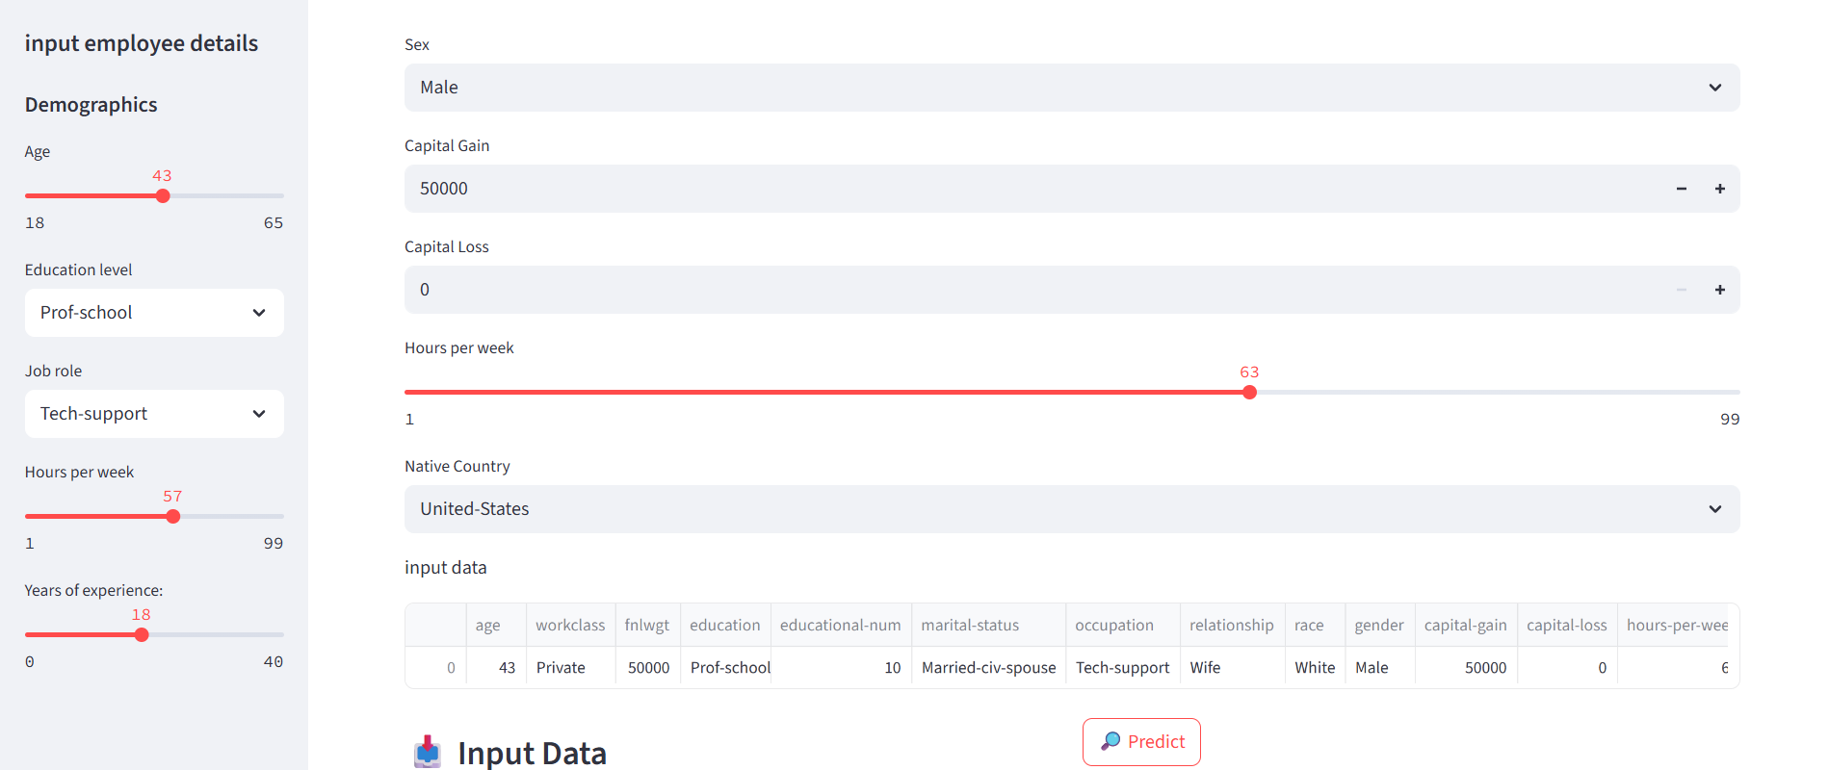

Slide 22
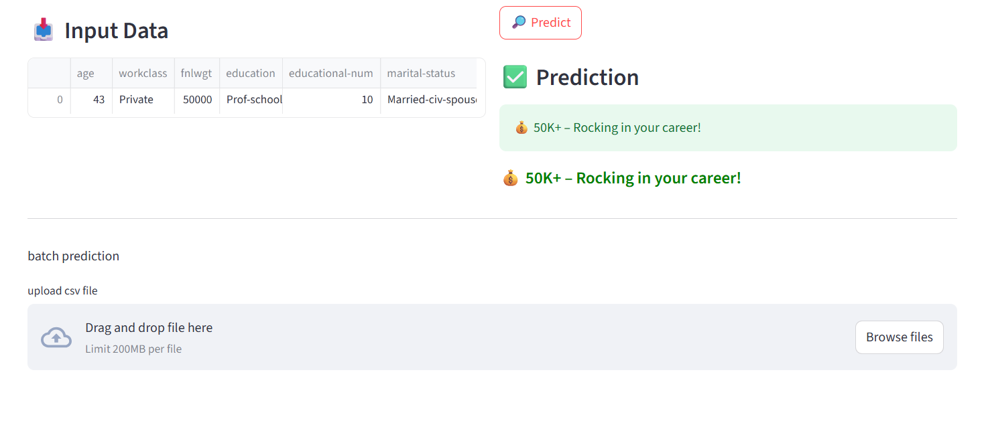

Slide 23
Conclusion
The model deployed in streamlit requires all the necessary features such as workclass, fnlwgt, marital-status and others. Those values are made a dataframe and is used for prediction. These informations are collected in a user interface and then combined, passed to the trained machine learning model for prediction. The result provides users with an estimate salary class either greater than 50k or less than 50k.

Slide 24
Future scope(Optional)
The current system can be improved in terms of accuracy and better prediction. Also the model can be trained with better data to predict accurate or precise values of the salary rather than classifying it. This version provides a surface level classification but can be changed into an accurate salary prediction model with better datasets and using supervised models. In future, these systems can be used in HR teams or other departments to decide salaries of employees.

Slide 25
References
IBM skillsbuild : edunet foundation, Artificial Intelligence professional badge
https://www.w3schools.com/python/python_ml_getting_started.asp
https://www.ijasret.com/VolumeArticles/FullTextPDF/842_47._SALARY_PREDICTION_USING_MACHINE_LEARNING.pdf.

Slide 26
THANK YOU

