Slide 1

Welcome To The User Awareness Training Of ISO/IEC 27001:2013 (Information Security Management Systems)
Xebia Confidential & Proprietary
Software Development Done Right

Slide 2
'Information is an asset which, like other important business assets, has value to an organization and consequently needs to be suitably protected’
-ISO 27001:2013

Slide 3
Information can be:
Created
Stored
Destroyed
Processed
Transmitted
Used
Corrupted
Lost
Stolen
Printed or written on paper
Stored electronically
Displayed / published on web

Slide 4
‘…Whatever form the information takes, or means by which it is shared or stored, it should always be appropriately protected’
-ISO 27001:2013

Slide 5
What is Information Security?
The quality or state of being secure to be free from danger.
Security is achieved using several strategies simultaneously or used in combination with one another.
Security is recognized as essential to protect vital processes and the systems that provide those processes.
Security is not something you buy, it is something you do.

Slide 6
The architecture where an integrated combination of appliances, systems and solutions, software, alarms, and vulnerability scans working together.
Monitored 24x7
Having People, Processes, Technology, policies, procedures.
Security is for PPT and not only for appliances or devices.

Slide 7
Organization Staff
PEOPLE
Business Processes
PROCESSES
Technology Used
TECHNOLOGY

Slide 8
IMPORTANCE OF INFORMATION SECURITY
Protects information from a range of threats
Ensures business continuity
Minimizes financial loss
Optimizes return on investments
Increases business opportunities
Business survival depends on information security.

Slide 9
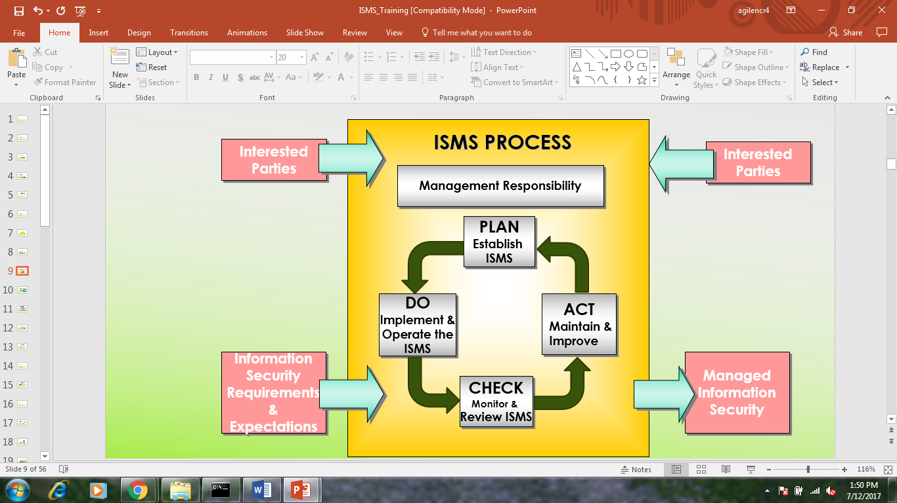

Slide 10
ISO 27001:2013 defines Information Security as the preservation of:
Confidentiality
Integrity
Availability
Ensuring that information is accessible only to those authorized to have access
Safeguarding the accuracy and completeness of information and processing methods
Ensuring that authorized users have access to information and associated assets when required

Slide 11
Confidentiality
Confidentiality of information refers to the protection of information from unauthorized disclosure.
The impact of unauthorized disclosure of confidential information can range from jeopardizing organization security to the disclosure of private data of employees.
Following table provides guideline to determine Confidentiality requirements:

Slide 12
RATING | DEFINITION | EXAMPLES
4 | These information / assets are restricted to Xebia Leadership team and are intended for business use. Impact of unauthorized disclosure can result in: Severe disruptions in business operations Adverse publicity Significant business loss/ financial loss | Financial and other company related information Employee remuneration /compensation related. Customer provided information requiring confidentiality as per request or classification, etc.
3 | These information / assets are permitted to be shared / used within a group of users / team for the project / function. Impact of unauthorized disclosure can result in: Affecting the functioning of the individual projects /functions. Adverse impact on relations with customer’s business associates. Adverse effect on employee’s Minimal business / financial loss | Memos, Work programs, Schedules, Test results, Status reports, Software code, Project plans and another project related artifacts, TEAMS application and content, Software Requirement Specifications, User mailbox access
2 | These information / assets are permitted to be shared / used by all the employees (authorized users) of the company. Unauthorized disclosure outside the company is against policy. Disclosure however, is not expected to seriously impact the company, employees, business partners, customers and /or other stakeholders. | Training material, Policy manuals, ISMS documents and templates, Other policies and resources available on the website and intranet, company policies and schemes, SOP
1 | These information / assets have been explicitly approved by management for release in the public domain and may be shared freely with all including outsiders (unauthorized users) without any potential harm. | Sales brochures and pamphlets, press releases

Slide 13
Integrity
Integrity refers to the completeness and accuracy of Information.
Integrity is lost if unauthorized changes are made to data or IT system by either intentional or accidental acts.
If integrity of data is not restored back, continued use of the contaminated data could result in inaccuracy, fraud, or erroneous decisions.
Integrity criteria of information can be determined with guideline established in the following table:

Slide 14
RATING | DEFINITION
4 | Loss of integrity of the information / asset (either partially or completely) could lead to: Significant Business, Financial and / or Legal Impact Embarrassment and / or negative publicity to the company The integrity of the information in this case either cannot be recovered or may be totally or partially recoverable at a significant and material financial cost.
3 | Loss of integrity of the information / asset (either partially or completely) would lead to a business impact for a project. The information can be recovered (either partially or completely) with some level of effort and minimal financial cost.
2 | Loss of integrity of the information / asset would moderately affect the completeness of the information and low business impact. The information can be recovered with minimal effort.
1 | No impact due to loss of integrity of the information / asset.

Slide 15
Availability
Availability indicates how soon the information is required, in case the same is lost.
If critical information is unavailable to its end users, the organization’s business operations may be affected.
Following table provides guideline to determine availability criteria of information assets:

Slide 16
RATING | DEFINITION
4 | The information / asset is such that: Accessibility or Unavailability would constitute disruption in work leading to high impact to the business operations and / or financial loss to the company. a very high cost, effort and will require a lot of time to restore Required for legal and regulatory compliance E.g.: Mail Server, Contingency Assets, Link Failure, Internet connection etc.
3 | The information / asset is such that: Accessibility or Unavailability would constitute a disruption in work leading to business impact to a part of the company restore
2 | The information / asset is such that: Non-Accessibility or unavailability would constitute a disruption of work leading to impact on the functioning of individual projects / functions Loss due to unavailability is moderate, provided functions are restored within a certain timeframe Non-availability of asset may have some impact on Xebia, if prolonged for a long period.
1 | The information / asset is such that: Non-Accessibility or Unavailability would constitute a disruption in work leading to low or no business loss. Asset can be easily replaced These assets may be unavailable for an extended period, at little or no cost to the company, and require little or no effort when restored. Non-availability of asset would have minimal / insignificant impact on Xebia.

Slide 17
Security breaches leads to
Reputation loss
Financial loss
Intellectual property loss
Legislative Breaches leading to legal actions (Cyber Law)
Loss of customer confidence
Business interruption costs

Slide 18
What is Risk, Threat & Vulnerability ?
Risk: A possibility that a threat exploits a vulnerability in an asset and causes damage or loss to the asset.
Threat: Something that can potentially cause damage to the organization, IT Systems or network.
Vulnerability: A weakness in the organization, IT Systems, or network that can be exploited by a threat.

Slide 19
Relationship between Risk, Threats, and Vulnerabilities
exploit
Threats
Vulnerabilities
increase
increase
protect against
expose
Controls *
Risk
Information assets
reduce
indicate
increase
met by
have
Protection Requirements
Asset values
* Controls: A practice, procedure or mechanism that reduces risk

Slide 20
Threat Identification
Agent
The catalyst that performs the threat. E.g. Human, Machine, Nature
Motive
Something that causes the agent to act. E.g. Accidental, Intentional
Results
The outcome of the applied threat. The results normally lead to the loss of CIA.

Slide 21
Threat Sources
Source | Motivation | Threat
External Hackers | Challenge Ego Game Playing | System hacking Social engineering Dumpster diving
Internal Hackers | Deadline Financial problems Disenchantment | Backdoors Fraud Poor documentation
Terrorist | Revenge Political | System attacks Social engineering Letter bombs Viruses Denial of service
Poorly trained employees | Unintentional errors Programming errors Data entry errors | Corruption of data Malicious code introduction System bugs Unauthorized access

Slide 22
S.No. | Categories of Threat | Example
1 | Human Errors or failures | Accidents, Employee mistakes
2 | Compromise to Intellectual Property | Piracy, Copyright infringements
3 | Deliberate Acts or espionage or trespass | Unauthorized Access and/or data collection
4 | Deliberate Acts of Information extortion | Blackmail of information exposure / disclosure
5 | Deliberate Acts of sabotage / vandalism | Destruction of systems / information
6 | Deliberate Acts of theft | Illegal confiscation of equipment or information
7 | Deliberate software attacks | Viruses, worms, macros Denial of service
8 | Deviations in quality of service from service provider | Power and WAN issues
9 | Forces of nature | Fire, flood, earthquake, lightening
10 | Technical hardware failures or errors | Equipment failures / errors
11 | Technical software failures or errors | Bugs, code problems, unknown loopholes
12 | Technological Obsolence | Antiquated or outdated technologies

Slide 23
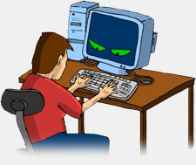
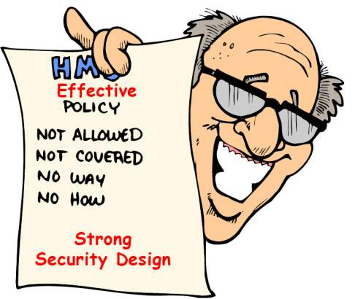
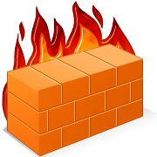
RISKS & THREATS
High User Knowledge of IT Systems
Theft, Sabotage, Misuse
Virus Attacks
Systems & Network Failure
Lack Of Documentation
Lapse in Physical Security
Natural Calamities & Fire

Slide 24
ISO 27001
ISO 27001: This International Standard covers all types of organizations (e.g. commercial enterprises, government agencies, non-profit organizations).
This international standard specifies the requirements for establishing; implementing, operating, monitoring, reviewing, maintaining and improving documented ISMS within the context of the organization’s overall business risks. It specifies requirements for the implementation of security controls customized to the needs of individual organizations or parts thereof.
The ISMS is designed to ensure the selection of adequate and proportionate security controls that protect information assets and give confidence to interested parties.

Slide 25
Features of ISO 27001:2013
Plan, Do, Check, Act (PDCA) Process Model
Process based approach
Stress on Continual Process Improvements
Scope covers Information Security not only IT Security
Covers People, Process and Technology
5600 plus organizations worldwide have been certified
14 Clauses, 35 Control objectives, 114 controls

Slide 26
IS POLICY
SECURITY ORGANISATION
MANAGEMENT REVIEW
PLAN
Establish
ISMS
DO
Implement &
Operate the
ISMS
ACT
Maintain &
Improve
ASSET IDENTIFICATION & CLASSIFICATION
CORRECTIVE & PREVENTIVE ACTIONS
CHECK
Monitor &
Review ISMS
CONTROL SELECTION & IMPLEMENTATION
CHECK PROCESSES
OPERATIONALIZE THE PROCESES

Slide 27
BENEFITS
At the organizational level : Commitment
At the legal level: Compliance
At the operating level: Risk management
At the commercial level: Credibility and confidence
At the financial level: Reduced costs
At the human level: Improved employee awareness

Slide 28
USER RESPONSIBILITIES

Slide 29
Information Security Policy
Compliance
Organisation of Information Security
Business Continuity Planning
Confidentiality
Integrity
Asset Management
INFORMATION
Incident Management
Human Resource Security
Availability
System Development & Maintenance
Physical Security
Access Control
Communication & Operations Management

Slide 30
CHANGE MANAGEMENT
Any department
Immediate Manager
Submit
Change Request form
No
IT/ CISO Approval
Rejected
Yes
Change Management Form
Change moved to production

Slide 31
INCIDENT MANAGEMENT
Any department
Reports to
Submitted
Immediate Manager/ CISO/ IT Support
Incident Reporting form
to
IT/ CISO
Submit
Security Incident Final Report

Slide 32
Business Continuity Planning
Torrential Rains
Step 1: Monitor weather advisories
Step 2: Notify on-site employees
Step 3: Call local radio and TV stations to broadcast weather closing information for employees at home
Step 4: Place closing sign on all affected location offices
Step 5: Arrange for snow and ice removal

Slide 33
Floods
Step 1: Monitor flood advisories
Step 2: Determine flood potential to location
Step 3: Determine employees at risk
Step 4: Pre-stage emergency power generating equipment
Step 5: Assess damage

Slide 34
Cyclones
Step 1: Listen to Hurricane advisories
Step 2: Shut down all equipment
Step 3: Check gas, water and electrical lines for damage
Step 4: Evacuate area, if flooding is possible
Step 5: Do not use landline telephones, in the event of severe lightning
Step 6: Assess damage

Slide 35
Earthquakes
Step 1: Shut down utilities
Step 2: Evacuate building if necessary
Step 3: Account for all personnel
Step 4: Determine impact of organization disruption
Step 5: Gather at assembly area
Step 6: Account for all personnel
Step 7: Search for missing personnel
Step 8: Asses damage

Slide 36
Fires
Step 1: Evacuate personnel on alarm, as necessary
Step 2: Shut down utilities
Step 3: Attempt to suppress fire in early stages
Step 4: Notify fire department.
Step 5: Gather at assembly area
Step 6: Account for all personnel
Step 7: Search for missing personnel
Step 8: Asses damage

Slide 37
Document Classification And labelling
Information can be classified into four categories:
Classification | Examples
Public | Public press releases Marketing Materials after release External vacancy notices
Internal | Training materials Email and phone directories Customer contact details
Confidential | Financial and budgets Employee personnel data Source Code Non-disclosure agreements with clients\vendors
Restricted | Legal proceedings and investigations Merger and acquisition activities High level strategic planning

Slide 38
Assets usage policy
Anti-virus must be installed on each laptop
All PCs, laptops and workstations should be secured with a password-protected screensaver with the automatic activation feature set at 15 minutes or less, or by logging-off or locking the workstation.
Report any theft of Xebia’s assets to the immediate manager/supervisors.
Introduction of malicious programs into the network or server
Revealing your account password to others or allowing use of your account by others.
Sending Spam via e-mail, text messages, pages, instant messages, voice mail, or other forms of electronic communication.
Opening e-mail attachments received from unknown senders, which may contain viruses, malware, or Trojan horse code.

Slide 39
Access Control - Physical
Follow Security Procedures
Wear Identity Cards and Badges
Ask unauthorized visitor his credentials
Attend visitors in Reception and Conference Room only
Bring visitors in operations area without prior permission
Bring hazardous and combustible material in secure area
Practice “Piggybacking” / “Tailgating”
Bring and use pen drives, zip drives, ipods, other storage devices unless and otherwise authorized to do so

Slide 40
Password Guidelines
Always use at least 8 character password with combination of alphabets, numbers and special characters (*, %, @, #, $, ^)
Use passwords that can be easily remembered by you
Change password regularly as per policy
Use password that is significantly different from earlier passwords
Use passwords which reveals your personal information or words found in dictionary
Write down or Store passwords
Share passwords over phone or Email
Use passwords which do not match above complexity criteria

Slide 41

Internet Usage
Use internet services for business purposes only
Do not access internet through dial-up connectivity
Do not use internet for viewing, storing or transmitting obscene or pornographic material
Do not use internet for accessing auction sites
Do not use internet for hacking other computer systems
Do not use internet to download / upload commercial software / copyrighted material
IT support is continuously monitoring Internet Usage. Any illegal use of internet and other assets shall call for Disciplinary Action.

Slide 42
E-mail Usage
Use official mail for business purposes only
Follow the mail storage guidelines to avoid blocking of E-mails
If you come across any junk / spam mail, do the following
Remove the mail.
Inform the security help desk
Inform the same to server administrator
Inform the sender that such mails are undesired
Do not use official ID for any personal subscription purpose
Do not send unsolicited mails of any type like chain letters or E-mail Hoax
Do not send mails to client unless you are authorized to do so
Do not post non-business related information to large number of users
Do not open the mail or attachment which is suspected to be virus or received from an unidentified sender

Slide 43
Security Incidents
Report Security Incidents (IT) to Helpdesk through
E-mail: itsupportindia@xebia.com
Telephone extension: 238
Examples:
IT Incidents: Mail Spamming, Virus attack, Hacking, etc.
Non-IT Incidents: Unsupervised visitor movement, Information leakage, Bringing unauthorized Media
Do not discuss security incidents with any one outside organization
Do not attempt to interfere with, obstruct or prevent anyone from reporting incidents

Slide 44
Other Responsibilities:
Ensure your Desktops are having latest antivirus updates
Ensure your system is locked when you are away
Always store laptops/ media in a lockable place
Be alert while working on laptops during travel
Ensure sensitive business information is under lock and key when unattended
Ensure back-up of sensitive and critical information assets
Understand Compliance Issues such as
Cyber Law
IPR, Copyrights, IT Act 2000 etc.
Contractual Obligations with customer
Verify credentials, if the message is received from unknown sender
Always switch off your computer before leaving for the day
Keep yourself updated on information security aspects

Slide 45
THANK YOU

