Slide 1
CS 4476 PS2
Devin Fromond
dfromond3@gatech.edu
dfromond3
903761713

Slide 2
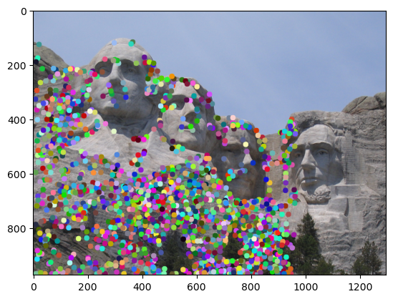
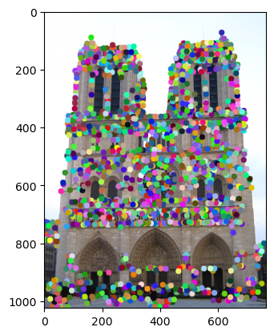
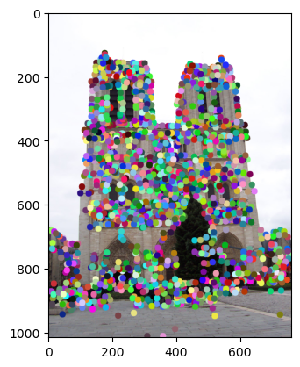
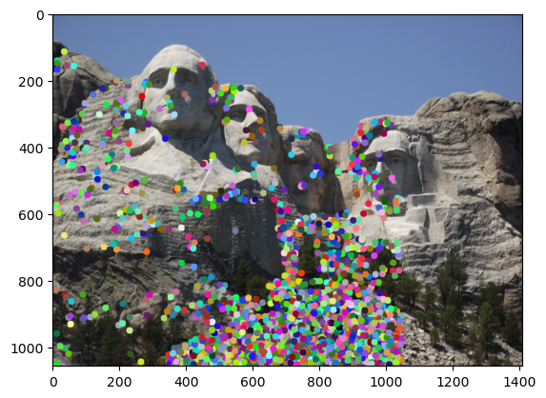
1.1: Harris Corner Detector
<insert visualization of Notre Dame interest points from ps2.ipynb here> [2.5 pts]
< insert visualization of Rushmore interest points from ps2.ipynb here > [2.5 pts]

Slide 3
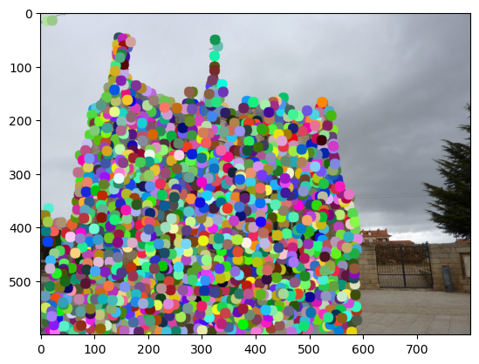
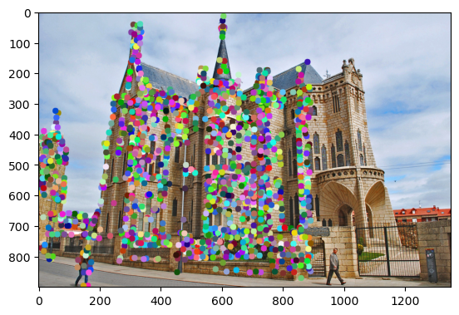
1.1: Harris Corner Detector
< insert visualization of Gaudi interest points from ps2.ipynb here > [2.5 pts]

Slide 4
1.1: Harris Corner Detector
Briefly describe how the Harris corner detector works. [1 pt]
The Harris corner detector finds points within an image where the intensity changes in both the x and y directions. If this was only in x OR y, then this would be an edge. We compute the gradients then form the second-moment matrix from these gradients. Then, we calculate the corner response and filter, only keeping strong corner points
What does the second_moments() helper function do? [1 pt]
Second-moments computes the average gradient products in a particular area by smoothing them with a gaussian. This details how intensity changes around a particular pixel.
What does the corner_response() helper function do? [1 pt]
Corner response takes in the outputs from second-moments and computes the harris score (R) which is an indicator of how “corner-esque” the region is. Low/neg values are likely edges.

Slide 5
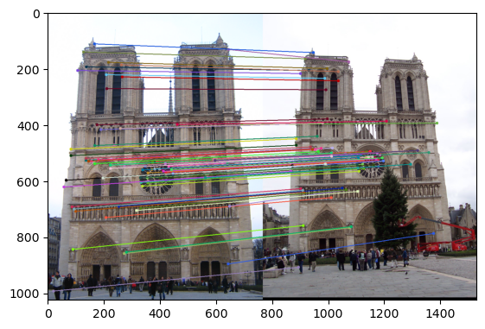
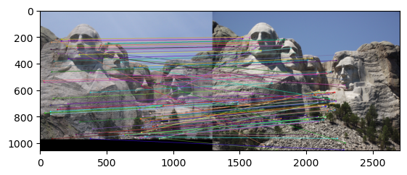
1.3: Feature Matching
<insert feature matching visualization of Notre Dame from ps2.ipynb> [2.5 pts]
<insert feature matching visualization of Rushmore from ps2.ipynb > [2.5 pts]

Slide 6
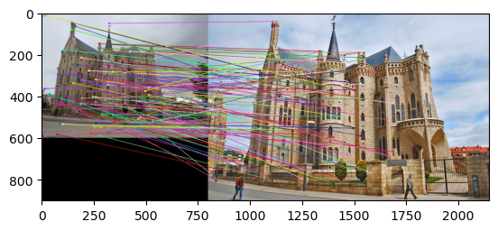
1.3: Feature Matching
<insert feature matching visualization of Gaudi from ps2.ipynb > [2.5 pts]
<Describe your implementation of feature matching.> [1.5 pts]
We begin by computing the distances from feat1 and feat2. We then apply the NNDR ration test and only match if the closest neighbor is closer than the second closest by a certain degree (specified by the ratio variable in the code). Then, we return the pairs with the confidences.

Slide 7
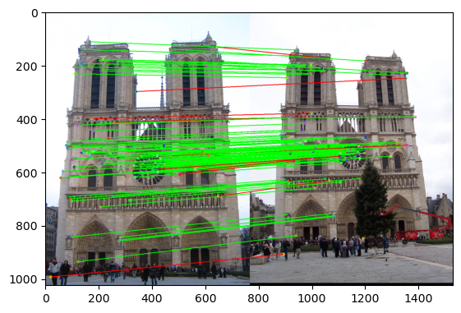
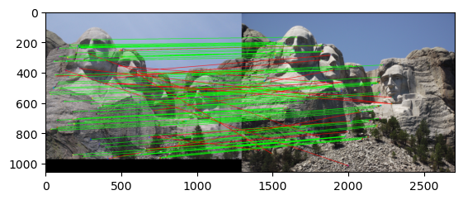
Results: Ground Truth Comparison
<Insert visualization of ground truth comparison with Notre Dame from ps2.ipynb here> [1 pt]
<Insert visualization of ground truth comparison with Rushmore from ps2.ipynb here> [1 pt]

Slide 8
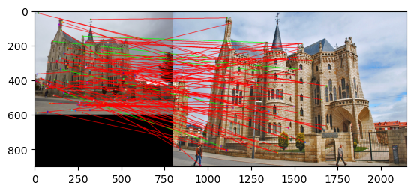
Results: Ground Truth Comparison
<Insert visualization of ground truth comparison with Gaudi from ps2.ipynb here> [1 pt]
<Insert numerical performances on each image pair here. Also discuss what happens when you change the 4x4 subgrid to 2x2, 5x5, 7x7, 15x15 etc?> [2.5 pts]
Notre Dame: 0.89 accuracy w/ ratio=0.75
Rushmore: 0.82 accuracy w/ ratio=0.80
Gaudi: 0.06 accuracy w/ ratio=0.90
Larger subgrids make descriptors more detailed which may increase feature matching but is more difficult to compute and is very sensitive to rotations, shifts, etc.

Slide 9
1.4(a): Hyperparameter Tuning part 1 [Extra credit]
<Insert images of the ground truth correspondence and their corresponding accuracies for varying sigma in the second moments [3, 6, 10, 30] > [0.5 pts]
When changing the values for large sigma (>20), why are the accuracies generally the same? [0.5 pts]

Slide 10
1.4(a): Hyperparameter Tuning part 2 [Extra credit]
<Insert images of the ground truth correspondence and their corresponding accuracies for varying feature width in the SIFT [8, 16, 24, 32] > [0.5 pts]
What is the significance of changing the feature width in SIFT? [0.5 pts]

Slide 11
1.4(c): Accelerated Matching [Extra credit]
<Insert Runtime/Accuracy of your faster matching implementation. What did you try and why is it faster?> [1 pts]

