Slide 1
CS 4476 PS4
Devin Fromond
dfromond3@gatech.edu
903761713

Slide 2
Part 1: Standard Scaler: Why did we use StandardScaler instead of looping over all the dataset twice for mean and standard deviation? Why a simple loop will not be a good choice in a deployed production grade ML system?
<text answer here>
We used StandardScaler since it is able to compute both the mean and standard deviation in one pass as opposed to computing these with slow loops. These loops do not really utilize numpy or any other additional speed-ups. With a large dataset, we require efficiency – especially over loops.
Part 1: Why do we normalize our data (0 mean, unit standard deviation)?
<text answer here>
We must normalize our data to ensure all features have the same scale and so no one feature dominates others. This goes back to the fairness principle and ensuring the model does not have any inherent bias.

Slide 3
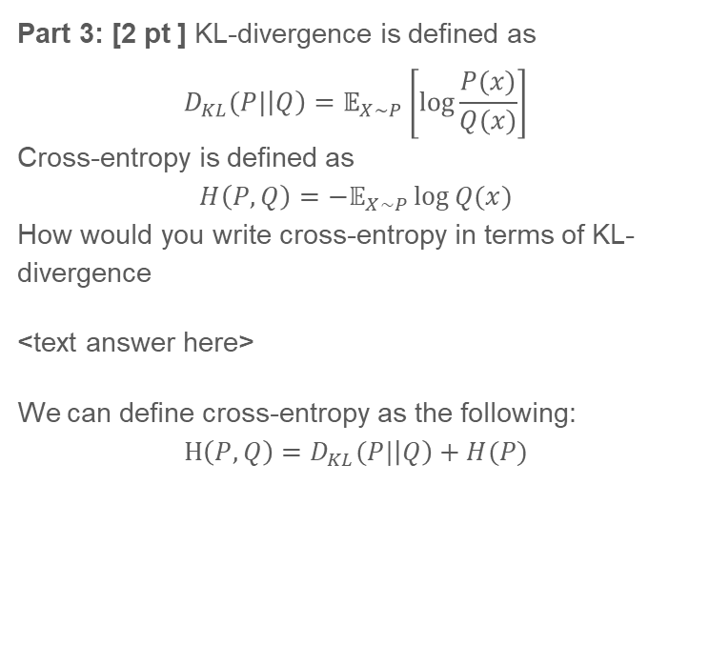
Part 3: Loss function. Why did we need a loss function?
<text answer here>
We need a loss function to determine how far the model’s predictions are from the actual values of the data. The loss function provides feedback on its errors to dynamically improve accuracy during training.
Part 3: [2 pt ] KL-divergence is defined as
$$D_{KL}(P|\left|Q\right)=𝔼_{X\sim P}\left[\log{\frac{P(x)}{Q(x)}}\right]$$
Cross-entropy is defined as
$$H\left(P,Q\right)=−𝔼_{X\sim P}\log{Q(x)}$$
How would you write cross-entropy in terms of KL-divergence
<text answer here>
We can define cross-entropy as the following: $$H\left(P,Q\right)=D_{KL}(P|\left|Q\right)+H(P)$$

Slide 4
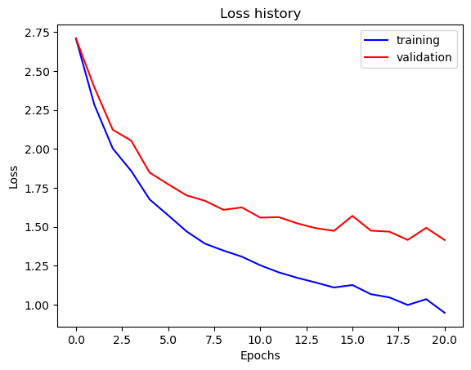
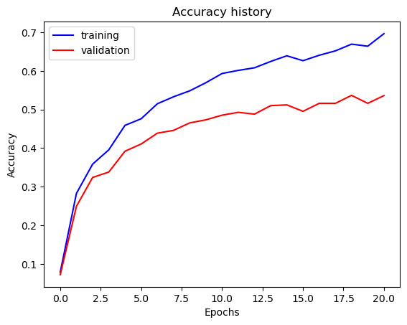
Part 5: Training SimpleNet
<Loss plot here> <Accuracy plot here>
Final training accuracy value: 0.6965
Final validation accuracy value: 0.5360

Slide 5
Part 6: Simple Segmentation Net
Class Index | Class name | Simple Segmentation Net Class IoU
0 | Building | 0.7874
1 | Tree | 0.7555
2 | Sky | 0.8431
3 | Car | 0. 5973
4 | SignSymbol | 0. 0000
5 | Road | 0. 8502
6 | Pedestrian | 0. 0000
7 | Fence | 0. 0000
8 | Column_Pole | 0. 0000
9 | Sidewalk | 0. 5608
10 | Bicyclist | 0. 0000
Validation mIoU: 0.4013
Number of Epochs: 5

Slide 6
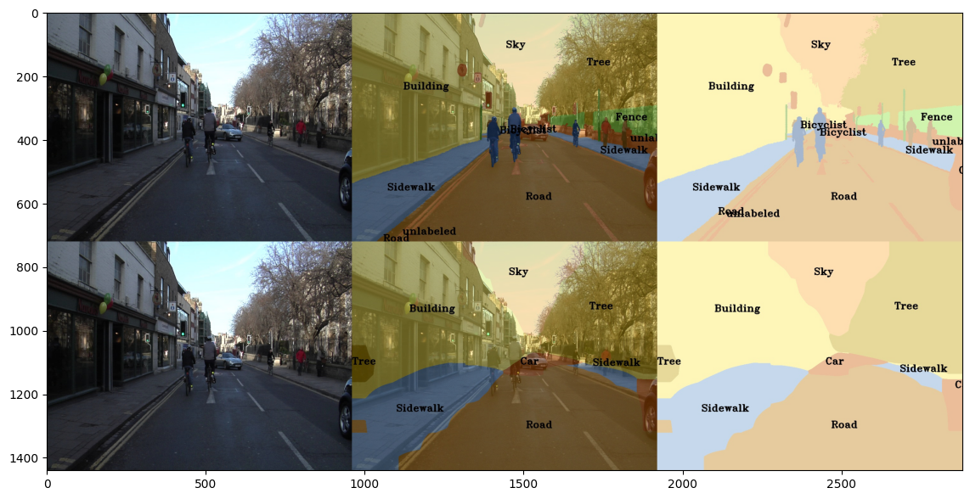
Part 6: Simple Segmentation Net
Paste a figure of the generated semantic segmentation from Colab. It should be a 2x3 grid, with ground truth on the top row, and your predictions on the bottom row.

Slide 7
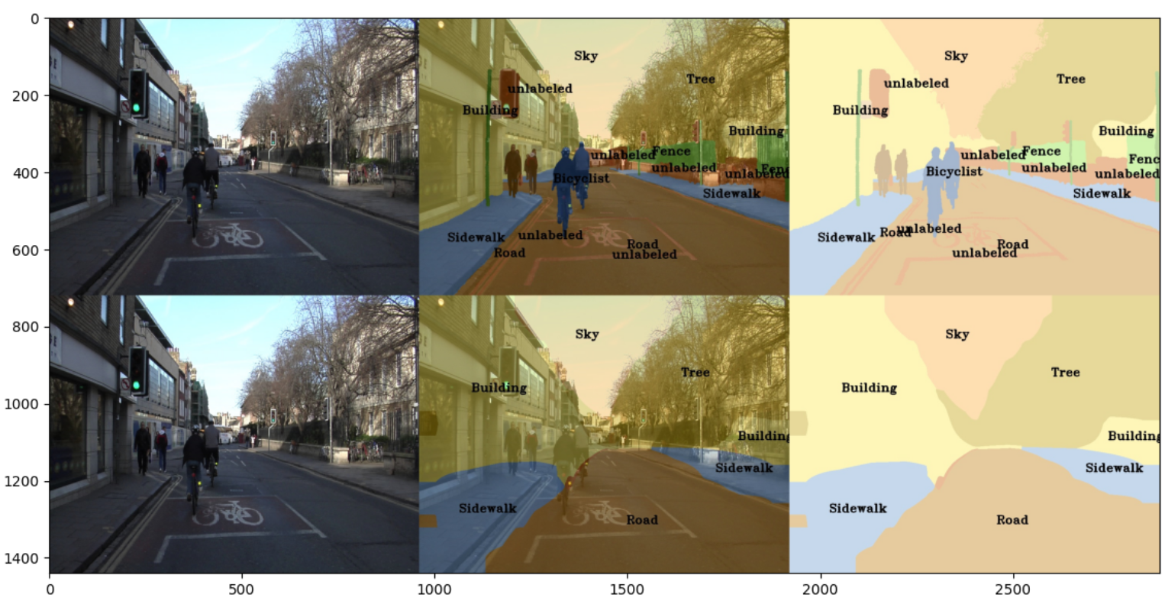
Part 6: Simple Segmentation Net
Which classes have the lowest mIoU? Why might they be the most difficult? Provide an example RGB image from Camvid that illustrates your point.
Classes that tend to contain smaller objects or more granular detail are more difficult to detect. Using the image to the left as reference, we can see bicyclists were not identified as well as more granular details on the right side – such as a fence.

Slide 8
Conclusion: briefly discuss what you have learned from this project.
<Text solution here>
This project has pulled back the curtain on image classification machine algorithms from being a black box to learning how to tune hyperparameters and what the strengths of the models are.

Slide 9
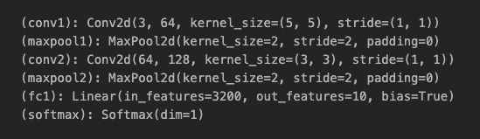
Theory: Neural Nets
Given are the layers of a neural network. Calculate the total number of learnable parameters for each layer and in total.
Conv 1: (3 x 5 x 5)(64) + 64 = 4864
Conv 2: (64 x 3 x 3)(128) + 128 = 73856
FC1: (32100 x 10) + 10 = 32010
Total (sum all 3): 110730
Note: You can look to pytorch docs to understand what each of the parameters correspond to.

Slide 10
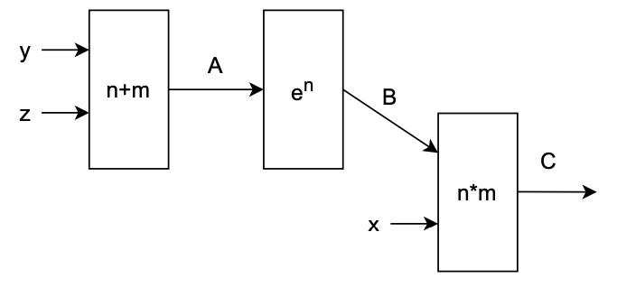
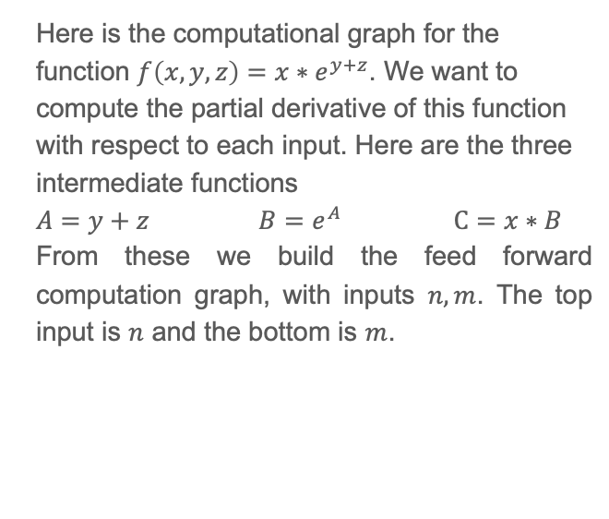
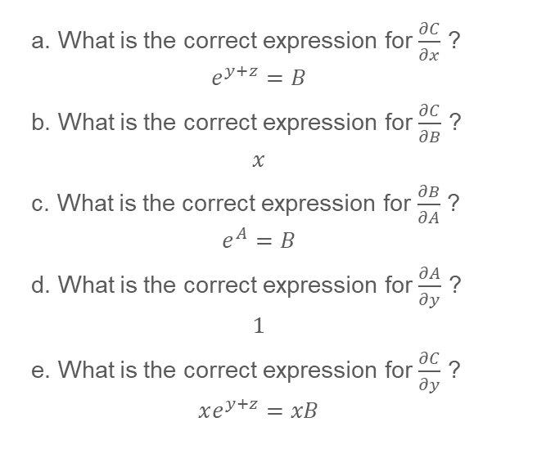
Theory: Neural Nets (cont.)
Here is the computational graph for the function $f\left(x,y,z\right)=x∗e^{y+z}$. We want to compute the partial derivative of this function with respect to each input. Here are the three intermediate functions
$A=y+z$ $B=e^{A}$ $C=x∗B$
From these we build the feed forward computation graph, with inputs $n, m$. The top input is $n$ and the bottom is $m$.
a. What is the correct expression for $\frac{∂C}{∂x}$ ?
$$e^{y+z}=B$$
b. What is the correct expression for $\frac{∂C}{∂B}$ ?
$$x$$
c. What is the correct expression for $\frac{∂B}{∂A}$ ?
$$e^{A}=B$$
d. What is the correct expression for $\frac{∂A}{∂y}$ ?
$$1$$
e. What is the correct expression for $\frac{∂C}{∂y}$ ?
$$xe^{y+z}=xB$$

Slide 11
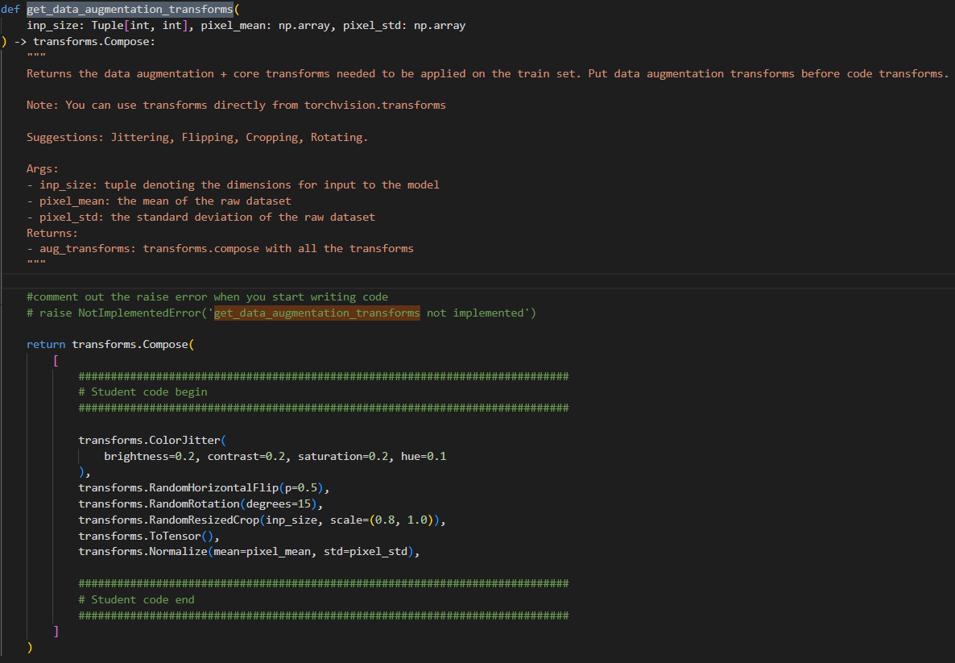
EC1.1: Screenshot of your get_data_augmentation_transforms()
<Screenshot here if attempted; do not delete the slide if not attempted>

Slide 12
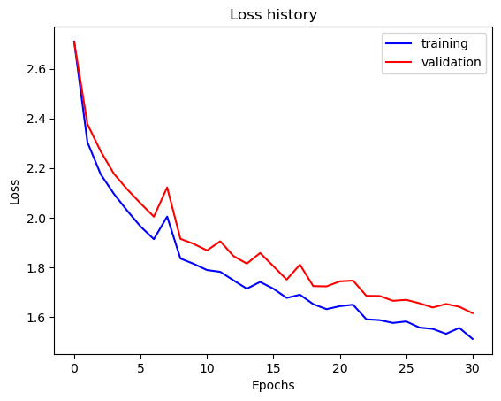
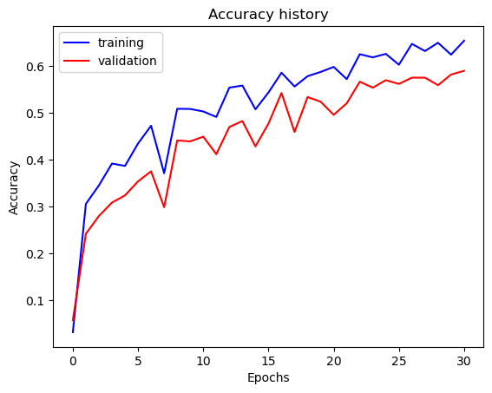
EC1: Training to solve overfitting
<Loss plot here> <Accuracy plot here>
Final training accuracy value: 0.6543
Final validation accuracy value: 0.5900

Slide 13
EC2: PSPNet
Class Index | Class name | PSPNet Class IoU
0 | Building | 0. 8942
1 | Tree | 0. 8552
2 | Sky | 0. 9148
3 | Car | 0. 8551
4 | SignSymbol | 0. 0000
5 | Road | 0. 9302
6 | Pedestrian | 0. 1859
7 | Fence | 0. 5235
8 | Column_Pole | 0. 0010
9 | Sidewalk | 0. 8205
10 | Bicyclist | 0. 5842
Validation mIoU: 0.6124
Number of Epochs: 55

Slide 14
EC2: PSPNet
Paste a figure of the generated semantic segmentation from Colab. It should be a 2x3 grid, with ground truth on the top row, and your predictions on the bottom row.

