Slide 1
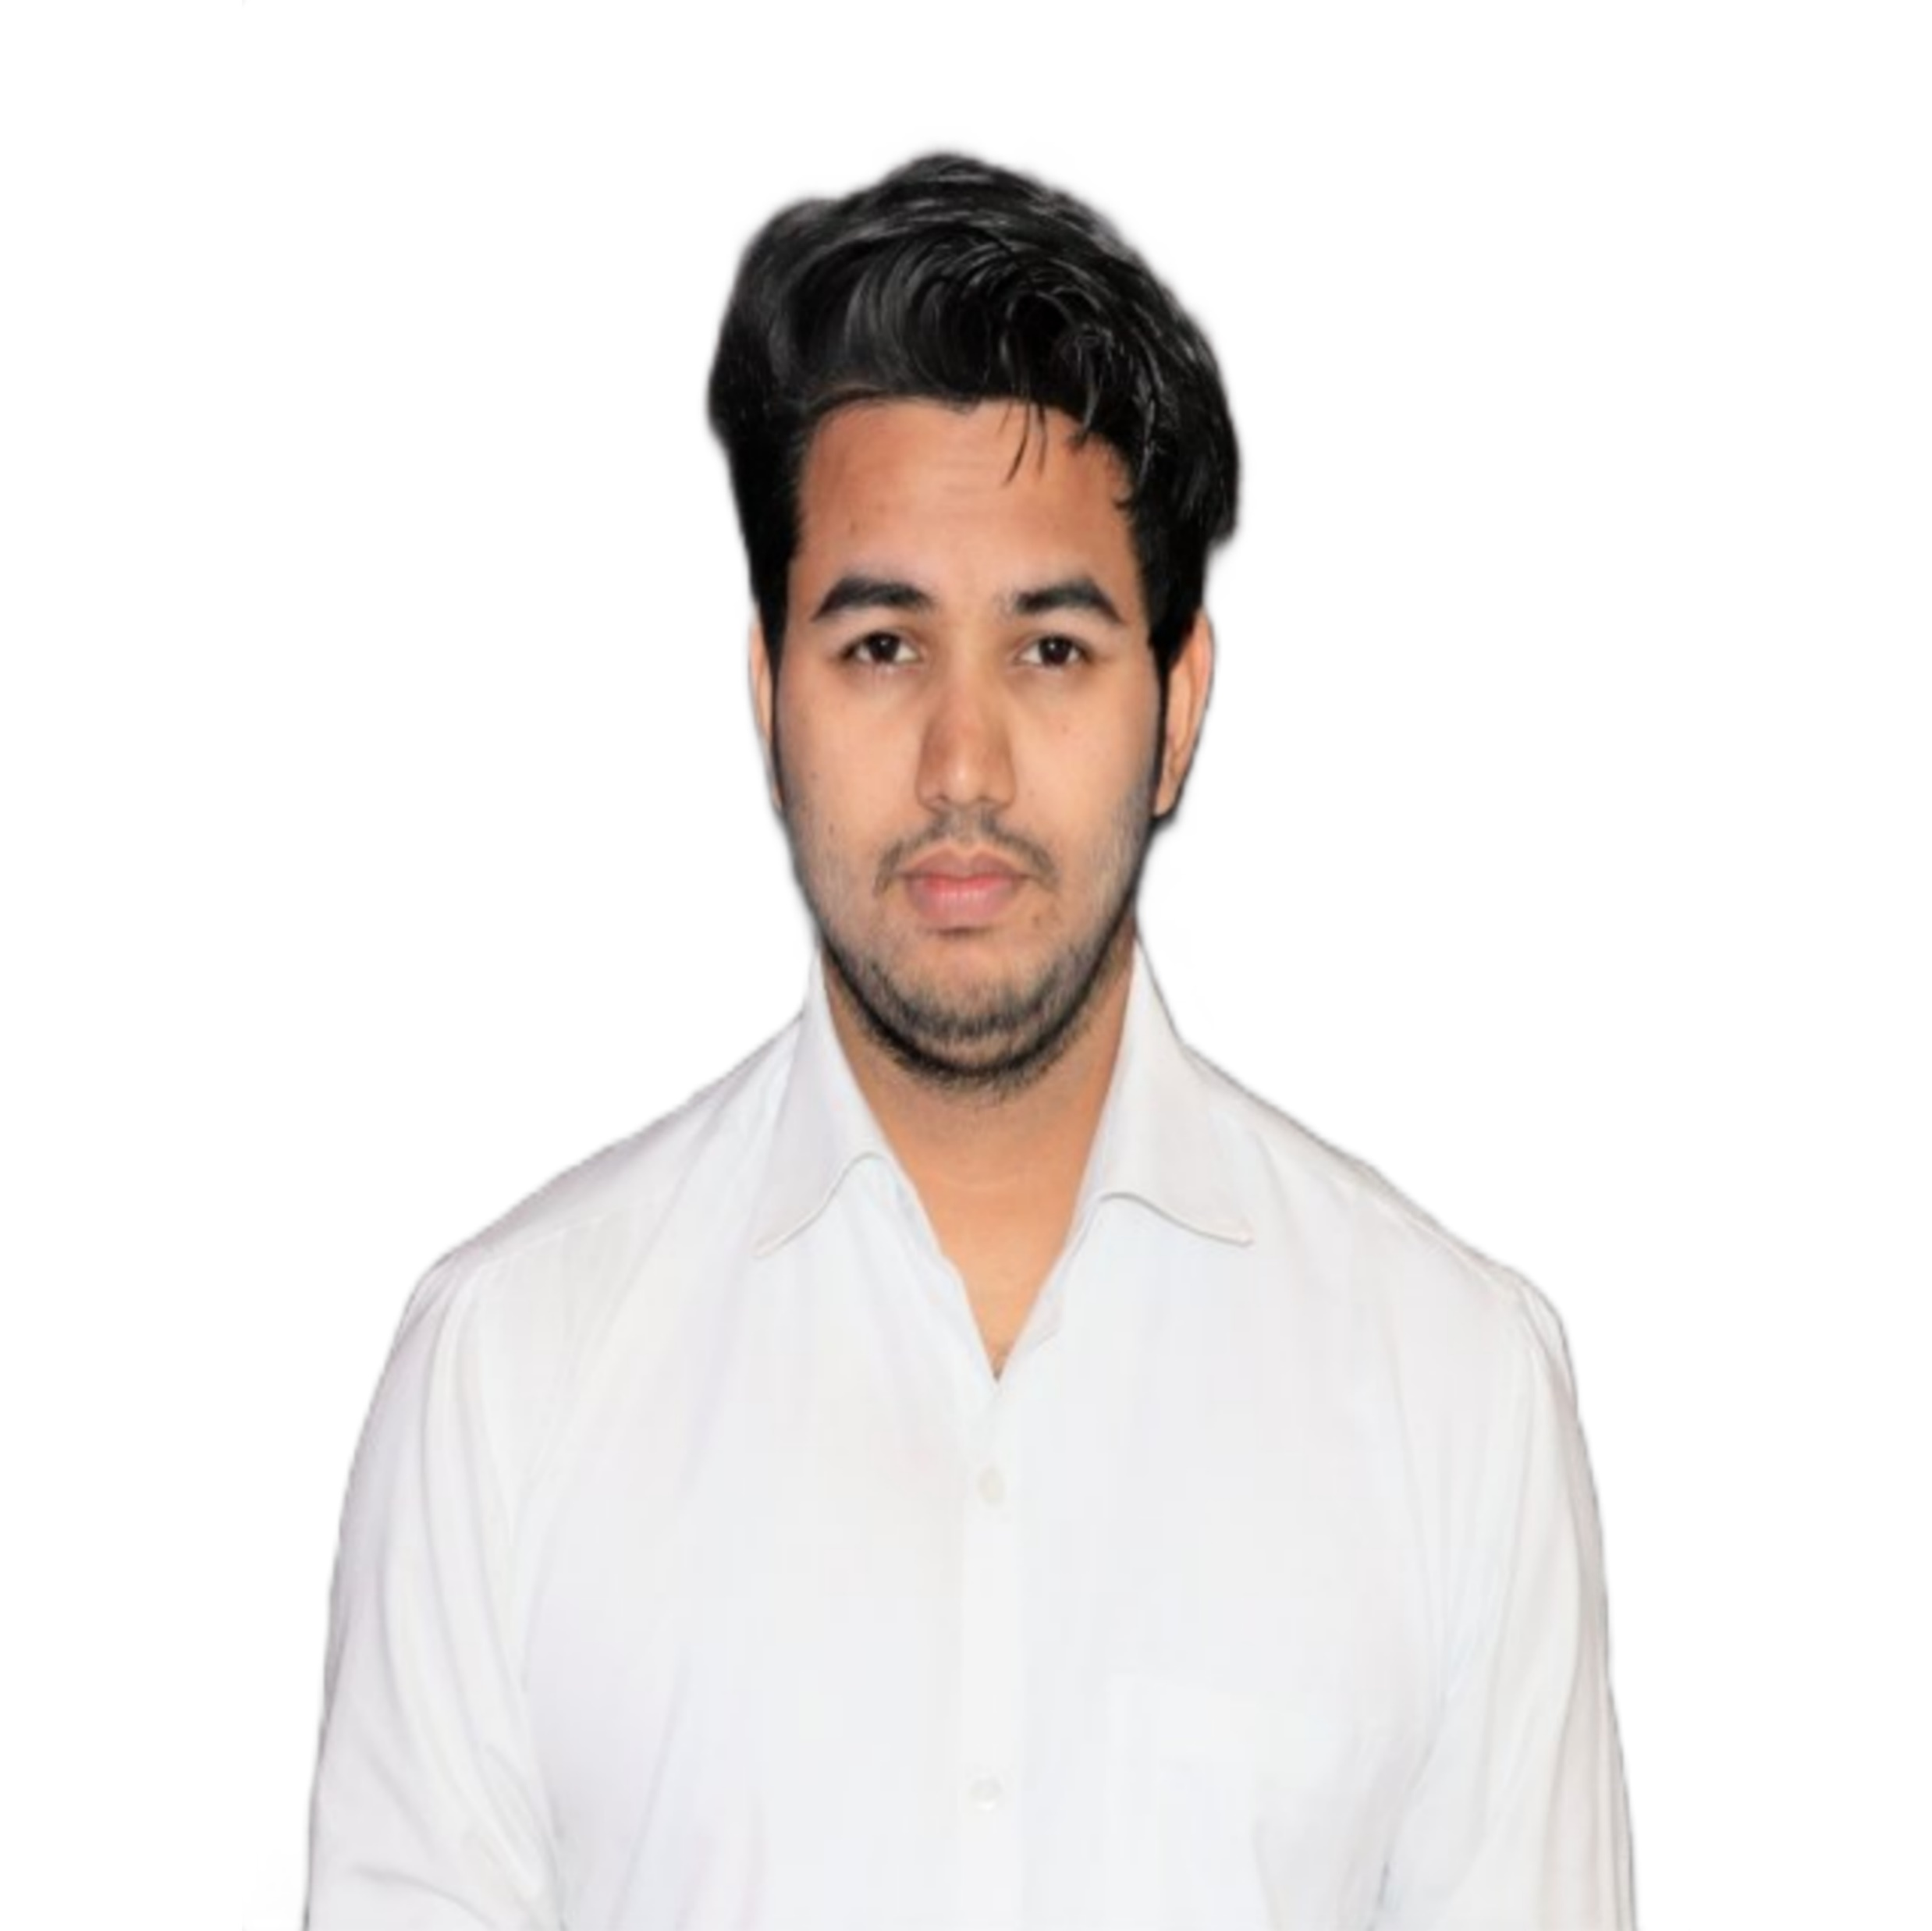



Deviprasad Pandey
Analyst/Software Engineer
Zeal College of Engineering and Research
Computer Engineering : 2017 – 2021
Certification
AWS CP
AZ900, AZ204, AZ104, AZ 400, AZ305
Pune
Skills
deviprasad.vinodkumar-pandey@capgemini.com
+91 8668705176
C# | C# Basics, OOPS, Generics, Collections, Arrays, Loops, Lambda exp , Delegates and evets, File IO and serialization
ASP.NET | Fundamentals of ASP.NET,ASP.NET MVC Framework , Routing , Code First Approach and Data first approach
LINQ | Introduction to LINQ, LINQ Syntax, Query Operators, Aggregate Functions
Entity Frameworks | Overview of ORM Products, Basics of Entity Framework, LINQ to Entities to Perform Curd Operations
ADO.NET | ADO.NET Connected and Disconnected Architecture, DB Connectivity Architecture, Data Set and Data Reader class
Database | Sql Server
UI Tech | HTML 5 & CSS 3,JavaScript and Bootstrap
Tools | Git
Add On skills | Peer learning
A4
DOTNET Developer
Hands on experience in creating microservices with C#,ASP.NET MVC Framework ,HTML5,CSS and Sql Serve
Proficient in creating Single page Web Application in ASP.NET WEB APPLICATION with MVC ,Authentication and routing.
Hands on experience in developing web pages using HTML5, CSS3, Object Oriented Java script. Good understanding of Document Object Model (DOM) and DOM Functions.
Farm Scheme
Created e-commerce website which provides an opportunity to streamline the agricultural value chain and reduce inefficiencies in the distribution of farm produce. (DotNet)
.
Check out my work on GitHub & Video Profile

