Slide 1
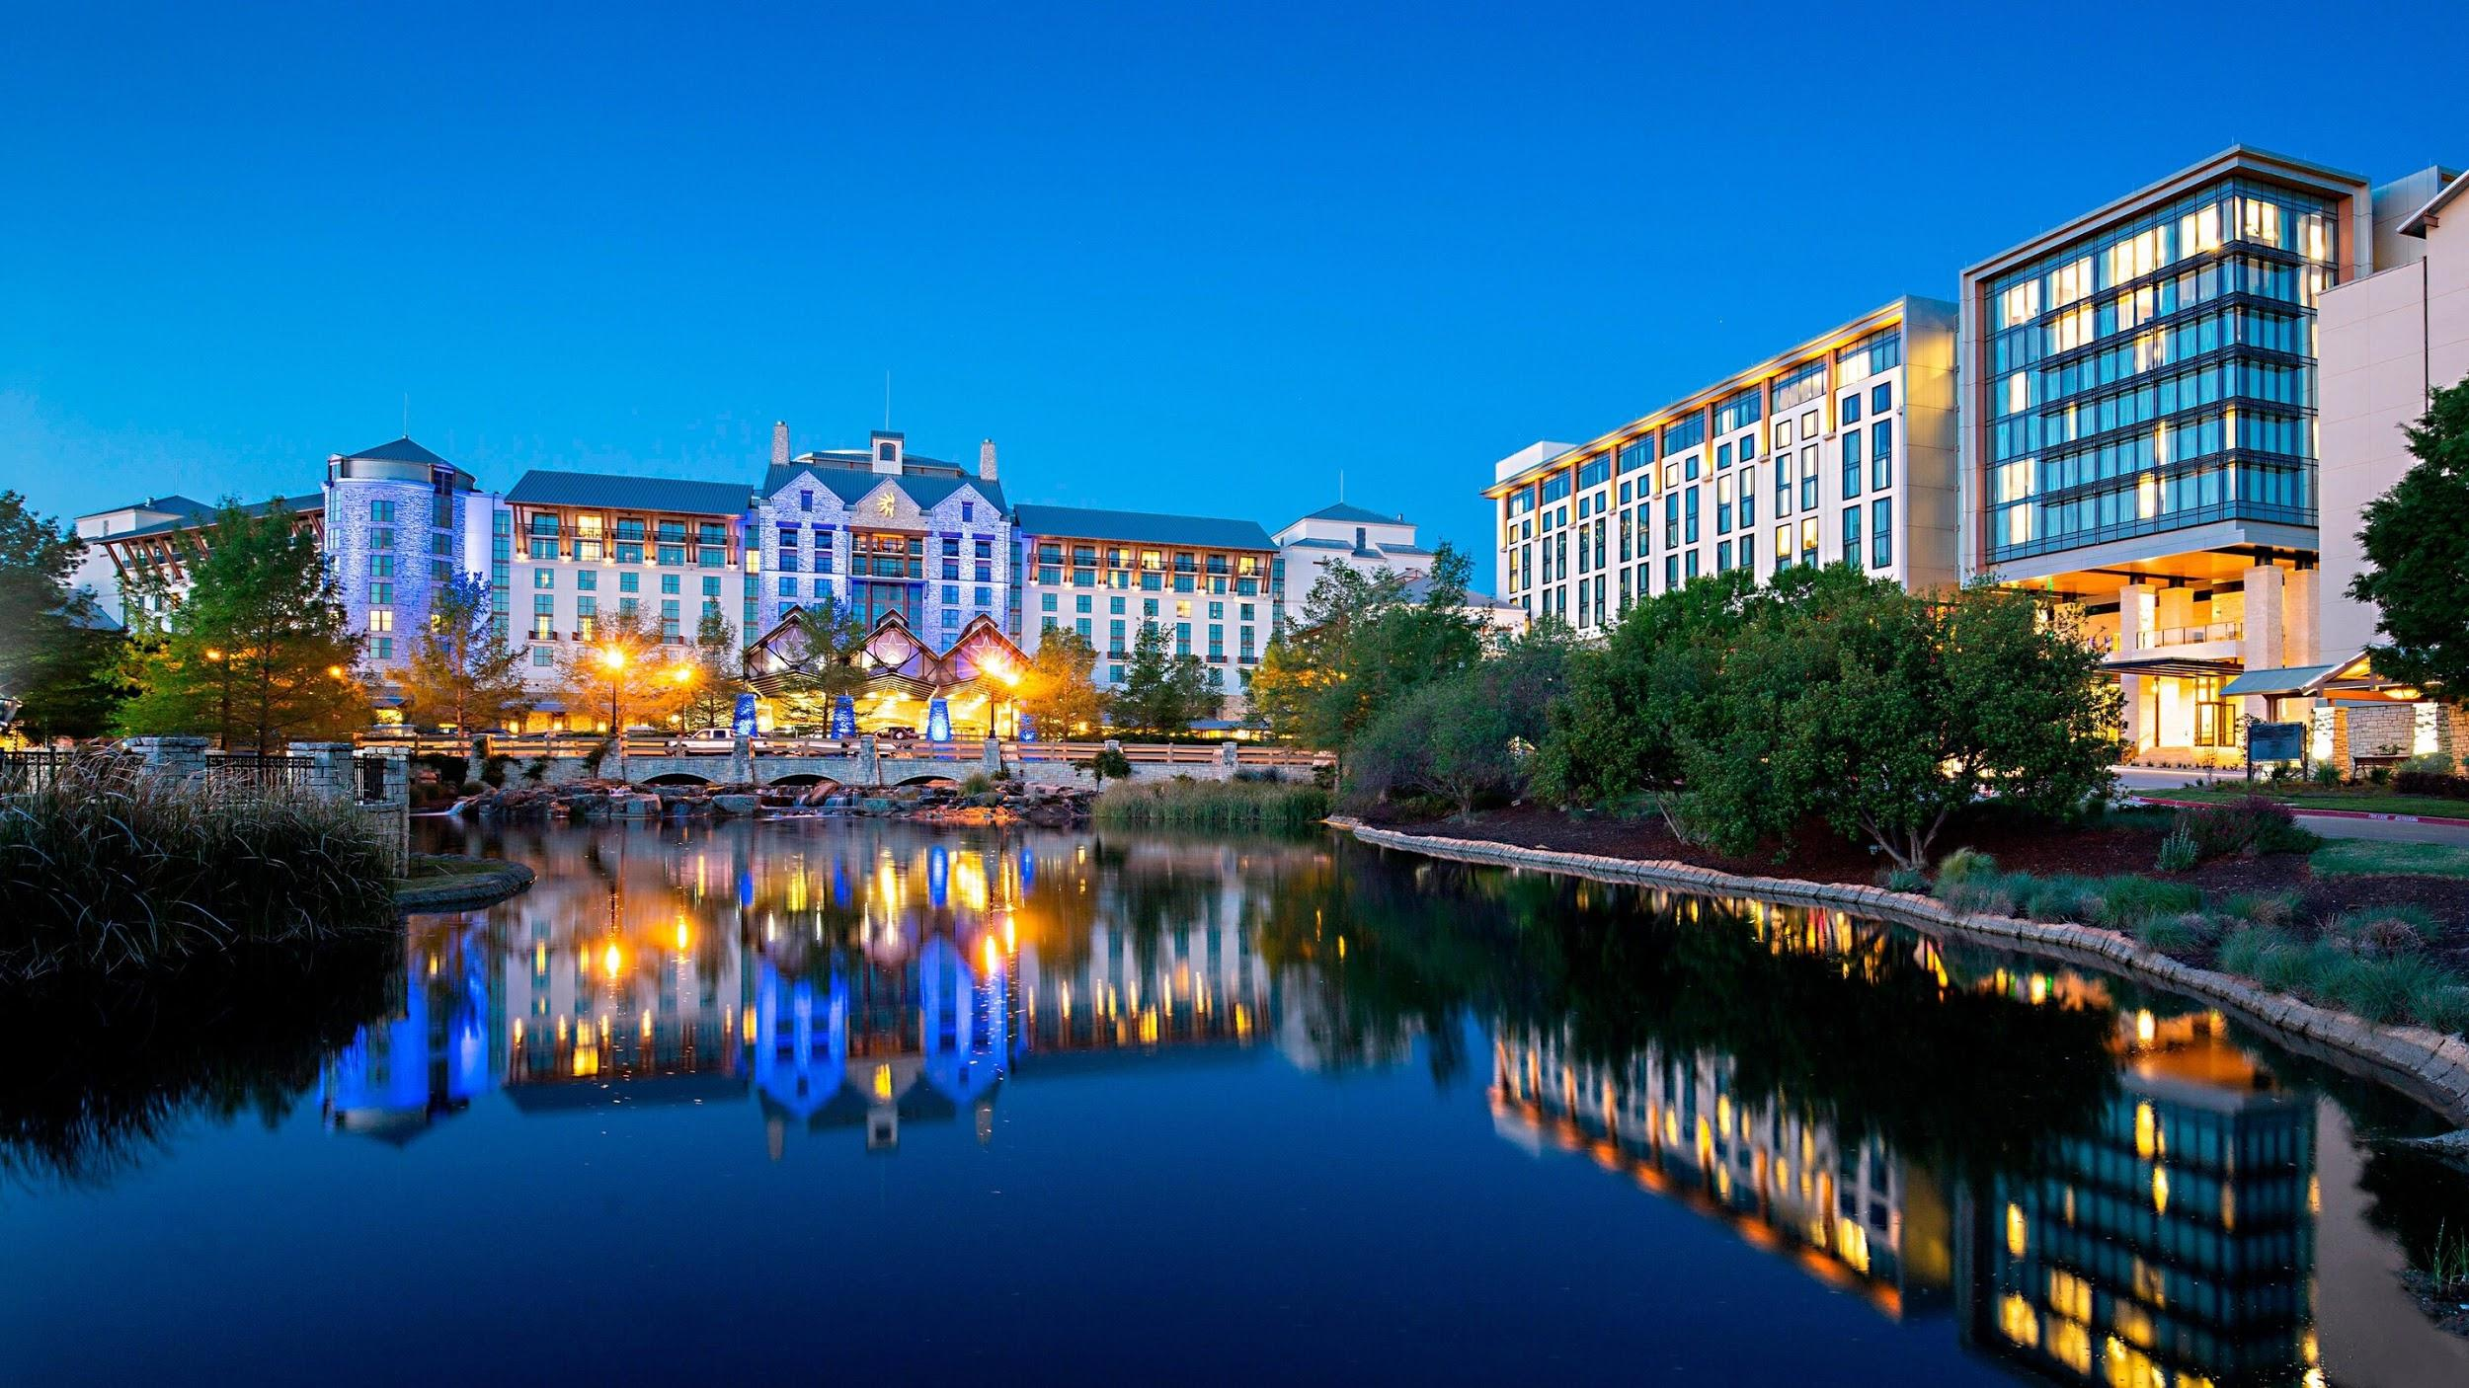
Notes:
Hi! I’m Elliot Wilens and for my final metis project I decided to create a hotel revenue management system from scratch.
But before I go into that, I’ll share a little background about myself. I live in Dallas but have moved around quite a bit since I graduated from Michigan State University in 2016.
I studied Hospitality Business there, and I’ve always been passionate about computers, and and almost changed my major when I found about about revenue management. It encompasses a lot of my favorite things...computer science, analytical thinking, being around good people...but most of all, travel! It took me a lot of cool places… SHARE SCREEN
After graduating from Michigan State, I moved to Texas and started my revenue management career at the Gaylord Texan, pictured here.

Slide 2
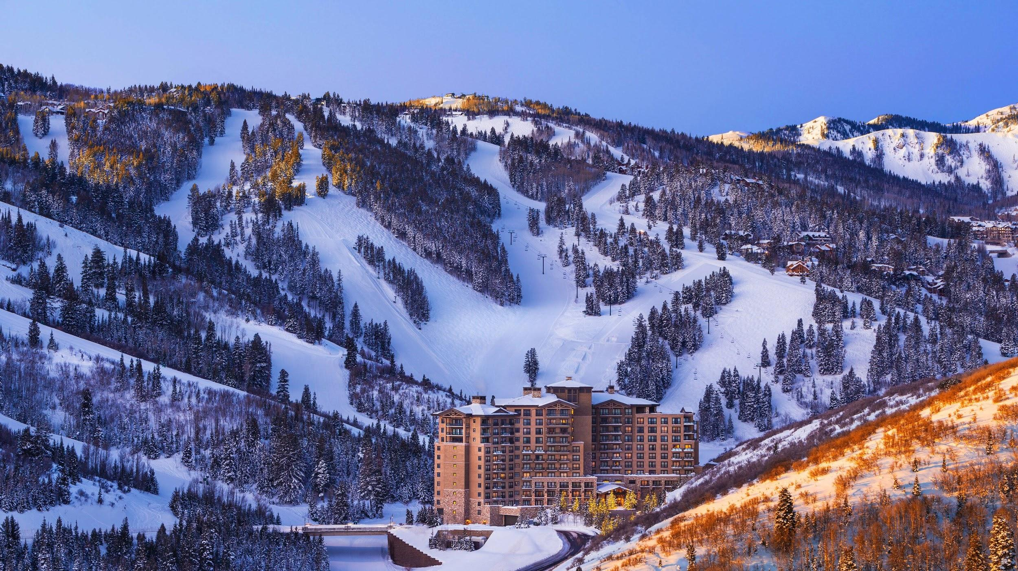
Notes:
I then moved to Park City Utah as the Revenue Manager for the St. Regis Deer Valley, where I managed rooms inventory/pricing as well as the in-house reservations team.

Slide 3
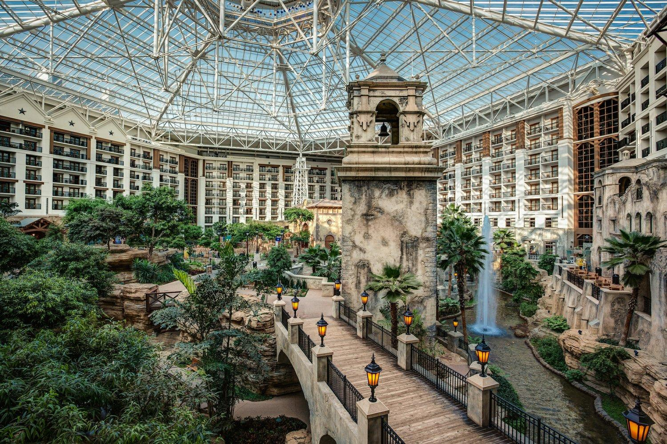
Notes:
Then I came back to the Gaylord Texan as a Senior Revenue Manager, responsible for managing the online room inventory & pricing for the 1800-room hotel.

Slide 4
Selling the right room, at the right price, to the right customer, at the right time
Notes:
Revenue management is about selling the right room, at the right price, to the right customer, at the right time.
My objective for this project was to set up a foundation for hotels to do this successfully.

Slide 5
HOTEL REVENUE MANAGEMENT SYSTEM
Notes:
I’ve always been curious about the revenue management systems I’ve used, and wanted to make one myself. Here I’ve done that, and am excited to share it with you today/

Slide 6
PROJECT WORKFLOW
List of Reservations
Cancellation Forecast
Engineering Demand Features
Hotel Demand Forecast
Notes:
Here’s a brief overview of the project workflow
Started with a list of reservations for each of the 2 hotels included in the dataset
I then used machine learning to predict whether or not each of these reservations will cancel.
And after that, I transformed the reservations into hotel day-level statistics so that we could predict hotel demand by date.

Slide 7
A List of Reservations
THE DATA

Slide 8
List of Reservations
Cancellation Forecast
Engineering Demand Features
Hotel Demand Forecast
The Data
The dataset contains reservations for stays between July 1, 2015 - August 31, 2017
Resort Hotel (H1)
40k reservations
Capacity: 187 rooms
City Hotel (H2)
80k reservations
Capacity: 226 rooms
Notes:
All reservations were for dates July 1 2015 – Aug 31 2017
Hotel 1 was a resort hotel with 187 rooms, for which there are 40k reservations
Hotel 2 was a city hotel with 226 rooms, for which there are 80k reservations

Slide 9
Cancellation Forecast
Notes:
I used the XGBoost gradient boosting algorithm to predict whether or not each reservation would cancel, or not cancel.

Slide 10
List of Reservations
Cancellation Forecast
Engineering Demand Features
Hotel Demand Forecast
Cancellation forecasts are critical to answer the question...
How many rooms should I sell on this night?
Each predicted cancellation is added back onto the ‘shelf’ for sale
This can get us into trouble very easily...
Notes:
Cancellation forecasts are an important part of the revenue management process.
Each predicted cancellation is added back onto the shelf for sale. So over-forecasting cancellations can result in guests being turned away with reservations, while under-forecasting cancellations results in lost revenue that cannot be recovered.

Slide 11
List of Reservations
Cancellation Forecast
Engineering Demand Features
Hotel Demand Forecast
XGBoost Classification Results
F-1 Scores
Hotel 1 (Resort): 0.78
Hotel 2 (City): 0.82
Notes:
Here are the results of the predictive cancellation model.
The F-1 scores were promising. Here’s what the predictions look like in practice...(NEXT SLIDE)

Slide 12
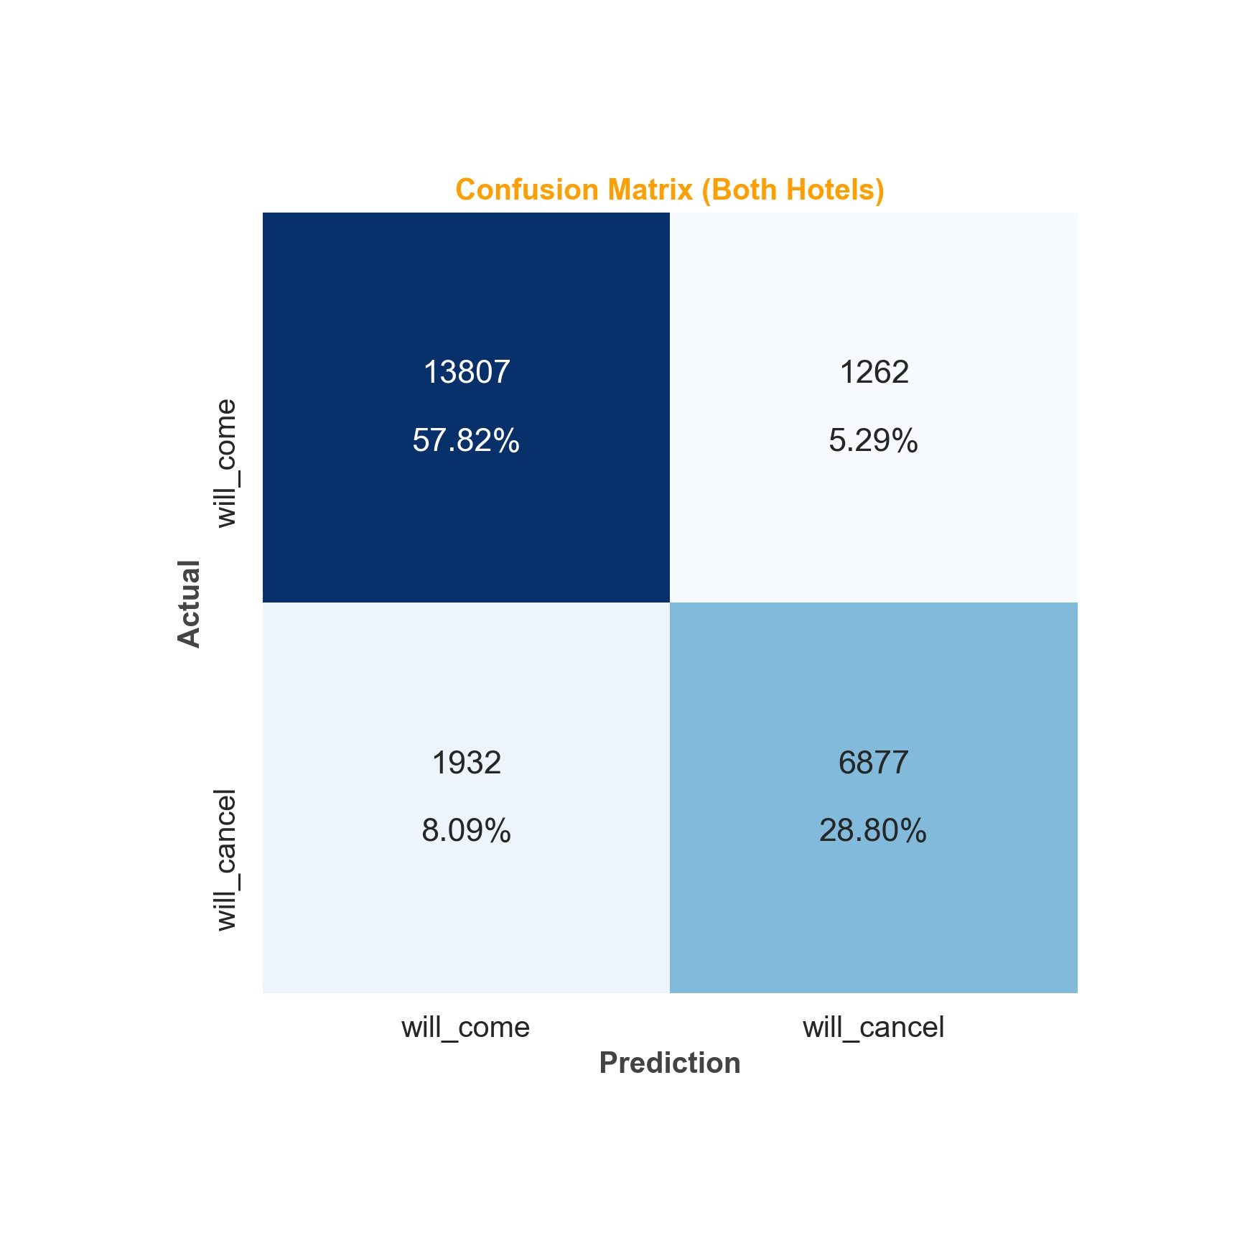
List of Reservations
Cancellation Forecast
Engineering Demand Features
Hotel Demand Forecast
Upset guests & front desk agents!
F-1 Scores
Hotel 1 (Resort): 0.78
Hotel 2 (City): 0.82
Lose $$
Notes:
This is a handy way of evaluating classification results, called a confusion matrix.
The top left and bottom right squares is where the model correctly classified reservations as a cancellation/not a cancellation
The bottom left square shows how many times the model incorrectly predicted that the guest would NOT cancel. The result… lost revenue.
The top right square indicates how many times the model predicted a cancellation, but the guest arrived. This means upset guests, as well as front desk agents that had to relocate them.
In practice a hotel could easily adjust this model’s risk factor to take a more aggressive, or more conservative approach to predicting their cancellations based on their needs.

Slide 13
Engineering Demand Features

Slide 14
List of Reservations
Cancellation Forecast
Engineering Demand Features
Hotel Demand Forecast
Transforming List of Reservations into hotel statistics by day….
Reservation Num | Arrival Date | Checkout Date | Rate Booked | will_cancel | More info...
1 | 2017-08-01 | 2017-08-03 | 150 | True | ...
2 | 2017-08-02 | 2017-08-04 | 100 | False | ...
Start with this…
Go back in time to Aug 1, 2017, and count only the reservations that have already booked at that point, for each future arrival date.
We can then calculate how many rooms actually booked after that. That number is demand – which is what we’re trying to predict for each future date.
Notes:
The first step in engineering demand features was transforming a list of reservations into hotel statistics by day.
I started with a list of reservations, along with a lot of information about each one. I used that information to predict cancellations, which is now a column in the reservations data.
But in order to model demand at a hotel level, I had to go back in time to Aug 1, 2017, and count only the reservations that have already booked at that point, for each upcoming arrival date.
We can then calculate how many rooms actually booked after that. This number is DEMAND, which is what we’re trying to predict for each future date.

Slide 15
List of Reservations
Cancellation Forecast
Engineering Demand Features
Hotel Demand Forecast
Transforming List of Reservations into hotel statistics by day….
Reservation Num | Arrival Date | Checkout Date | Rate Booked | will_cancel | More info...
1 | 2017-08-01 | 2017-08-03 | 150 | True | ...
2 | 2017-08-02 | 2017-08-04 | 100 | False | ...
Start with this...
Stay Date | Rooms Booked | Avg. Rate | Proj. Cancellations | More stats...
2017-08-01 | 1 | 150 | 1 | ...
2017-08-02 | 2 | 125 | 1 | ...
2017-08-03 | 1 | 100 | 0 | ...
After transformation...
Notes:
After the transformation, our data looks like this bottom table. Instead of a list of reservations, we’re now working with day-level hotel statistics, with aggregated reservations data for each upcoming date.
With this, we’re able to generate lots of predictors, or ‘features’ for our model.

Slide 16
List of Reservations
Cancellation Forecast
Engineering Demand Features
Hotel Demand Forecast
Features generated for each future stay date:
Remaining supply
Num available rooms for sale (includes cancellation forecast)
Notes:
…and here they are.
The first is remaining supply – this tells us exactly how many rooms we should attempt to sell for each night. It uses the cancellation predictions in its calculation.

Slide 17
List of Reservations
Cancellation Forecast
Engineering Demand Features
Hotel Demand Forecast
Features generated for each future stay date:
Remaining supply
Num available rooms for sale (includes cancellation forecast)
On the books
Num rooms already sold
Notes:
On the books
Which is the number of rooms we’ve already sold for each upcoming date

Slide 18
List of Reservations
Cancellation Forecast
Engineering Demand Features
Hotel Demand Forecast
Features generated for each future stay date:
Remaining supply
Num available rooms for sale (includes cancellation forecast)
On the books
Num rooms already sold
Pickup
Num rooms booked over the last 5/ 15/ 30 days
Notes:
Pickup
Booking trends for the last five, fifteen, and thirty days

Slide 19
List of Reservations
Cancellation Forecast
Engineering Demand Features
Hotel Demand Forecast
Features generated for each future stay date:
Remaining supply
Num available rooms for sale (includes cancellation forecast)
On the books
Num rooms already sold
Pickup
Num rooms booked over the last 5/ 15/ 30 days
Pace
This-year variance to same-time last-year (STLY) for all above stats
Notes:
Pace
This year variance to same time last year for all of the above stats
Tells us how we are trending for a given date compared to last year. (PAUSE 2 seconds)

Slide 20
List of Reservations
Cancellation Forecast
Engineering Demand Features
Hotel Demand Forecast
Features generated for each future stay date:
Remaining supply
Num available rooms for sale (includes cancellation forecast)
On the books
Num rooms already sold
Pickup
Num rooms booked over the last 5/ 15/ 30 days
Pace
This year variance to same-time last year (STLY) for all above stats
Gap to last-year actuals
Num rooms left to book in order to reach last year’s final sales
Notes:
The last feature I’d like to mention is gap to last-year actuals, which is the number of rooms left to book in order to reach last year’s final sales

Slide 21
Modeling Demand
Notes:
I used the Random Forest Regression algorithm to model demand for each hotel.

Slide 22
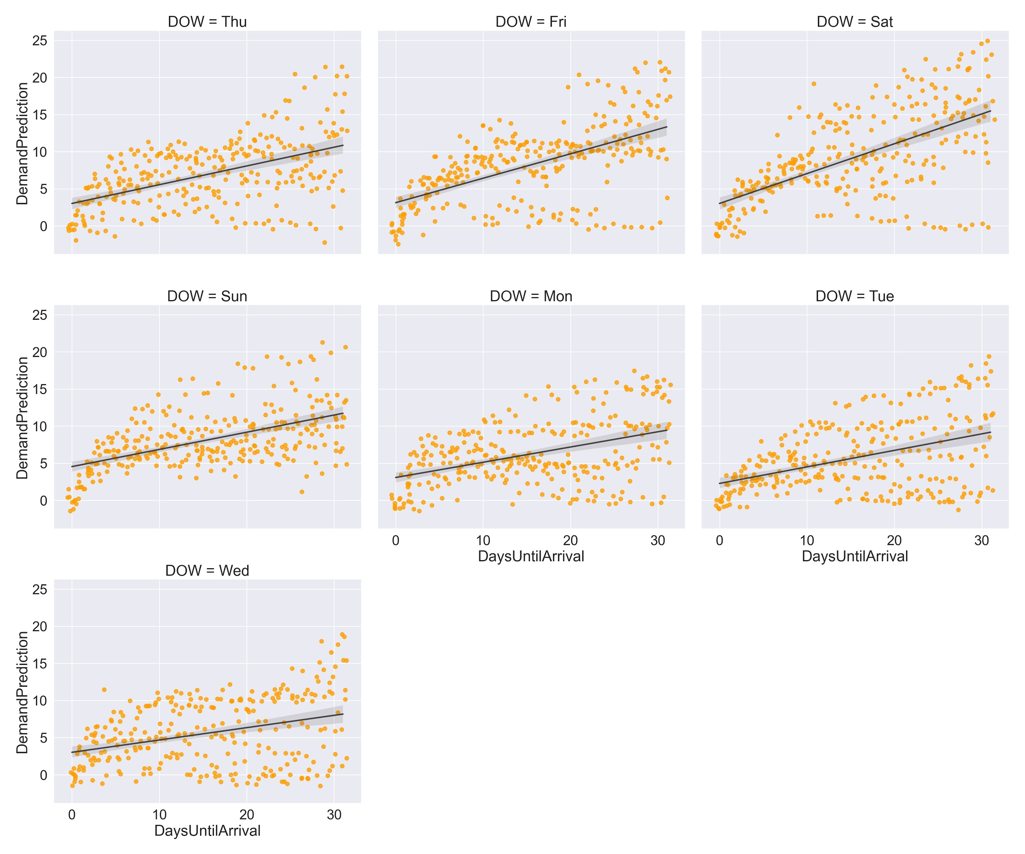
List of Reservations
Cancellation Forecast
Engineering Demand Features
Hotel Demand Forecast
H1 Model Results
Resort Hotel
187 Rooms
R² Score: 0.79
Mean Abs. Error: 2.1 Room Nights
Notes:
Here are the results for Hotel 1, the Resort Hotel.
R-squared tells us how much of the variance in hotel demand can be explained by the features I have created.
The mean-absolute error of 2.1 room nights tells us that for any night, our prediction is likely to be 2.1 rooms off from actual sales. That’s pretty good for an anonymous hotel with 187 rooms.
The plots on the right show how my predictions fared by day of week. For hotel 1, you can see the most variance occurs on weekends (Friday & Saturday). These are the dates where the model is having the most trouble forecasting demand.

Slide 23
List of Reservations
Cancellation Forecast
Engineering Demand Features
Hotel Demand Forecast
Several Use Cases for Hotels
Pricing insights
Allow for calculated and effective overselling
Staff scheduling & financial planning
Notes:
Being able to predict demand helps hotels in several ways.
Pricing insights – identifies days where demand exceeds supply
Allows for calculated and effective overselling
Helps with staff scheduling & financial planning (it’s good to know how many guests we’ll have in the hotel)

Slide 24



THANK YOU!
You can find me:
Via email: wilensel@gmail.com
On GitHub (github.com/edubu2)
On LinkedIn (linkedin.com/in/elliotwilens)
Sources:
Metis Data Science Bootcamp (ML techniques)
ScienceDirect (hotel dataset)
SlidesCarnival.com (for slide deck template)
Notes:
Thank you so much for your time. My contact information is listed here - please don't hesitate to reach out. Thank you and have a great day!

Slide 25
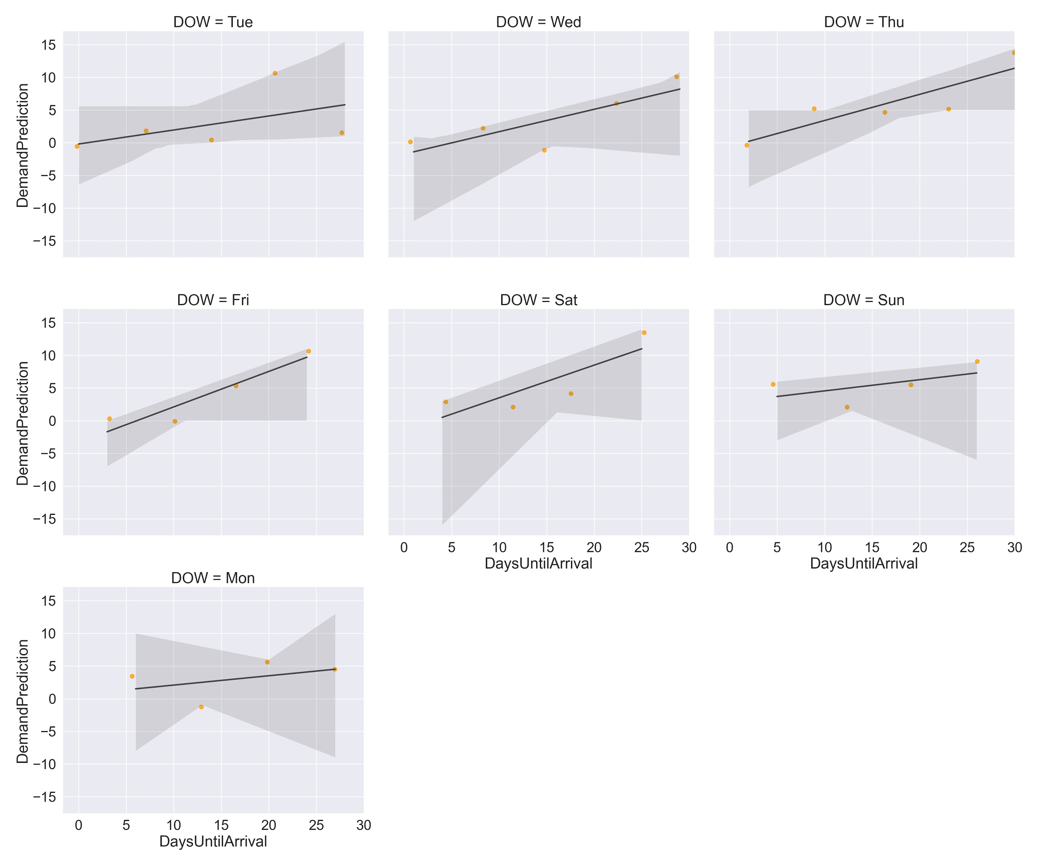
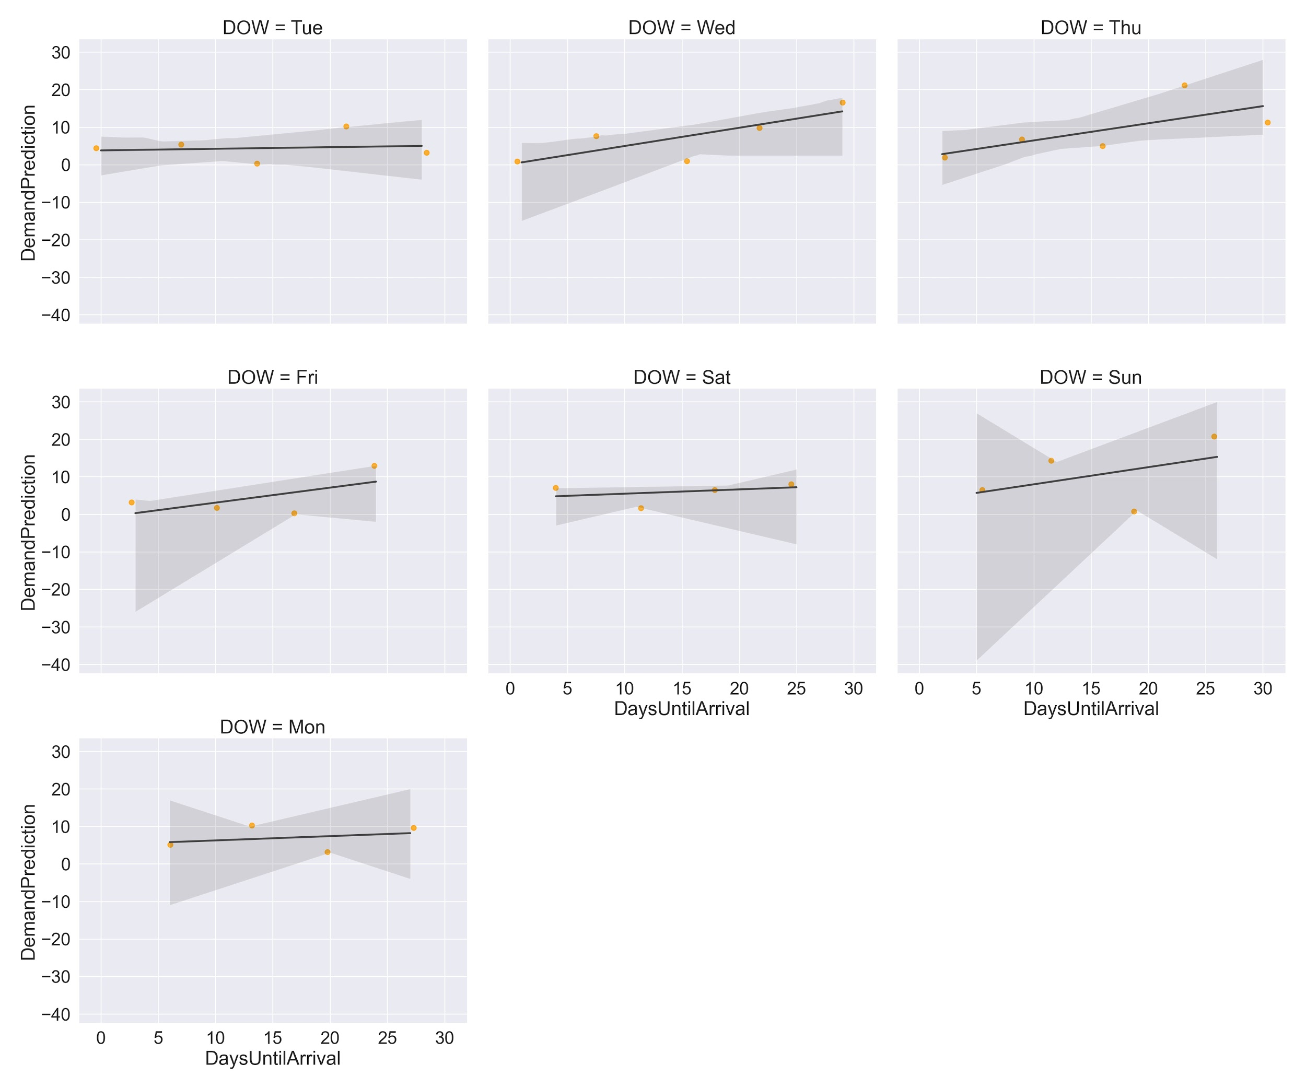
APPENDIX A: DOW PREDICTION EVALUATION
Hotel 1
Hotel 2

Slide 26
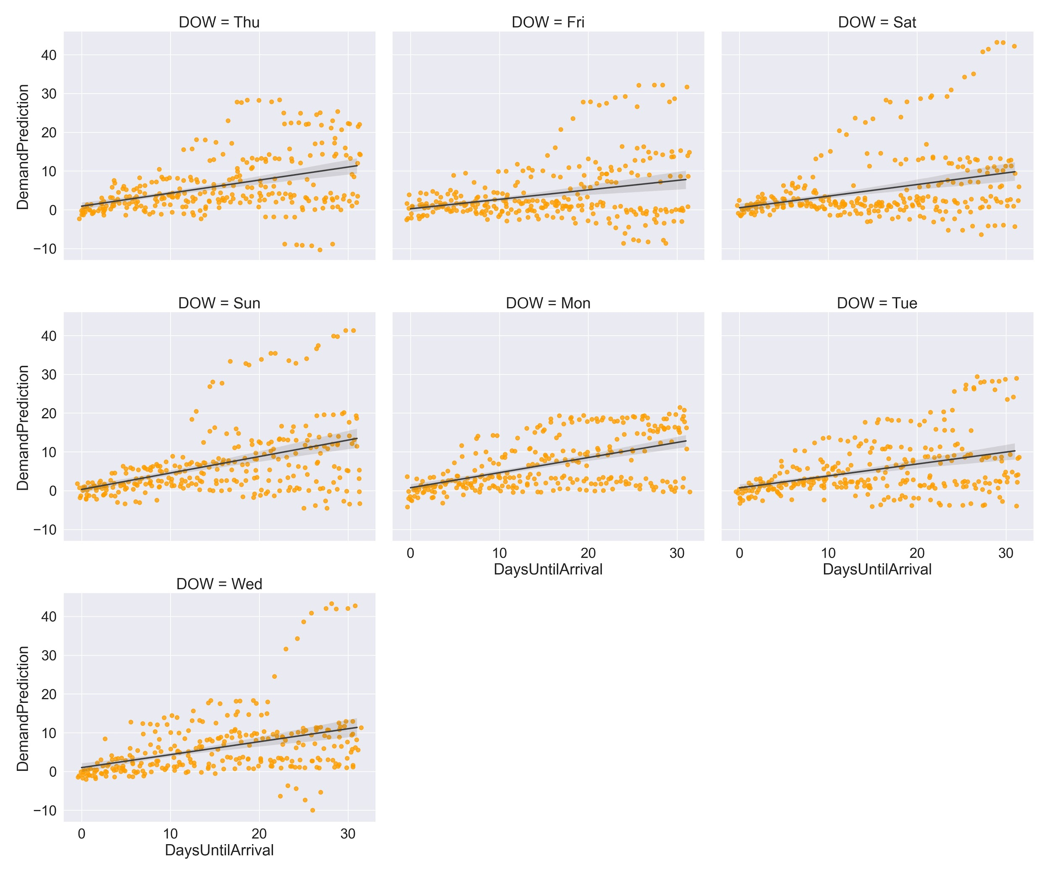
APPENDIX B
H2 Demand Model
Results
Resort Hotel
226 Rooms
R2 Score: 0.76
Mean Abs. Error: 3.1 Room Nights
Notes:
The model for hotel 2, our city hotel, has similar results. The R-squared score is slightly lower, but that’s due to having much more variance on the weekends than even Hotel 1.
Weekdays are more consistent for the city hotel and therefore easier to predict.

