Slide 1
Building a Hotel Revenue Management System (from scratch)
Elliot Wilens

Slide 2
About me
Hotel Experience
Senior Revenue Manager @ Marriott – 5 years
Michigan State University - Hospitality Business (B.A.)
Data/Computer Science Experience
Metis Data Science Bootcamp
Google IT Automation with Python (Coursera)
Undergrad. Teaching Assistant – Computer Science & Engineering @ Michigan State

Slide 3
Agenda
Brief introduction to Revenue Management
The hotels
The simulation
Models
Feature engineering
Model selection
Model performance
What to expect next week

Slide 4
A little background… Hotel Revenue Management
A sort of check & balance for hotel management companies
Many stakeholders with different motivations
GM: Guest reviews, owner relations, employee engagement
Sales: “Sell as many rooms as possible! (who cares about the price, anyways?)”
Events: “Don’t upset my groups!”
Front Desk: “Don’t get me yelled at!”
Revenue management’s purpose is to manage the room & function space inventory and pricing with one thing in mind…

Slide 5
The objective… Hotel Revenue Management
MAXIMIZE HOTEL REVENUE
Selling the right rooms, at the right price, to the right customer, at the right time
Manage daily room pricing and inventory by type
How many rooms are we selling online for each date?
Is that enough rooms? Too many?
Using data to buy support from hotel management
a good year for us means a larger budget for operations

Slide 6
The dataset: a list of reservations
2 anonymous hotels
H1 – 187-room Resort Hotel
40k reservations
H2 – 226-room City Hotel
79k reservations
Reservations contain all reservations (cancelled & fulfilled) that touched the dates of July 1, 2015 – Aug 31, 2017
Both hotels are somewhere in Europe, likely Portugal

Slide 7
A simulation
You are the Revenue Manager responsible for H1 and H2.
The date is August 1, 2017, and you need to price rooms such that we maximize room revenue for the rest of August
What kind of information do you need?
Current OTB (on-the-books) data
Predicted cancellations
Demand for each upcoming date
Historical data (STLY – Same-Time-Last-Year)
Recent Booking trends

Slide 8
Models
Predicting Cancellations
Reservation-level
Predicting Demand
Hotel day-level

Slide 9
Predicting Cancellations/ Supply
Features
time-based
Weekday/weekend
Booking window (time between date booked & arrival date)
Customer info
Type: Transient (Leisure) / Group / Contract / Transient-Party (catering)
Num. prev bookings
Num. prev cancellations
Notes:
The data was anonymized to prevent us from being able to replicate a live hotel’s financials.

Slide 10
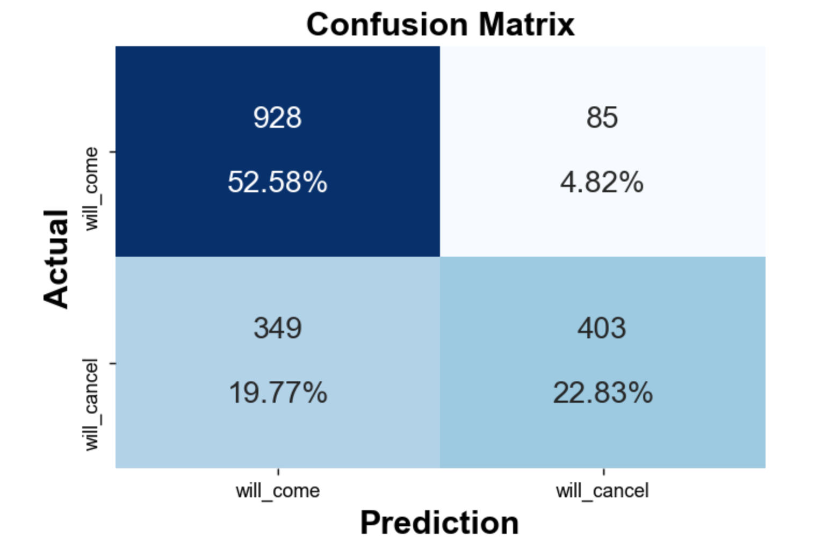
Model Selection (Cancellations)
XGBoost > Random Forest > Logistic Regression
Metric: F-Beta (β = 0.5)
Favors precision
too much recall: angry guests (and front desk… and events…)
too much precision: angry owners (and boss…)
sweet spot: F-0.5
F-0.5 score: 0.745
Relocated guests
Lost $$

Slide 11
Predicting Demand
Feature Engineering (~70 engineered features)
OTB (on the books) data by Customer Type
RoomsOTB, RevOTB, RateOTB
OTB pace vs. STLY (same time last year)
Recent pickup (L30, L15, L05 days) for each future arrival date
Pickup pace to STLY
Estimated selling price
LY estimated selling price
Last year actual
gap to last year actual by segment

Slide 12
Model Selection (Demand)
XGBoost > Random Forest > Linear Regression (once again)
R² scores (CV scores only as of now):
Linear Regression: 0.71
Random Forest: 0.67
XGBoost: 0.78
But low performance on the test set…. 0.47.
Suggests overfitting & need for more rigorous feature selection
Preliminary results from this morning
RF performance: 0.31
LR: 0.03

Slide 13
Coming Soon…
Recommended pricing
based on results of demand prediction @ various price points
Revenue Management application

Slide 14
Appendix
The dataset: ScienceDirect
https://www.sciencedirect.com/science/article/pii/S2352340918315191

