Slide 1
ARDUPILOT
INTRODUCTION TO ARDUPILOT

Slide 2
ABOUT ARDUPILOT
Ardupilot is an Open Source, Unmanned Vehicle Autopilot Software Suite, Capable of controlling autonomous: Multirotor drones Fixed-wing and VTOL aircraft.
Ardupilot has capable to control Helicopters, Boats and also Ground rovers.
Ardupilot is developed to control model aircrafts.
It is used in many industries and research companies.

Slide 3
Working and Uses of Ardupilot
The basic goal of the software is to provide control of the vehicle, either autonomously, or via pilot input through radio control transmitter or ground control station, or via companion computer on board the vehicle.
Ardupilot can be used for Robotic applications, Remote sensing, Academic research, Package delivery, Aerial photography and film making etc.,.

Slide 4
Simulation Process
The Simulation tab provides a SITL (Software in the Loop) simulation capability. Many typical frame types for each Vehicle type have been created. This allows us to see the expected behavior for vehicles in missions, or with a joystick attached, actually be able to fly/drive the vehicle simulation as if with RC. This allows us to see potential effects of parameter changes on vehicle behavior or explore mission generation, without risking our vehicle first.

Slide 5
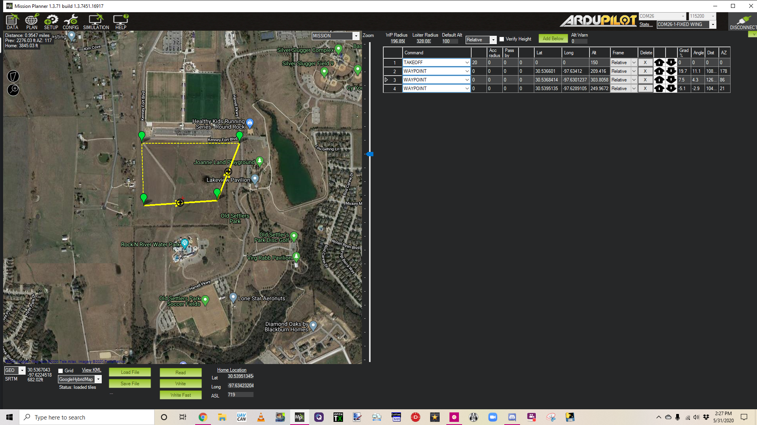

Slide 6
The Flight Plan
Upper Left corner: Displays the distance from HOE, the heading and distance from the last entered waypoint, and total mission trip distance.
Right side: Displays the waypoints list for the mission.
Bottom: At the bottom of the planner view we will see the latitude and longitude of the mouse cursor. We can select different maps providers, Load or save waypoints files, Read or write the mission to the autopilot.

Slide 7
Overview
ArduPilot is an open source, unmanned vehicle Autopilot Software Suite, capable of controlling autonomous: Multirotor drones. Fixed-wing and VTOL aircraft. Helicopters.

