Slide 1
TRAFFIC SIGN RECOGNITION using CNN

Slide 2
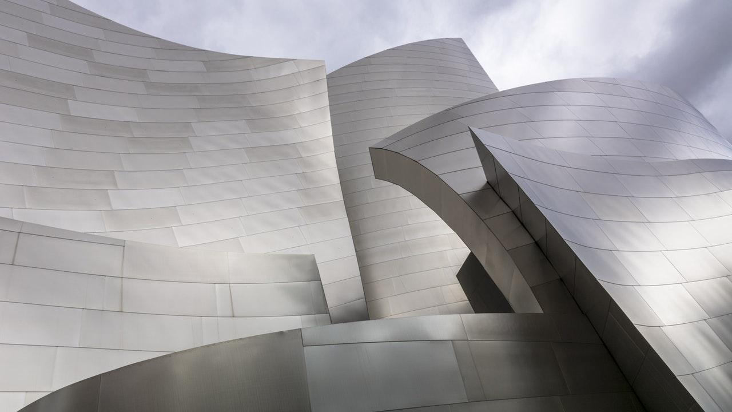
ABSTRACT
Traffic Sign Recognition(TSR) is an important part of the driver support functions needed to make intelligent vehicles. The automatic system for classification of traffic signs is a critical task of an Advanced Driver Assistance Systems(ADAS) and a fundamental technique utilized as integral part to the various vehicles. With the advances in the new hardware and software platforms, deep learning has been used in ADAS technologies. Traffic signs are an important part of road infrastructure. So, it is very important task to detect and classify traffic signs for autonomous vehicles. In this paper, we firstly create a traffic sign dataset from ZED stereo camera mounted on the top of Recera mini autonomous vehicle and we use Tiny-YOLO real-time object detection and classification system to detect and classify traffic signs. Then we test the model on our dataset in terms of accuracy, loss, precision and intersection over union performance metrics.

Slide 3
INTRODUCTION
Traffic signs or road signs erected at the side of or above roads to give instructions or provide information to road users.
Signs are treaty signed in 1968 which has been able to standardize traffic signs across different countries.
There are different types of traffic signs:-
1. Warning signs
2. Prohibitory signs
3. Mandatory signs
Traffic sign recognition(TSR):
1. Delection
2. Classification.

Slide 4

SIX BOX APPROACH
DATA
TASK
MODEL
EVALUATION
LEARNING
LOSS

Slide 5

1. DATA
Dataset used in the paper is created from ZED stereo camera mounted on the top of Racecar mini autonomous vehicle.
dataset used for the implementation is GTSRB (German Traffic Sign Recognition):

Slide 6
2. TASK
Here we are going to build a model that identifies a traffic sign from a plate and digital photograph. The sign may be viwed from various angles and in many diverse background situations

Slide 7
3. MODEL
Model/method we have used to classify the dataset is using convolutional neural networks (CNN). Three main types of layers are used to build CNN architectures: Convolutional
Layer, Pooling Layer, and Fully-Connected Layer. These layers are stacked together in
different ways depending on the architecture of the given CNN. Every layer of a CNN
transforms the previous volume of activations to the next using a differentiable function.

Slide 8
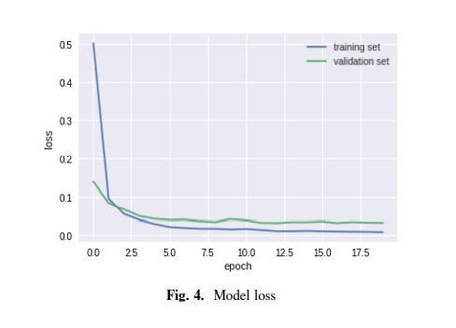
4. LOSS

Slide 9
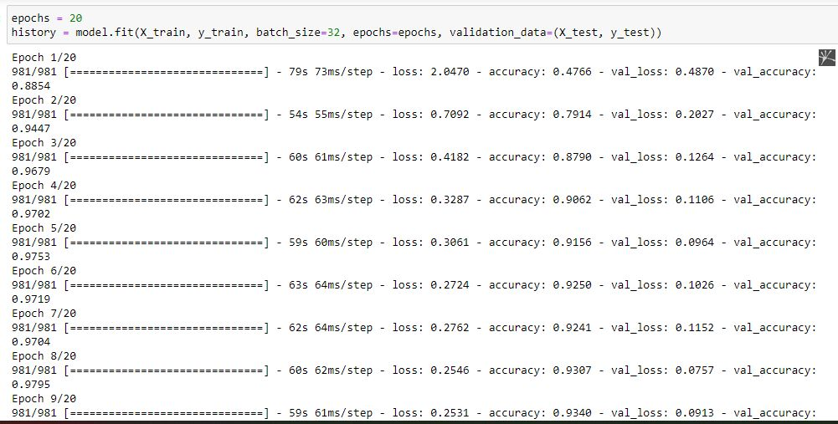
5. LEARNING

Slide 10
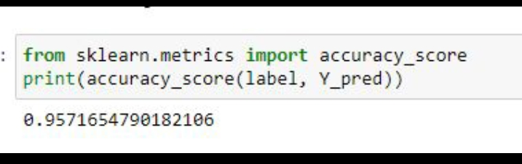
6. EVALUATION

Slide 11

CONCLUSION

