Slide 1
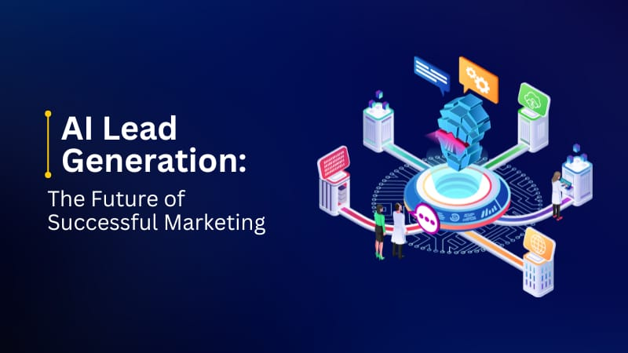
AI-Powered Lead Generation System Using Salesforce CRM
Submitted By: Devi Thota B.Tech – Computer Science & Engineering

Slide 2
Introduction
What is AI-Powered Lead Generation?
Automating the identification, scoring, and nurturing of potential customers using machine learning integrated directly with CRM platforms.
Platform: Salesforce Sales Cloud + Einstein AI
The world's #1 CRM with built-in predictive intelligence — purpose-built for enterprise-scale lead management.
Why It Matters
Sales reps spend 64% of their time on non-selling tasks. AI automation reclaims that time for high-value customer interactions.
Project Scope
End-to-end pipeline — from raw lead capture to AI-scored, sales-ready opportunities fully managed within Salesforce.

Slide 3
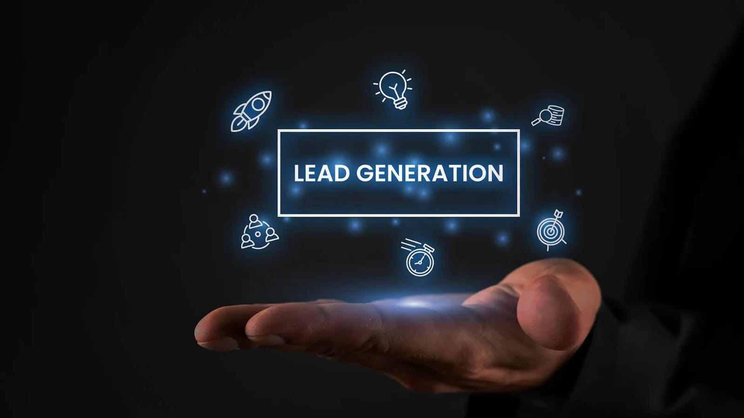
The Problem: Why Traditional Lead Generation Fails
🔍 Manual Filtering
Reps sift through hundreds of leads using gut feel — missing high-value prospects buried in the noise.
⚖️ No Prioritization
All leads treated equally — high-intent buyers buried under low-quality contacts with no scoring system.
⏱️ Slow Response Time
Average follow-up takes 42 hours. Leads go cold within minutes of showing buying intent.
🗂️ Data Silos
Lead data scattered across spreadsheets, email, and disconnected tools — no single source of truth.

Slide 4
Project Objectives
Automate Lead Capture
Einstein AI Scoring
Automated Nurturing Workflows
Apply Einstein AI to score and rank every lead by conversion probability in real time, every hour.
Ingest leads from multiple channels — web forms, social media, email campaigns — directly into Salesforce CRM.
Trigger targeted nurturing sequences based on lead score thresholds — no manual handoffs required.
Unified Sales Dashboard
Measurable Impact
Provide teams with a Lightning Dashboard for full pipeline visibility and actionable, AI-driven insights.
Reduce manual effort by ≥60% and improve lead-to-opportunity conversion rate across the pipeline.

Slide 5
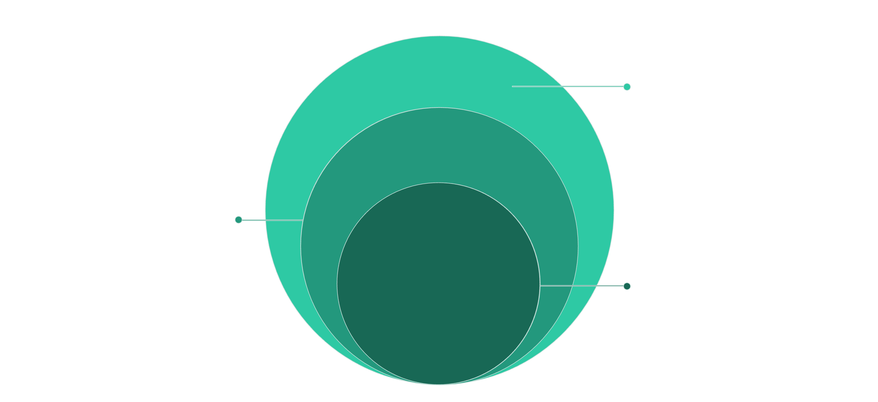
System Architecture
Delivery
Automation, routing and Lightning KPIs
Platform
Salesforce Sales Cloud and lead records
Core AI
Einstein ML models and scoring
The architecture follows a clean five-tier separation of concerns — from raw data ingestion at the top to real-time executive dashboards at the bottom. Einstein AI sits at the core, orchestrating intelligent decisions between the data and CRM layers.

Slide 6
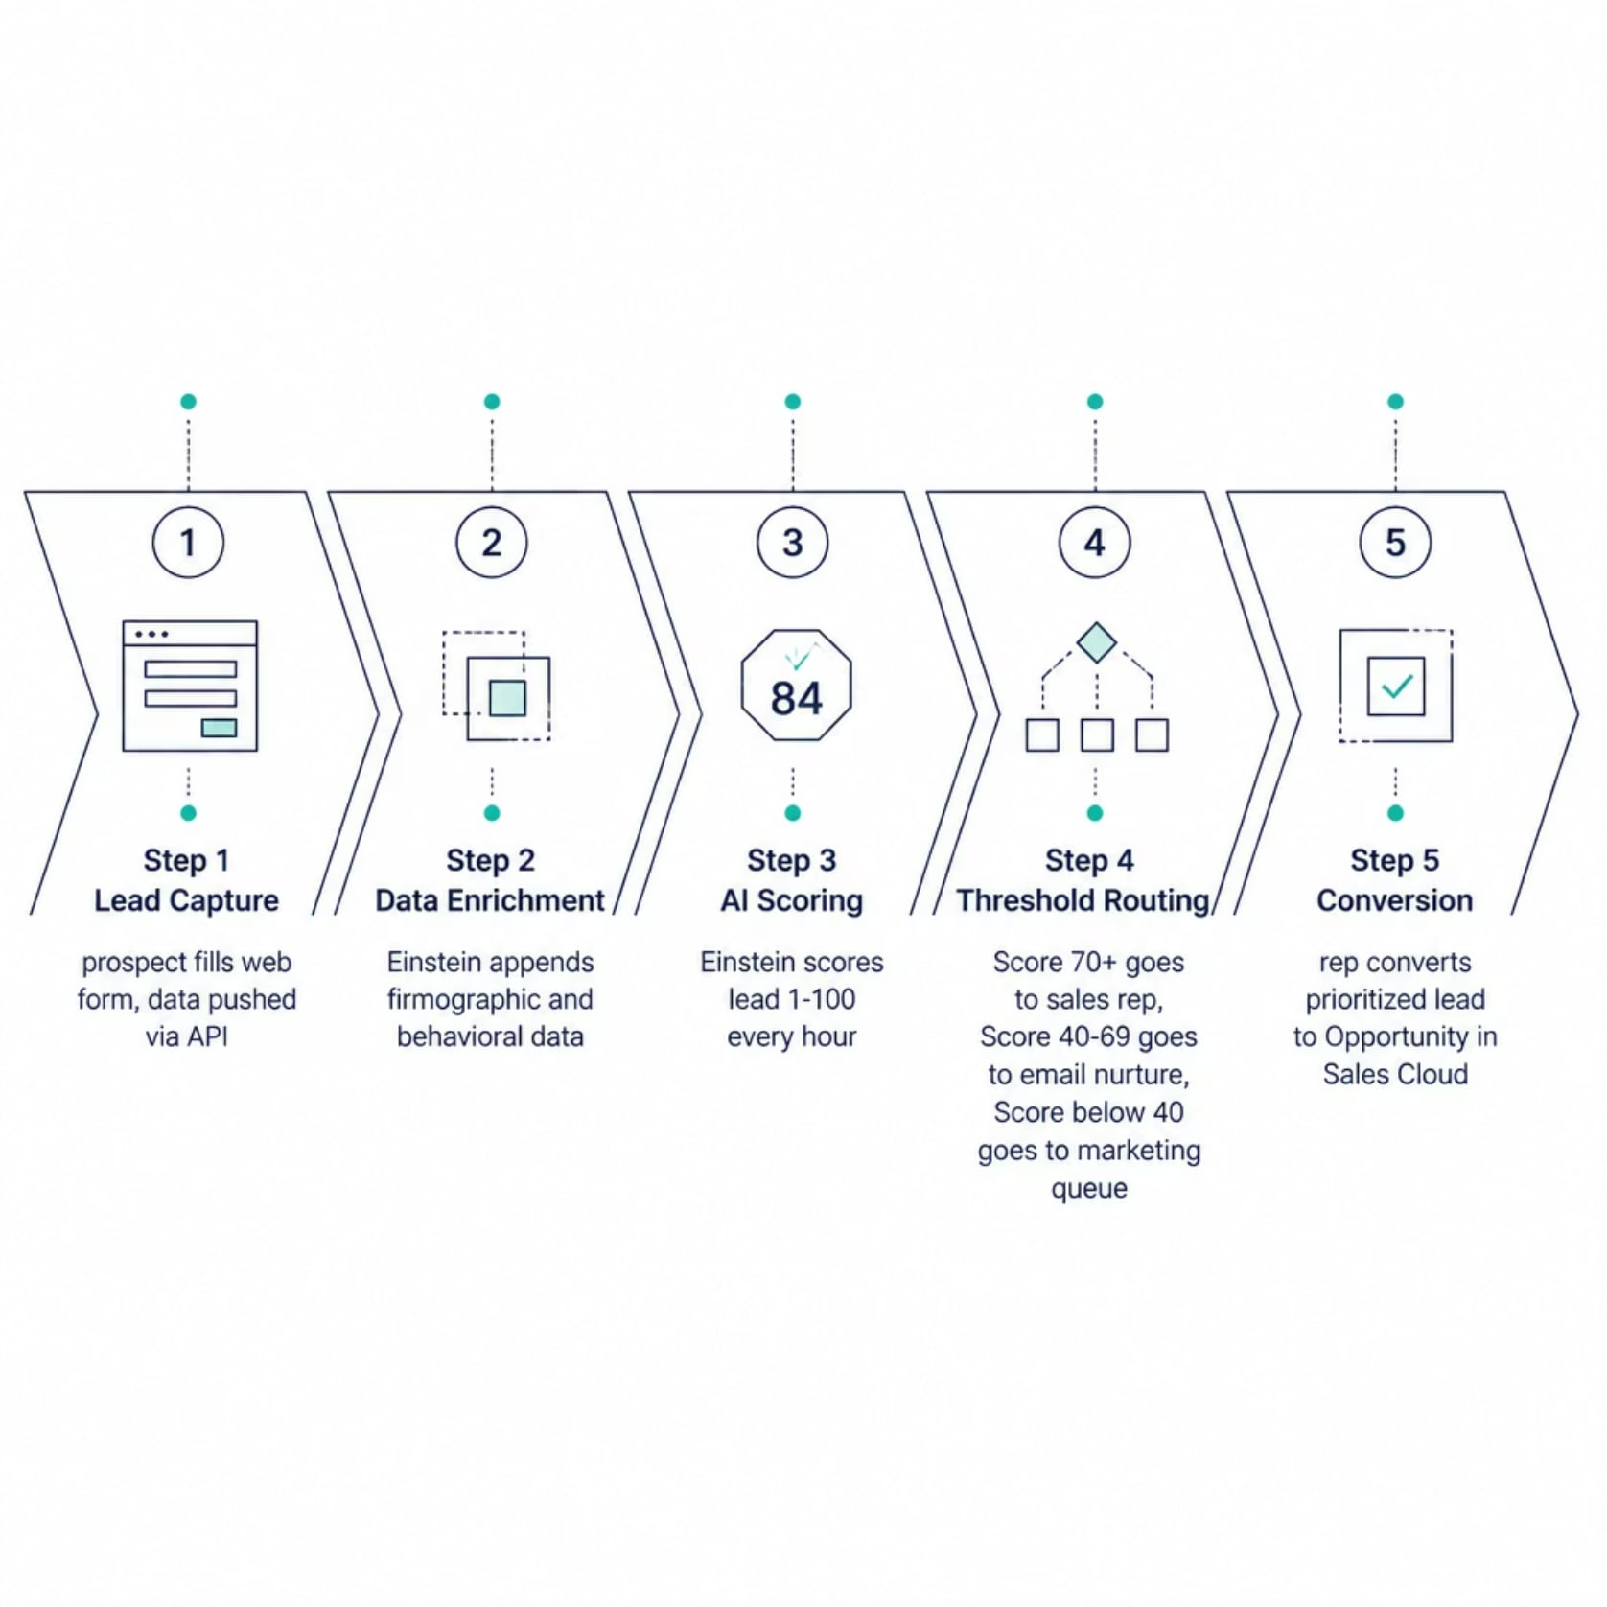
System Workflow
Score-Based Routing Logic
Leads are rescored every hour — as behavior changes, routing updates automatically with no manual intervention.
🟢 Score ≥ 70
🟡 Score 40–69
Routed to marketing queue for top-of-funnel campaigns until score improves.
Immediately assigned to a sales rep for direct outreach and fast-track conversion.
Enrolled in automated email nurture sequence to build engagement over time.
🔴 Score < 40

Slide 7
Technologies Used
Salesforce Sales Cloud
Salesforce Einstein AI
Apex (Java-like)
Custom server-side business logic and trigger automation — full programmatic control over CRM events.
Core CRM — lead management, opportunity tracking, and pipeline reporting at enterprise scale.
Predictive lead scoring, behavioral analysis, and next-best-action recommendations built natively into the CRM.
Salesforce Flow + LWC
REST API / Web-to-Lead
No-code/low-code workflow automation for routing and notifications; Lightning Web Components for custom dashboard UI.
Multi-channel lead ingestion from external sources — web forms, social ads, and third-party platforms.

Slide 8
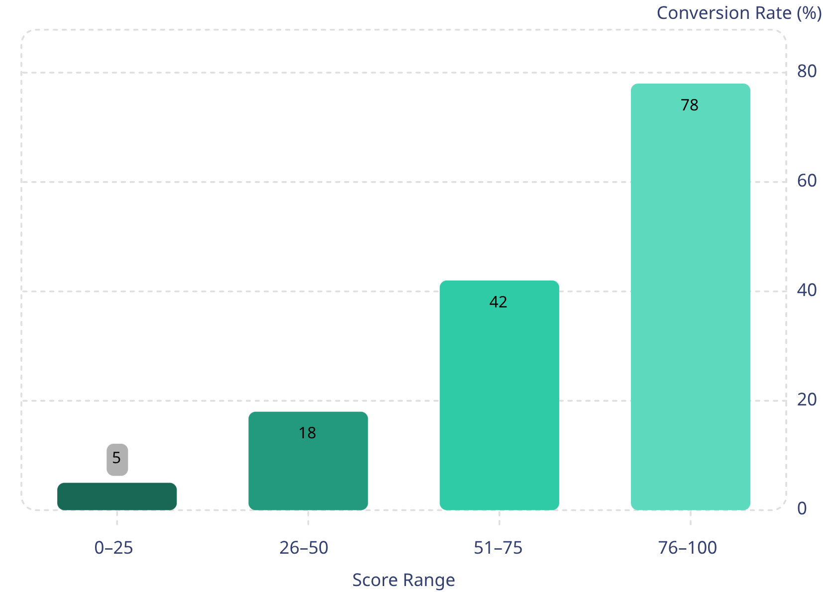

AI Lead Scoring: How Einstein Works
How Einstein Scores Your Leads
Input Features
Job title, company size, industry, email engagement, website visits, and past purchase history all feed the model.
Auto Model Selection
Einstein automatically selects the best algorithm — Logistic Regression, Random Forest, or Naive Bayes — tailored specifically to each organization's own data.
Score Output
Every lead receives a 1–100 score plus top positive and negative factors displayed directly on the lead record.
Higher Einstein scores strongly correlate with lead conversion — demonstrating the model's real predictive power. Note: Replace with your actual project results.
Real-world proof: Square scores 25,000 leads/month with a 64% improvement in conversion efficiency using Einstein Lead Scoring.

Slide 9
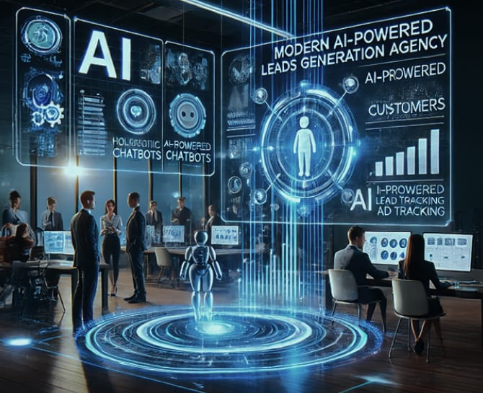
Salesforce Dashboard — Live Demo
The Lightning Dashboard provides real-time visibility into the AI-powered lead pipeline — from raw capture to closed opportunity.
Dashboard Components
KPI Tiles
Total leads, average Einstein score, conversion rate, and open opportunities — at a glance.
Visual Charts
Lead score distribution, source-wise lead volume, and weekly conversion trend visualized in real time.
Rep Priority View
Each sales rep sees a personalized to-do list ranked by AI score — highest value leads always on top.
Insert your Salesforce Dashboard screenshot here during final demo.

Slide 10


Advantages of the System
60%+
Less Manual Work
Reduction in manual lead qualification time — reps focus on selling, not sorting through low-quality contacts.
1hr
Rescore Frequency
Leads rescored every hour. If behavior changes, routing updates automatically — zero stale data in the pipeline.
25hrs
Saved Per Week
Sellers save up to 25 hours per week with Agentforce AI handling prospecting and follow-ups automatically.
∞
Scalable & Cloud-Native
Handles thousands of leads with zero infrastructure overhead — grows with your business, not against it.
This system demonstrates how AI-native CRM design transforms sales operations — turning data into decisions, and decisions into closed deals.

Slide 11
THANK YOU

