Slide 1


AI-Based Contract Clause Classification & Risk Detection System
Contracts contain numerous legal clauses that require careful review before signing. This project presents an Artificial Intelligence-based system that automatically identifies and classifies contract clauses while detecting potentially risky legal terms. By combining Natural Language Processing (NLP) with Machine Learning, the system reduces manual effort, improves accuracy, and provides faster contract analysis for legal professionals and organizations.
PRESENTED BY: DEVIYANSH RAJPUROHIT

Slide 2



The Problem with Manual Contract Review
Existing Challenges
Why Automation Is Needed
An AI-powered solution can analyze contracts at scale, classify legal clauses into predefined categories, and flag risky contractual terms — making the review process faster, more accurate, and significantly more cost-effective than traditional manual methods.
Legal contracts are often lengthy and written in complex legal language. Manual review demands significant time and specialized expertise. Human reviewers frequently overlook critical clauses related to liability, confidentiality, payment, or termination — exposing organizations to financial and legal risk.
Contracts can span hundreds of pages with dense legal terminology
Missed clauses can result in costly litigation or unfavorable terms
Legal teams are often understaffed and overburdened
Consistency in review is difficult to maintain across reviewers

Slide 3
Proposed Solution
The system combines Natural Language Processing with a rule-based risk detection engine to deliver intelligent, explainable contract analysis in real time.
NLP Clause Understanding
ML Classification Engine
NLP techniques parse and interpret legal text, extracting semantic meaning from complex contractual language to enable accurate classification.
A supervised Machine Learning model predicts the clause type from 17 predefined legal categories, outputting a confidence score for each prediction.
Rule-Based Risk Detection
Structured Output
A dedicated engine scans for high-risk legal patterns such as unlimited liability, automatic renewal clauses, and warranty disclaimers.
Every analysis returns four fields: Clause Category, Prediction Confidence, Risk Level, and a plain-language Risk Explanation.

Slide 4
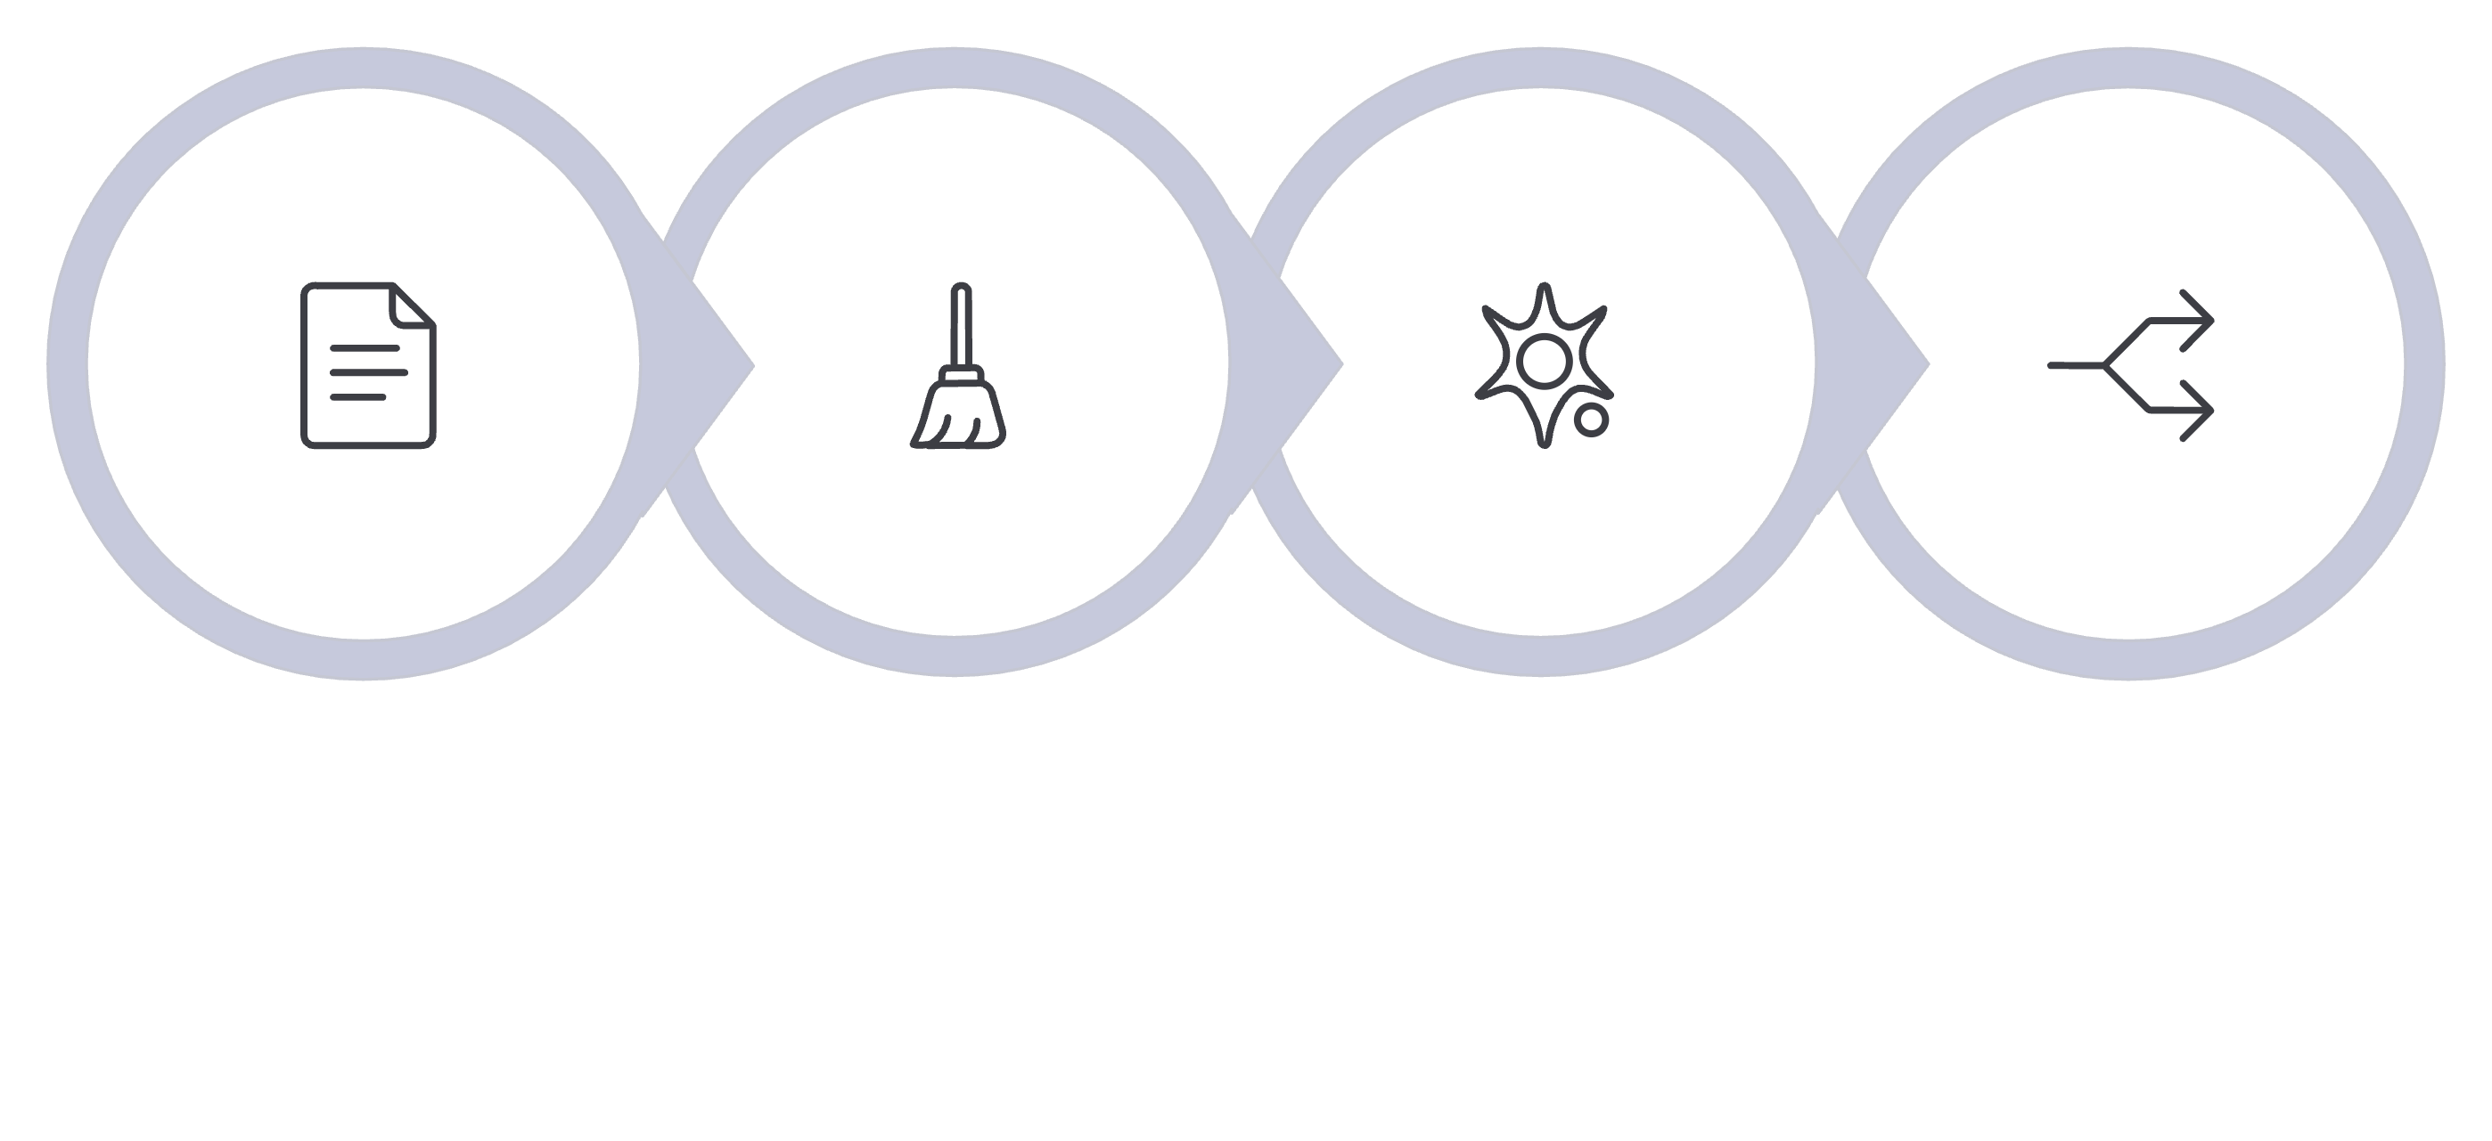
Dataset & Data Preprocessing
CUAD Dataset
Preprocessing Pipeline
The project uses the Contract Understanding Atticus Dataset (CUAD) — a widely recognized benchmark containing thousands of real-world legal contract clauses sourced from diverse business agreements. CUAD is annotated by legal experts, making it ideal for training supervised classification models.
Before training, raw text undergoes a structured cleaning and transformation process:
Remove duplicate records
Convert text to lowercase
Strip punctuation and special characters
Remove common English stop words
Normalize text (stemming/lemmatization)
Convert text to numerical features using TF-IDF Vectorization
The processed dataset is then split into training and testing sets for model evaluation.
Raw Text
Clean Text
TF-IDF
Train/Test
This pipeline ensures that raw legal text is transformed into clean, numerical representations that the ML model can effectively learn from, while the train/test split enables unbiased performance evaluation.

Slide 5
Machine Learning Model: Logistic Regression
The classification model is built on Logistic Regression — a supervised ML algorithm widely used for text classification due to its speed, interpretability, and strong performance on high-dimensional sparse data like TF-IDF vectors.
Fast Training
Lightweight Model
Logistic Regression trains quickly even on large text datasets, enabling rapid iteration during development and testing cycles.
Low computational footprint makes the model suitable for deployment in resource-constrained environments or edge scenarios.
Strong Accuracy
Explainable Predictions
Delivers reliable classification performance across 17 legal clause categories, with interpretable probability scores for each prediction.
Model coefficients provide transparency into which terms most influence each clause classification — critical for legal accountability.

Slide 6
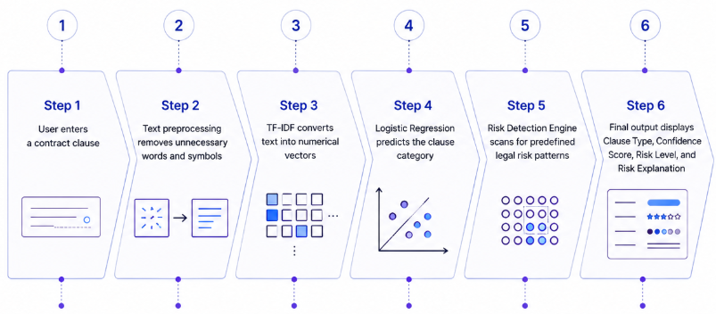
End-to-End System Workflow
The system processes each contract clause through a structured six-step pipeline, delivering intelligent analysis in seconds.
This streamlined workflow enables legal professionals to receive structured, explainable contract analysis without requiring deep ML expertise — the system handles all complexity behind a simple text input interface.

Slide 7





Results & Model Performance
Evaluation Metrics Used
Overall Accuracy
Model quality was assessed using a comprehensive set of standard classification metrics:
88.24%
Accuracy
Precision
Overall correctness of predictions
Correctness of positive predictions
Achieved on the held-out testing dataset from CUAD, demonstrating strong generalization across diverse contract types and legal domains.
Recall
F1-Score
Completeness of detected clauses
Harmonic mean of precision and recall
Top-Performing Clause Categories
Confidentiality
Liability
Insurance
Force Majeure
Governing Law
The model demonstrates particularly reliable performance on high-stakes legal categories, making it well-suited for real-world contract review workflows.

Slide 8

Technologies Used
The system is built on a modern, lightweight Python stack designed for efficiency, reproducibility, and ease of deployment in legal tech environments.
Core Language
Python — the primary language for all data processing, ML modeling, and application logic.
Data & ML Libraries
Scikit-learn for ML pipelines, Pandas and NumPy for data manipulation, and Joblib for model serialization.
NLP & Modeling
TF-IDF Vectorizer for text feature extraction and Logistic Regression for clause classification.
Development Tools
Visual Studio Code, Jupyter Notebook for experimentation, and Git for version control and collaboration.

Slide 9
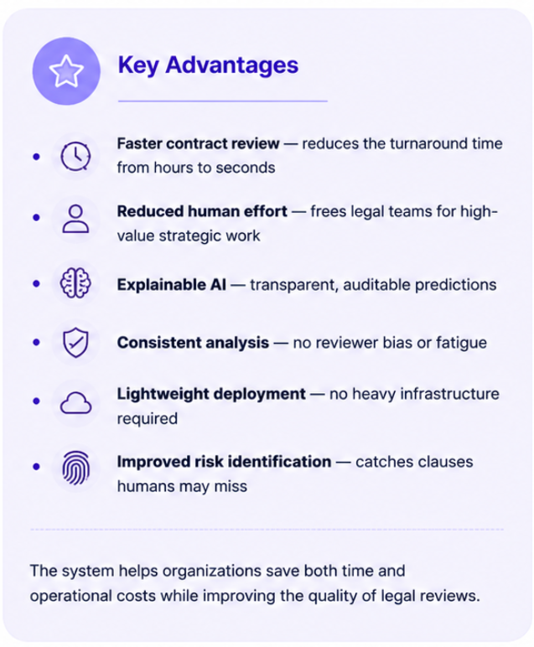
Applications & Advantages
Target Applications
The system is applicable across any organization that regularly handles legal contracts at scale:
Law Firms
Accelerate due diligence and contract review for clients
Corporate Legal Departments
Standardize internal contract review processes
Banking & Insurance
Manage high volumes of financial and policy contracts
Procurement & Contract Management
Automate vendor and supplier agreement reviews

Slide 10
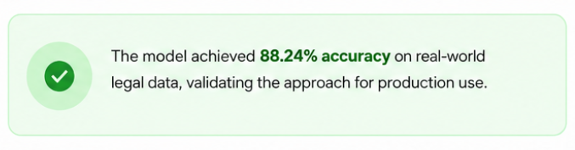
Conclusion & Future Scope
Future Roadmap
Conclusion
01
The AI-Based Contract Clause Classification System successfully automates the identification of legal contract clauses while detecting potential contractual risks. By integrating Natural Language Processing with Machine Learning, the system significantly improves the efficiency, consistency, and accessibility of contract analysis — demonstrating the growing potential of AI in modern legal technology.
LegalBERT / Transformer Models
Upgrade to domain-specific transformer architectures for higher accuracy
02
Full PDF Contract Analysis
Extend from clause-level to full-document processing
03
OCR Integration
Support scanned contracts and legacy document formats
04
AI Legal Chatbot
Interactive assistant for querying contract terms conversationally
05
Web-Based Analyzer & Cloud Deployment
Thank You !!
Scalable SaaS platform for enterprise legal teams

