Slide 1

UNSPOKEN WORDS

Slide 2

HOMEPAGE

Slide 3

LOGO

Slide 4
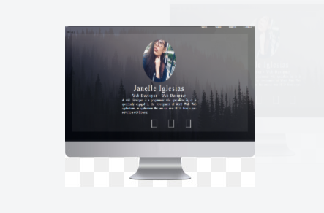
ABOUT

Slide 5

CONTACT

Slide 6
About the Website

Slide 7
The website will let you express your feelings.
Let’s everybody see you’re work.
You can compose your own poem and share it with everybody.
You can be open. (cussing)

Slide 8
MAIN OBJECTIVES
To inspire others
Help them express what they feel

Slide 9
BENEFITS
IT WILL INHENCE YOUR KNOWLEDGE
HELPS YOU BE MORE EXPRESSIVE
IT WILL INHECE YOUR SKILLS

Slide 10
PROBLEMS
Some people aren’t that expressive
People tend to keep their problems

Slide 11
THANK YOU!

